Slide 1
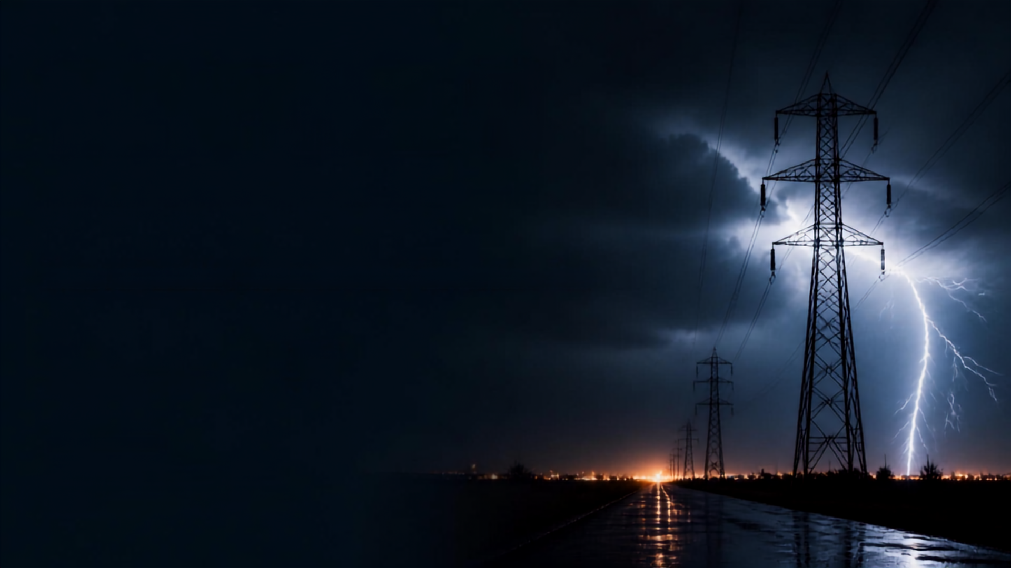
GRIDPULSE AI
Power Outage & Grid Equipment Failure Advisor
Detect. Explain. Recommend. Simulate. Act.
TEAM
TRACK
Eat-Code-Sleep
AI
TEAM MEMBERS
Darshan Thummar , Kishan Vadsola , Vishv Undavia , Shreeja Updhayay

Slide 2

THE PROBLEM
Outages are often predictable but action comes too late
Early warning signals exist but go unseen
Data is siloed across systems and conditions
Maintenance is reactive or calendar-driven
Failures can cascade into widespread outages
Operators lack a single, actionable risk view

Slide 3
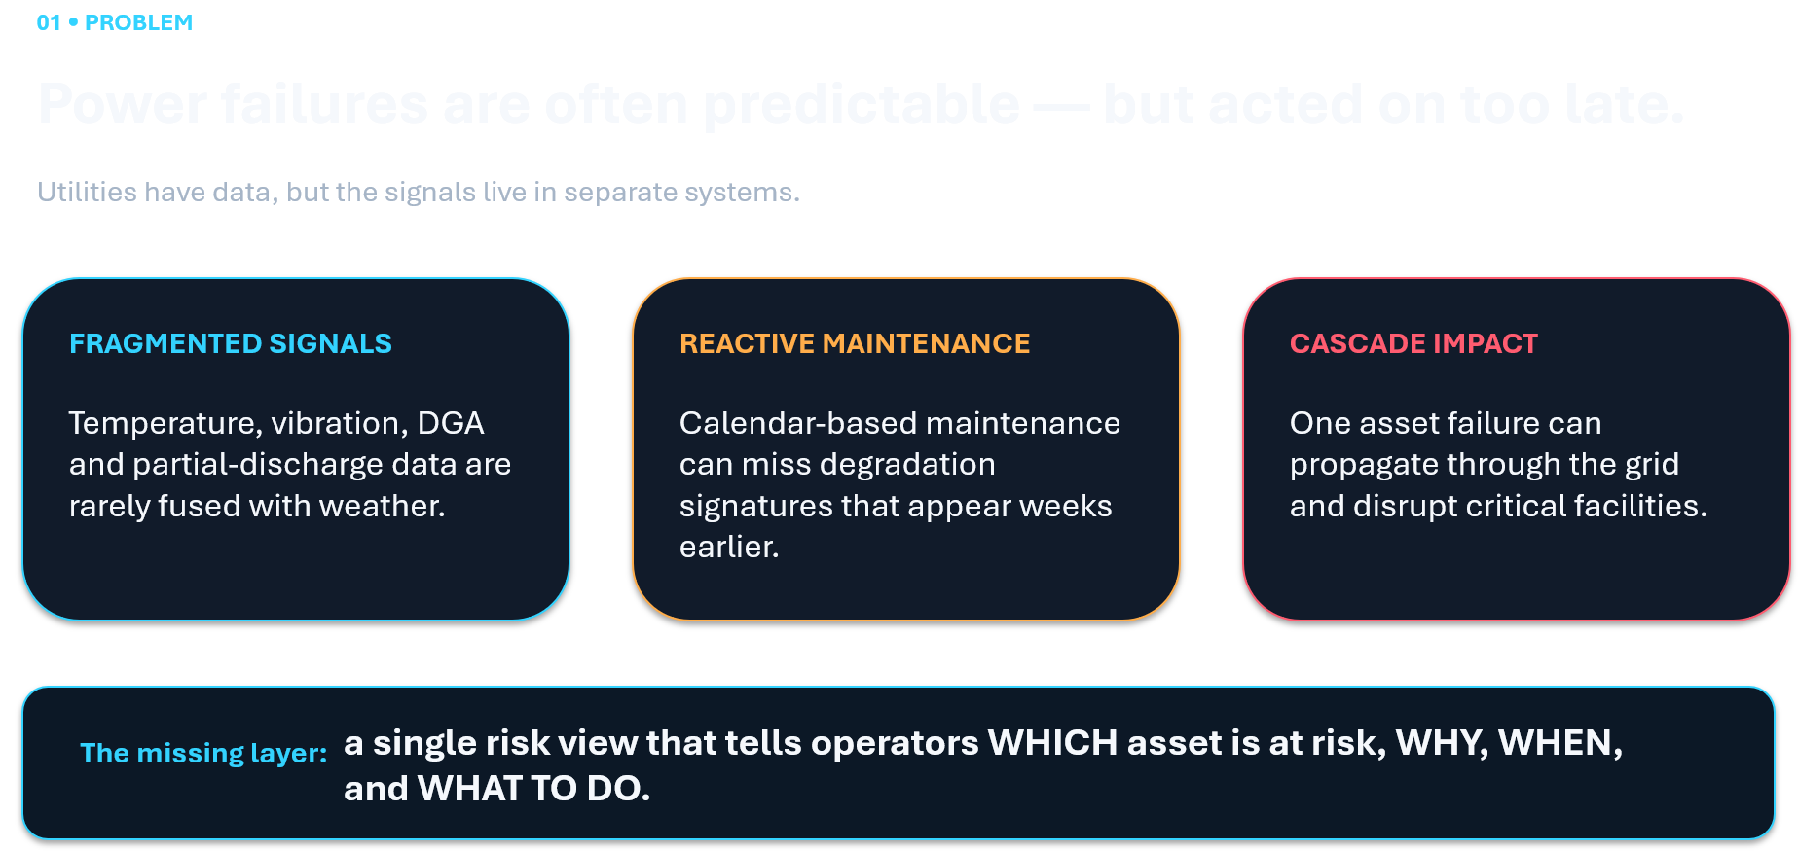

Slide 4

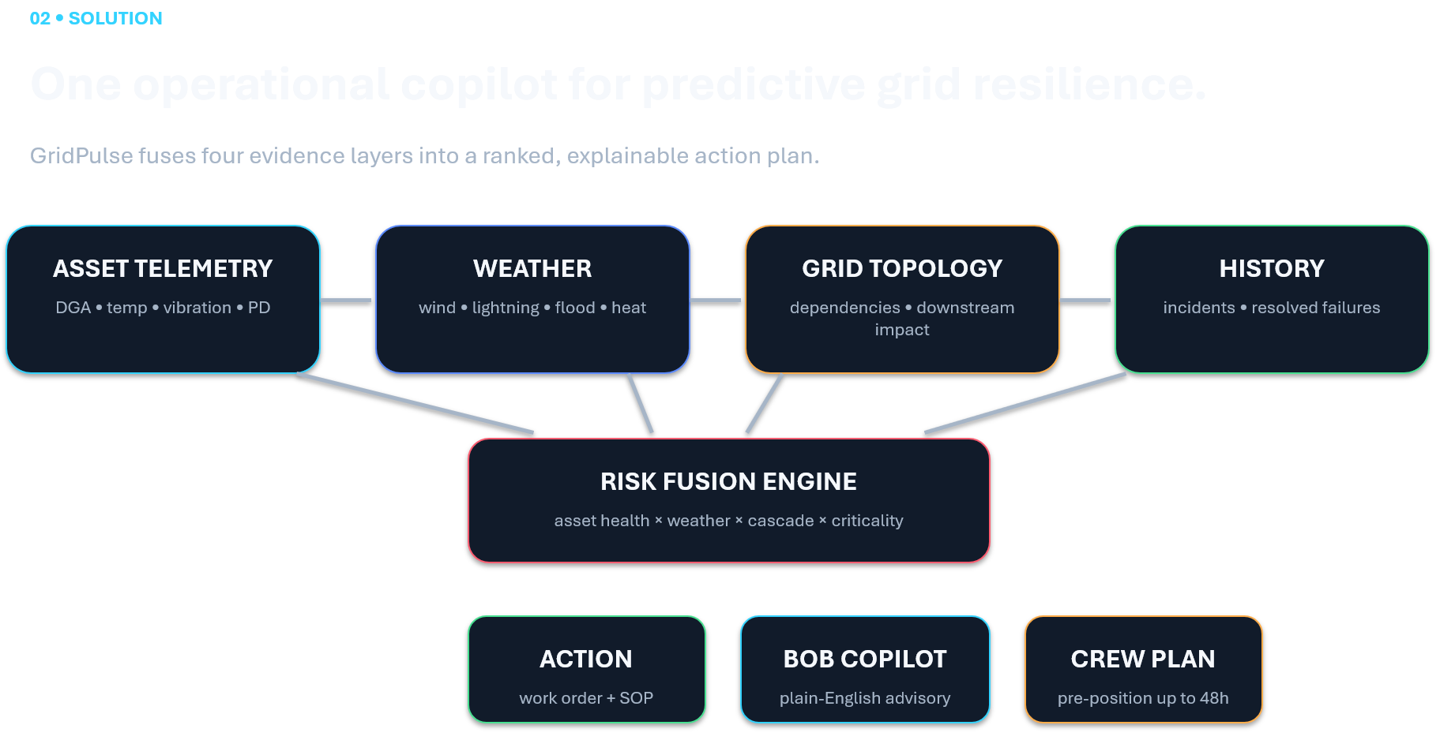


Slide 5

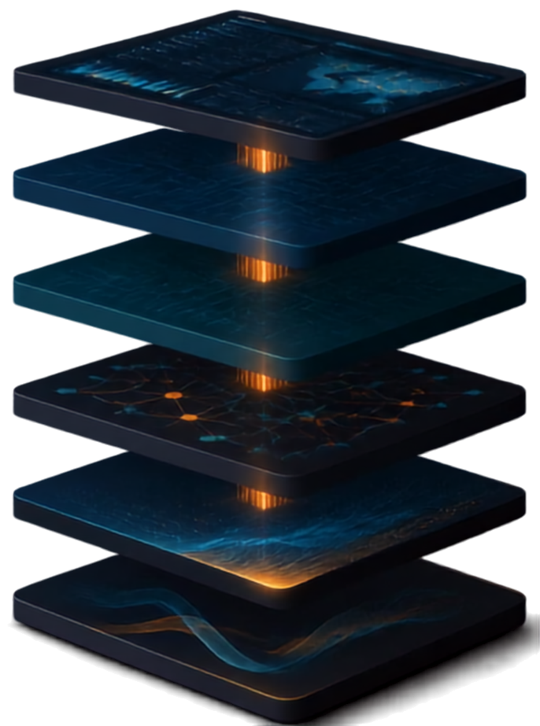


ARCHITECTURE
A modular AI platform that
turns data into outage foresight
USER INTERFACE
React Dashboard
real-time visibility
APPLICATION LAYER
FastAPI
high-performance backend
DATA LAYER
PostgreSQL
reliable relational data
Neo4j
GRAPH LAYER
connected grid intelligence
IBM watsonx.ai / Granite
advanced AI foundation
AI LAYER
Risk engines
DGA analysis
temperature/vibration analysis
weather risk
cascade/topology analysis
RISK ENGINES

Slide 6

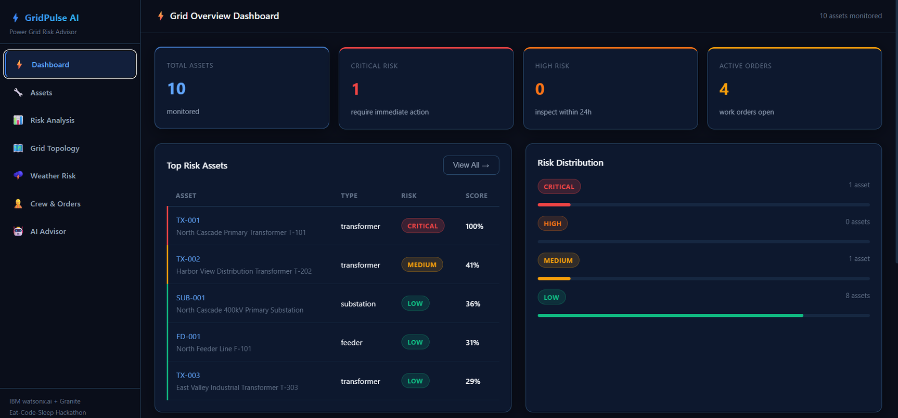



DEMO / KEY FEATURE
See overall grid health at a glance
Identify the assets that matter most
Understand the real drivers of risk
Get clear AI reasoning you can trust
Act with recommended steps and priority
DETECT
EXPLAIN
PRIORITIZE
DISPATCH

Slide 7





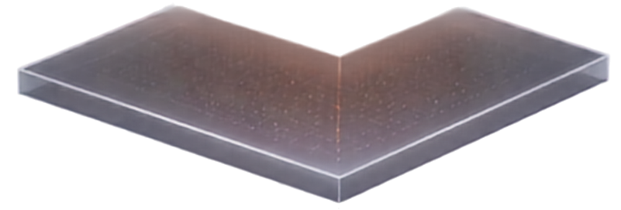

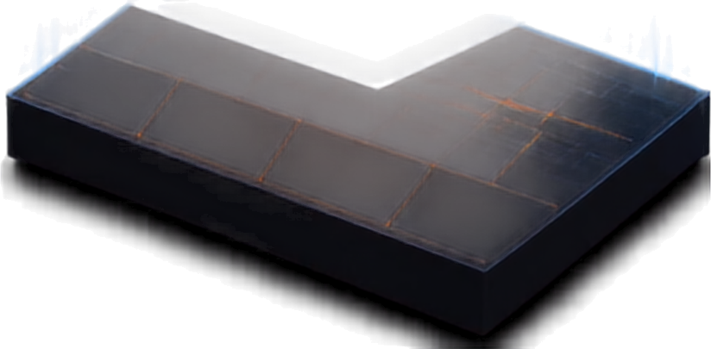



IBM TECHNOLOGIES
Powering GridPulse AI end to end
IBM Bob
AI-assisted development that accelerates and elevates delivery
IBM watsonx.ai
AI reasoning and advisory layer that turns data into insight
IBM Granite
LLM-powered recommendations grounded in grid knowledge
Application workflow
GRIDPULSE AI
Integrated into risk detection, explanation, and decision workflows

Slide 8
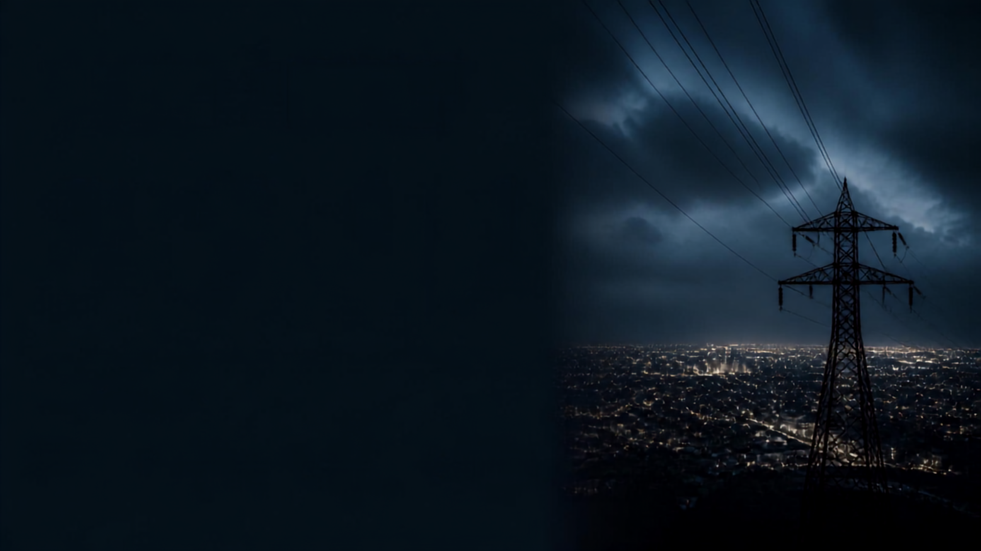



RESULTS & IMPACT
95
48
4
1
automated tests passed
hour crew
pre-positioning concept
evidence
layers
combined
unified
operator
decision view
expected impact
earlier
failure
detection
better
maintenance
prioritization
faster
field
response
reduced
avoidable
outage risk

Slide 9


THE TEAM
Darshan Thummar
Team Lead, Full Stack & AI Architecture
Shreeja Upadhyay
Backend & Risk Engine
Kishan Vadsola
Frontend & Dashboard
Vishv Undavia
AI Integration, Testing & Demo
Detect. Explain. Prioritize. Act.

