Slide 1



How To Accelerate Analytics For Postgres With Dremio
DE/BI Trainee Vadym Khodak
@Vaddimart
live:vaddimart

Slide 2
What is Dremio?
Dremio is the Data-as-a-Service Platform. Make your data engineers more productive, and your data consumers more self-sufficient.
Dremio provides a quantum leap in performance, based on four areas of innovation.
Apache Arrow Execution
From 1 to 1000+ nodes, architected for cloud deployments: elastic compute runs on object stores.
Native Push-Downs
Optimized query semantics for each data source – Amazon S3, ADLS, RDBMS, NoSQL, HDFS, and more.
Data Reflections™
Accelerate data and queries automatically, up to 1000x faster, with the full power of relational algebra.
Vertically Integrated Query Engine
Cost-based query planner automatically generates query plans to make optimal use of Data Reflections™ and push-downs.
www.dremio.com

Slide 3
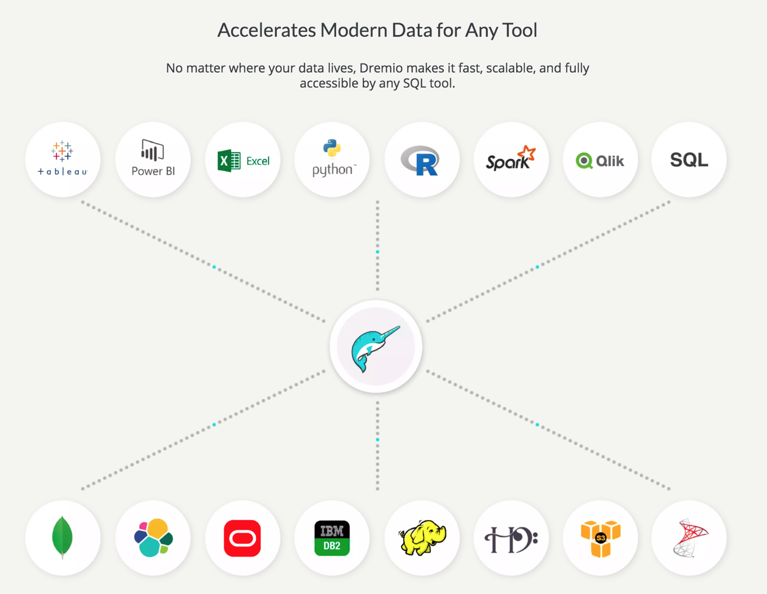

Slide 4
How the table looks like?
- type BIGINT
- type BIGINT
- type TEXT
- type TEXT
- type TEXT
- type TEXT
- type TEXT
- type TEXT
- type TEXT
- type TEXT
- type DOUBLE PRECISION
- type DOUBLE PRECISION
- type TEXT
- type BIGINT
1944406
180360835
DRUG/NARCOTIC
POSSESSION OF NARCOTICS PARAPHERNALIA
Tuesday
05/15/2018
01:25
SOUTHERN
ARREST, BOOKED
0 Block of 6TH ST
-122.41004163181597
37.781953653725715
(37.781953653725715°, -122.41004163181597°)
18036083516710
index
IncidntNum
Category
Descript
DayOfWeek
Date
Time
PdDistrict
Resolution
Address
X
Y
Location
PdId
SELECT * FROM public."SFincidents";
Successfully run. Total query runtime: 12 secs 159 msec. 2215467 rows affected.
www.datasf.org

Slide 5
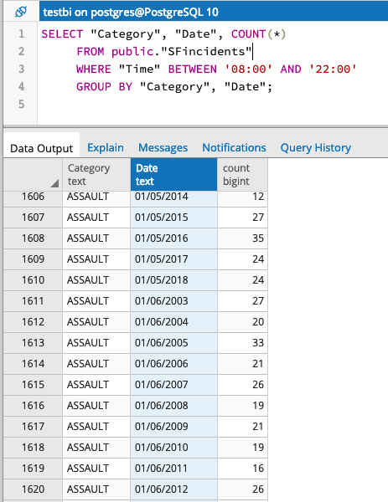
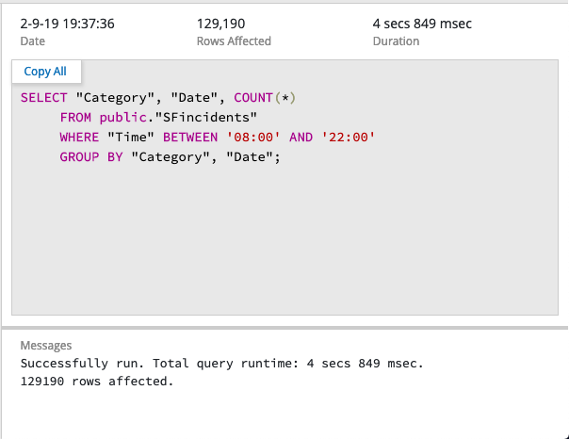
Testing Different Types Of Connections (pgAgent )

Slide 6
Testing Different Types Of Connections (Dremio)
import datetime
import pandas as pd
from my_python.myfirstlib import connect_to_dremio, connect_to_postgres
with open('SF_dremio.csv', 'w') as csv_file:
row_title = f"id,date_time,duration\n"
csv_file.write(row_title)
print("SF_dremio")
for i in range(100):
start = datetime.datetime.now()
engine = connect_to_dremio()
sql = '''SELECT "Category", "Date", COUNT(*)
FROM postgresql.public."SFincidents"
WHERE "Time" BETWEEN '08:00' AND '22:00'
GROUP BY "Category", "Date"
'''
result = pd.read_sql(sql, engine)
with open('SF_dremio.csv', 'a') as csv_file:
row = f"{i},{datetime.datetime.now()},{datetime.datetime.now() - start}\n"
csv_file.write(row)
print(row.replace("\n", ""))
del engine, result

Slide 7
Testing Different Types Of Connections (Python & SQL)
with open('SF_python_sql.csv', 'w') as csv_file:
row_title = f"id,date_time,duration\n"
csv_file.write(row_title)
print("SF_python_sql")
for i in range(100):
start = datetime.datetime.now()
engine = connect_to_postgres()
sql = """
SELECT "Category", "Date", COUNT(*)
FROM public."SFincidents"
WHERE "Time" BETWEEN '08:00' AND '22:00'
GROUP BY "Category", "Date";
"""
result = pd.read_sql(sql, engine)
with open('SF_python_sql.csv', 'a') as csv_file:
row = f"{i},{datetime.datetime.now()},{datetime.datetime.now() - start}\n"
csv_file.write(row)
print(row.replace("\n", ""))
del engine, result

Slide 8
Testing Different Types Of Connections (Pandas)
with open('SF_pandas.csv', 'w') as csv_file:
row_title = f"id,date_time,duration\n"
csv_file.write(row_title)
print("SF_pandas")
for i in range(100):
start = datetime.datetime.now()
engine = connect_to_postgres()
result = pd.read_sql('SELECT * FROM public."SFincidents"', engine)
result = result[result.Time >= '08:00']
result = result[result.Time < '22:00']
result = result.drop(
['IncidntNum', 'Descript', 'DayOfWeek', 'Time', 'PdDistrict', 'Resolution',
'Address', 'X', 'Y', 'Location', 'PdId', 'index_id'], axis=1)
result = result.groupby(['Category', 'Date']).count()
with open('SF_pandas.csv', 'a') as csv_file:
row = f"{i},{datetime.datetime.now()},{datetime.datetime.now() - start}\n"
csv_file.write(row)
print(row.replace("\n", ""))
del engine, result

Slide 9

Make Dremio Reflections

Slide 10
Testing Different Types Of Connections
(Dremio Reflections)
with open('SF_dremio_reflections.csv', 'w') as csv_file:
row_title = f"id,date_time,duration\n"
csv_file.write(row_title)
print("SF_dremio_reflections")
for i in range(100):
start = datetime.datetime.now()
engine = connect_to_dremio()
sql = '''SELECT "Category", "Date", COUNT(*)
FROM postgresql.public."SFincidents"
WHERE "Time" BETWEEN '08:00' AND '22:00'
GROUP BY "Category", "Date"
'''
result = pd.read_sql(sql, engine)
with open('SF_dremio_reflections.csv', 'a') as csv_file:
row = f"{i},{datetime.datetime.now()},{datetime.datetime.now() - start}\n"
csv_file.write(row)
print(row.replace("\n", ""))
del engine, result

Slide 11
Analyzing The Result Using Python
import plotly.offline as py
import plotly.graph_objs as go
import pandas as pd
.
SF_dremio = pd.read_csv('SF_dremio.csv')
SF_reflections = pd.read_csv('SF_dremio_reflections.csv')
SF_pandas = pd.read_csv('SF_pandas.csv')
SF_postgres = pd.read_csv('SF_postgres.csv')
SF_python_sql = pd.read_csv('SF_python_sql.csv')
SF_dremio_trace = go.Scatter(x=SF_dremio.index, y=SF_dremio['duration'], name='Dremio')
SF_reflections_trace = go.Scatter(x=SF_reflections.index, y=SF_reflections['duration'], name='Dremio Reflections')
SF_postgres_trace = go.Scatter(x=SF_postgres.index, y=SF_postgres['duration'], name='PostgreSQL pgAgent')
SF_pandas_race = go.Scatter(x=SF_pandas.index, y=SF_pandas['duration'], name='Pandas')
SF_python_sql_trace = go.Scatter(x=SF_python_sql.index, y=SF_python_sql['duration'], name='Python and SQL')
py.plot([SF_dremio_trace, SF_postgres_trace, SF_reflections_trace, SF_pandas_race, SF_python_sql_trace])
py.plot([SF_dremio_trace, SF_postgres_trace, SF_python_sql_trace, SF_reflections_trace])

Slide 12
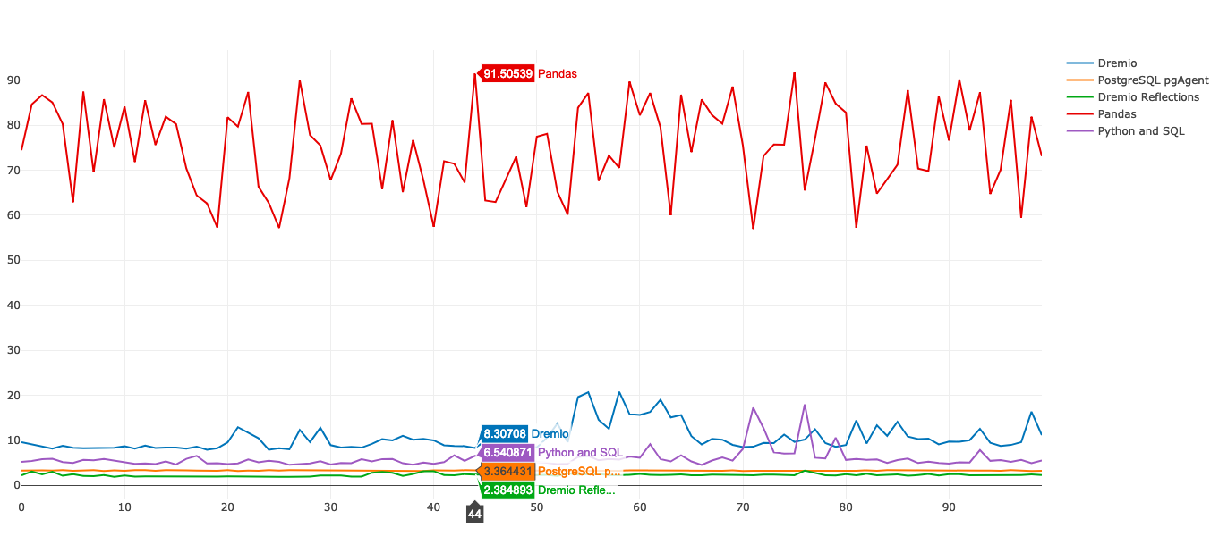
Result With Pandas

Slide 13
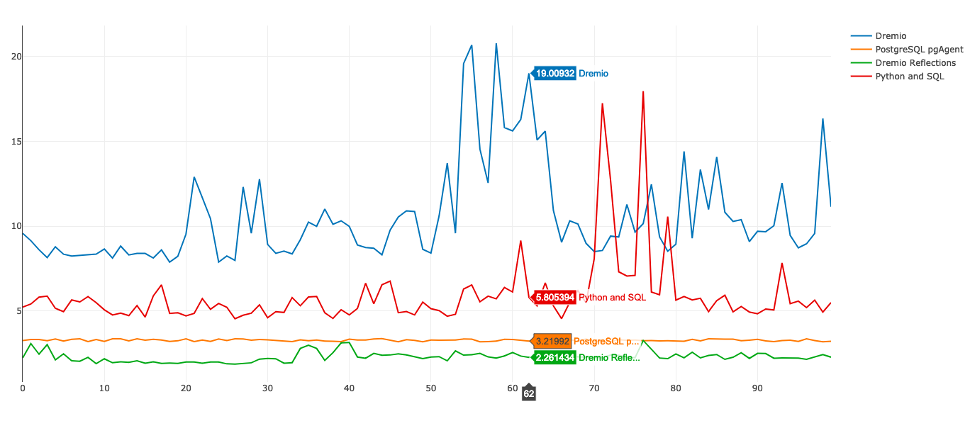
Result Without Pandas

Slide 14
Conclusion
query duration depends on the connection;
the fast type of connection is Dremio Reflection connection;
the slowest type of connection is Pandas connection;
Pandas connection will be a good choice if you need to do many operations with
one particular dataset;
Dremio Reflections can dramatically accelerate analytical processing.

Slide 15




Links
FOR PRESENTATION MATERIALS:
https://github.com/VadymKhodak/dremio_presentation.git
https://docs.google.com/presentation/d/1ByTBxC_PgGB3BAx3YGqpRO1YP5Qai_IVpmCvX-s3Tpo/edit?usp=sharing
FOR MORE INFORMATION ABOUT DREMIO:
https://www.dremio.com/tutorials/accelerating-postgres-with-dremio/
https://www.dremio.com/product/
https://www.youtube.com/watch?v=iPjd6gVLQQM
https://www.youtube.com/watch?v=8L5fuB4fjPg&t=526s
https://www.youtube.com/watch?v=nB8tBZSOzbY&t=2s

Slide 16
THANKS FOR LISTENING!!!
ANY QUESTIONS?
@Vaddimart
live:vaddimart

