Slide 1
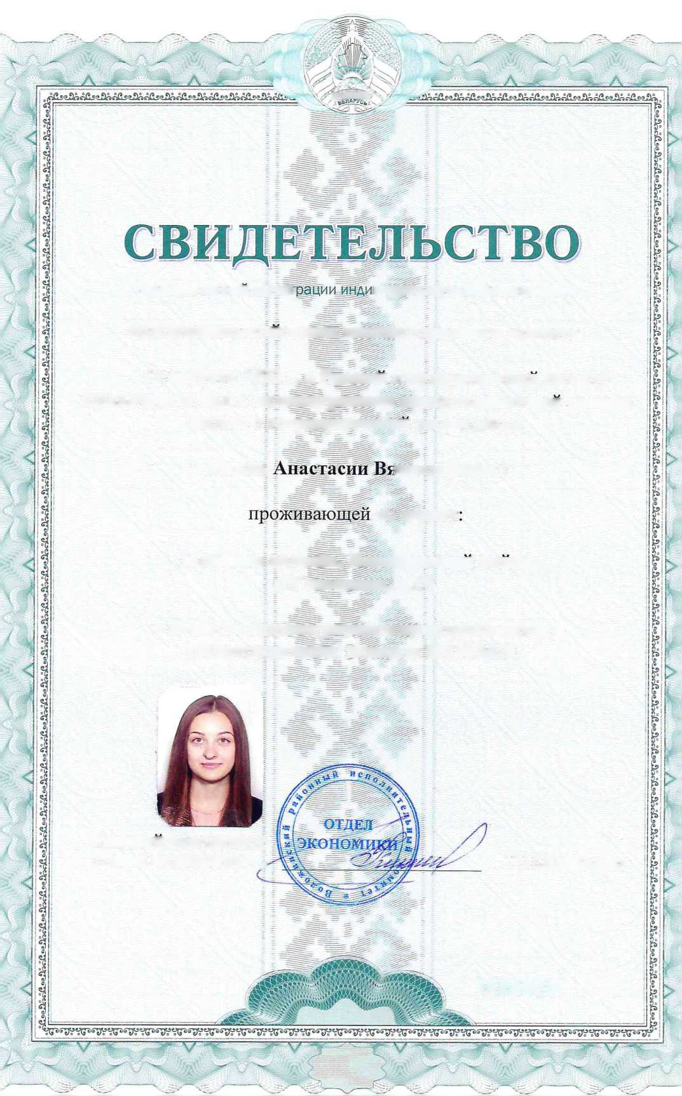

-f,
i®
s
I®
>1
r?ag!3SStJ
■s
■)
o rocyAapcTBeHHOH pemc
BMAyaAbHoro npeAnpHHwviaTeAfl
BOJIOXCHHCKHM paHOHHBIM HCIIOJIHHTeJItHBIM KOMHTeTOM
12 aerycTa 2022 r. b E^hhbih rocyzjapcTBeHHBin perncTp lOpH^HHeCKHX Jim H HH£HBH£yaJIBHBIX IIpe^IIpHHHMaTeJieH BHeceHa 3anHCB o rocyAapcTBeHHOH perncTpan;™
{•
Parejib
IHeCJiaBOBHBI
no a^pecy
MHHCKaa oOjiactb, Bojiohchhckhh pawoH, a.yjia30BHHH, JX. 17,
f
b xanecTBe HH^HBH^yajiBHoro npe^npnHHMaTejia c perncTpaipioHHBiM HOMepoM 691999420.
(V
rJiaBHBin cnennajincT OT^eJia 3K0H0MHKH ^
C.n.KjIHMOBHH
0869316
?vn

