Slide 1

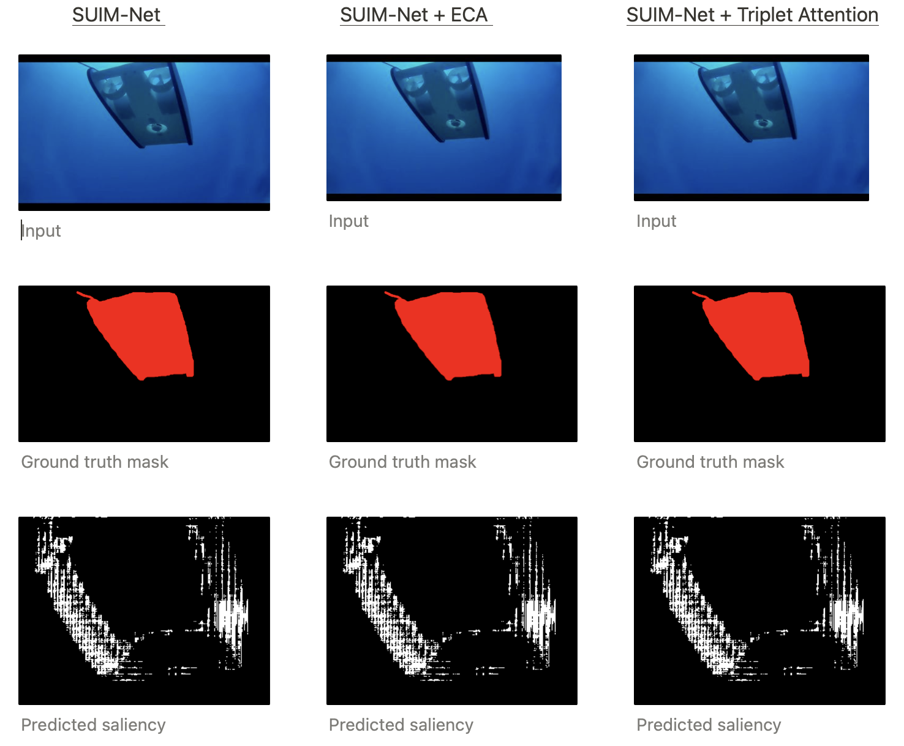
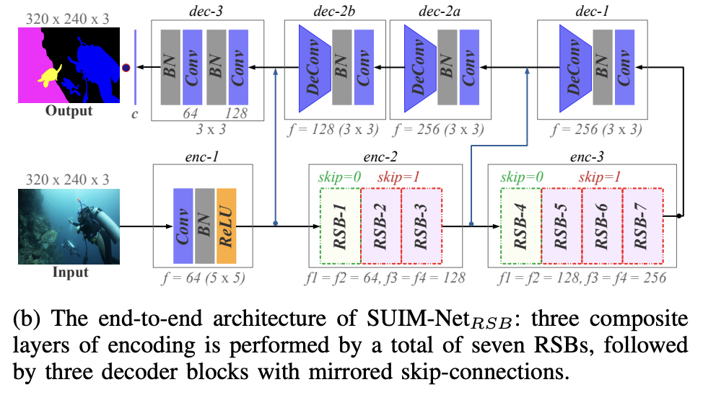
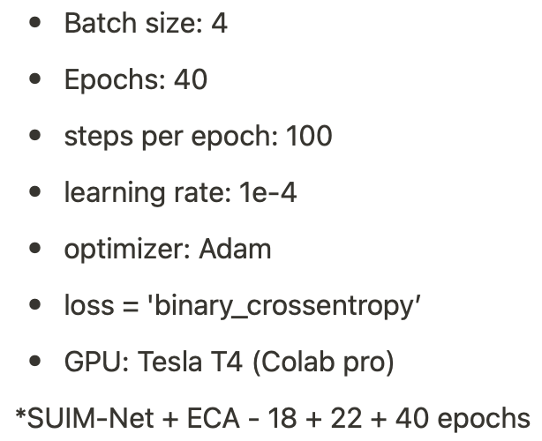
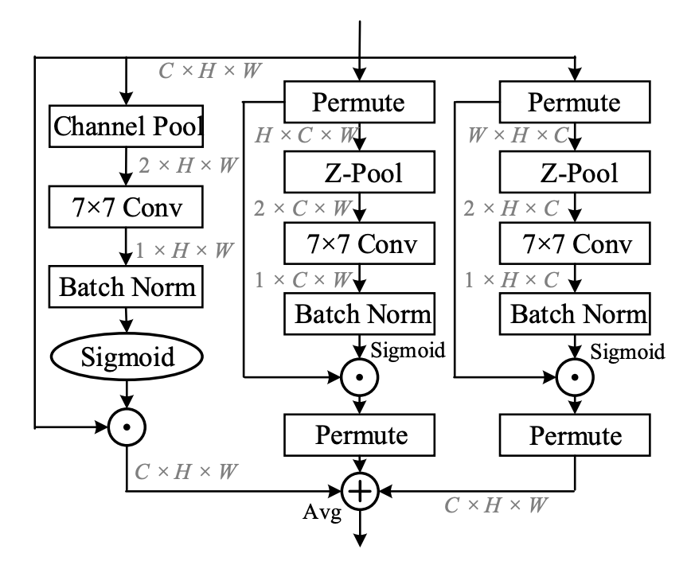
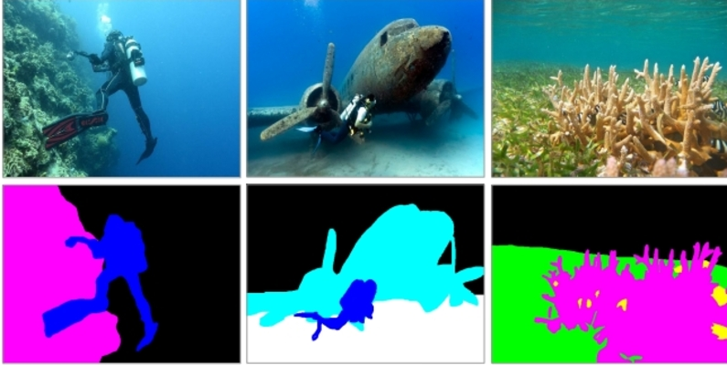
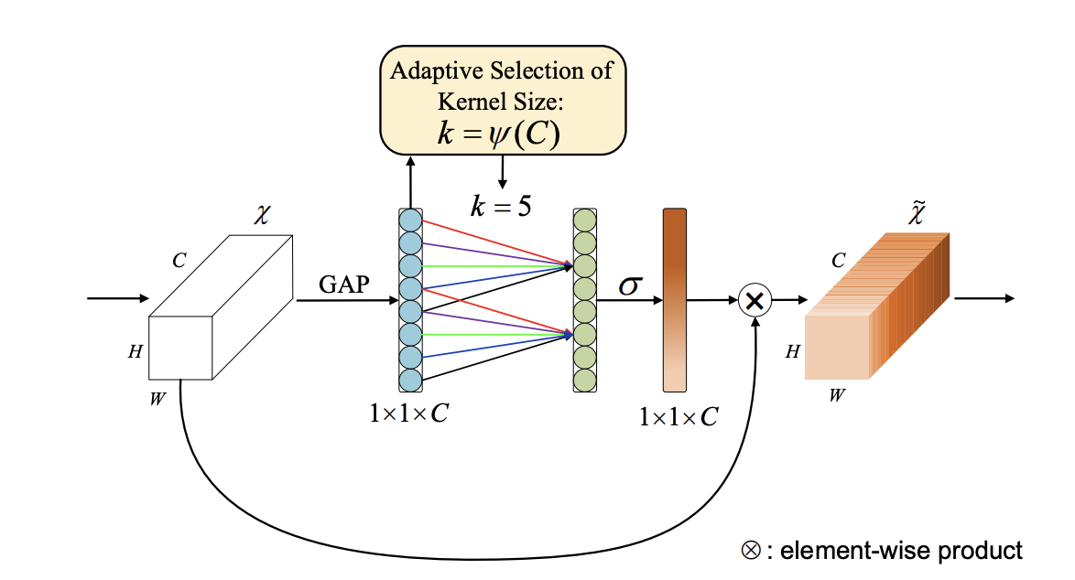
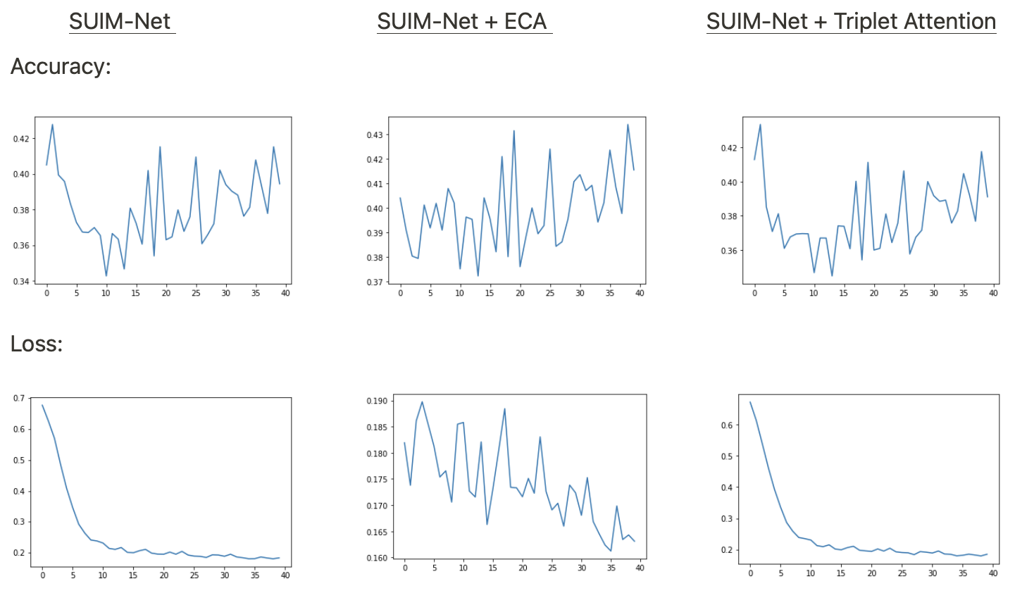
Indiana University Bloomington
Sematic Segmentation on the Underwater Images
Hari Mudipalli, MS Data Science • Steven Fields, MS Data Science • Dinesh Challa, MS Data Science • Khushboo Singh, MS Data Science
Luddy School of Informatics, Computing, and Engineering
Abstract
Modeling Semantic Segmentation
Results
Semantic Segmentation is a popular problem in the computer vision domain.
Underwater segmentation is not explored as deep as segmentation on ground objects.
In this project, we are interested in applying segmentation techniques to underwater images.
As one of the important features of the human visual system, the visual attention mechanism is essential in image generation, scene classification, target detection and tracking when applied in the field of computer vision.
We first implemented SUIM-Net_{RSB} and later experimented by introducing the Efficient Channel Attention and Triplet Attention module in SUIM-Net_{RSB}.
SUIM-Net with Residual Skip Block
Setup
Triplet Attention Module
Observations
Efficient Channel Attention(ECA)
Challenges
Experiments
Initially we wanted to experiment with Visual Transformer for Image segmentation to evaluate its performance. But due to computational challenge as well as time constraint we had to change our idea. Even after shifting ideas, computation still proved to be a challenge.
For better comparison, we ran the experiments on same setup.
Firstly, we executed the SUIM-Net with smaller parameters compared to original authors.
Experiment 1: Introduced ECA module after 1st encoder block.
Experiment 2: Initiated Triplet Attention module between encoder 1 and skip connection to decoder 3.
Future Work
We would want to use DeiT(Data Efficient Image Transformer) for a future experiment for underwater image segmentation.
We would also want to try current model with different dataset(currently we have only 1500 images(SUIM) available)

