Slide 1
OPENAI CODEX ASSISTED PROJECT
Fabulous Unisex Salon
Management System
SALON
OPS
A web-based salon management platform for appointments, services, staff workflow, billing, feedback, reporting, and Razorpay-ready payments.
Presented by Vageesh Hiremath
May 29, 2026

Slide 2
Agenda
02
01
Problem and project objective
02
Solution overview and workflow
03
Features and technology stack
04
Demo screens and Codex contribution
05
Challenges, results, roadmap, and Q&A

Slide 3
Problem Statement
03
Salon operations can become difficult to manage manually.
Current Pain Points
Manual appointment records increase double-booking risk.
Registers and phone calls
Billing and payment tracking require repeated admin effort.
Separate billing records
Staff schedules and service availability are not centralized.
No instant slot visibility
Customers need a simple way to book and track appointments.
HIGH FRICTION

Slide 4
Solution Overview
04
A single role-based platform for salon operations.
Customer Portal
Customers can browse services, book slots, view bills, and submit feedback.
Admins can manage services, staff, appointments, billing, reports, and payments.
Admin Portal
Staff can view assigned appointments and daily schedules.
Staff Portal
Razorpay can be used for online payment after account keys are configured.
Connected workflow, cleaner operations

Slide 5
How It Works
05
1
Select services
2
Check slot
3
Create booking
4
Manage status
5
Generate bill
PHP + MySQL + AJAX + Razorpay + Role-Based Authentication
Codex was used to inspect the codebase, update features, fix issues, and verify project readiness.

Slide 6
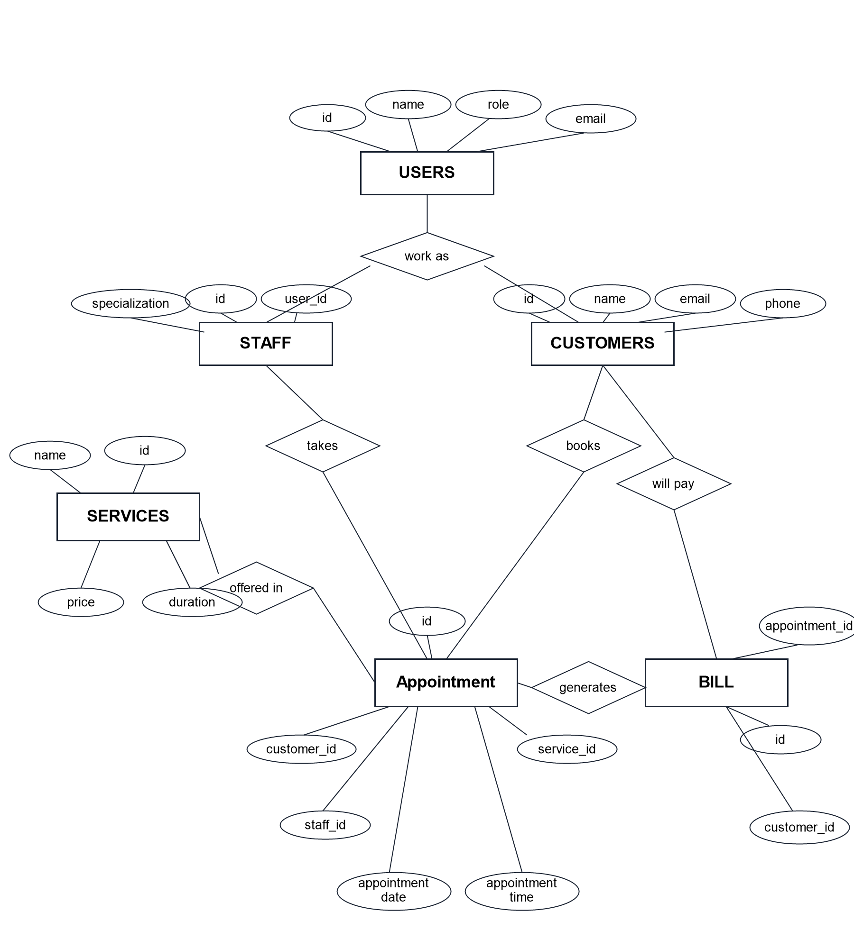
ER Diagram / Database Model
06

Slide 7
Key Features
07
Smart Booking
Role Dashboards
Billing
Service, date, time, staff, and slot availability checks.
Separate workflows for admin, staff, and customers.
Bills are generated after completed appointments.
Payments
Reports
Supports pay-at-salon and Razorpay-ready payment flow.
Revenue, feedback, appointment, and service insights.

Slide 8
Technology Stack
08
Frontend
HTML, CSS, JavaScript, AJAX
Backend
PHP procedural application structure
Database
MySQL database with phpMyAdmin
Runtime
WAMP localhost environment
Payments
Razorpay integration and INR payment tracking
AI Assistance
OpenAI Codex for code changes and verification

Slide 9
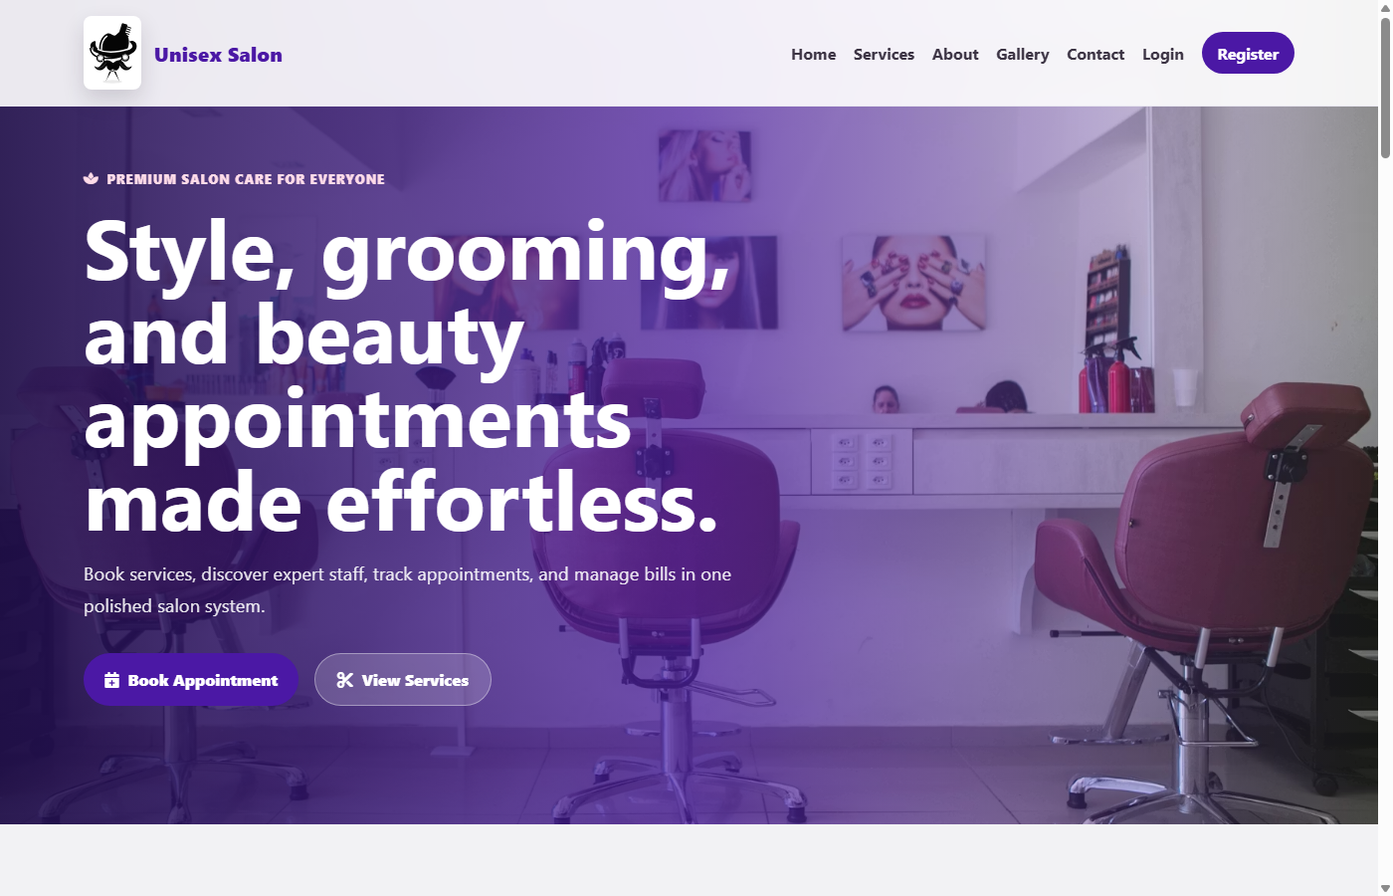
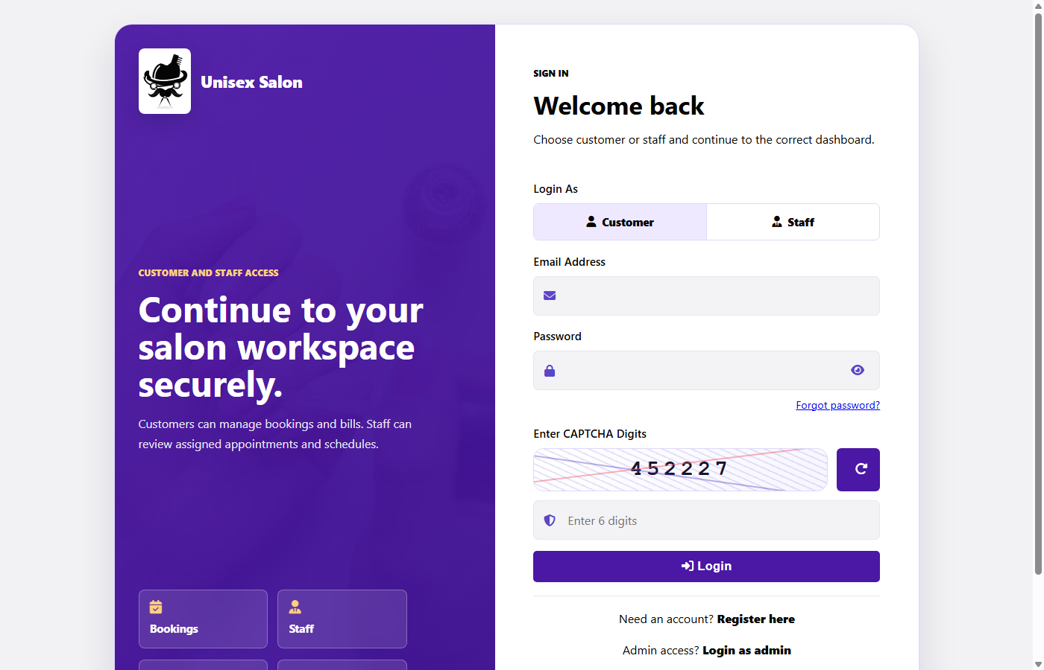
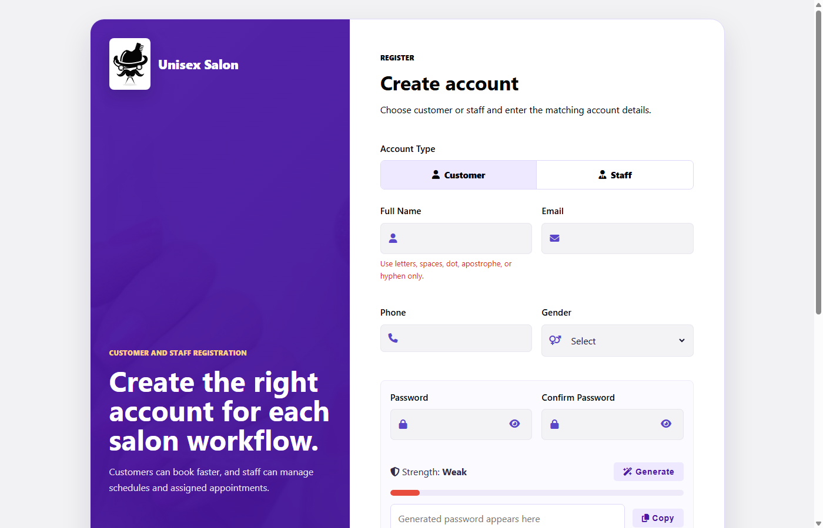
Demo / Screenshots
09
Live application screens from the salon management workflow
Landing page
Secure login
Customer registration
Demo can continue through customer booking, staff status updates, generated bill, payment record, feedback, and admin revenue chart.

Slide 10
Challenges & Learnings
10
Challenges
Learnings
Keeping database schema aligned with payment changes.
Payment status must be consistent across booking and billing.
Removing placeholder branding from project views.
Small schema issues can affect real workflows.
Avoiding duplicate or pending records after online payment.
Regular linting and endpoint checks improve reliability.

Slide 11
Results & Impact
11
3
24+
13
100%
User roles
Services
Core tables
PHP lint pass
Improves appointment organization and staff visibility.
Reduces manual billing and payment tracking effort.
Provides a cleaner experience for customers and administrators.
Makes the project ready for demonstration and future deployment.

Slide 12
Future Roadmap
12
Perform a complete Razorpay test payment demo.
Add email or SMS reminders for appointments.
Improve staff leave management and calendar planning.
Add loyalty points, coupons, and customer offers.
Prepare hosting, backup, and deployment documentation.

Slide 13
Thank You
Questions & Answers
Fabulous Unisex Salon Management System
Presented by Vageesh Hiremath

