Slide 1
RESEARCH PROJECT ON AES-128:IMPLEMENTATION ON FPGA
Vangelis Ananiadis,Maria-Nikoletta Kalantzi (Students, UTH)
Supervising Professor: Karakonstantis Georgios

Slide 2
TABLE OF CONTENTS
01
02
BASIC IDEA OF ENCRYPTION/DECRYPTION
GENERAL IMPLEMENTATION OF AES-128 ENCRYPTION
03
04
VULNERABILITIES
OUR IMPLEMENTATION/
VIVADO RESULTS

Slide 3
WHAT IS ENCRYPTION?
Encryption is the process of securing information and data during transmission or storage.Specifically it transforms plaintext into ciphertext using a mathematical algorithm and a secret key.

Slide 4
WHAT IS DECRYPTION?
Decryption is the reverse operation of Encryption.In particular is the process of converting ciphertext back to its original form, plaintext, using the same initial cryptographic key.

Slide 5
IMPLEMENTATION OF AES-128 ENCRYPTION
The implementation of Encryption involves a process of 10 rounds, each consisting of four key steps: SubBytes, ShiftRows, MixColumns and AddRoundKey.The first and final rounds have slight variations.

Slide 6
MAIN COMPONENTS OF ALGORITHM
INPUT
128-bit cipher, or plaintext.
KEY
128-bit key
OUTPUT
128-bit cipher, or plaintext.
STATE ARRAY
Data structure representing the intermediate result of the process at every stage

Slide 7
STEPS OF PROCESSING
1
2
3
4
SubBytes
ShiftRows
MixColumns
AddRoundKey
Substitutes every byte in the state array independently using a substitution box (S-box)
Enhances diffusion by cyclically shifting the rows of the state aray
Mixes the bytes within each column of the state array to enhance diffusion
XOR-ing the current state matrix with the round key derived from key expansion process
Key Expansion:
Is the process of taking the initial 128-bit key and generating a series of additional round keys

Slide 8
IMPLEMENTATION OF DECRYPTION
The implementation of Decryption involves a process that it is designed to undo the transformations applied during encryption.Each round uses the inverse steps of encryption: Inverse SubBytes, Inverse ShiftRows, Inverse MixColumns, Inverse AddRoundKey.In addition a reverse order of round keys is used.

Slide 9
VULNERABILITIES
SIDE CHANNEL ATTACKS:
Cache Attacks
Electromagnetic Interference Attacks
Timing Attacks
Power Analysis Attacks

Slide 10
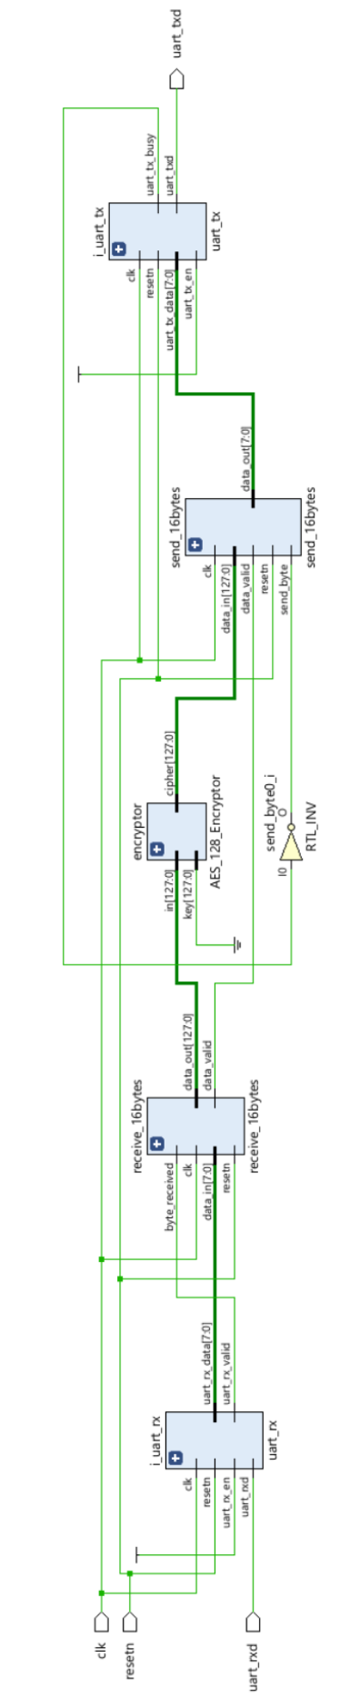
OUR IMPLEMENTATION
In order to better understand its inner workings, we implemented an AES-128 Encryption and Decryption core in Verilog. With the goal to verify and test our design on FPGAs we integrated universal asynchronous receiver / transmitter (UART) communication. The design was synthesized and analyzed in Vivado to generate power, timing, and area results.

Slide 11
VIVADO RESULTS

Slide 12
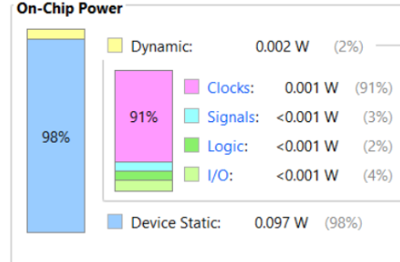
POWER
The total on-chip power measures at 0.099W, with a significant portion (98%) attributed to device static power. Dynamic power accounts for only 2%, distributed across clocks (91%), signals (3%), logic (2%), and I/O (4%)

Slide 13
TIMING
CLOCK(Hz) | WORST NEGATIVE SLACK(WNS)(ns) | TOTAL NEGATIVE SLACK(TNS)(ns)
100 | -28.78 | -3,626.91
25 | 1.220 | 0
25.77 | 0.02 | 0
25.87 | 0 | 0

Slide 14
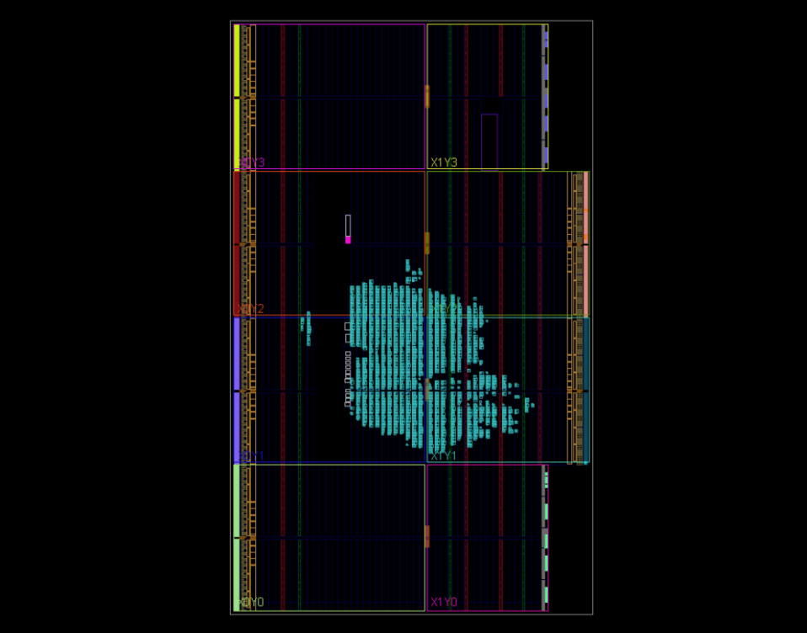
AREA
The area utilization on the FPGA, as shown in the provided schematic generated by Vivado, reflects the layout of the AES-128 encryption implementation. The image visualizes the placement of logic blocks and interconnections within the FPGA.

Slide 15
THANK YOU FOR YOUR TIME

