Slide 1

Compressed NN Implementation for Low Power Medical Imaging
Vaggelis Ananiadis, 03409,
Supervisor: Prof. Karakostantis G.

Slide 2
Topic Description
Deploying and optimizing a CNN to an FPGA, for a low-power, accurate and real-time breast cancer diagnosis from ultrasound images.

Slide 3
Challenges
Power Usage
Accuracy
Can a CNN implementation be more energy efficient than it would be on a CPU or GPU?
How can we retain the performance of the CNN under the strict resource constraints of the FPGA?
Throughput
Is it possible to make a CNN run faster than it would on a CPU or a GPU?

Slide 4
Project focus
Find a suitable CNN
Modify and Train CNN
Optimize CNN for FPGA inference
Synthesize and implement model
Compare results between FPGA and CPU
Conclusions
Future Prospects

Slide 5
Model, Dataset and Training
Model
Dataset
Training
Modified LeNet CNN for Breast Cancer Diagnosis from Ultrasound Images.
Originally 780 images,
augmented to ~2k images classified under normal, benign and malign.
Augmentations:
Zoom, Rotation, Flipping, Stretching
Split into Training 70%, Validation 15% and Testing 15%
Pruning:
Constant 75%, begins after 5 epochs, applied at every epoch after
Adam Optimizer
Learning rate: 0.001
Batch size: 32
100 epochs w/ checkpoints
Python 3.10,
Keras v2,
Tensorflow 2.14
Initial Accuracy of the proposed Modified LeNet was 75%.
Training with these techniques (excluding pruning), 80% accuracy was achieved.

Slide 6
HLS Inference
FPGA
Model Parameters
HLS optimizations
Zynq UltraScale+ MPSoC
Part: XCZU3EG-SBVA484-1-E
Medium scale,
just enough resources to enable experimentation, while requiring heavy optimizations.
The design was then implemented on a smaller board, a Zynq-7000 ZedBoard, for comparison.
Input image size: 16x16
3x 2D Convolution Layers:
- Filter sizes:
32→4, 64→8, 128→16
- Kernel sizes: 3, 2, 4
- Stride:
1, 2, 2 - ReLU Activation
Dropout rate: 20%
Quantization: None,
BRAMs are plentiful
Reuse factor: 16,
DSPs are a bottleneck
IO Stream: stream,
parallel would require sacrificing accuracy. LUTs are another bottleneck
Granularity: model,
name or function create larger designs
hls4ml 1.1.0,
Vitis 2023.2

Slide 7
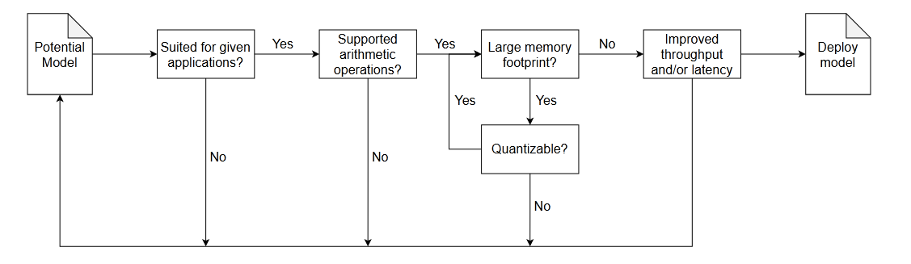
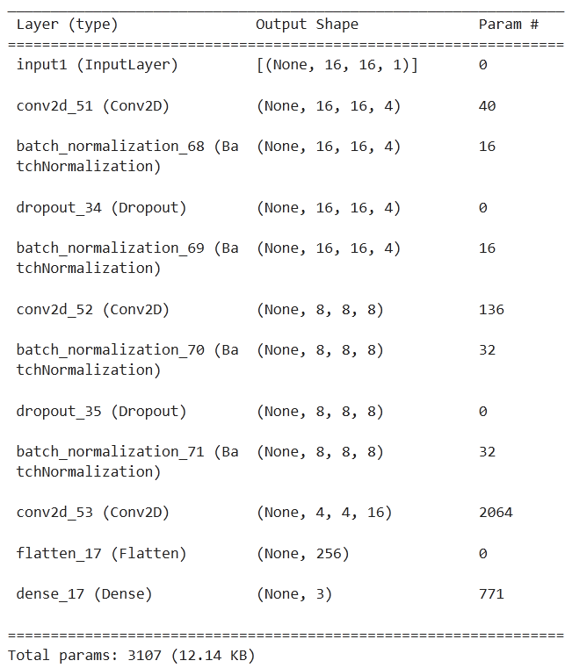
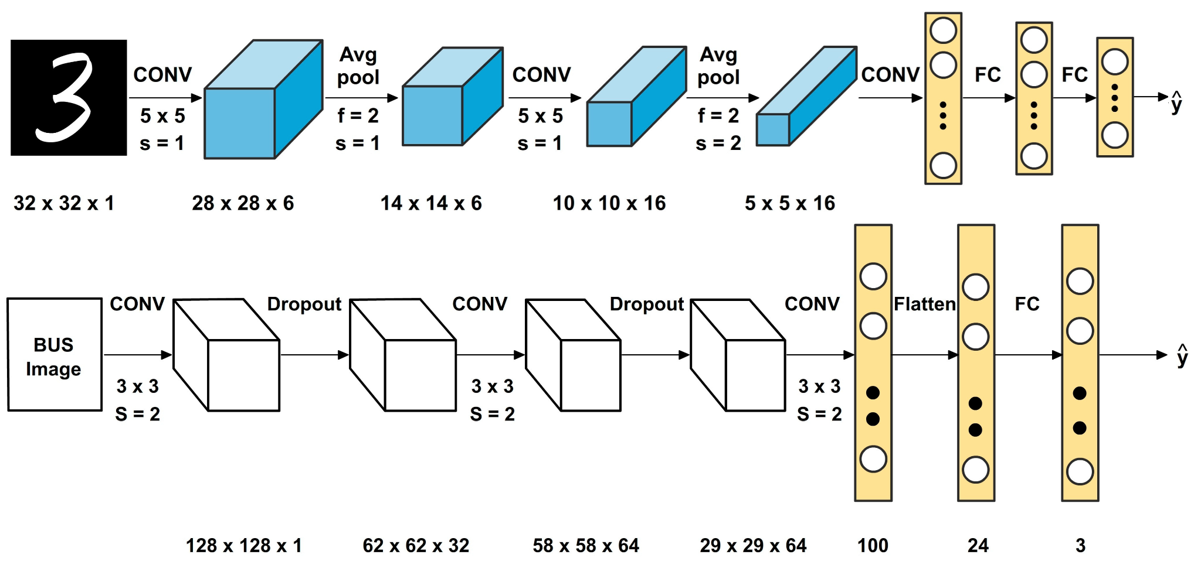
Find, train and modify a model
Final model
Model inspiration
Balasubramaniam, Sathiyabhama, et al. "A modified LeNet CNN for breast cancer diagnosis in ultrasound images." Diagnostics 13.17 (2023): 2746

Slide 8
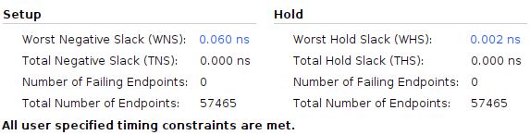
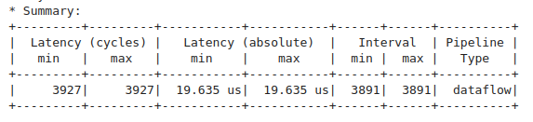


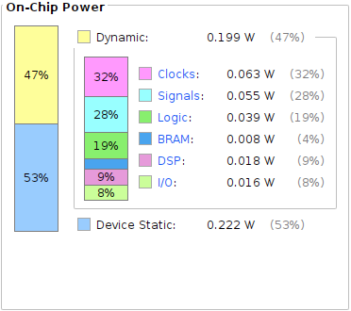
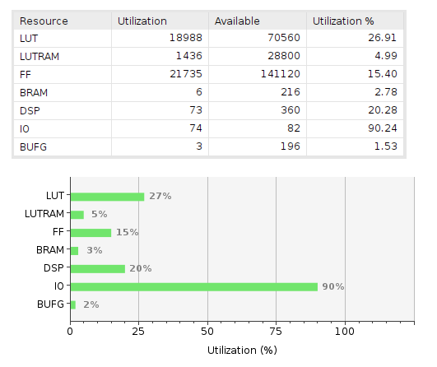

Latency/ Throughput
Zynq UltraScale+ MPSoC - Results
Model Accuracy
Power usage
Resource Utilization

Slide 9
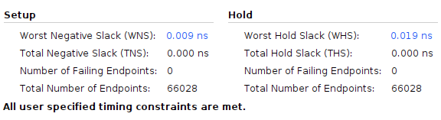
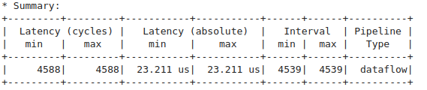

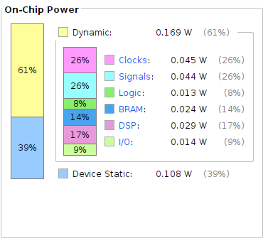
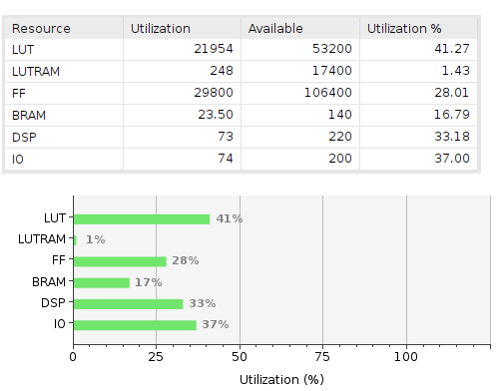
Latency/ Throughput
ZedBoard - Results
Model Accuracy
Power usage
Resource Utilization

Slide 10
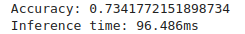
CPU Estimates
Model Accuracy
80%
Power usage
A low estimate is 20W for inference.
Latency/ Throughput
Measured on an Intel Core 5 120U

Slide 11
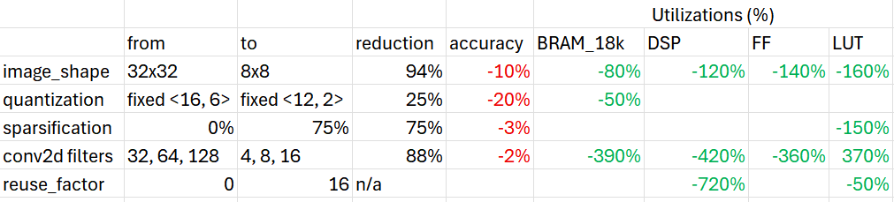
Optimizations against Results

Slide 12
Summary and Comparisons
Power Usage
Accuracy
Both FPGAs consume less than 0.5W, while CPUs need at the very least 15-20W for small scale inference.
71% accuracy was achieved on the FPGA for the inferred model.
The CPU has a 85% accuracy.
Throughput
The latency for the CPU is 90ms, while for the FPGA it is 19μs. In a real system a CPU would not be practical.

Slide 13
Future Prospects
Improve diagnostic accuracy
Expansion to other medical domains
Explore advanced quantization options
70%, while reasonable, leaves room for improvement. Larger FPGAs allow for larger Networks.
Porting another medical imaging CNN should be a simple process.
Taking advantage of advanced quantization techniques, using frameworks, such as HGQ, or QKeras.
CNN to FPGA Wrapper
Hardware aware CNN search
A wrapper for automating the optimal inference of a CNN, by automatically tuning parameters.
Explore hardware-aware CNN architectures to auto-optimize networks for FPGA constraints.
Notes:
70%, while reasonable, leaves room for improvement.

Slide 14
Troubleshooting...
Silent failure before compilation
ML Framerwork
Implementation silently fails at random points
The model is too large.
Solutions include reducing input size and changing io_stream from parallel to serial.
Keras v2 is better supported than Keras v3, or PyTorch.
OOM killer kicks in due to low memory. Can be avoided by adding swap memory.
Implementation does not start
Dependencies
HGQ documentation
Conflict between hls4ml and Vitis for specific versions (2022.2, for example*). Upgrade to Vitis 2023.2 or later.
Required package versions can be found on hls4ml documentation. A clean conda environment is necessary to avoid package version conflicts.
Documentation of the High Granularity Quantization framework is austere.
* This is only reported by fastmachinelearning on GitHub issues and not on the documentations.
and many more…

Slide 15
Tools used
Vitis Suite
hls4ml 1.1.0
Python 3.10
Vitis HLS 2023.2
Vivado 2023.2
Vitis 2023.2
tensorflow 2.14
keras 2.14

Slide 16

Ευχαριστώ για τον χρόνο σας!

