Slide 1

SMART INDIA HACKATHON 2026
TITLE PAGE
Problem Statement ID – SIH26025
Problem Statement Title - Development of an AI-enabled Low Cost Real Time Mine Subsidence Monitoring, Prediction and Early Warning System for Underground Coal Mines in India
Theme - Smart Automation
PS Category- Hardware
Team ID- SIH26-A0H-T226
Team Name - ForgeByte

Slide 2
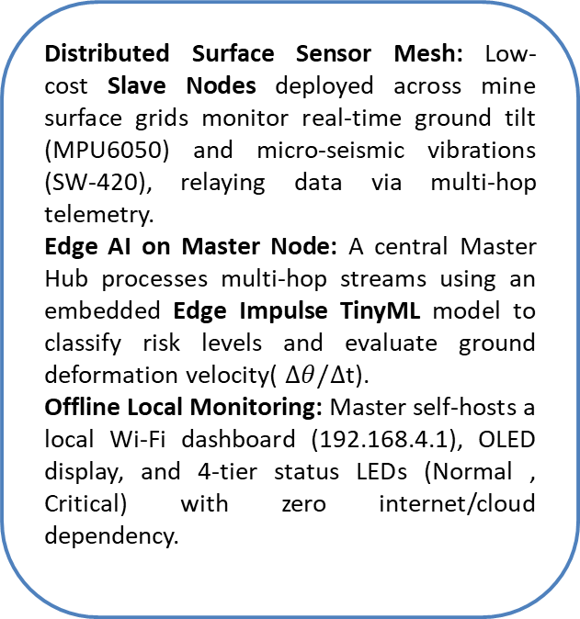
IDEA TITLE
ForgeByte
Detailed Explanation of Proposed Solution
How It Addresses the Problem
Innovation & Uniqueness
Distributed Surface Sensor Mesh: Low-cost Slave Nodes deployed across mine surface grids monitor real-time ground tilt (MPU6050) and micro-seismic vibrations (SW-420), relaying data via multi-hop telemetry.
Edge AI on Master Node: A central Master Hub processes multi-hop streams using an embedded Edge Impulse TinyML model to classify risk levels and evaluate ground deformation velocity( $Δθ/Δ$t).
Offline Local Monitoring: Master self-hosts a local Wi-Fi dashboard (192.168.4.1), OLED display, and 4-tier status LEDs (Normal , Critical) with zero internet/cloud dependency.
Proactive vs. Post-Facto: Replaces slow, manual, periodic surveying with continuous 24/7 automated real-time ground movement detection.
Zero Infrastructure Dependency: Operates 100% autonomously in remote coalfields with no cellular network or cloud connection required.
Rapid Evacuation Windows: Provides instant automated early warnings to mine operators and nearby communities before catastrophic surface failure occurs.
Targeted Closed-Loop Local Siren: Master sends a downstream command to trigger a loud buzzer and strobe LED specifically on the endangered node (e.g., Node 13), directly evacuating at-risk workers without mass panic.
Intelligent False-Alarm Filter: TinyML spectral analysis (FFT) filters out benign vibrations from heavy mining dumpers/traffic vs. true rock shearing.
Self-Healing & Solar-ReadyMesh: Automatic heartbeat detection reroutes packets if a node is damaged by shifting terrain; deep-sleep enables long-term solar-powered operation.

Slide 3
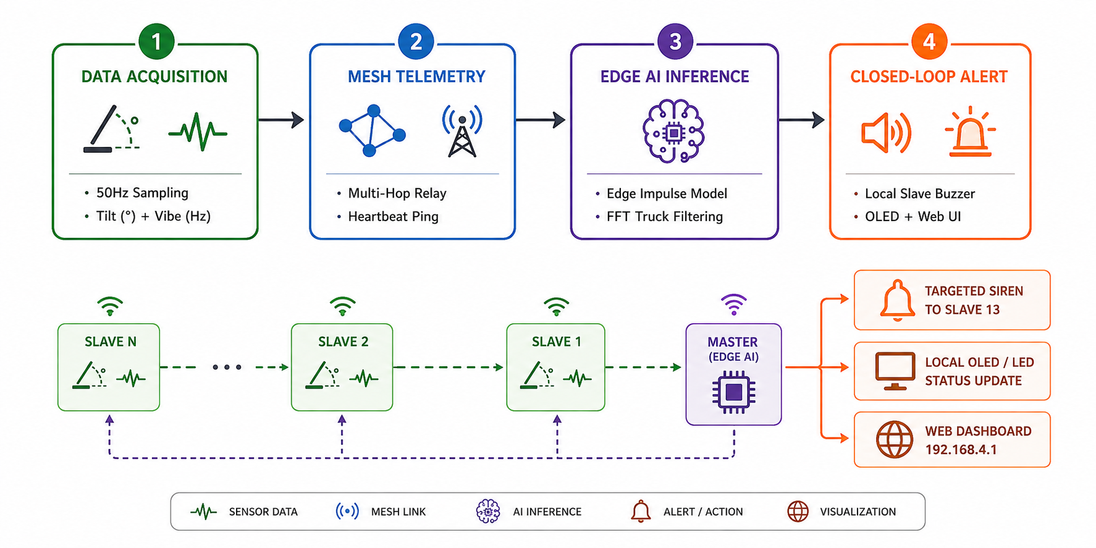
TECHNICAL APPROACH
ForgeByte
Technologies & Tools Used
Implementation Methodology
Hardware & Edge Devices:
Controllers: ESP8266 (Master Hub & Multi-hop Slave Nodes)
Sensors: MPU6050 (6-Axis Inclinometer/Tilt), SW-420 (Micro-seismic Vibration)
Outputs: 0.96" I2C OLED Display, 4-Tier Status LEDs (🟢🟡🟠🔴), Piezo Buzzers
Power: 3.7V 18650 Li-ion battery with 5V Solar Harvesting & Deep-Sleep
Languages & Firmware:
Embedded Core: C++ / Embedded C (Arduino framework / ESP-IDF)
Web Dashboard: HTML5, CSS3, Vanilla JavaScript (Chart.js embedded in ESP32 Flash)
AI / ML & Communication Protocols:
TinyML Framework: Edge Impulse Studio & TensorFlow Lite for Microcontrollers
Protocols: ESP-NOW / LoRa Wireless Mesh, Wi-Fi SoftAP (HTTP WebServer), I2C

Slide 4
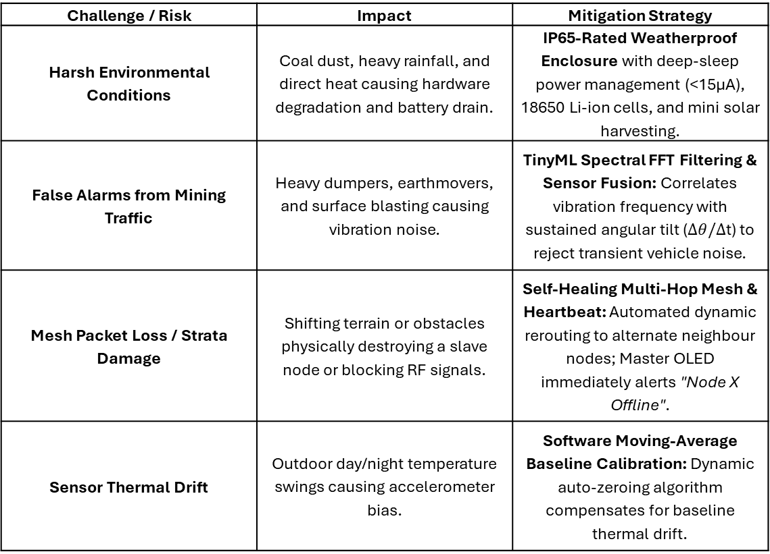
FEASIBILITY AND VIABILITY
ForgeByte
Challenge / Risk | Impact | Mitigation Strategy
Harsh Environmental Conditions | Coal dust, heavy rainfall, and direct heat causing hardware degradation and battery drain. | IP65-Rated Weatherproof Enclosure with deep-sleep power management (<15µA), 18650 Li-ion cells, and mini solar harvesting.
False Alarms from Mining Traffic | Heavy dumpers, earthmovers, and surface blasting causing vibration noise. | TinyML Spectral FFT Filtering & Sensor Fusion: Correlates vibration frequency with sustained angular tilt ($Δθ/Δ$t) to reject transient vehicle noise.
Mesh Packet Loss / Strata Damage | Shifting terrain or obstacles physically destroying a slave node or blocking RF signals. | Self-Healing Multi-Hop Mesh & Heartbeat: Automated dynamic rerouting to alternate neighbour nodes; Master OLED immediately alerts "Node X Offline".
Sensor Thermal Drift | Outdoor day/night temperature swings causing accelerometer bias. | Software Moving-Average Baseline Calibration: Dynamic auto-zeroing algorithm compensates for baseline thermal drift.
Technical Feasibility: Uses proven COTS (commercial off-the-shelf) microcontrollers (ESP32) and sensors. The Edge Impulse TinyML model has a tiny footprint (<100KB RAM), running efficiently with zero cloud lag.
Economic Feasibility: Ultra-low BoM (Bill of Materials) cost of < ₹600 per slave node, compared to commercial geotechnical systems costing over ₹50,000+. Enables scalable, high-density grid deployment.
Operational Feasibility: Plug-and-play surface deployment requiring zero civil excavation or trenching; operates 100% autonomously without cellular/internet coverage.

Slide 5
IMPACT AND BENEFITS
ForgeByte
Multi-Dimensional Benefits
Impact on Target Audience & Stakeholders
Social Benefits:
Zero Casualties: Drastically reduces injury and loss of life for mining personnel and surface inhabitants.
Public Trust: Builds safety confidence for communities living in subsidence-prone coal belts (e.g., Raniganj, Jharia, Singrauli).
Economic Benefits:
Massive Cost Savings: Prevents millions in post-disaster compensation, infrastructure repair (roads, rail lines, pipelines), and legal liabilities.
Low CapEx & Scalable: Indigenous hardware (< ₹600) makes full-field sensor coverage affordable compared to expensive imported systems (₹50k+).
Environmental Benefits:
Groundwater & Soil Protection: Early crack detection prevents groundwater table drainage and aquifer breach.
Fire Prevention: Reduces surface air ingress through fissures that trigger hazardous spontaneous coal-seam fires.
🇮🇳 Strategic / "Make in India":
Fully indigenous, low-power AI-IoT solution promoting smart, sustainable, and safe Indian coal mining.
Mine Workers & Field Crews: Instant on-site life safety via targeted slave sirens (e.g., Node 13 buzzer) providing crucial evacuation lead time before ground collapse.
Local Communities & Villagers: Safeguards nearby residential homes, rural schools, and agricultural land from unannounced sinkhole disasters.
Mine Operators (Coal India Ltd / CIL): Provides 24/7 real-time situational awareness via offline local dashboards, preventing abrupt mine shutdowns and equipment losses.
Regulatory Authorities (DGMS & Ministry of Coal): Delivers continuous, automated geotechnical risk tracking to ensure strict safety compliance.

Slide 6
RESEARCH AND REFERENCES
ForgeByte
[1] Wang et al., "Design of Wireless Sensor Networks for Real-Time Mining Safety Telemetry," IEEE Trans. Ind. Informatics.
[2]Chen et al., "Mining-Induced Ground Subsidence Prediction Using Machine Learning," Int. J. Min. Sci. Technol. (Elsevier).
[3] Das et al., "Low-Cost MEMS Sensor-Based Surface Tilt Monitoring for Geohazard Warning," IEEE Sensors Journal.
[4] Sharma et al., "Resilient Multi-Hop Wireless Mesh Networks for Mining Field Telemetry," IEEE IoT Journal.
[5] Tseng et al., "TinyML and Edge-AI for Ultra-Low-Power Real-Time Geohazard Early Warning," IEEE Embedded Systems Letters.

