Slide 1
Power BI: Guide for Data Visualization & DAX
23/04/2026
Vagia Xevgeni

Slide 2
Agenda
Project Overview
Datasets Overview
Business Insights

Slide 3
Project Overview
Project Name: Final Project in the course: Power BI: Guide for Data Visualization & DAX
Objective: prepare a report for for Airbnb
Focus: create 4 pages related to Overview, Host, Property and Booking analysis on Power BI
Tools and Technologies: Microsoft Power BI Desktop
Data Source: Airbnb public data

Slide 4
Datasets Overview
listings.csv
calendar.csv
reviews.csv
Source: https://insideairbnb.com/get-the-data/
Main tables used
Reviews
listing_id (FK to listings), id (PK), date, reviewer_id, reviewer_name, comments
Listings
llisting_id (PK), listing_url, name, description, picture_url, host_id, host_url, host_name, host_since, host_location, host_about, host_response_time, host_response_rate, host_acceptance_rate, host_is_superhost, host_thumbnail_url, host_picture_url, host_verifications, host_has_profile_pic, host_identity_verified, neighbourhood_cleansed, latitude, longitude, property_type, room_type, accommodates, bathrooms, bathrooms_text, bedrooms, beds, amenities, price, minimum_nights, maximum_nights, has_availability, review_scores_rating, review_scores_accuracy, review_scores_cleanliness, review_scores_checkin, review_scores_communication, review_scores_location, review_scores_value, instant_bookable
Calendar/Bookings
listing_id (FK to listings), date, available, price, adjusted_price, minimum_nights, maximum_nights

Slide 5
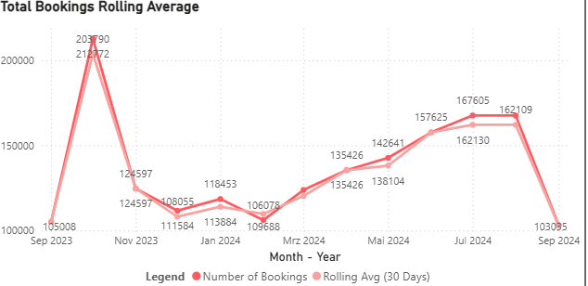
Business Insights
Is there seasonality on the Bookings ?
Yes, is seems that the interest is rising from March and while we expect the peak on Summer season months (June, July, August), September and October shows us when to go for vacations or when to… avoid going!
Recommendation: Launch campaigns 60-90 days before the peak season to lock in revenue early with discounted advance rates.

Slide 6
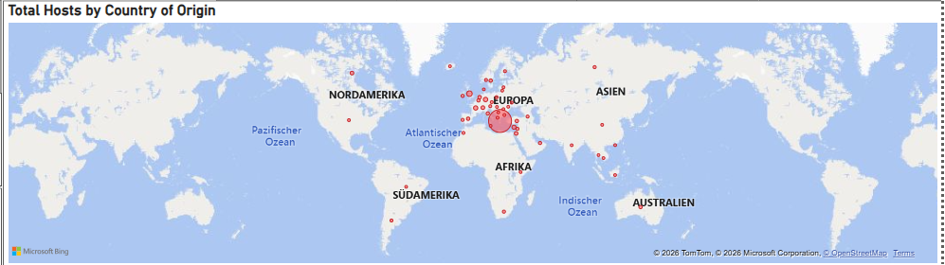
Business Insights
Where are most Greek hosts/hostesses located ?
As expected, the main country of residence of Greek host/hostess is Greece. The rest, are mainly located in Europe.
Recommendation: Select one “low-density” region from your map (e.g. North America) for a pilot marketing campaign to see if the platform’s specific value proposition resonates outside of Europe.

Slide 7
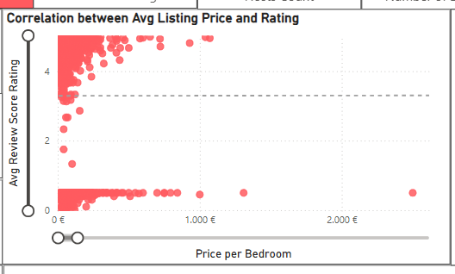
Business Insights
Are prices and ratings correlated?
Most listings cluster around high ratings (i.e. 4-5) regardless of price. Also, reviewers tend to either give low ratings (0) or high ones (4 - 5) but not in the middle!
Recommendation: Reach out to guests who didn’t leave a review; they are often the “middle ground” customers who had an okay experience but weren’t motivated to post.

Slide 8
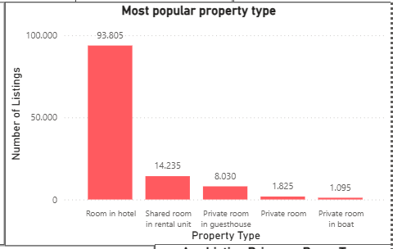
Business Insights
Which is the most popular property type and what does this indicate?
The clear leader is the room in a hotel.
That indicates that this platform might be used primarily as a distribution channel for professional hospitality business rather than individuals renting out their spare bedrooms or apartments.
Recommendation: Consider a loyalty program that rewards guests for booking across different property types to encourage those who usually book hotels to try a high-rated apartment or private roοm.

Slide 9
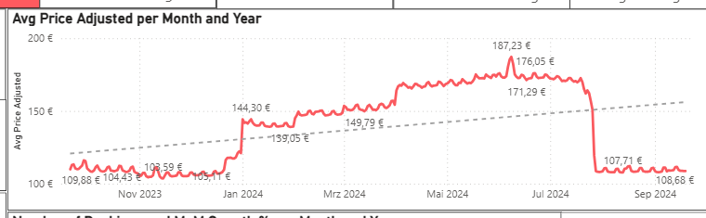
Business Insights
How are the prices fluctuated?
From the end of 2023 (December) the booking prices start to rise. This fluctuation happened for at least 7 months of 2024 while on August 2024 the situation got back to normal.
The highest price is shown on the 8th of June 2024, and equals to 187,23 €.
Recommendation: For the months showing lower average prices (like November or January), use targeted “last-minute” flash sales to fill gaps in the calendar.

