Slide 1

SMARTSTUDY
Plan Smart, Achieve More!" 📚✨
BY:
K.VAGMI SREE
Mani Kumari
LucasRatna
Prameela

Slide 2

📖 WHAT IS SMARTSTUDY?
SmartStudy, AI-powered study planner
Helps students organize their schedules efficiently
Enhances productivity with personalized reminders

Slide 3
PROBLEM STATEMENT
AI Personalized Study Planner is an intelligent tool that creates customized study plans based on students' goals, strengths, and preferences. Using BERT architecture, it optimizes study schedules to help students achieve academic success efficiently.

Slide 4
✅ OUR SOLUTION – SMARTSTUDY!
-AI-generated study plans
- Difficulty-based time allocation
- Subject-wise study important recommendations

Slide 5
HOW IT WORKS
1. User inputs total available study time.
2. Selects subjects and assigns difficulty weights.
3. AI generates an optimized study schedule.
4. AI provides tips and recommend important topics to study

Slide 6
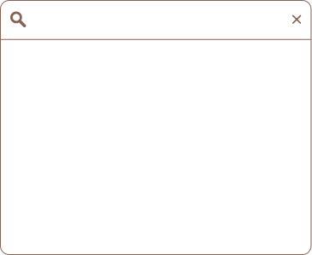
TECHNOLOGIES USED
Streamlit
Python
– A Python framework for creating web applications with minimal effort
The core programming language used for logic and data handling
Pandas
Random
A data manipulation library used for handling and processing data.
A built-in Python module for generating random selections, likely used for scheduling or assigning tasks.

Slide 7
FUTURE ENHANCEMENTS
User Authentication
Database Integration
Smart Scheduling
Notifications
UI & Customization
Export & Reports

Slide 8
CONCLUSION
The project successfully enhances efficiency, automation, and user experience, making tasks more manageable and scalable. With seamless integration and future growth potential, it ensures improved productivity and adaptability to evolving needs.

Slide 9

THANK YOU.

