Slide 1
Chapter 2
Basic Concepts of
2D Computer Graphics
Resumes of the book
Computer Graphics using Java 2D and 3D
Computação Gráfica
Prof. Carlos Carreto
Engenharia Informática
Instituto Politécnico da Guarda

Slide 2
Objectives
Understand the sequence of operations of a 2D graphic system.
Understand 2D coordinate systems and graph equations.
Identify the various coordinate spaces in the render pipeline.
Understand the structure of a Java 2D program and the Graphics2D class.
Develop Java programs to draw graphs from their equations.
Use basic 2D geometric primitives.
Construct new shapes through the Constructive Area Geometry and GeneralPath methods.

Slide 3

2D Rendering Process
A 2D graphics object is processed in a pipeline of transformation and viewing.
Construct 2D objects.
Apply transformations to objects.
Apply color and other rendering properties (attributes).
Render the scene on a graphical device.

Slide 4
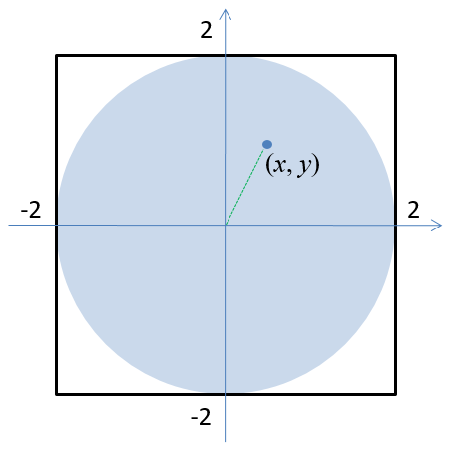
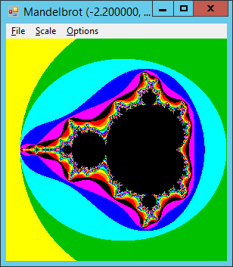
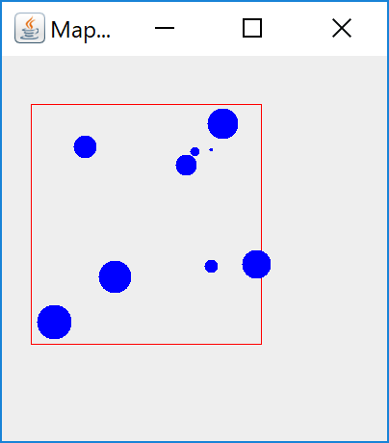
Different Coordinate Spaces of the Pipeline
int[][] Data =
{{6824, 7479, 122},
{1358, 7594, 612},
{2625, 1990, 880},
{6088, 7404, 266},
{6809, 2419, 358},
{8790, 2522, 755},
{5435, 4974, 45},
{7332, 8604, 812},
{5741, 6806, 590},
{0, 0, 900 },
{7336, 6944, 783}};
Data is not always defined in the device coordinate system.

Slide 5
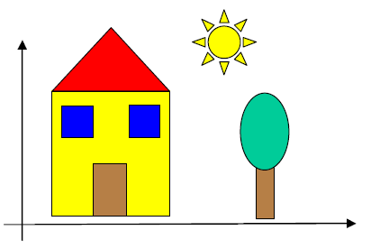
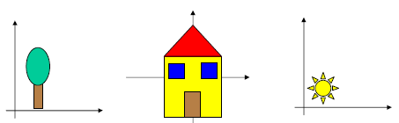
Different Coordinate Spaces of the Pipeline
Object Space
Universe/World Space
In some applications it is advantageous to work with different coordinate spaces.

Slide 6
Different Coordinate Spaces of the Pipeline
Object Space
The objects can be defined in the respective Object Spaces, to facilitate their construction.

Slide 7
Different Coordinate Spaces of the Pipeline
Universe Space
The objects are then positioned in the Universe Space to form the desired scene.

Slide 8
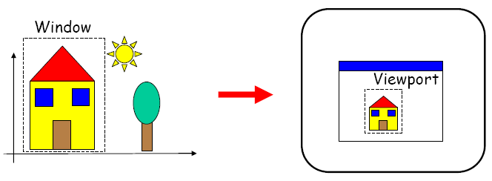
Different Coordinate Spaces of the Pipeline
The rendering of the scene is done by mapping the contents of a Window, defined in coordinates of the Universe Space, in a Viewport defined in coordinates of the Device Space.
Universe Space
Device Space

Slide 9
Different Coordinate Spaces of the Pipeline
Object Space
Universe Space
Device Space

Slide 10
Mapping Window - Viewport
The Window is the area of the universe that interests to visualize and has coordinates in the Universe Coodinates System (UCS).
The Viewport is the area of the device where the content of the Window will be mapped and has coordinates in the Device Coordinate System (DCS).
UCS
DCS

Slide 11
Mapping Window - Viewport
The mapping converts the coordinates of the Universe Coordinate System (UCS) to coordinates of the Device Coordinate System (DCS).
Notice however that in many applications the UCS = DCS and the mapping is not needed.
P_{UCS} (X_{U}, Y_{U})
P_{DCD} (X_{D}, Y_{D})

Slide 12
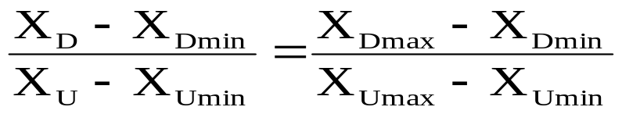
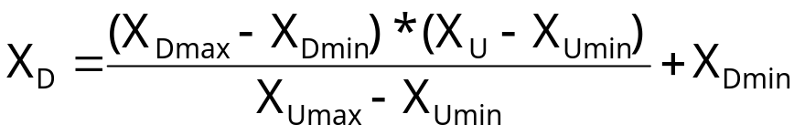
Mapping Window - Viewport
To determine the X_{D} coordinate
X_{Umax}
X_{Dmax}
X_{U}
X_{D}
X_{Umin}
X_{Dmin}
Scale factor of the X axis (S_{X})

Slide 13
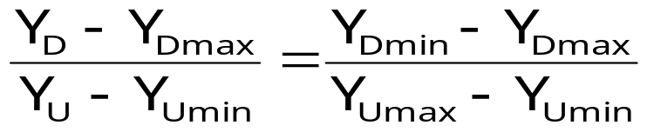
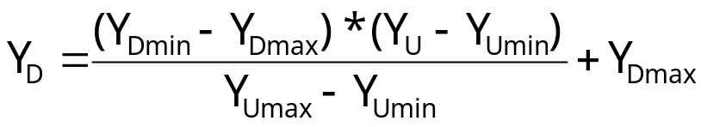
Mapping Window - Viewport
To determine the Y_{D} coordinate
(We reverse the relation of the Y axes because they grow in opposite directions)
Y_{Umax}
Y_{Dmax}
Y_{U}
Y_{D}
Y_{Umin}
Y_{Dmin}

Slide 14
Mapping Window - Viewport
If the Window and Viewport do not have the same aspect ratio (width / height ratio), the scale factors according to X and Y axes will be different and the scene will be distorted. For this not to happen, we can use the scaling factor that is smaller.
Window
Viewport
S_{X} ≠ S_{Y}
S = Min (S_{X}, S_{Y})

Slide 15
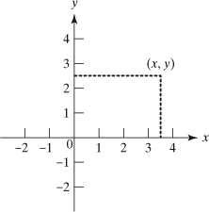
2D Coordinate System

Slide 16
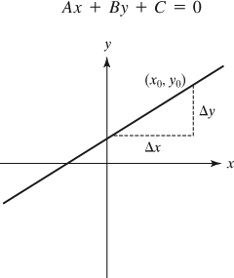
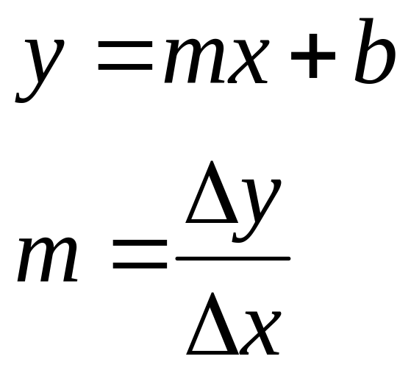
Simple Graphics Primitives
Linear Equation of a Line

Slide 17

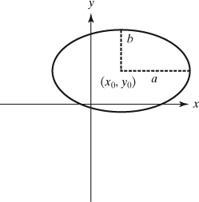
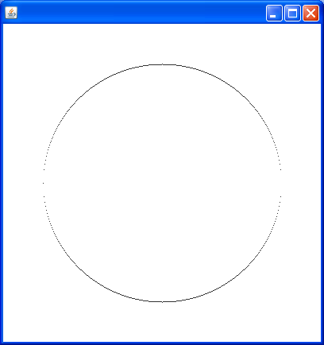
Simple Graphics Primitives
Quadratic Equation of an Ellipse
The rendering of primitives by directly applying equations of the type y = f (x), usually does not work due to rounding problems caused by the finite resolution of the output device.

Slide 18
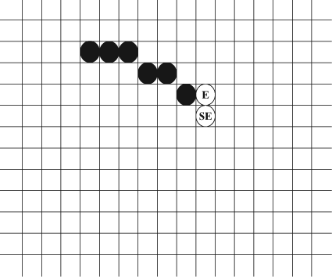

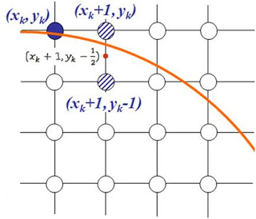
Simple Graphics Primitives
Quadratic Equation of an Ellipse
The rendering of a circle consists of determining which pixels are to be activated.
In the right example, the Middle-Point Algorithm chooses between the East pixel and the Southwest pixel of the last active pixel.

Slide 19
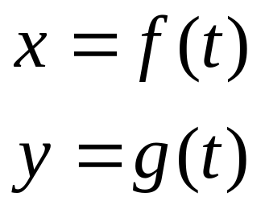
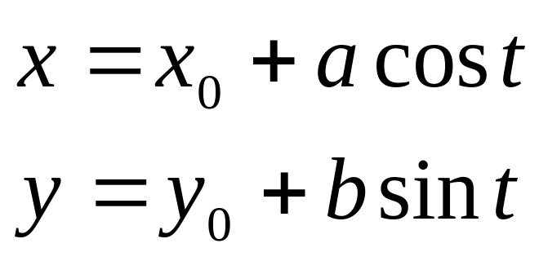
Parametric Equations
Parametric equations provide a generic method for drawing graphical primitives as we will se.
Parametric equation of an ellipse
0 < t < 360

Slide 20
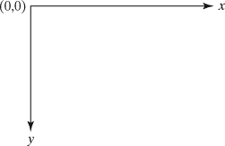
Java 2D’s Coordinate System
Java 2D's coordinate system originates from origin (0, 0) with the x-axis increasing rightward and the y-axis increasing downward.

Slide 21
Class Graphics2D
Java 2D API rendering engine.
Extends the Graphics class (java.AWT.Graphics).
Encapsulates all rendering functions.
Two ways to get a Graphics2D object
void paintComponent(Graphics g){
. . .
Graphics2D g2 = (Graphics2D) g;
. . .
}
Or
Graphics2D g2 = (Graphics2D) obj.getGraphics()

Slide 22
Some Methods of the Graphics Class
There is no clear separation between the modeler and the renderer in the Graphics class. For example, a single method drawOval is responsible for both defining (modeling) an ellipse and drawing (rendering) the ellipse.
void setColor(Color c)
void setFont(Font f)
void setXORMode(Color c)
void setPaintMode()
void translate(int x, int y)
void drawLine(int x1, int y1, int x2, int y2)
void drawRect(int x1, int y1, int width, int height)
void drawOval(int x1, int y1, int width, int height)
void drawArc(int x1, int y1, int width, int height, int start, int arc)
void drawRoundRect(int x1, int y1, int width, int height, int arcW, int arcH)
void drawPolygon(int[] xPoints, int[] yPoints, int nPoints)
void fillRect(int x1, int y1, int width, int height)
void fillOval(int x1, int y1, int width, int height)
void fillArc(int x1, int y1, int width, int height, int start, int arc)
void fillRoundRect(int x1, int y1, int width, int height, int arcW, int arcH)
void fillPolygon(int[] xPoints, int[] yPoints, int nPoints)
void drawString(String str, int x, int y)

Slide 23
Some Methods of the Class Graphics2D
The separation of modeling and rendering is more apparent in Graphics2D. For example, to draw an ellipse you will create an instance of Ellipse2D (which implements the Shape interface) and call the draw method to render it.
void draw(Shape s)
void fill(Shape s)
void setTransform(AffineTransform Tx)
void transform(AffineTransform Tx)
void setPaint(Paint p)
void setStroke(Stroke s)
void clip(Shape s)
void setComposite(Composite c)
void addRenderingHints(Map hints)

Slide 24
A Simple Program in Java 2D
public class Hello2D extends JApplet {
public static void main(String s[]) {
JFrame frame = new JFrame();
frame.setTitle("Hello 2D");
frame.setDefaultCloseOperation(
JFrame.EXIT_ON_CLOSE);
JApplet applet = new Hello2D();
applet.init();
frame.getContentPane().add(applet);
frame.pack();
frame.setVisible(true);
}
public void init() {
JPanel panel = new Hello2DPanel();
getContentPane().add(panel);
}
}
frame
applet
panel
Technique used in the book examples so that the application can be run as both an applet and a Windows application.

Slide 25
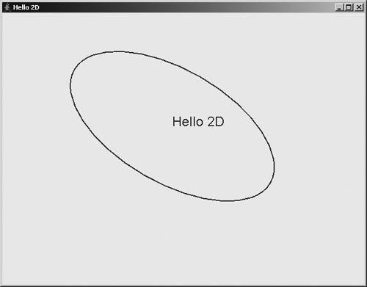
A Simple Program in Java 2D
class Hello2DPanel extends JPanel {
public Hello2DPanel() {
setPreferredSize(new Dimension(640, 480));
}
public void paintComponent(Graphics g) {
super.paintComponent(g);
Graphics2D g2 = (Graphics2D)g;
g2.setColor(Color.blue);
Ellipse2D e = new Ellipse2D.Double(-100, -50, 200, 100);
AffineTransform tr = new AffineTransform();
tr.rotate(Math.PI / 6.0);
Shape shape = tr.createTransformedShape(e);
g2.translate(300,200);
g2.scale(2,2);
g2.draw(shape);
g2.drawString("Hello 2D", 0, 0);
}
}
Code
Run

Slide 26
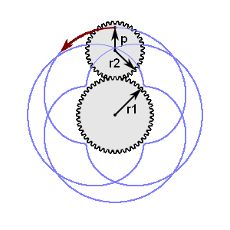

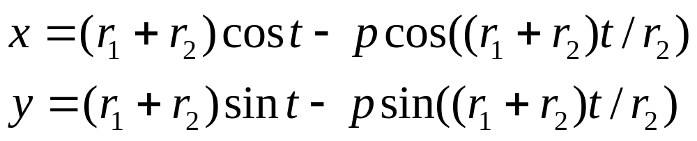
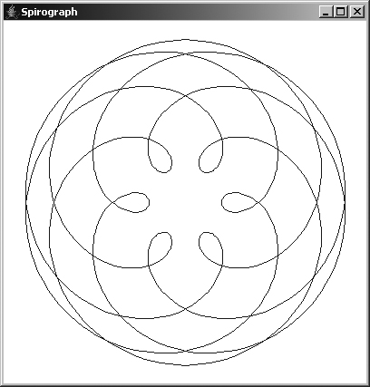
Implementation of a Spirograph
The parametric equation
Code
Run

Slide 27
Algorithm to Plot a
Parametric Equation
int x1=(int)f(t); //value of x for t = t0;
int y1= (int)g(t); //value of y for t = t0;
int x2;
int y2;
int nPoints;
double dt = (range of t)/nPoints;
. . .
for (int i=1; i<nPoints; i++) {
double t = i * dt;
x2 = (int)f(t); //parametric equation of x
y2 = (int)g(t); //parametric equation of y
g2.drawLine(x1, y1, x2, y2);
x1 = x2;
y1 = y2;
}

Slide 28

Algorithm to Plot a
Parametric Equation
int r = 100;
int nPoints = 8;
int x1 = (int) (r * Math.cos(0));
int y1 = (int) (r * Math.sin(0));
int x2;
int y2;
double dt = 2 * Math.PI / nPoints;
for (int i = 0; i <= nPoints; i++) {
double t = i * dt;
x2 = (int) (r * Math.cos(t));
y2 = (int) (r * Math.sin(t));
g2.drawLine(x1, y1, x2, y2);
x1 = x2;
y1 = y2;
}
x = r cos(t) y = r sin(t)
Example:
t = i * (360/8)
t₂ = 2 * (360/8)
t₃
t₁
t₀ = 0 * (360/8)
...
t₈

Slide 29
Geometric Models
2D graphics objects that constitute a virtual world model may include geometric shapes, text objects, and images.
Geometric objects can be constructed using the Shape class.
In Java 2D, a geometric object can be rendered by Graphics2D if it implements the Shape interface.
Graphics2D contains draw(Shape s) and fill(Shape s) methods that draws the outline of the shape or fills the interior of the shape.
Java 2D provides facilities to construct basic shapes and to combine them to form more complex shapes.

Slide 30
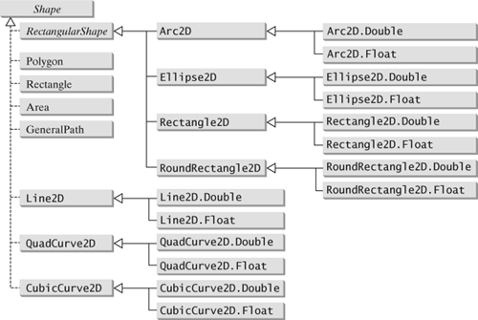
The Shape Class
The Shape class is used to create graphic object models allowing the separation between modeling and rendering.

Slide 31
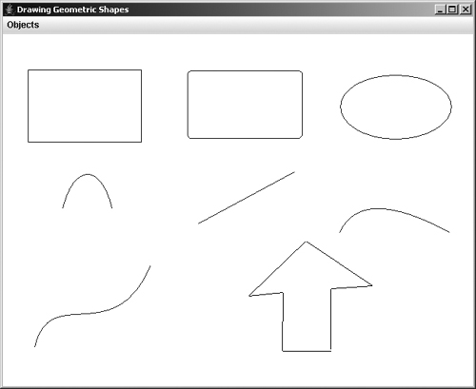
Demonstration of Shapes
Line
Rectangle
Round rectangle
Ellipse
Arc
Quadratic curve
Cubic curve
Polygon
Usa a técnica “rubber-banding” para construir os objetos gráficos interactivamente.
Code
Run

Slide 32
Rubber-Banding Technic
Enable XOR drawing mode to not change the background.
When pressing the mouse button:
  Get the coordinates of the mouse and set the initial coordinates of the object to draw.
When dragging the mouse:
  If the object has already been drawn, draw the object in the last known position to delete it (XOR mode).
  Get the current coordinates of the mouse and set the final coordinates of the object.
  Draw the object using the initial and the final coordinates.
When releasing the mouse button:
  Obtain the current coordinates of the mouse and set the final coordinates of the object.
  Draw the object one last time using the initial and final coordinates.

Slide 33
Defining and Drawing Shapes
Examples
Line2D line = new Line2D.Double(x1, y1, x2, y2);
Rectangle2D ri = new Rectangle(x, y, rectwidth, rectheight);
Rectangle2D ri = new Rectangle(20,30,100,80);
Rectangle2D rd = new Rectangle2D.Double(20.0,30.0,100.0,80.0);
Rectangle2D rf = new Rectangle2D.Float(20f,30f,100f,80f);
RoundRectangle2D rrect = new RoundRectangle2D.Double(20,30,100,80,5,5);
Ellipse2D ellipse = new Ellipse2D.Float(20f, 30f, 100f, 80f);
Polygon poly = new Polygon(int[] xcoords, int[] ycoords, int npoints);

Slide 34
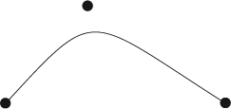
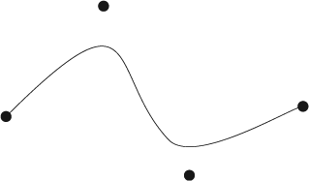
Defining and Drawing Shapes
Quadratic curve
QuadCurve2D quad = new QuadCurve2D.Double(x1, y1, x2, y2, x3, y3);
Cubic curve
CubicCurve2D cubic = new CubicCurve2D.Float(x1 ,y1, x2, y2, x3, y3, x4, y4);

Slide 35
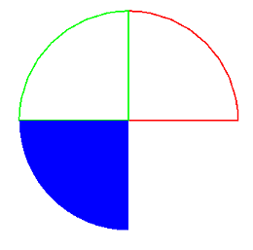
Defining and Drawing Shapes
Arc
Arc2D arc = new Arc2D.Float(x, y, rectwidth, rectheight, ang1, ang2, Arc2D.OPEN);
g2.setPaint(Color.RED);
g2.draw(new Arc2D.Double(50, 50, 300, 300, 0, 90, Arc2D.PIE));
g2.setPaint(Color.GREEN);
g2.draw(new Arc2D.Double(50, 50, 300, 300, 90, 90, Arc2D.PIE));
g2.setPaint(Color.BLUE);
g2.fill(new Arc2D.Double(50, 50, 300, 300, 180, 90, Arc2D.PIE));

Slide 36
Constructive Area Geometry
Method for creating more complex graphic objects (Shapes) from the combination of existing graphic objects.
Method based on the combination of object areas.
Classe Area(Shape s)
  void add(Area a)
  void intersect(Area a)
  void subtract(Area a)
  void exclusiveOr(Area a)

Slide 37
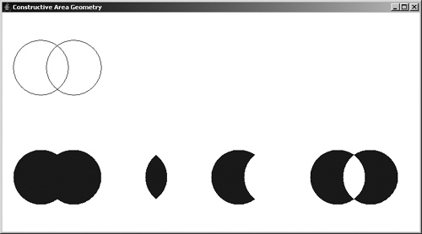
Constructive Area Geometry
Shape s1 = new Ellipse2D.Double(0, 0, 100, 100);
Shape s2 = new Ellipse2D.Double(60, 0, 100, 100);
Area a1;
Area a2 = new Area(s2);
Implemented operations:
  Intersect
  Add
  Subtract
  Exclusive Or
g2.translate(20, 50);
g2.draw(s1);
g2.draw(s2);
g2.translate(0,200);
a1 = new Area(s1);
a1.add(a2);
g2.fill(a1);
g2.translate(180,0); a1 = new Area(s1); a1.exclusiveOr(a2); g2.fill(a1);
Code
Run

Slide 38
GeneralPath
Another method for creating complex graphic objects.
Method based on the construction of the frontier line of objects.
Classe GeneralPath()
  void moveTo(float x, float y);
  void lineTo(float x, float y);
  void quadTo(float x1, float y1, float x2, float y2);
  void curveTo(float x1, float y1, float x2, float y2, float x3, float y3);
  void closePath();

Slide 39
GeneralPath
Five types of segments
  SEG_MOVETO
  SEG_LINETO
  SEG_QUADTO
  SEG_CUBICTO
  SEG_CLOSE
GeneralPath ‘s Methods
  moveTo
  lineTo
  quadTo
  curveTo
  closePath

Slide 40
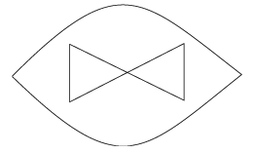
GeneralPath
GeneralPath path = new GeneralPath();
path.moveTo(-2f, 0f);
path.quadTo(0f, 2f, 2f, 0f);
path.quadTo(0f, -2f, -2f, 0f);
path.moveTo(-1f, 0.5f);
path.lineTo(-1f, -0.5f);
path.lineTo(1f, 0.5f);
path.lineTo(1f, -0.5f);
path.closePath();

Slide 41
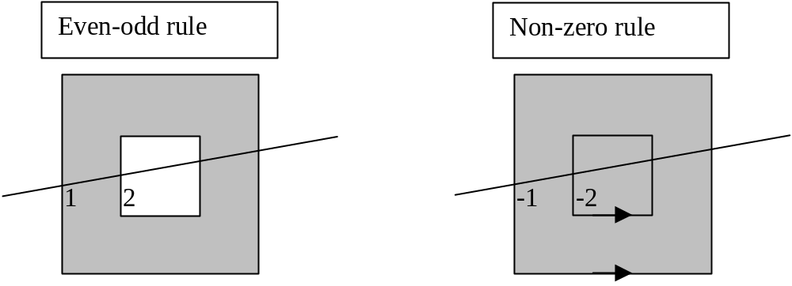
Winding Rules
Rules for determining the interior of a Shape
Even-odd Rule
Non-zero Rule
path.setWindingRule(GeneralPath.WIND_EVEN_ODD);
path.setWindingRule(GeneralPath.WIND_NON_ZERO);
Draw a line through the region and consider the directions of the paths that are crossed by the line. If the line crosses the path from left to right, increase the number of crosses by 1, if not, decrement by 1. The region belongs to the interior if the number of crosses is different from 0.
Draw a line through the region and consider the number of crossings with the path from the outside to reach the region. With the even–odd rule, the region is in the interior if the number of crossings is odd and exterior if the number is even.

Slide 42
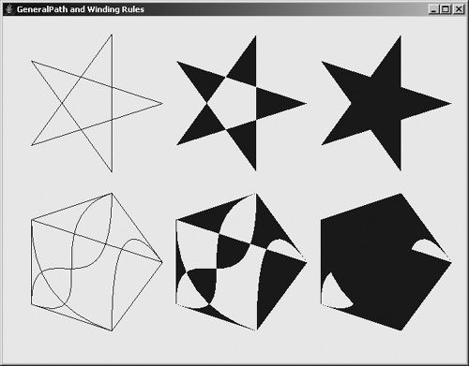
Winding Rules
Code
Run

Slide 43
End of Chapter 2

