Slide 1
Data Lakehouse Architecture for E-commerce Company
Designing a Scalable and Secure Data Solution on Azure
Vagner da Silver
2024-19-09
LinkedIn: https://www.linkedin.com/in/silvavagner/

Slide 2
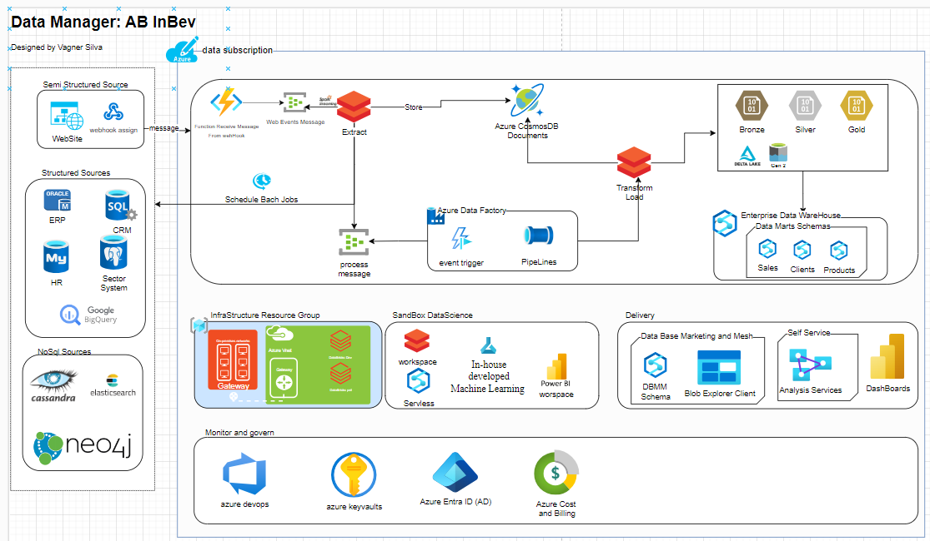
Proposed Architecture Diagram

Slide 3
Architecture Diagram Explanation
Scalability:
The architecture supports Azure's elastic scaling capabilities to handle increased transaction volumes seamlessly. Focuns on ETL ou ELT as Code using PySpark on DataBricks is possible increase de computer power automatically.
Real-time Access:
Event streaming with Azure Event Hubs allows immediate insights into customer interactions, enabling timely marketing decisions.
Data Centralization:
Azure Data Lake Storage and Azure Synapse for Enterprise DataWareHouse consolidates diverse data sources for comprehensive analysis and reporting.
User Accessibility:
Data Base Marketing and Mesh provide the way for keyusers provide their own data and analysi with the gold enterprise data. The Power BI and Analysis Services empowers non-technical staff to derive insights easily, fostering a data-driven culture.
Compliance:
Azure’s built-in compliance features ensure adherence to GDPR/LGPD through data anonymization, access controls, and auditing.
Data encryption (in transit and at rest).
Azure Active Directory for role-based access control and logging for compliance with GDPR/LGPD.
Technology Stack Overview
Cloud Services:
Azure for cloud infrastructure.
Data Ingestion Tools:
Azure Data Factory, Azure Event Hubs.
Storage Solutions:
Azure Data Lake Storage (ADLS).
Processing Engines:
Azure Databricks, Azure Synapse Analytics.
Analytics & BI Tools:
Power BI, Analisys Services.

