Slide 1
Data Lakehouse Architecture for E-commerce Company
Designing a Scalable and Secure Data Solution on Azure
Vagner da Silver
2024-19-09
LinkedIn: https://www.linkedin.com/in/silvavagner/

Slide 2
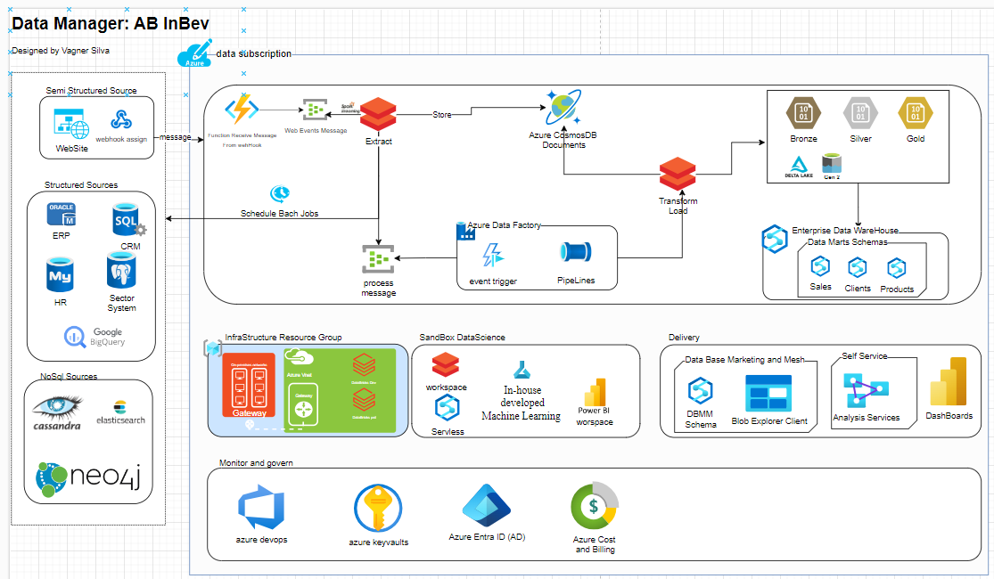

Proposed Architecture Diagram

Slide 3
Technology Stack Overview
Was choosed the azure plataforma because there may be higher availability of professionals skilled in Microsoft Technologies and this can sometimes lead lower recruitment costs.
The Microsoft Stack nowadays has a complete and robust data Analytics plataforma.
When we focus on provider self-service and marketing database platforms for key users with analytical skills, Microsoft offers lower costs and a more user-friendly platform, such as Azure Synapse and Microsoft Analysis Services Tabular.
Cloud Services:
Azure 100% Paas.
Data Ingestion Tools:
Azure Data Factory
Azure Event Hubs
Azure Functions
Storage Solutions:
Azure Data Lake Storage (GEN2).
DataBricks Delta Lake
Processing Engines:
Azure Databricks
Azure Synapse Analytics.
Analytics & BI Tools:
Analysis Services Tabular.
Power BI,

Slide 4
Scalability:
The architecture supports Azure's elastic scaling capabilities to handle increased transaction volumes seamlessly. Focuns on ETL ou ELT as Code using PySpark on DataBricks is possible increase de computer power automatically.
Real-time Access:
Event streaming with Azure Event Hubs allows immediate insights into customer interactions, enabling timely marketing decisions.
Data Centralization:
Azure Data Lake Storage and Azure Synapse for Enterprise DataWareHouse consolidates diverse data sources for comprehensive analysis and reporting.
User Accessibility:
Data Base Marketing and Mesh provide the way for keyusers provide their own data and analysi with the gold enterprise data. The Power BI and Analysis Services empowers non-technical staff to derive insights easily, fostering a data-driven culture.
Compliance:
Azure’s built-in compliance features ensure adherence to GDPR/LGPD through data anonymization, access controls, and auditing.
Azure Active Directory for role-based access control and logging for compliance with GDPR/LGPD.

