Slide 1
Some Examples of Research Methods Posters

Slide 2
Please note:
While you might pick up ideas, don’t just mindlessly copy these. The process of producing a good one involves extensive reading, study and thought about research methods linked to your own topic.
  Looking at examples can be helpful to get an idea of what to aim for but it rarely tells you much about the process. I can learn a little about football by watching it – but I can only become a good footballer by playing it.
The following are just examples. The have strengths and weaknesses. All students passed, but don’t assume these got merit and distinction grades and should be copied. I’ve just taken a random selection of different posters. Please use your critical judgment about what is good/bad about these.
Good presentation is important – but the most important thing is the content. Don’t forget – this is a research methods module, not a visual art module. The aim is to present a proposal for a valuable and feasible research project. The focus of the assessment is on your research methods knowledge, analysis, critique and presentation of these ideas.
  This doesn’t mean you can be creative. Presentation and communication of ideas is still important. You do get assessed on the poster and presentation (please see info and mark sheet given on the Moodle page).
NB. I’ve redacted student details – you will see little red boxes where I have removed names, email addresses etc.

Slide 3
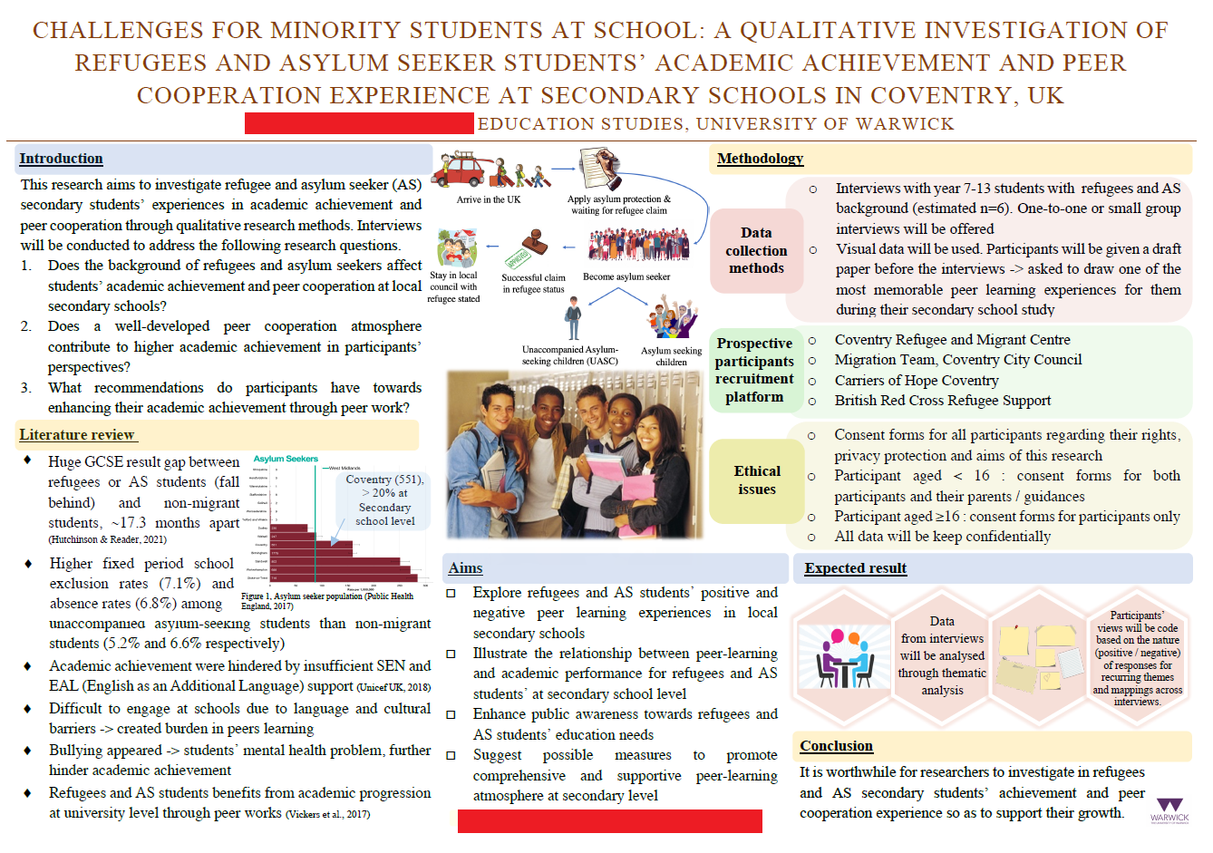

Slide 4
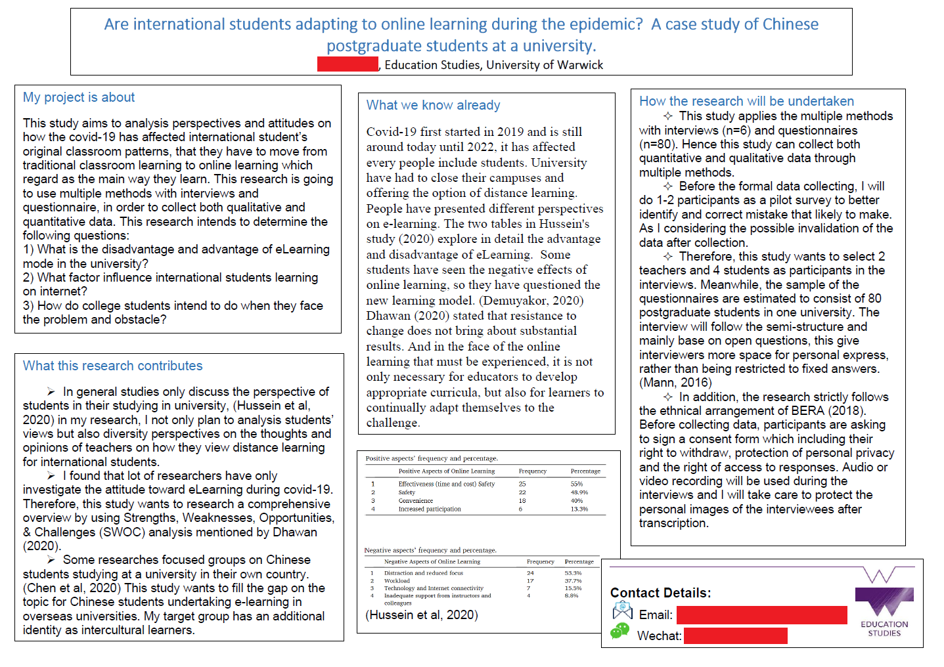

Slide 5


Slide 6
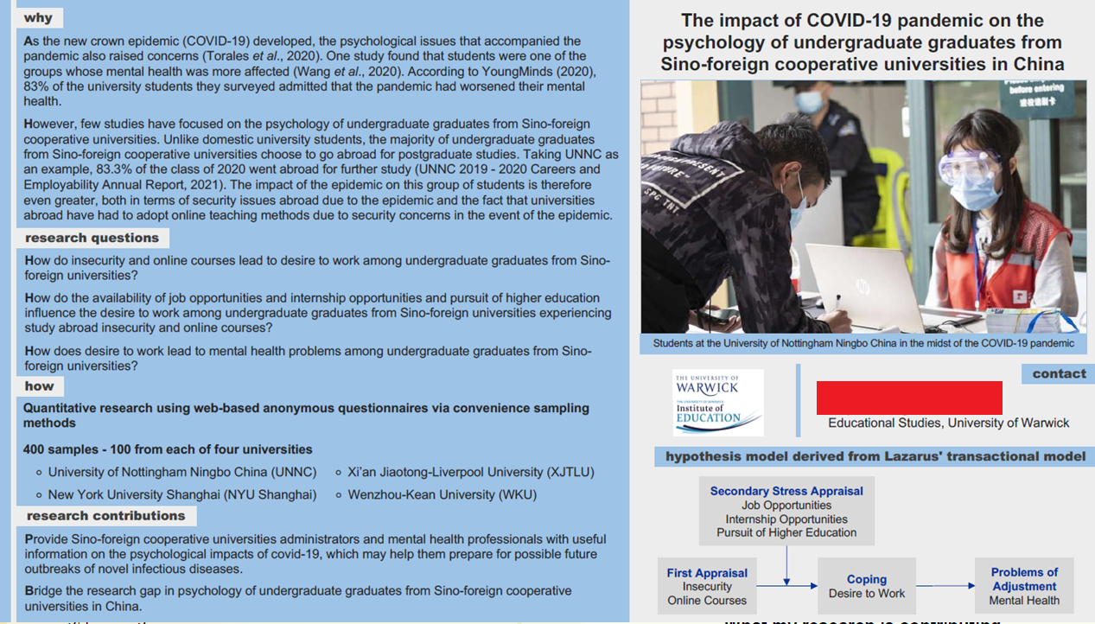

Slide 7


Slide 8
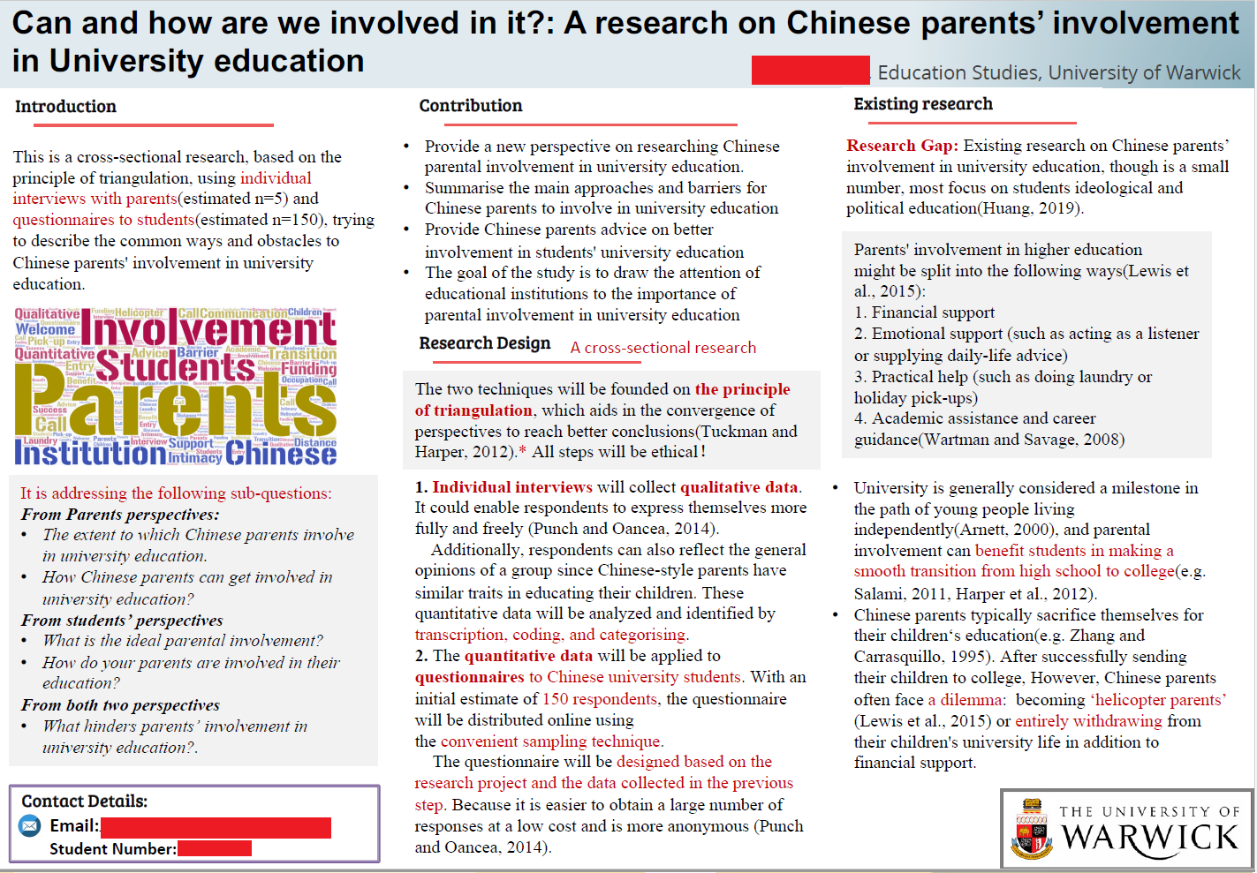

Slide 9
