Slide 1
Introduction to Algorithms
Levon Prazyan

Slide 2
Course Overview
Introduction
Sorting and Searching
Arrays and Lists
Stacks and Queues, Double Ended Queue
Heaps
Trees
Hash Tables
Dynamic Programming
Greedy Algorithms
Graph Algorithms
Network Flow
NP-Completeness

Slide 3
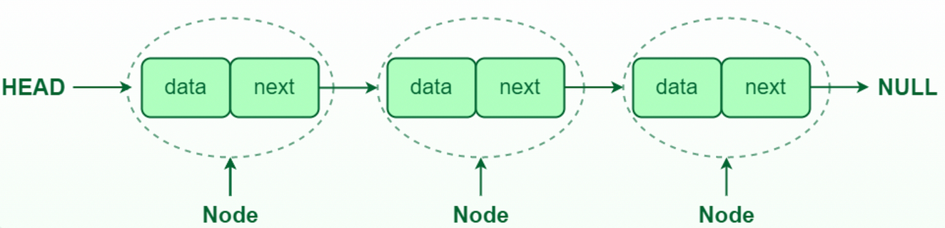
Single-Linked List

Slide 4
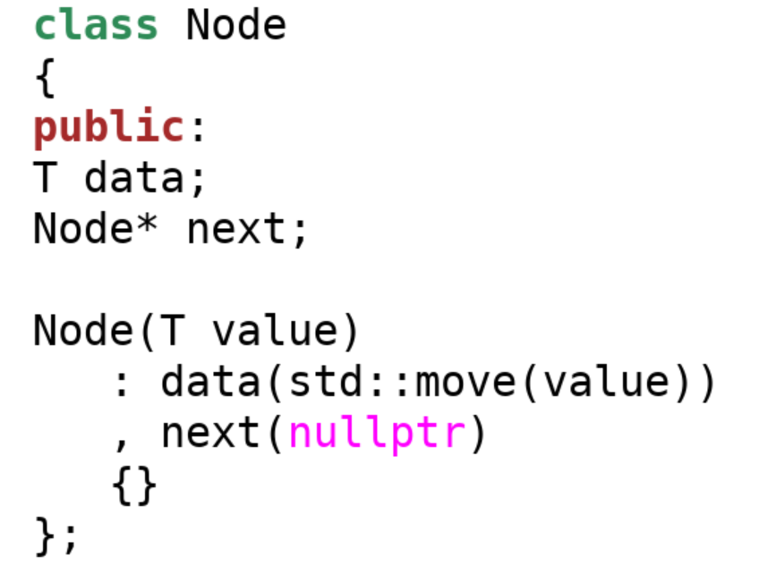
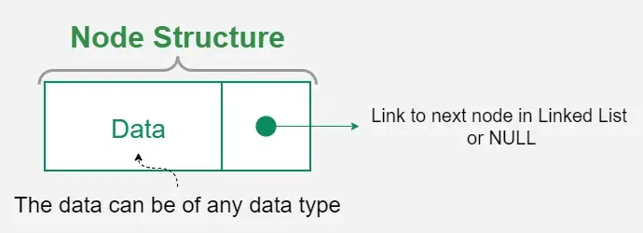
Singe-Linked List. Node class

Slide 5
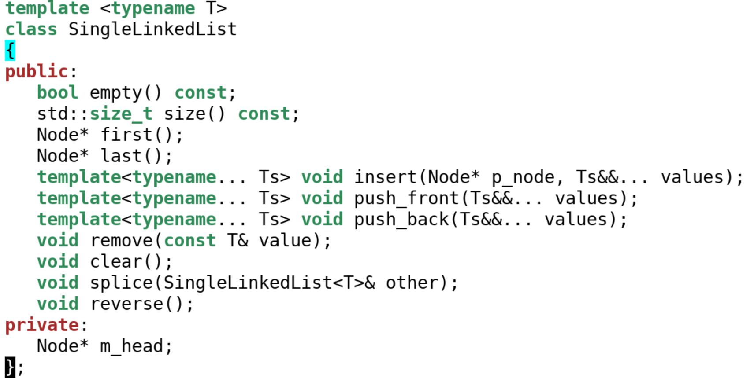
Singe-Linked List class

Slide 6
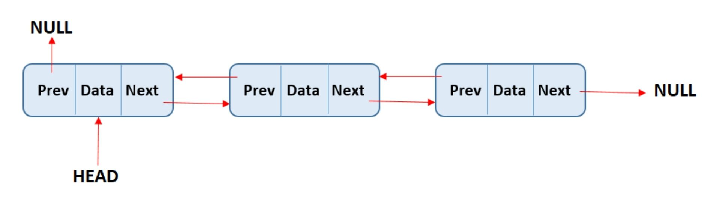
Double-Linked List

Slide 7
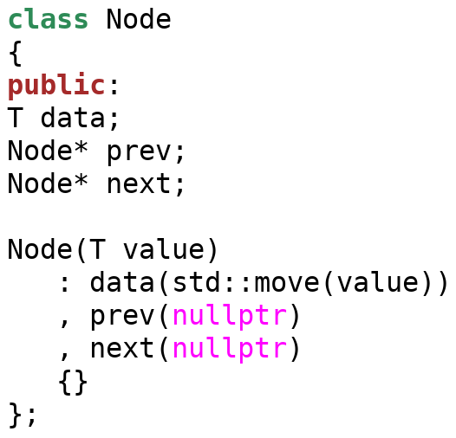
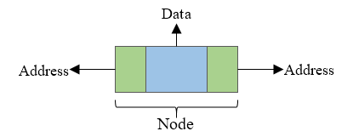
Double-Linked List Node

Slide 8
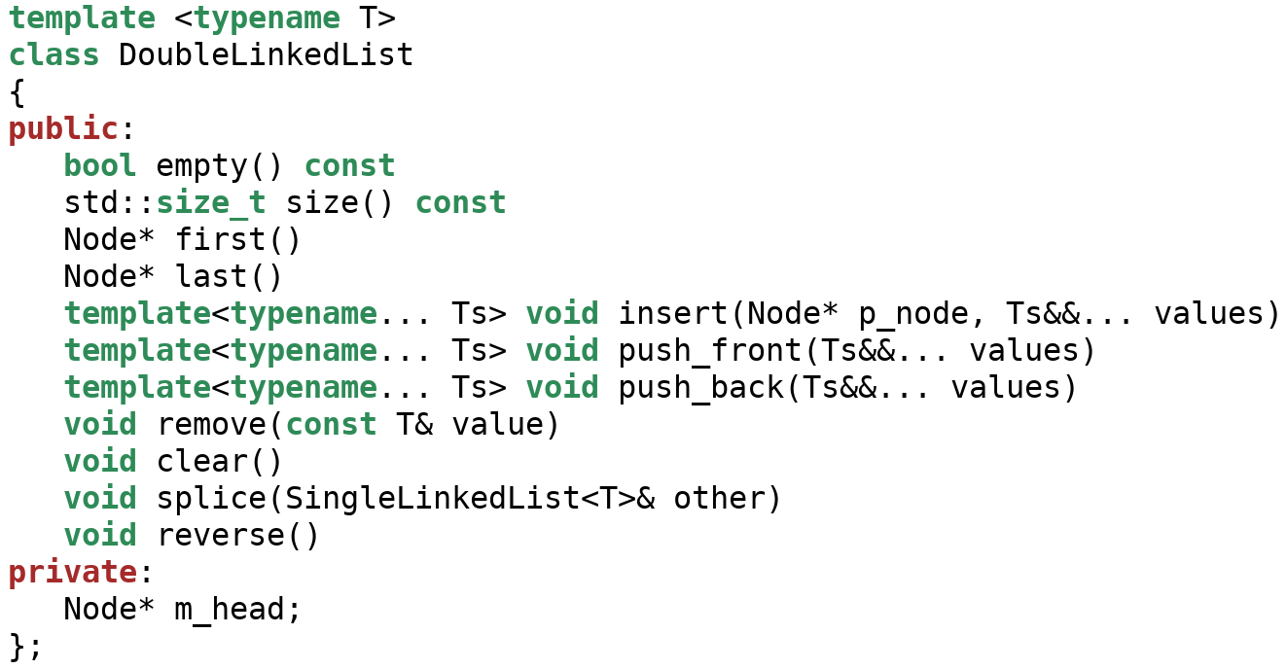
Double-Linked List class

Slide 9
Stack
A Stack is a linear data structure that follows the Last In, First Out (LIFO) principle.
Stack operations:
push: Add an element to the top of the stack.
pop: Remove the element from the top of the stack.
top: View the top element without removing it.
empty: Check if the stack is empty.
size: Get the number of elements in the stack.

Slide 10
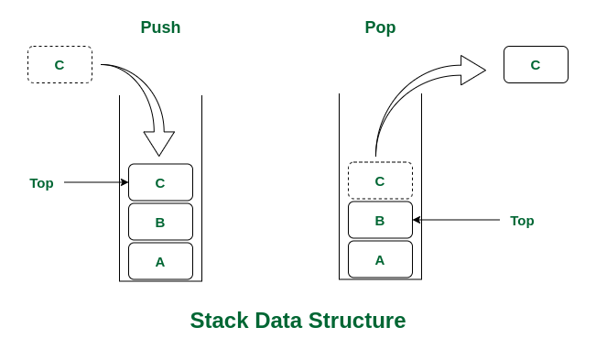
Stack

Slide 11
Queue
A queue is a linear data structure that follows the FIFO (First In, First Out) principle.
Queue operations:
push: Add an element to the back of the queue.
pop: Remove the element from the front of the queue.
front: get the front element without removing it.
empty: Check if the queue is empty.
size: Get the number of elements in the queue.

Slide 12
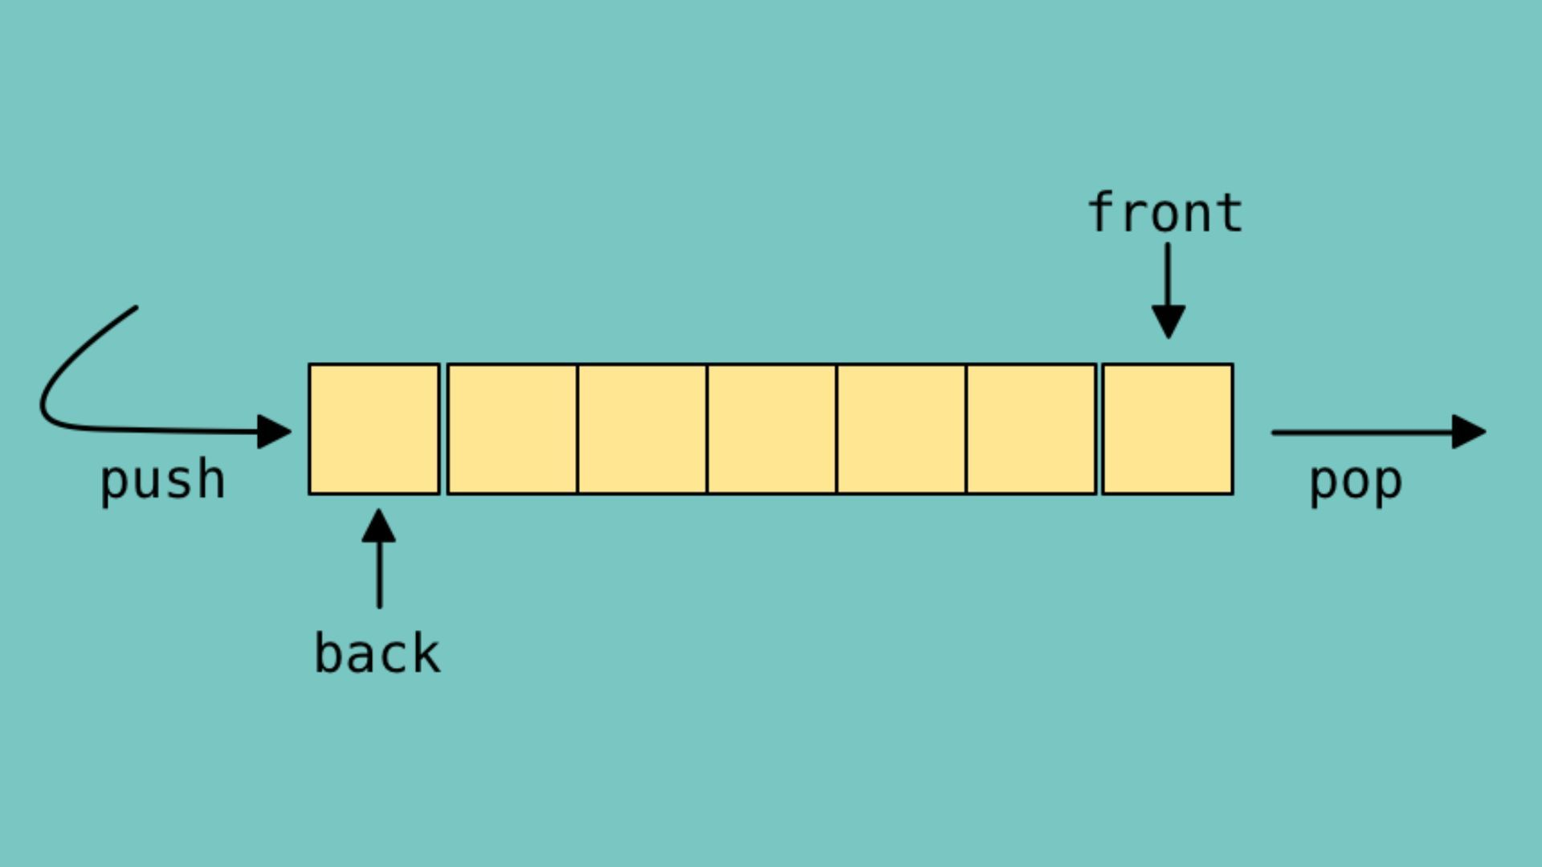
Queue

Slide 13
Deque
A deque (double-ended queue) is a linear data structure that allows insertion and deletion from both ends
push_front: Insert an element at the front.
push_back: Insert an element at the back.
pop_front: Remove an element from the front.
pop_back: Remove an element from the rear.
front: Get the front element without removing it.
back: Get the rear element without removing it.
empty: Check if the deque is empty.
size: Get the number of elements in the deque.
operator[]: Get the element

Slide 14
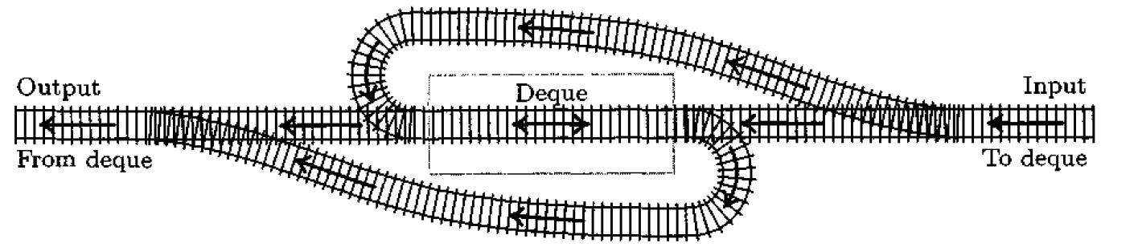
Deque

Slide 15
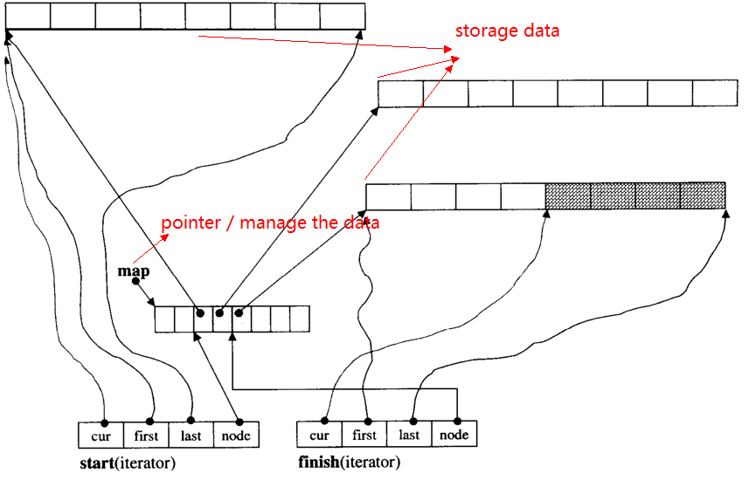
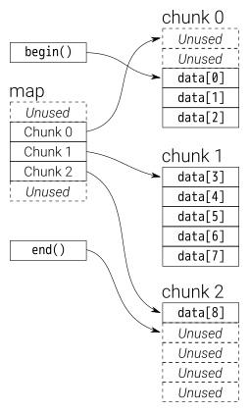
Deque

Slide 16
Thank You

