Slide 1
Introduction to Algorithms
Levon Prazyan

Slide 2
Course Overview
Introduction
Sorting and Searching
Arrays and Lists
Stacks and Queues, Double Ended Queue
Heaps
Trees
Hash Tables
Dynamic Programming
Greedy Algorithms
Graph Algorithms
Network Flow
NP-Completeness

Slide 3
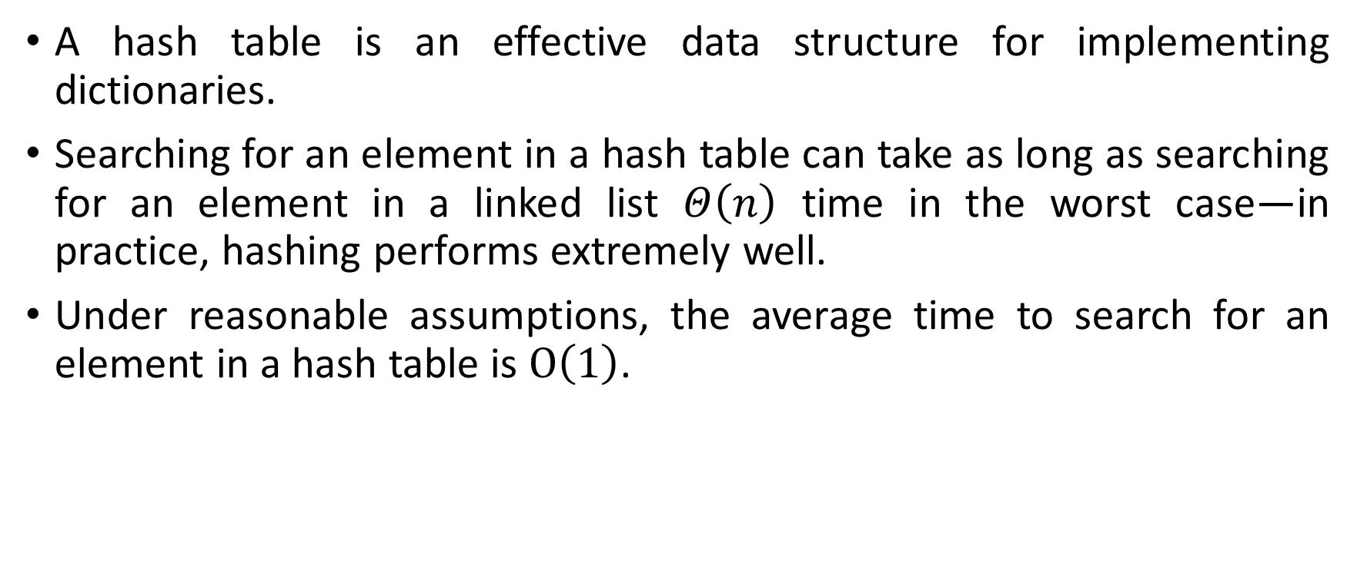
Hash Tables
A hash table is an effective data structure for implementing dictionaries.
Searching for an element in a hash table can take as long as searching for an element in a linked list $Θ\left(n\right)$ time in the worst case—in practice, hashing performs extremely well.
Under reasonable assumptions, the average time to search for an element in a hash table is $O\left(1\right)$.
Notes:
When the number of keys stored is small relative to the total number of possible keys, hash tables become an effective alternative to directly addressing an array, since a hash table typically uses an array of size proportional to the number of keys actually stored. Instead of using the key as an array index directly, the array index is computed from the key.

Slide 4
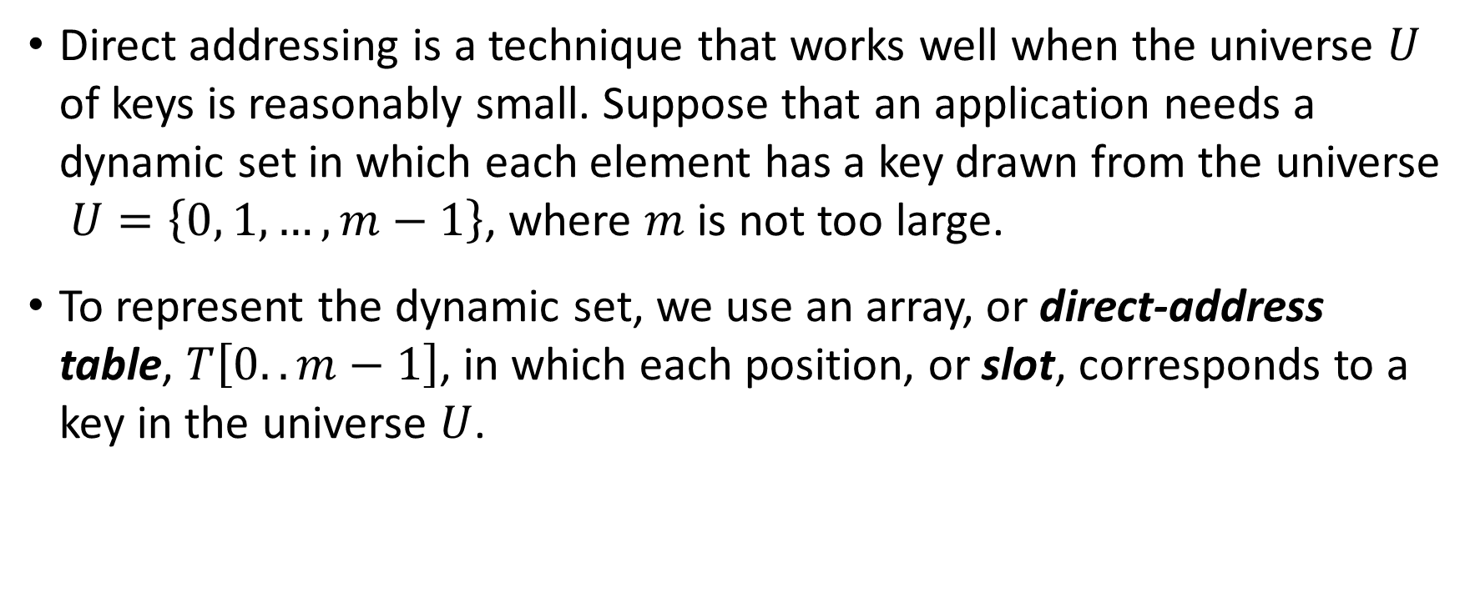
Direct-Address Tables (1)
Direct addressing is a technique that works well when the universe $U$ of keys is reasonably small. Suppose that an application needs a dynamic set in which each element has a key drawn from the universe $U=\left\{0, 1, …, m−1\right\}$, where $m$ is not too large.
To represent the dynamic set, we use an array, or direct-address table, $T\left[0..m−1\right]$, in which each position, or slot, corresponds to a key in the universe $U$.
Notes:
We shall assume that no two elements have the same key.

Slide 5
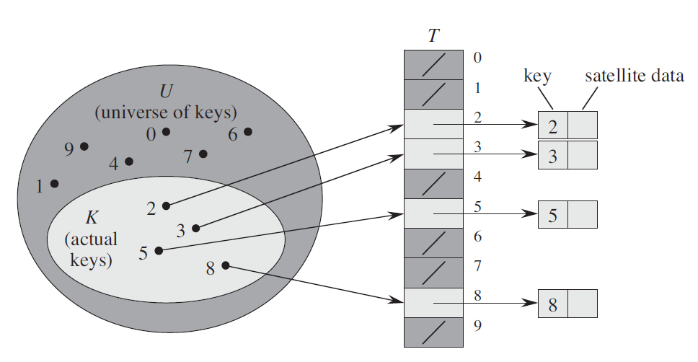
Direct-Address Tables (2)
Notes:
We shall assume that no two elements have the same key.

Slide 6
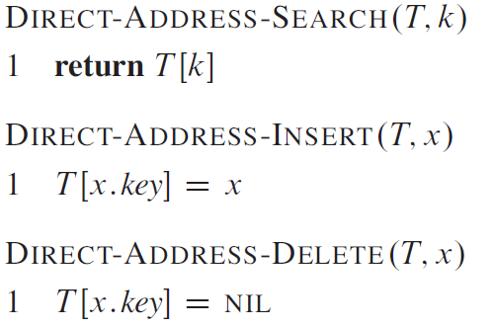
Direct-Address Tables: Operations (3)
Notes:
We shall assume that no two elements have the same key.
O(1) time

Slide 7
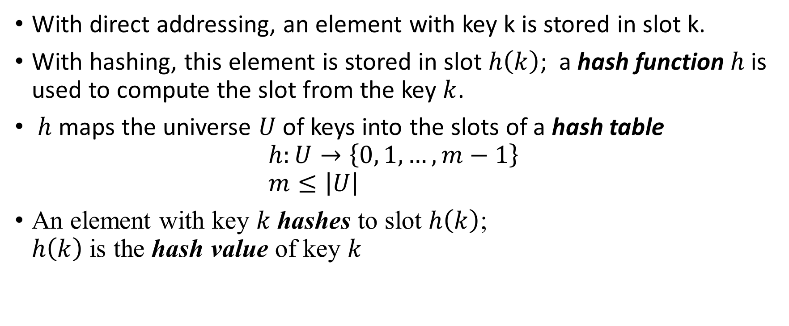
Hash Tables (1)
With direct addressing, an element with key k is stored in slot k.
With hashing, this element is stored in slot $h\left(k\right)$; a hash function $h$ is used to compute the slot from the key $k$.
$h$ maps the universe $U$ of keys into the slots of a hash table $h:U→\left\{0, 1, …, m−1\right\}$ $m≤\left|U\right|$
An element with key $k$ hashes to slot $h\left(k\right)$; $h\left(k\right)$ is the hash value of key $k$
Notes:
The downside of direct addressing is obvious: if the universe U is large, storing a table T of size |U| may be impractical, or even impossible, given the memory available on a typical computer. Furthermore, the set K of keys actually stored may be so small relative to U that most of the space allocated for T would be wasted.

Slide 8
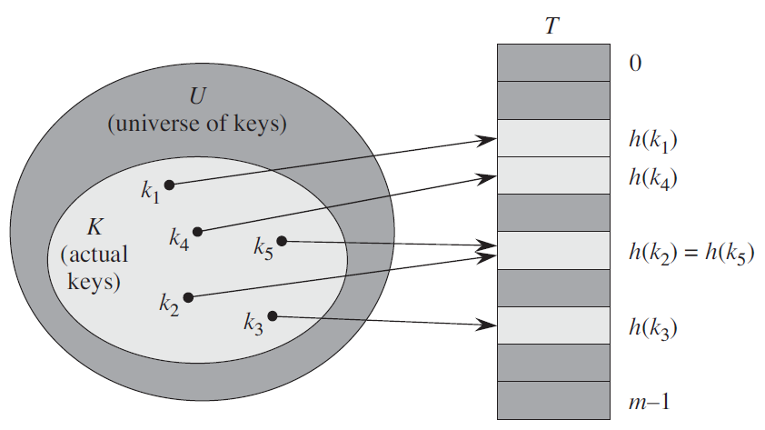
Hash Tables (2)

Slide 9
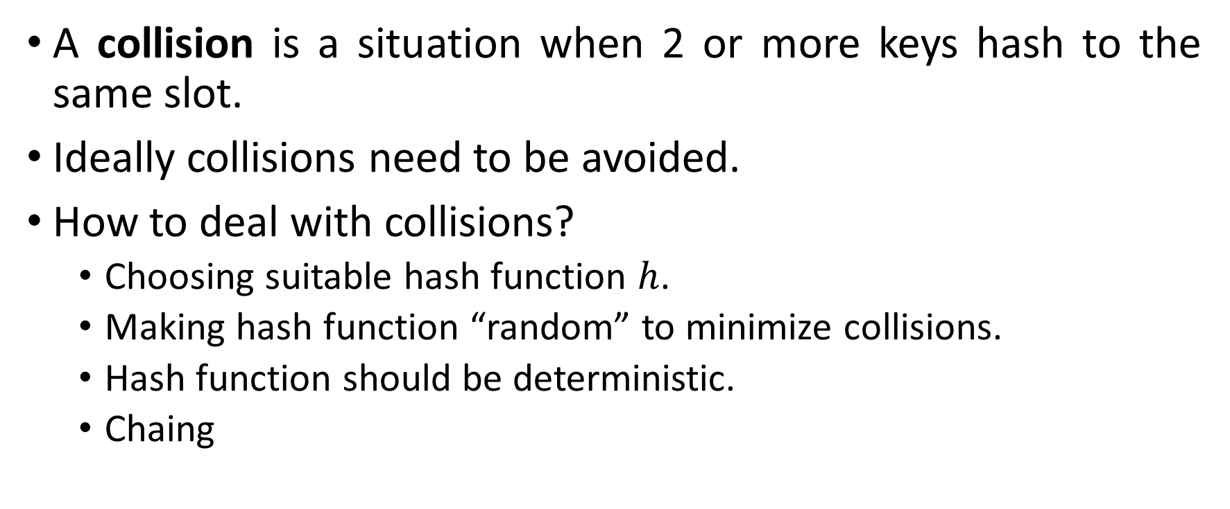
Hash Tables: Collision
A collision is a situation when 2 or more keys hash to the same slot.
Ideally collisions need to be avoided.
How to deal with collisions?
Choosing suitable hash function $h$.
Making hash function “random” to minimize collisions.
Hash function should be deterministic.
Chaing
Notes:
The ideal solution would be to avoid collisions altogether. We might try to achieve this goal by choosing a suitable hash function h

Slide 10
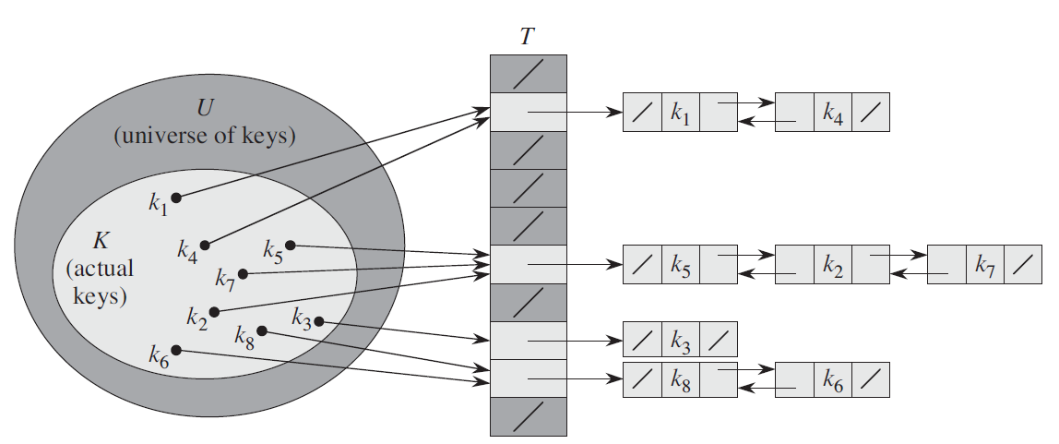
Hash Tables with Chaining: Operations (1)
In chaining all the elements with same hash value are placed into the same linkes list.

Slide 11
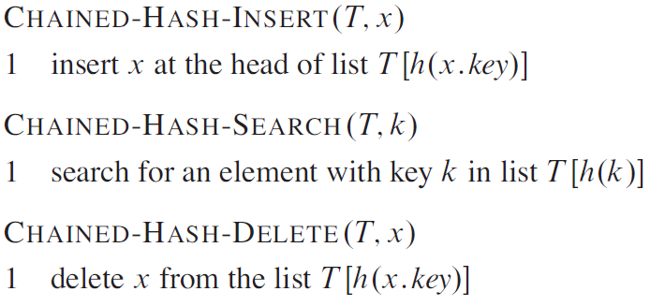
Hash Tables with Chaining: Operations (2)

Slide 12
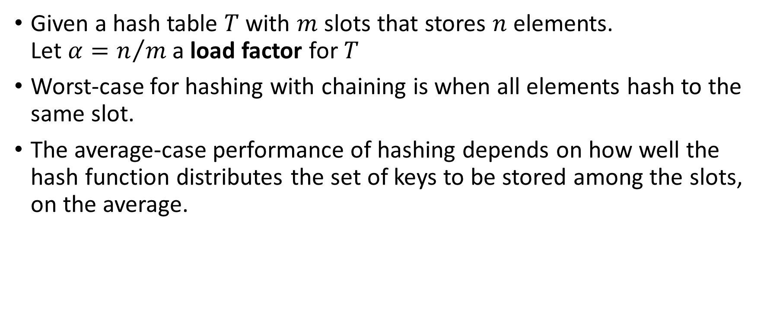
Analyzing Hashing with Chaining (1)
Given a hash table $T$ with $m$ slots that stores $n$ elements. Let $α=n/m$ a load factor for $T$
Worst-case for hashing with chaining is when all elements hash to the same slot.
The average-case performance of hashing depends on how well the hash function distributes the set of keys to be stored among the slots, on the average.

Slide 13
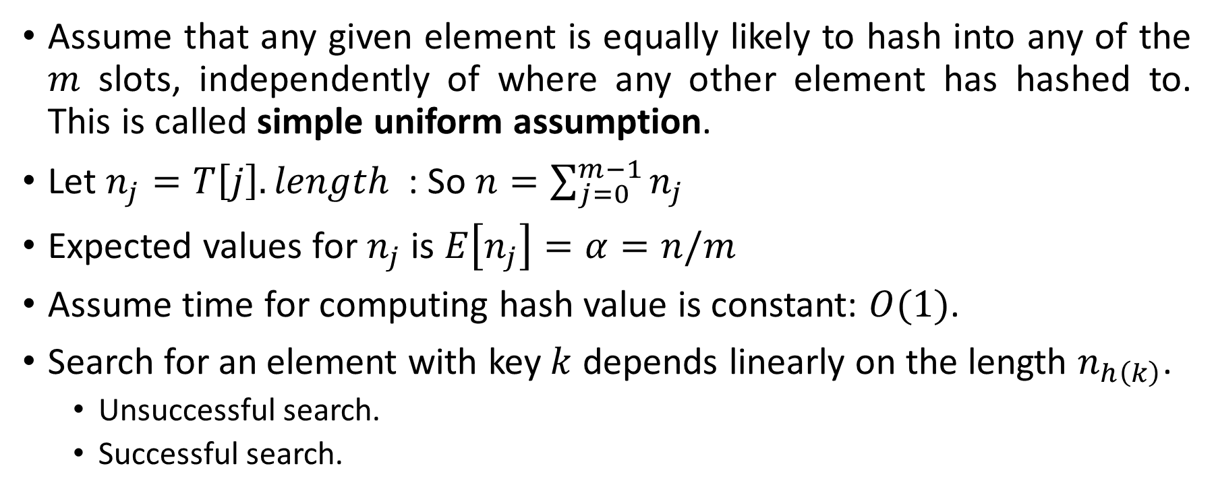
Analyzing Hashing with Chaining (2)
Assume that any given element is equally likely to hash into any of the $m$ slots, independently of where any other element has hashed to. This is called simple uniform assumption.
Let $n_{j}=T\left[j\right].length$ : So $n=\sum_{j=0}^{m−1}{n_{j}}$
Expected values for $n_{j}$ is $E\left[n_{j}\right]=α=n/m$
Assume time for computing hash value is constant: $O(1)$.
Search for an element with key $k$ depends linearly on the length $n_{h\left(k\right)}$.
Unsuccessful search.
Successful search.

Slide 14
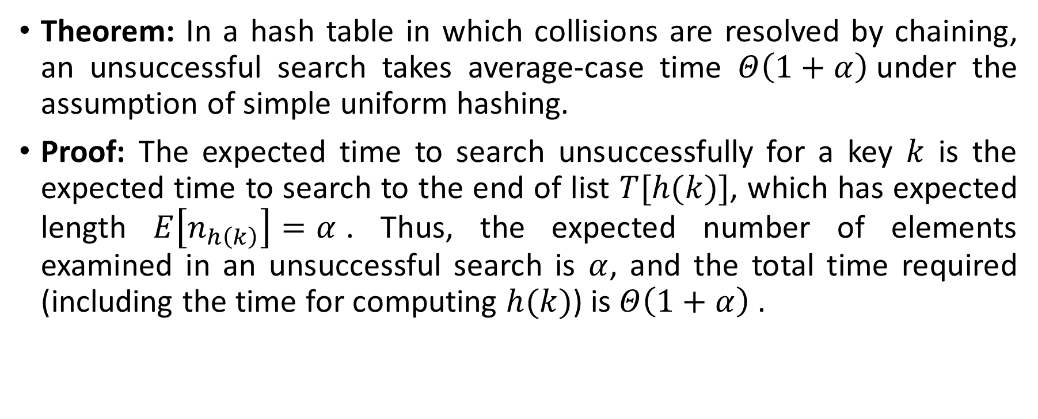
Analyzing Hashing with Chaining (3)
Theorem: In a hash table in which collisions are resolved by chaining, an unsuccessful search takes average-case time $Θ\left(1+α\right)$under the assumption of simple uniform hashing.
Proof: The expected time to search unsuccessfully for a key $k$ is the expected time to search to the end of list $T[h(k)]$, which has expected length $E\left[n_{h\left(k\right)}\right]=α$. Thus, the expected number of elements examined in an unsuccessful search is $α$, and the total time required (including the time for computing $h(k)$) is $Θ\left(1+α\right)$.
Notes:
Under the assumption of simple uniform hashing, any key $k$ not already stored in the table is equally likely to hash to any of the $m$ slots.

Slide 15
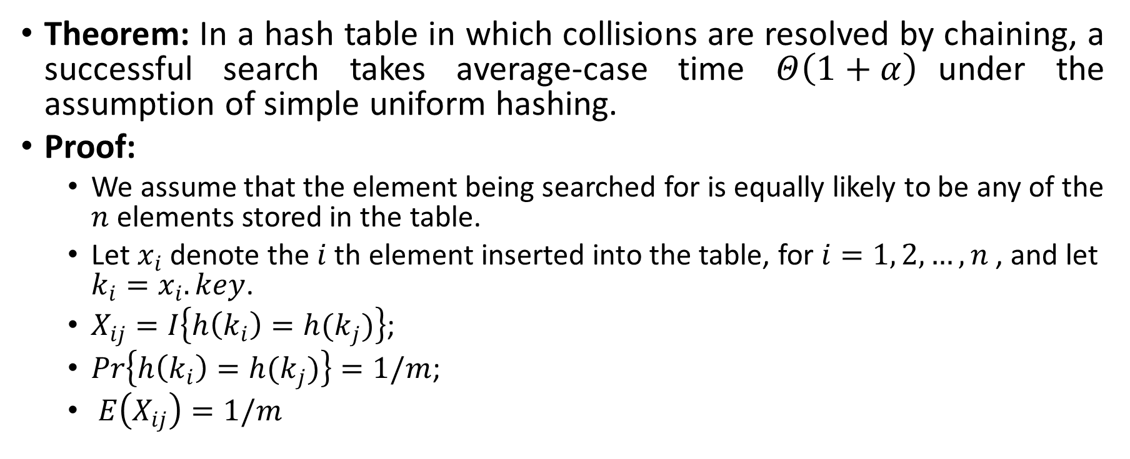
Analyzing Hashing with Chaining (4)
Theorem: In a hash table in which collisions are resolved by chaining, a successful search takes average-case time $Θ\left(1+α\right)$under the assumption of simple uniform hashing.
Proof:
We assume that the element being searched for is equally likely to be any of the $n$ elements stored in the table.
Let $x_{i}$ denote the $i$ th element inserted into the table, for $i=1, 2, …, n$ , and let $k_{i}=x_{i}.key$.
$X_{ij}=I\left\{h\left(k_{i}\right)=h(k_{j})\right\}$;
$Pr\left\{h\left(k_{i}\right)=h(k_{j})\right\}=1/m$;
$E\left(X_{ij}\right)=1/m$
Notes:
The number of elements examined during a successful search for an element x is one more than the number of elements that
appear before x in x’s list. Because new elements are placed at the front of the list, elements before x in the list were all inserted after x was inserted.

Slide 16
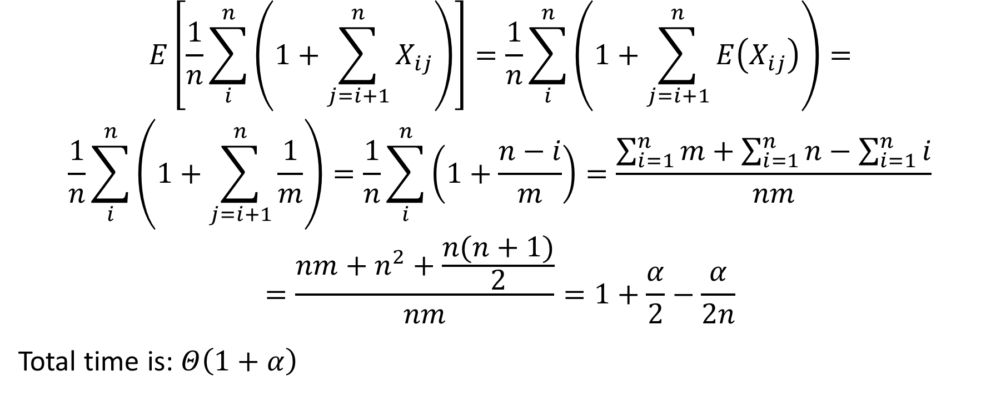
Analyzing Hashing with Chaining (5)
$$E\left[\frac{1}{n}\sum_{i}^{n}{\left(1+\sum_{j=i+1}^{n}{X_{ij}}\right)}\right]=\frac{1}{n}\sum_{i}^{n}{\left(1+\sum_{j=i+1}^{n}{E\left(X_{ij}\right)}\right)}=$$
$$\frac{1}{n}\sum_{i}^{n}{\left(1+\sum_{j=i+1}^{n}{\frac{1}{m}}\right)}=\frac{1}{n}\sum_{i}^{n}{\left(1+\frac{n−i}{m}\right)}=\frac{\sum_{i=1}^{n}{m}+\sum_{i=1}^{n}{n}−\sum_{i=1}^{n}{i}}{nm}$$
$$=\frac{nm+n^{2}+\frac{n(n+1)}{2}}{nm}=1+\frac{α}{2}−\frac{α}{2n}$$
Total time is: $Θ\left(1+α\right)$
Notes:
The number of elements examined during a successful search for an element x is one more than the number of elements that
appear before x in x’s list. Because new elements are placed at the front of the list, elements before x in the list were all inserted after x was inserted.

Slide 17
Hash functions
A good hash function satisfies (approximately) the assumption of simple uniform hashing.
Most hash functions assume that the universe of keys is the set of natural numbers.
if the keys are not natural numbers, we find a way to interpret them as natural numbers
For example, a character string can be interpreted as an integer expressed in suitable radix notation.
Notes:
Unfortunately, we typically have no way to check this condition, since we rarely know the probability distribution from which
the keys are drawn. Moreover, the keys might not be drawn independently.

Slide 18
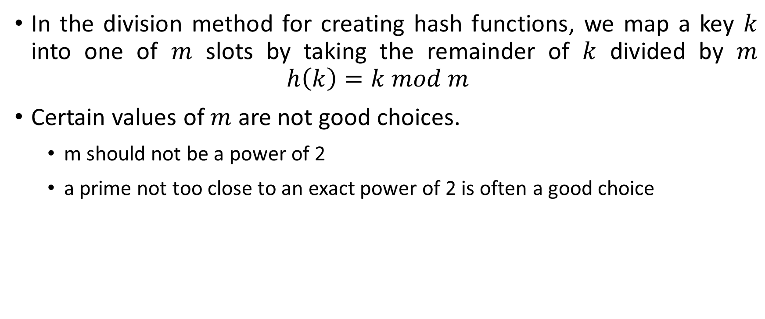
Hash functions: The Division Method
In the division method for creating hash functions, we map a key $k$ into one of $m$ slots by taking the remainder of $k$ divided by $m$ $h\left(k\right)=k mod m$
Certain values of $m$ are not good choices.
m should not be a power of 2
a prime not too close to an exact power of 2 is often a good choice

Slide 19
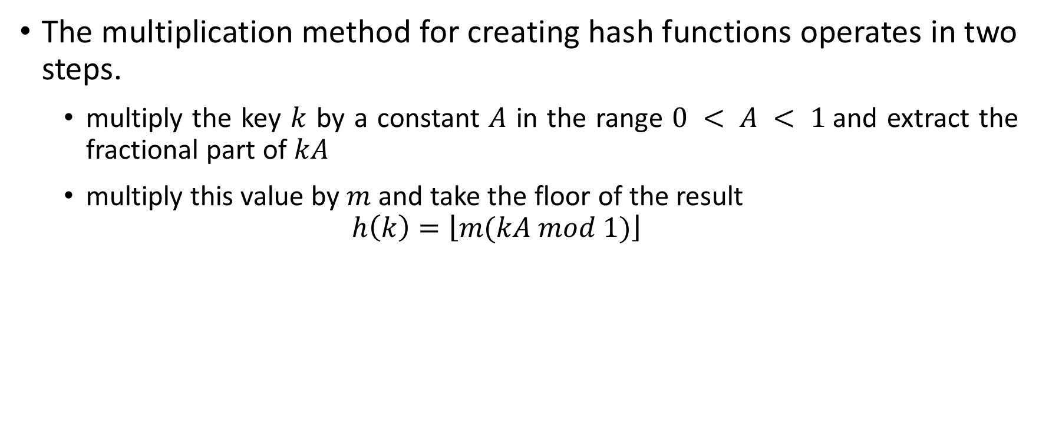
Hash functions: The Multiplication Method
The multiplication method for creating hash functions operates in two steps.
multiply the key $k$ by a constant $A$ in the range $0 < A < 1$and extract the fractional part of $kA$
multiply this value by $m$ and take the floor of the result
$$h\left(k\right)=\left\lfloor m(kA mod 1)\right\rfloor$$
Notes:
$$kA mod 1 = kA − \left\lfloor kA\right\rfloor$$
An advantage of the multiplication method is that the value of m is not critical. We typically choose it to be a power of 2

Slide 20
Thank You

