Slide 1
Introduction to Algorithms
Levon Prazyan

Slide 2
Course Overview
Introduction
Sorting and Searching
Arrays and Lists
Stacks and Queues, Double Ended Queue
Heaps
Trees
Hash Tables
Dynamic Programming
Greedy Algorithms
Graph Algorithms
Network Flow
NP-Completeness

Slide 3
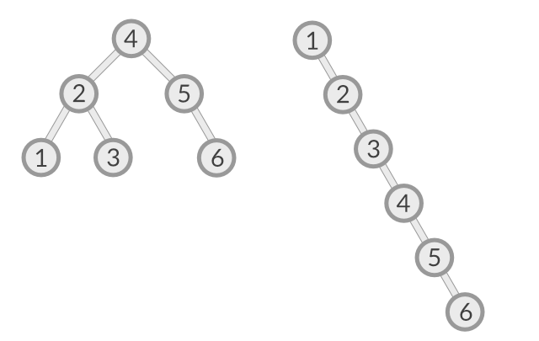
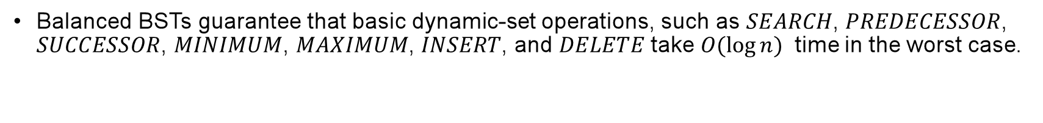
Balanced vs Unbalanced
Balanced BSTs guarantee that basic dynamic-set operations, such as $SEARCH$, $PREDECESSOR$, $SUCCESSOR$, $MINIMUM$, $MAXIMUM$, $INSERT$, and $DELETE$ take $O(\log{n})$ time in the worst case.
Notes:
Balanced Binary Tree: The height of the left and right subtrees of any node differs by at most one.

Slide 4
Red-Black Tree: Definition
A Red-Black Tree is a type of self-balancing binary search tree with one extra bit of storage per node: its color, which can be either RED or BLACK.
The tree maintains the following invariants:
Every node is either red or black.
The root is always black.
All leaves (NIL nodes) are black.
Red nodes cannot have red children (i.e., no two red nodes can be adjacent).
Every path from a node to its descendant NIL nodes must have the same number of black nodes.

Slide 5
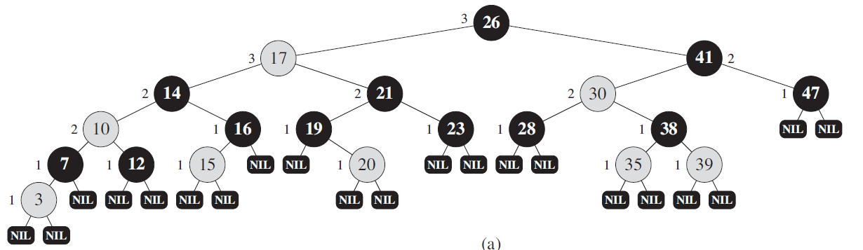
Red-Black Tree: Example (1)

Slide 6
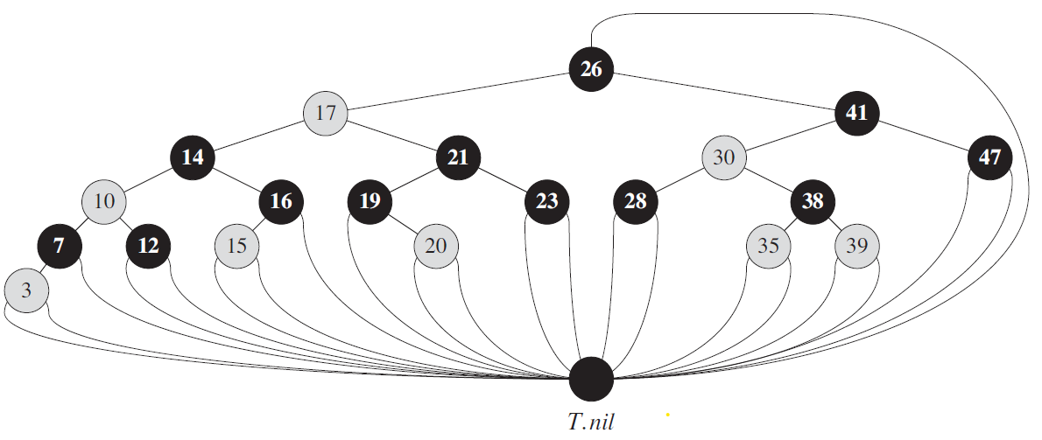
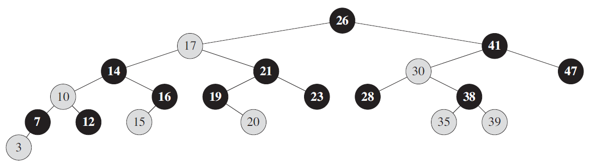
Red-Black Tree: Example (2)
Notes:
T.nil is an object with the same attributes as an ordinary node in the tree. Its color attribute is BLACK, and its other attributes—p, left, right, and key—can take on arbitrary values.

Slide 7
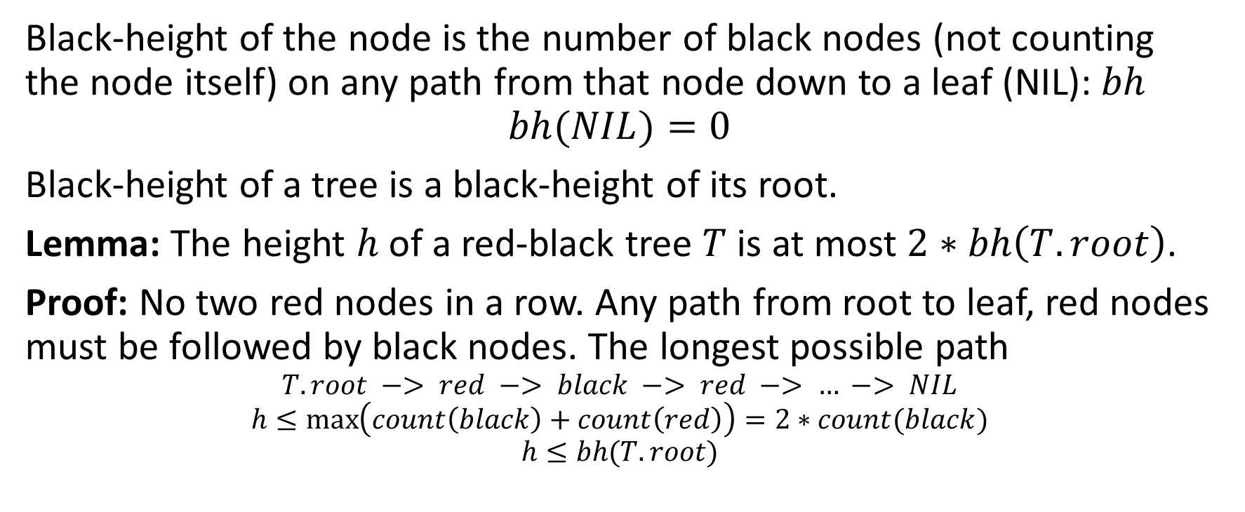
Red-Black Tree: Black-Height
Black-height of the node is the number of black nodes (not counting the node itself) on any path from that node down to a leaf (NIL): $bh$
$$bh(NIL)=0$$
Black-height of a tree is a black-height of its root.
Lemma: The height $h$ of a red-black tree $T$ is at most $2∗bh\left(T.root\right)$.
Proof: No two red nodes in a row. Any path from root to leaf, red nodes must be followed by black nodes. The longest possible path
$$T.root −> red −> black −> red −> … −> NIL$$
$$h≤\max\left(count\left(black\right)+count\left(red\right)\right)=2∗count(black)$$
$$h≤bh(T.root)$$

Slide 8
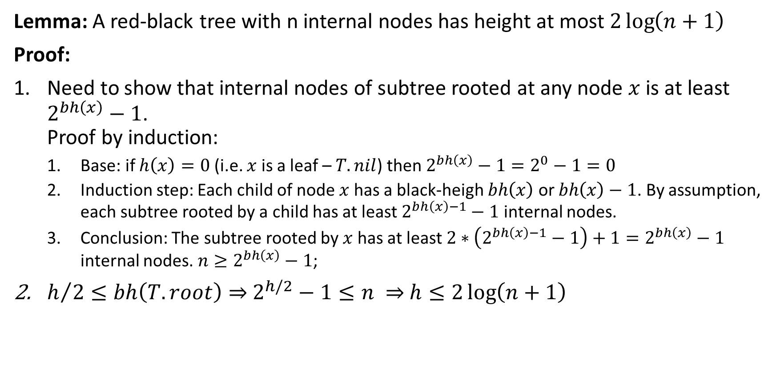
Red-Black Tree: Height
Lemma: A red-black tree with n internal nodes has height at most $2\log\left(n+1\right)$
Proof:
Need to show that internal nodes of subtree rooted at any node $x$ is at least $2^{bh\left(x\right)}−1$. Proof by induction:
Base: if $h\left(x\right)=0$ (i.e. $x$ is a leaf – $T.nil$) then $2^{bh\left(x\right)}−1=2^{0}−1=0$
Induction step: Each child of node $x$ has a black-heigh $bh\left(x\right)$ or $bh\left(x\right)−1$. By assumption, each subtree rooted by a child has at least $2^{bh\left(x\right)−1}−1$ internal nodes.
Conclusion: The subtree rooted by $x$ has at least $2∗\left(2^{bh\left(x\right)−1}−1\right)+1=2^{bh\left(x\right)}−1$ internal nodes. $n≥2^{bh\left(x\right)}−1$;
$h/2≤bh\left(T.root\right)⇒$ $2^{h/2}−1≤n ⇒$ $h≤2\log\left(n+1\right)$

Slide 9
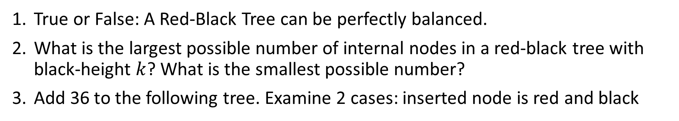
Red-Black Tree: Exercises 1
True or False: A Red-Black Tree can be perfectly balanced.
What is the largest possible number of internal nodes in a red-black tree with black-height $k$? What is the smallest possible number?
Add 36 to the following tree. Examine 2 cases: inserted node is red and black
Notes:
draw the complete binary search tree of height 3 on the keys f1; 2; : : : ; 15g. Add the NIL leaves and color the nodes in three different ways such that the black-heights of the resulting red-black trees are 2, 3, and 4.

Slide 10
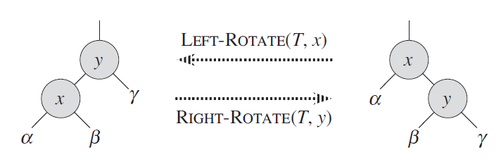
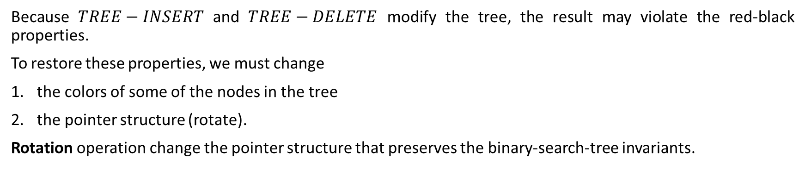
Red-Black Tree: Rotations
Because $TREE−INSERT$ and $TREE−DELETE$ modify the tree, the result may violate the red-black properties.
To restore these properties, we must change
the colors of some of the nodes in the tree
the pointer structure (rotate).
Rotation operation change the pointer structure that preserves the binary-search-tree invariants.

Slide 11
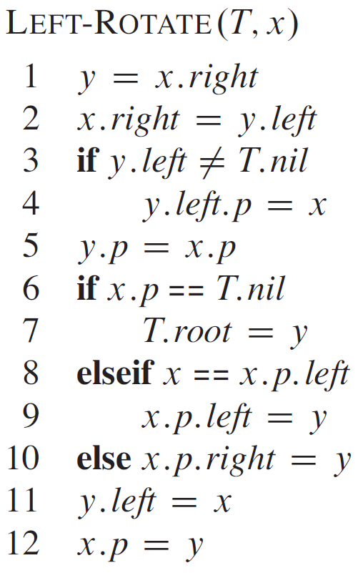
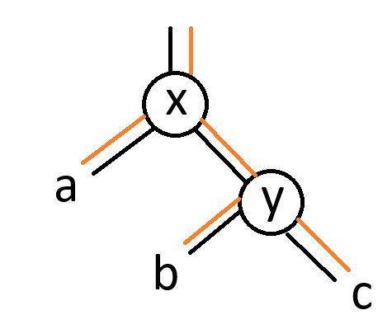
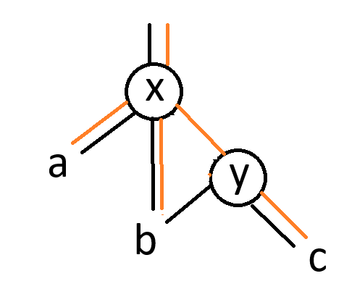
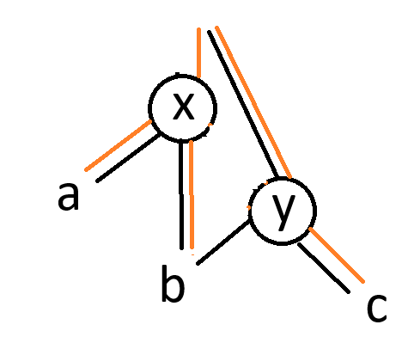
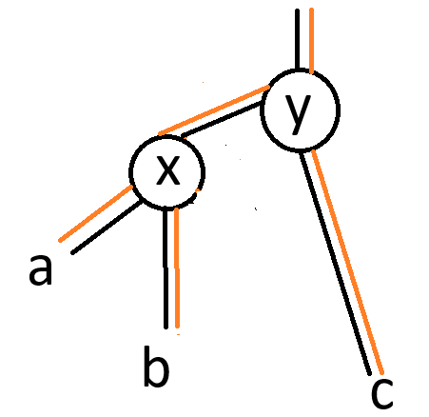
Red-Black Tree: Left Rotate
Notes:
O(1) time for rotate operations

Slide 12
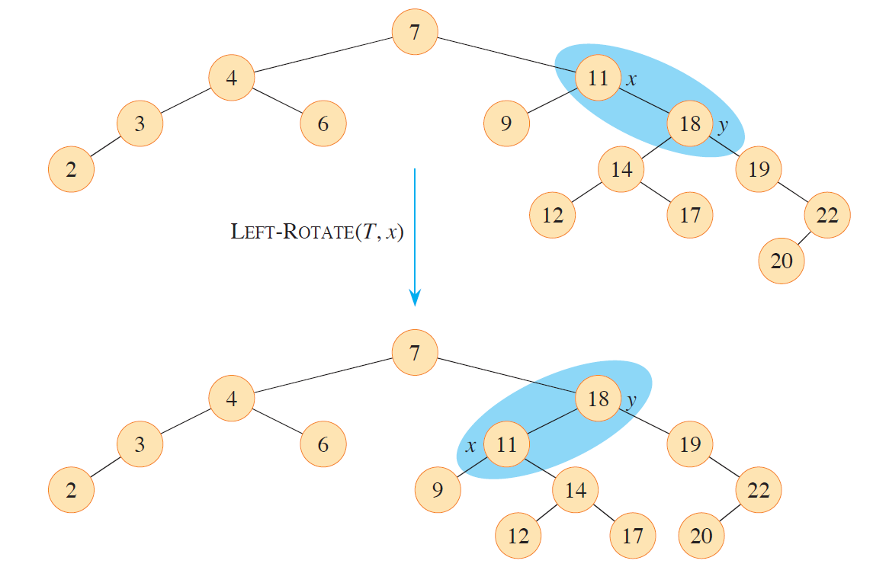
Red-Black Tree: Left Rotate Example

Slide 13
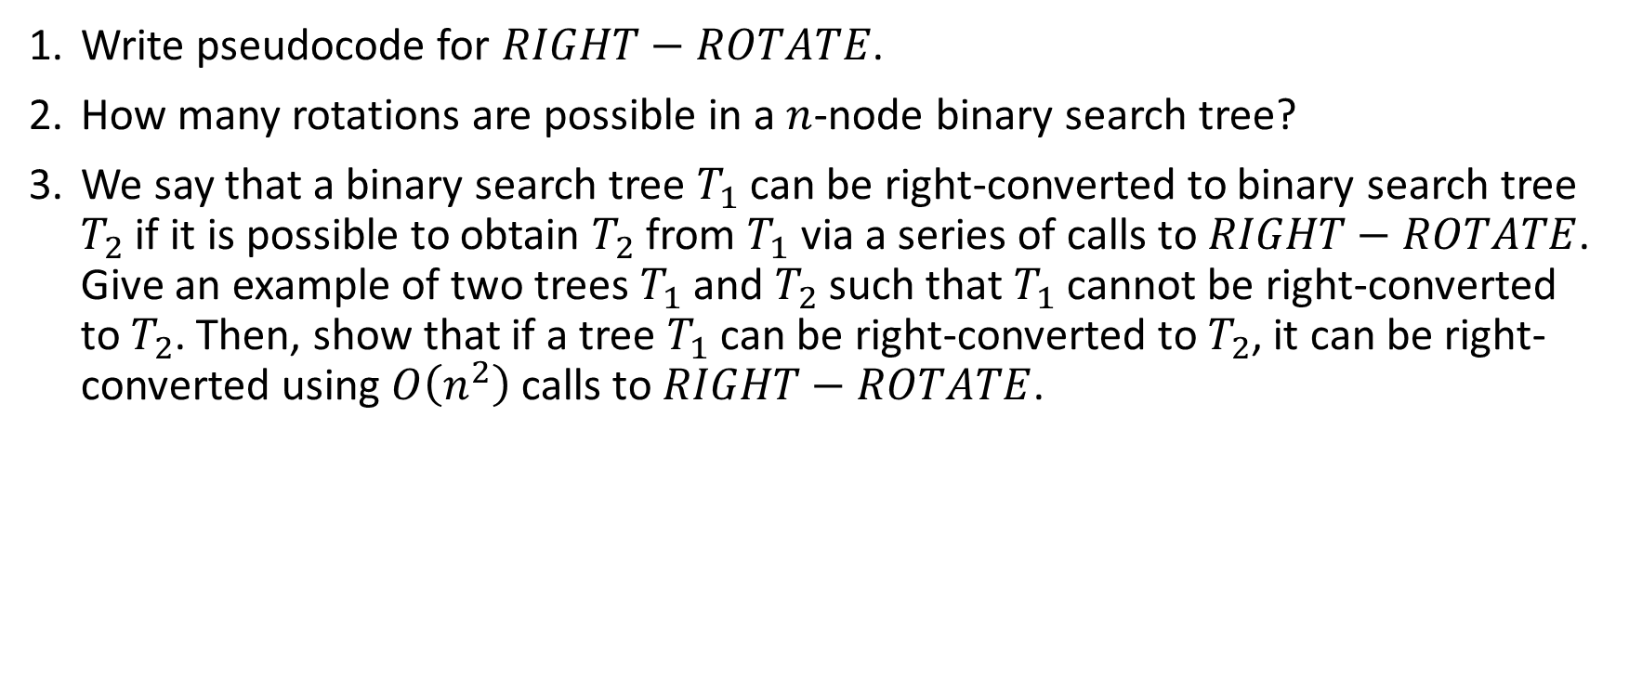
Red-Black Tree: Exercises 2
Write pseudocode for $RIGHT−ROTATE$.
How many rotations are possible in a $n$-node binary search tree?
We say that a binary search tree $T_{1}$ can be right-converted to binary search tree $T_{2}$ if it is possible to obtain $T_{2}$ from $T_{1}$ via a series of calls to $RIGHT−ROTATE$. Give an example of two trees $T_{1}$ and $T_{2}$ such that $T_{1}$ cannot be right-converted to $T_{2}$. Then, show that if a tree $T_{1}$ can be right-converted to $T_{2}$, it can be right-converted using $O\left(n^{2}\right)$ calls to $RIGHT−ROTATE$.

Slide 14
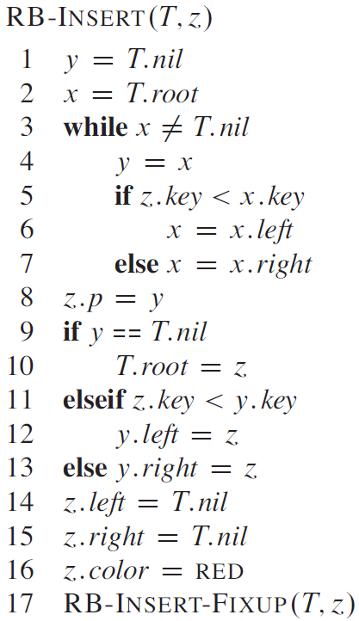
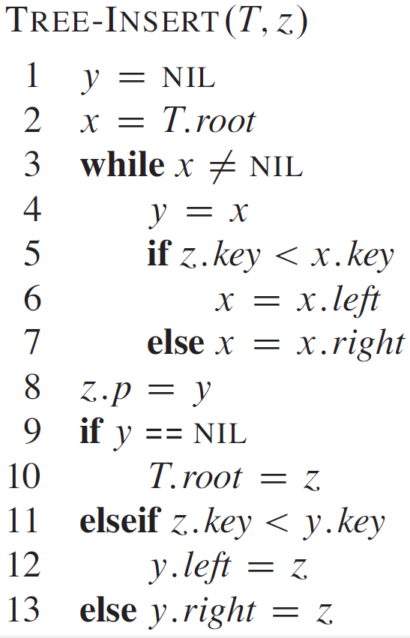
Red-Black Tree: Insert (1)

Slide 15
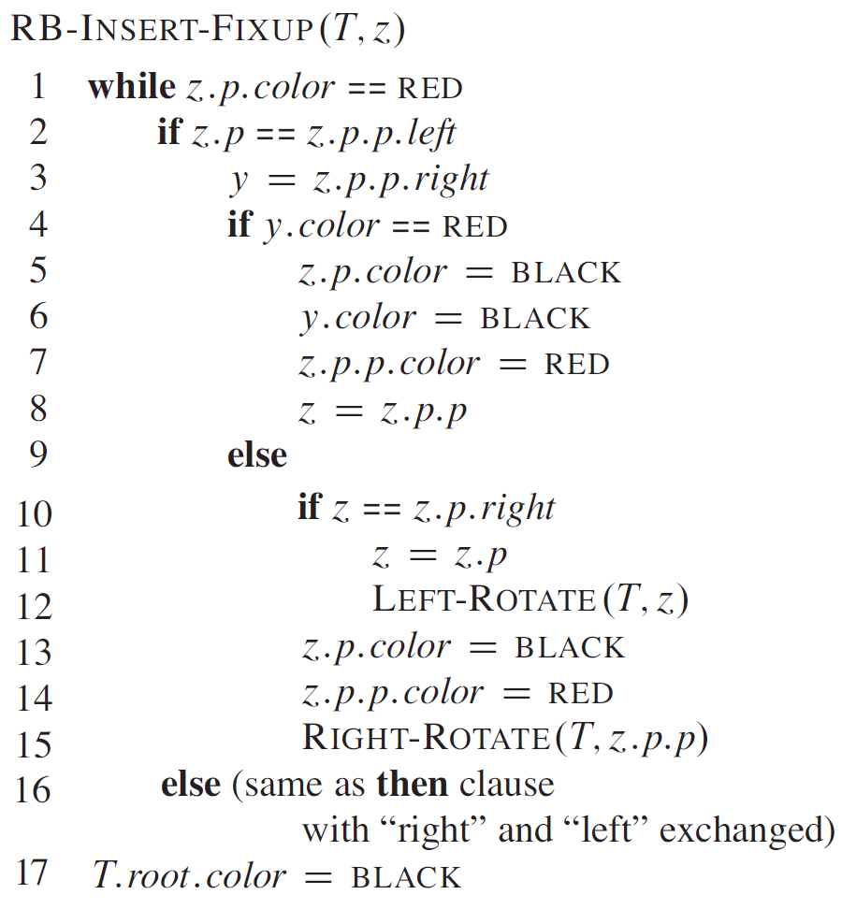
Red-Black Tree: Insert (2)

Slide 16
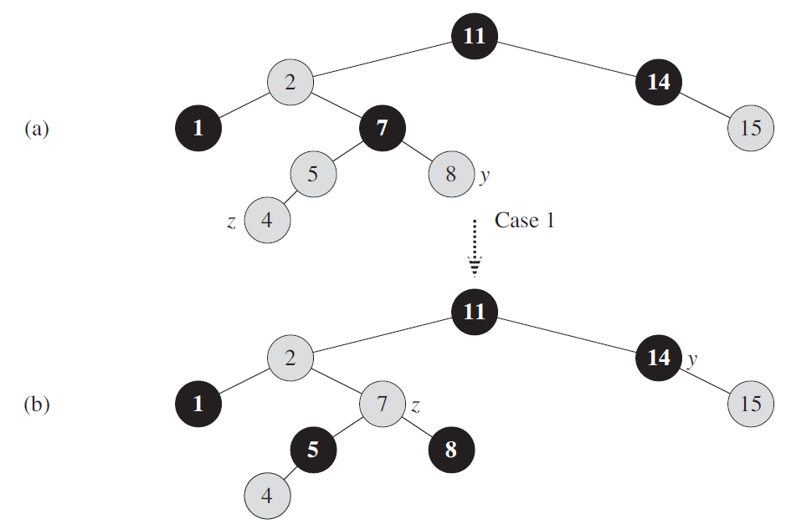
Red-Black Tree: Insert Fixup (1)

Slide 17
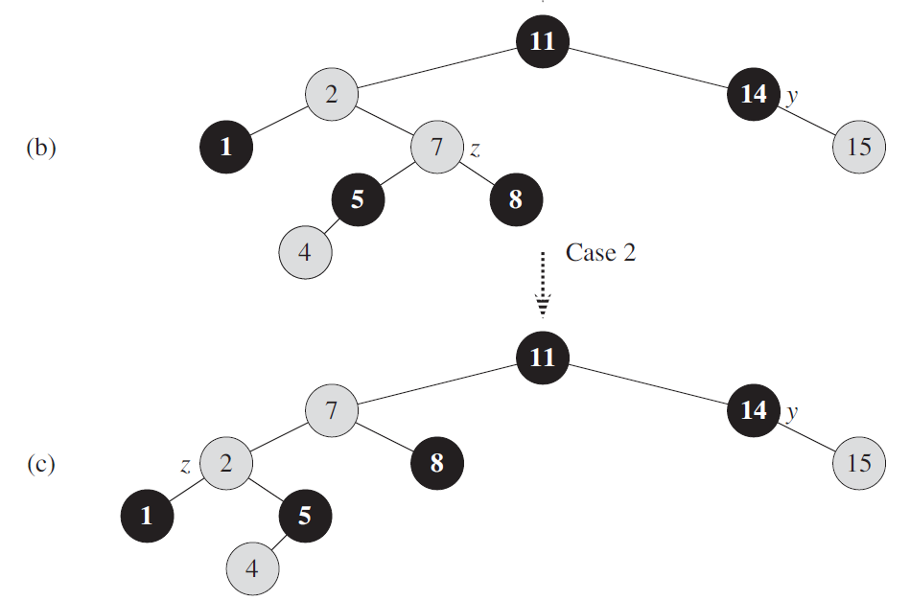
Red-Black Tree: Insert Fixup (2)

Slide 18
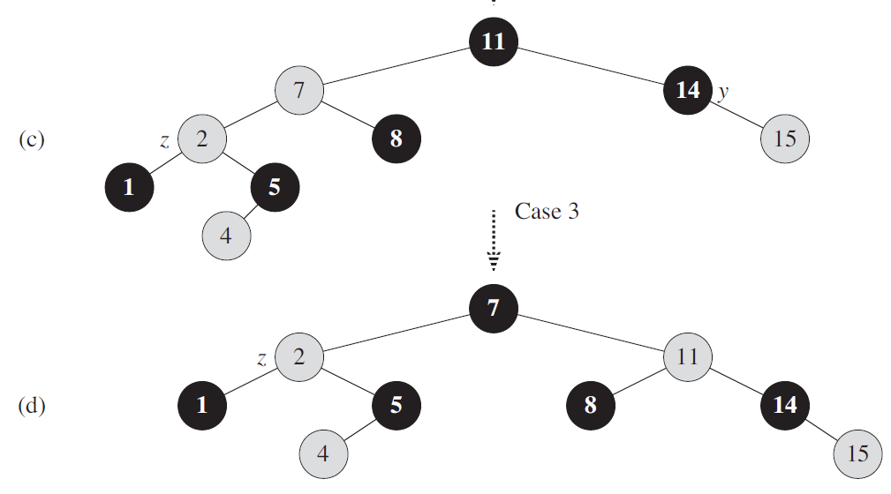
Red-Black Tree: Insert Fixup (3)

Slide 19
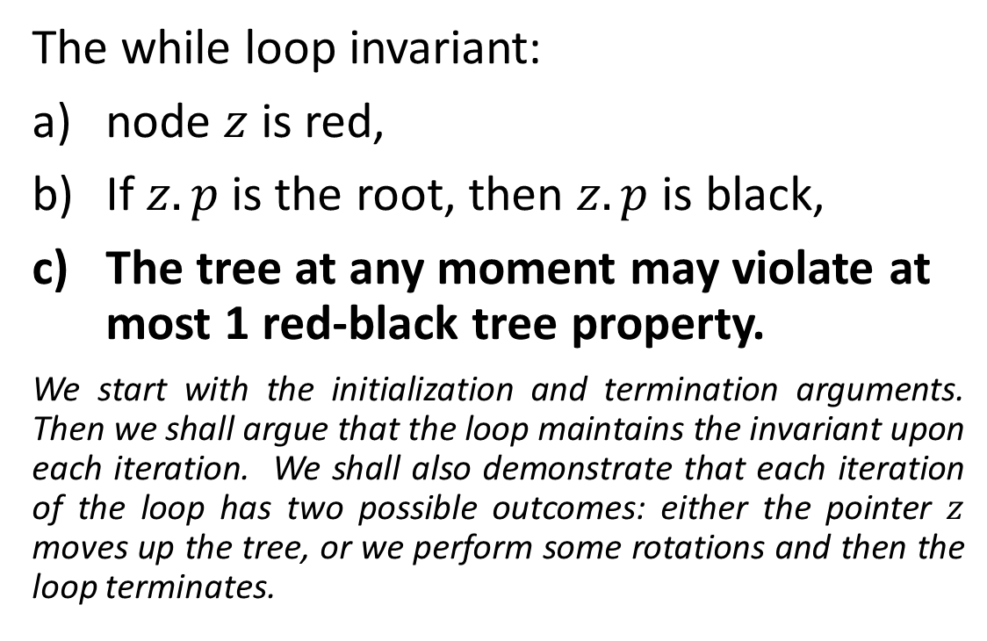
Red-Black Tree: Analyzing Insert Fixup (1)
The while loop invariant:
node $z$ is red,
If $z.p$ is the root, then $z.p$ is black,
The tree at any moment may violate at most 1 red-black tree property.
We start with the initialization and termination arguments. Then we shall argue that the loop maintains the invariant upon each iteration. We shall also demonstrate that each iteration of the loop has two possible outcomes: either the pointer $z$ moves up the tree, or we perform some rotations and then the loop terminates.
Notes:
If the tree violates property 2, it is because z is the root and is red.
If the tree violates property 4, it is because both z and z.p are red.

Slide 20
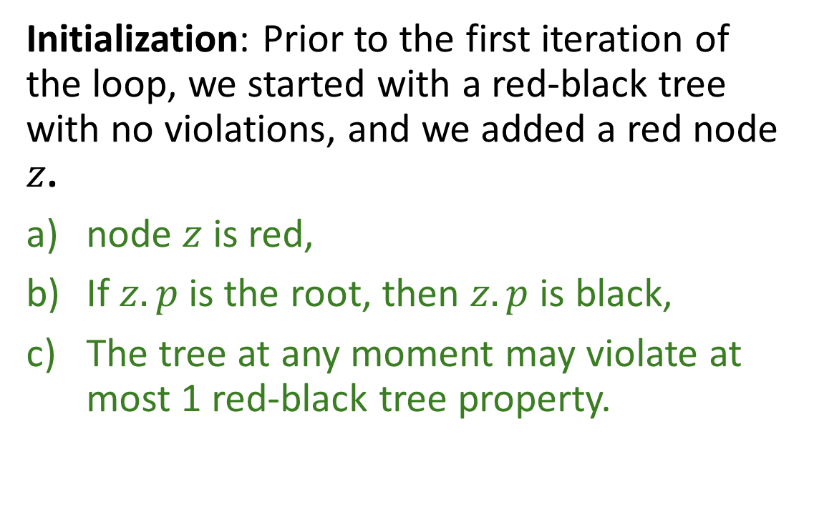
Red-Black Tree: Analyzing Insert Fixup (2)
Initialization: Prior to the first iteration of the loop, we started with a red-black tree with no violations, and we added a red node $z$.
node $z$ is red,
If $z.p$ is the root, then $z.p$ is black,
The tree at any moment may violate at most 1 red-black tree property.
Notes:
node $z$ is red,
If $z.p$ is the root, then $z.p$ is black,
The tree at any moment may violate at most 1 red-black tree property.
If the tree violates property 2, it is because z is the root and is red.
If the tree violates property 4, it is because both z and z.p are red.
The tree maintains the following invariants:
Every node is either red or black.
The root is always black.
All leaves (NIL nodes) are black.
Red nodes cannot have red children (i.e., no two red nodes can be adjacent).
Every path from a node to its descendant NIL nodes must have the same number of black nodes.

Slide 21
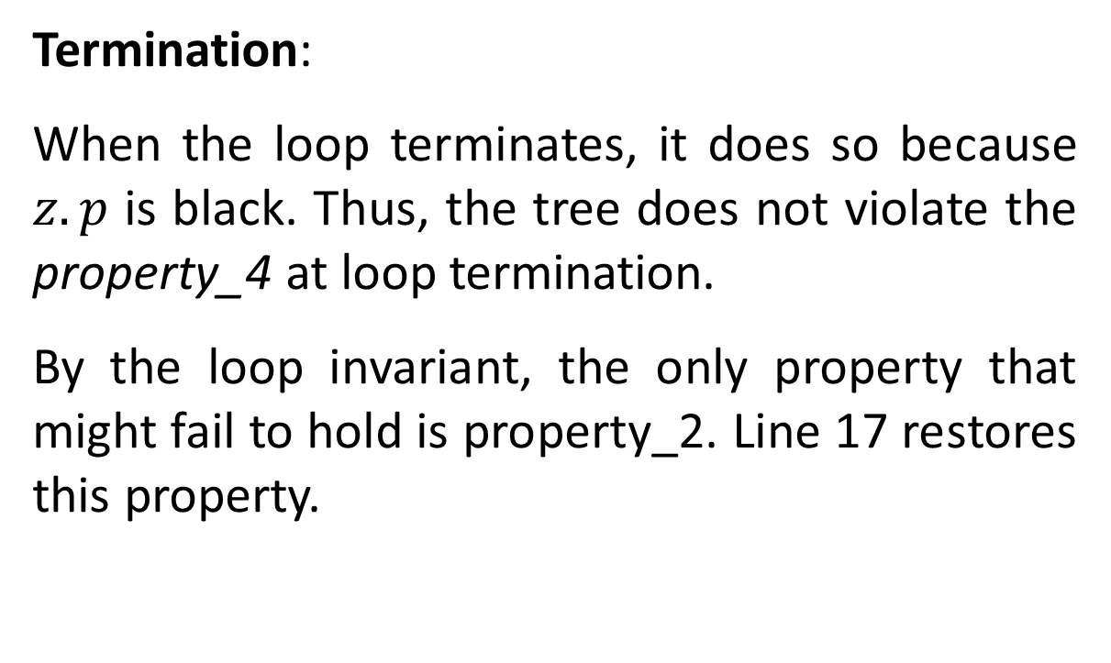
Red-Black Tree: Analyzing Insert Fixup (3)
Termination:
When the loop terminates, it does so because $z.p$ is black. Thus, the tree does not violate the property_4 at loop termination.
By the loop invariant, the only property that might fail to hold is property_2. Line 17 restores this property.
Notes:
node $z$ is red,
If $z.p$ is the root, then $z.p$ is black,
The tree at any moment may violate at most 1 red-black tree property.
If the tree violates property 2, it is because z is the root and is red.
If the tree violates property 4, it is because both z and z.p are red.
The tree maintains the following invariants:
Every node is either red or black.
The root is always black.
All leaves (NIL nodes) are black.
Red nodes cannot have red children (i.e., no two red nodes can be adjacent).
Every path from a node to its descendant NIL nodes must have the same number of black nodes.

Slide 22
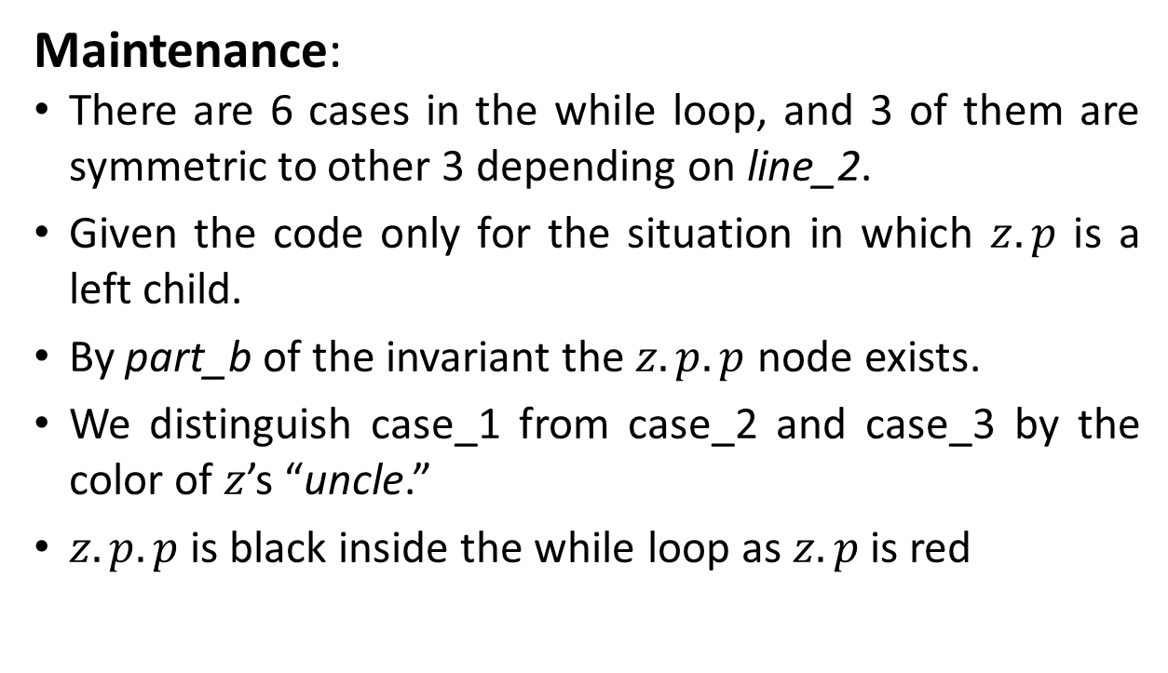
Red-Black Tree: Analyzing Insert Fixup (4)
Maintenance:
There are 6 cases in the while loop, and 3 of them are symmetric to other 3 depending on line_2.
Given the code only for the situation in which $z.p$ is a left child.
By part_b of the invariant the $z.p.p$ node exists.
We distinguish case_1 from case_2 and case_3 by the color of $z$’s “uncle.”
$z.p.p$ is black inside the while loop as $z.p$ is red
Notes:
node $z$ is red,
If $z.p$ is the root, then $z.p$ is black,
The tree at any moment may violate at most 1 red-black tree property.
If the tree violates property 2, it is because z is the root and is red.
If the tree violates property 4, it is because both z and z.p are red.

Slide 23
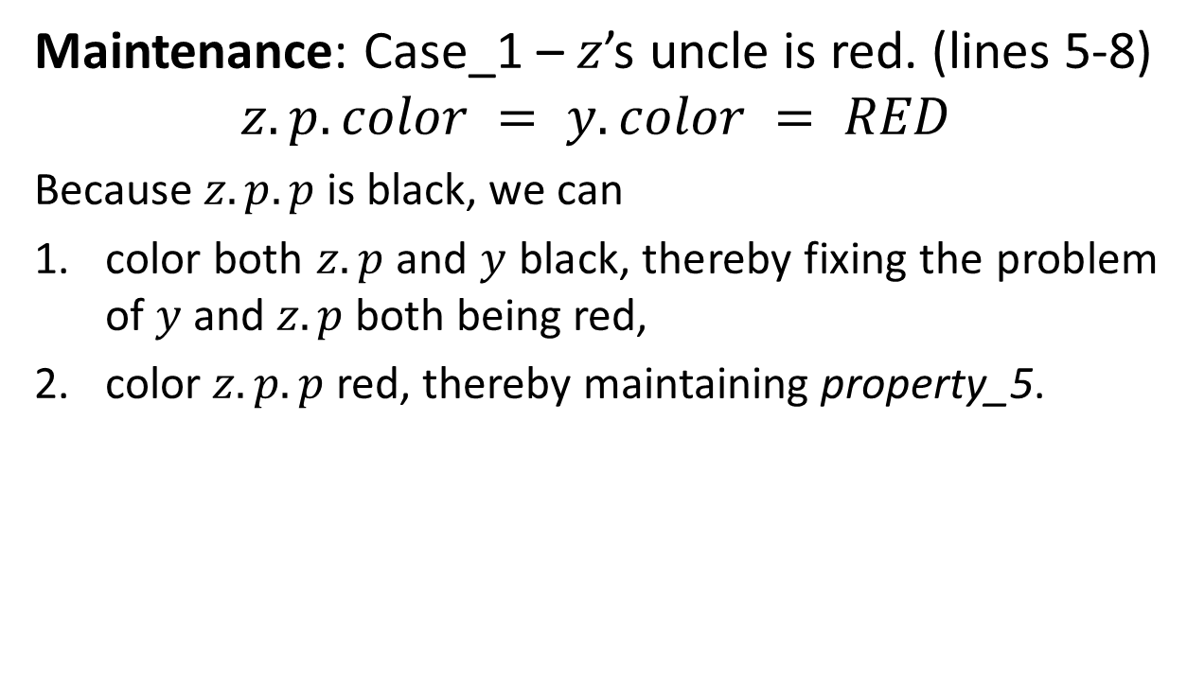
Red-Black Tree: Analyzing Insert Fixup (4)
Maintenance: Case_1 – $z$’s uncle is red. (lines 5-8)
$$z.p.color = y.color = RED$$
Because $z.p.p$ is black, we can
color both $z.p$ and $y$ black, thereby fixing the problem of $y$ and $z.p$ both being red,
color $z.p.p$ red, thereby maintaining property_5.
Notes:
$z.p.p$ is black inside the while loop as $z.p$ is red
The tree maintains the following invariants:
Every node is either red or black.
The root is always black.
All leaves (NIL nodes) are black.
Red nodes cannot have red children (i.e., no two red nodes can be adjacent).
Every path from a node to its descendant NIL nodes must have the same number of black nodes.

Slide 24
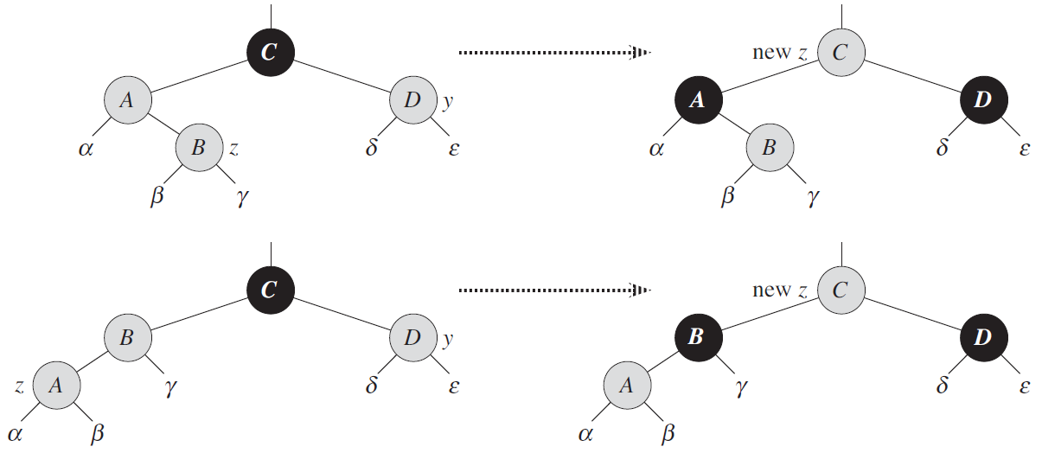

Red-Black Tree: Analyzing Insert Fixup (5)
Maintenance: Case_1 – $z$’s uncle is red. (lines 5-8)
$$z.p.color = y.color = RED$$
Notes:
node $z$ is red,
If $z.p$ is the root, then $z.p$ is black,
The tree at any moment may violate at most 1 red-black tree property.
Line 8 doesn’t break invariant

Slide 25
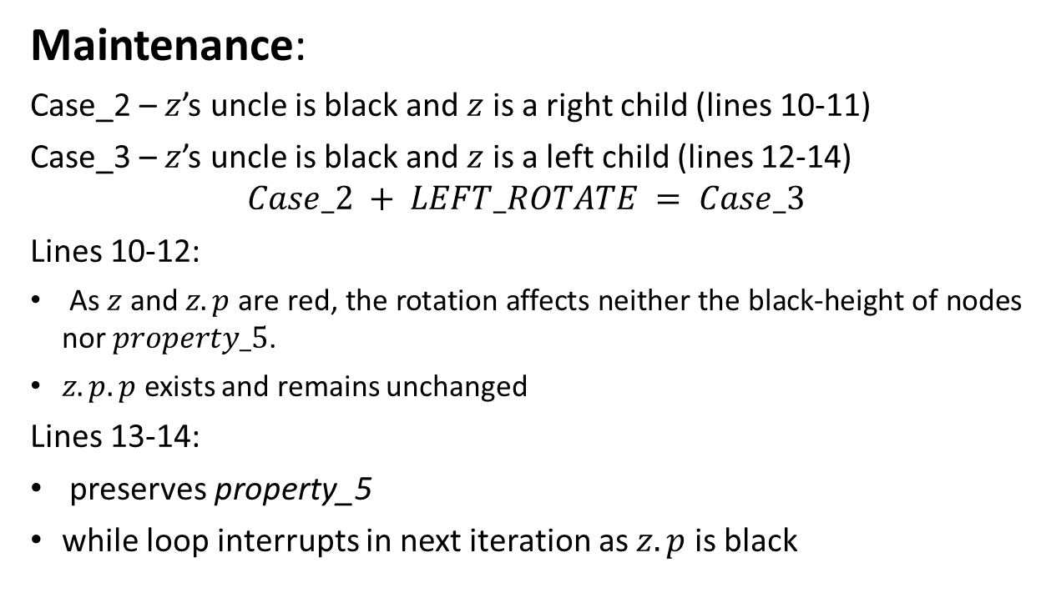
Red-Black Tree: Analyzing Insert Fixup (6)
Maintenance:
Case_2 – $z$’s uncle is black and $z$ is a right child (lines 10-11)
Case_3 – $z$’s uncle is black and $z$ is a left child (lines 12-14)
$$Case_2 + LEFT_ROTATE = Case_3$$
Lines 10-12:
As $z$ and $z.p$ are red, the rotation affects neither the black-height of nodes nor $property_5$.
$z.p.p$ exists and remains unchanged
Lines 13-14:
preserves property_5
while loop interrupts in next iteration as $z.p$ is black
Notes:
$z.p.p$ is black inside the while loop as $z.p$ is red
node $z$ is red,
If $z.p$ is the root, then $z.p$ is black,
The tree at any moment may violate at most 1 red-black tree property.

Slide 26
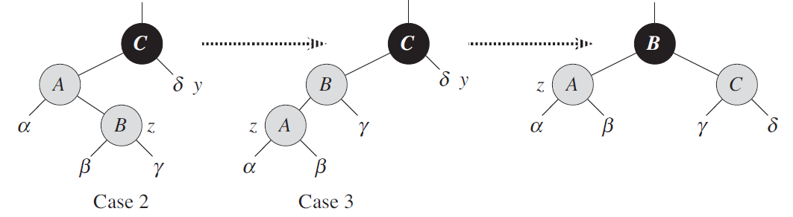
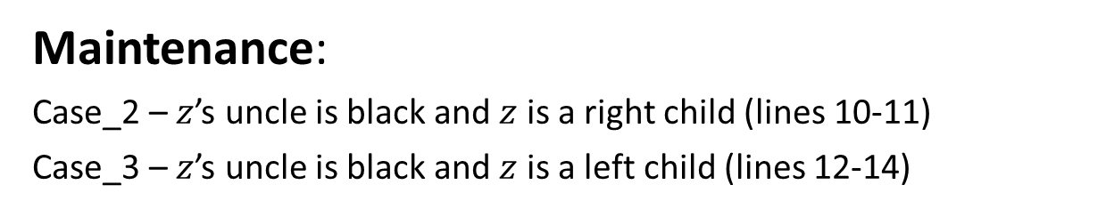
Red-Black Tree: Analyzing Insert Fixup (7)
Maintenance:
Case_2 – $z$’s uncle is black and $z$ is a right child (lines 10-11)
Case_3 – $z$’s uncle is black and $z$ is a left child (lines 12-14)
Notes:
$z.p.p$ is black inside the while loop as $z.p$ is red
node $z$ is red,
If $z.p$ is the root, then $z.p$ is black,
The tree at any moment may violate at most 1 red-black tree property.

Slide 27
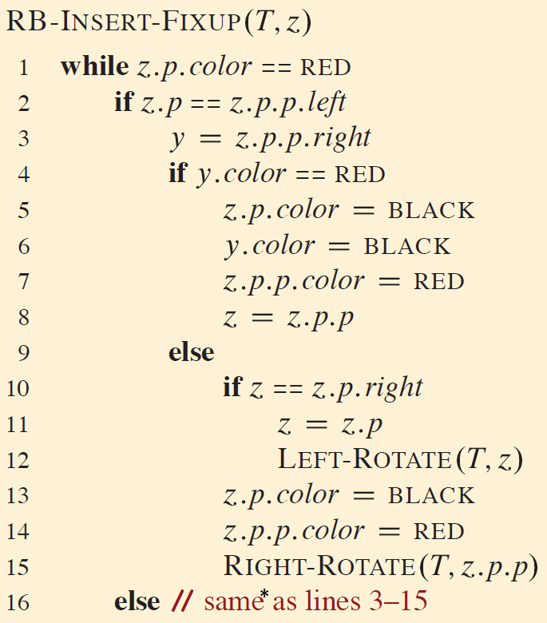
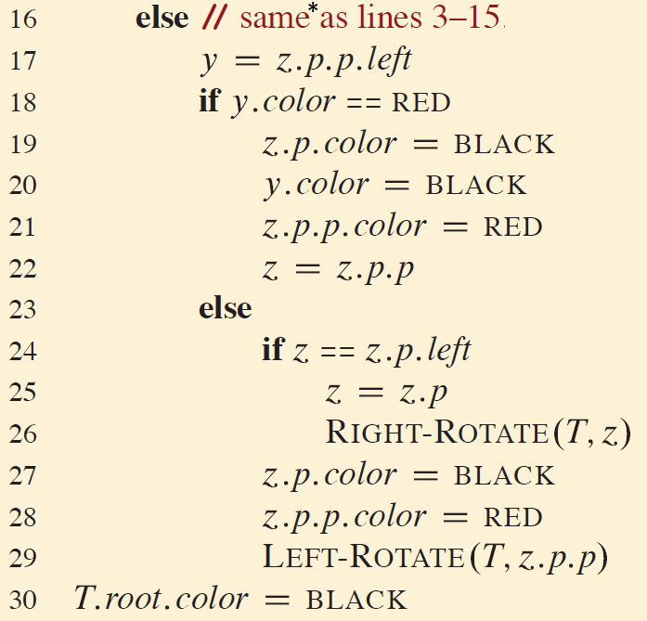
Red-Black Tree: Insert Fixup (8)

Slide 28
Red-Black Tree: Exercises 2
Show the red-black trees that result after successively inserting the keys 41; 38; 31; 12; 19; 8 into an initially empty red-black tree.
Show the red-black trees that result after successively inserting the keys 20, 15, 25, 10, 18, 8, 5 into an initially empty red-black tree.
Consider a red-black tree formed by inserting n nodes with RB-INSERT. Argue that if n > 1, the tree has at least one red node.

Slide 29
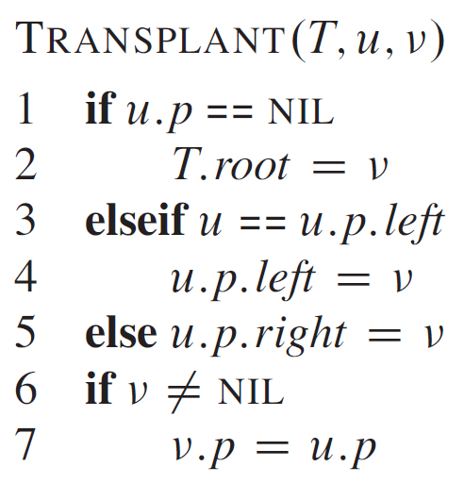
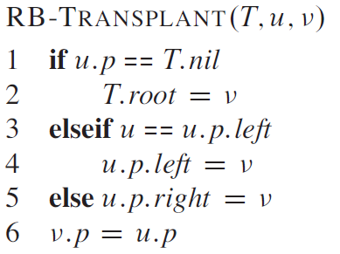
Red-Black Tree: Delete: Transplant

Slide 30
Red-Black Tree: Delete: Transplant

Slide 31
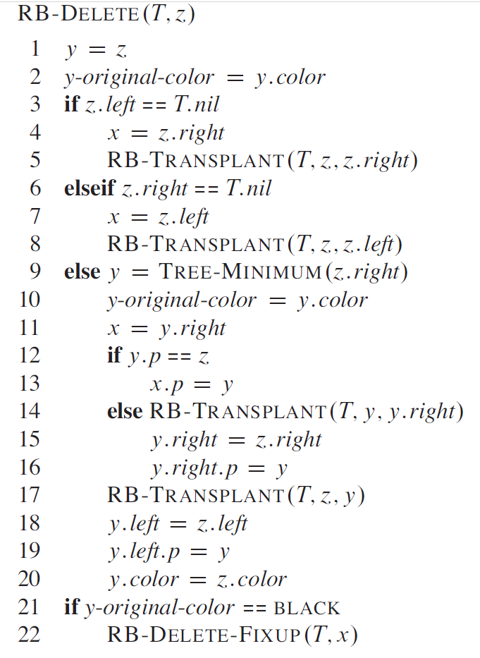
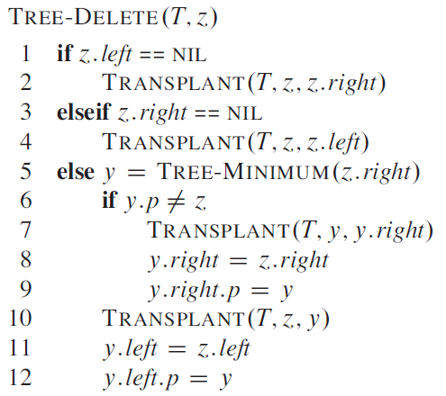
Red-Black Tree: Delete (1)

Slide 32
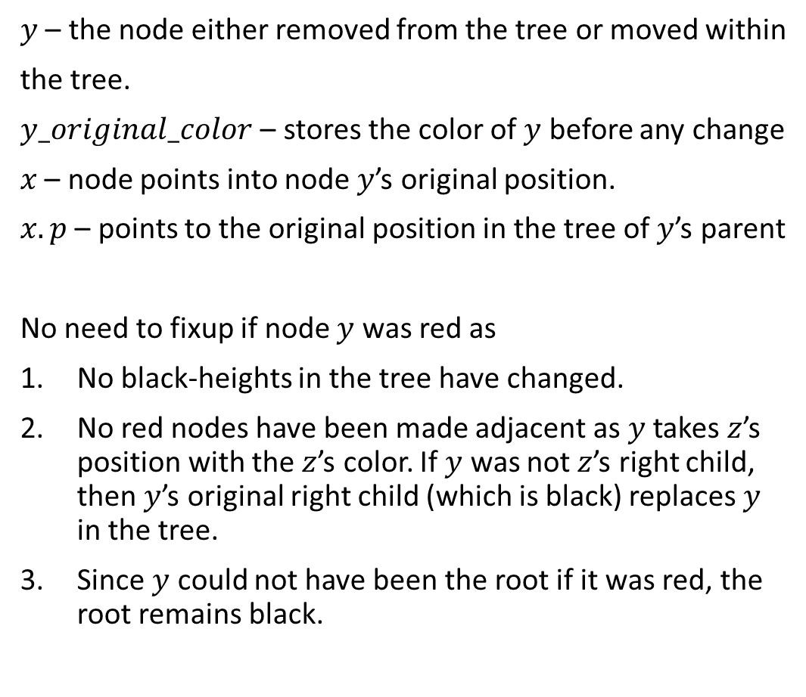
Red-Black Tree: Delete (2)
$y$ – the node either removed from the tree or moved within
the tree.
$y_original_color$ – stores the color of $y$ before any change
$x$ – node points into node $y$’s original position.
$x.p$ – points to the original position in the tree of $y$’s parent
No need to fixup if node $y$ was red as
No black-heights in the tree have changed.
No red nodes have been made adjacent as $y$ takes $z$’s position with the $z$’s color. If $y$ was not $z$’s right child, then $y$’s original right child (which is black) replaces $y$ in the tree.
Since $y$ could not have been the root if it was red, the root remains black.
Notes:
line 13. when z=y.p x points to y as z will be removed.

Slide 33
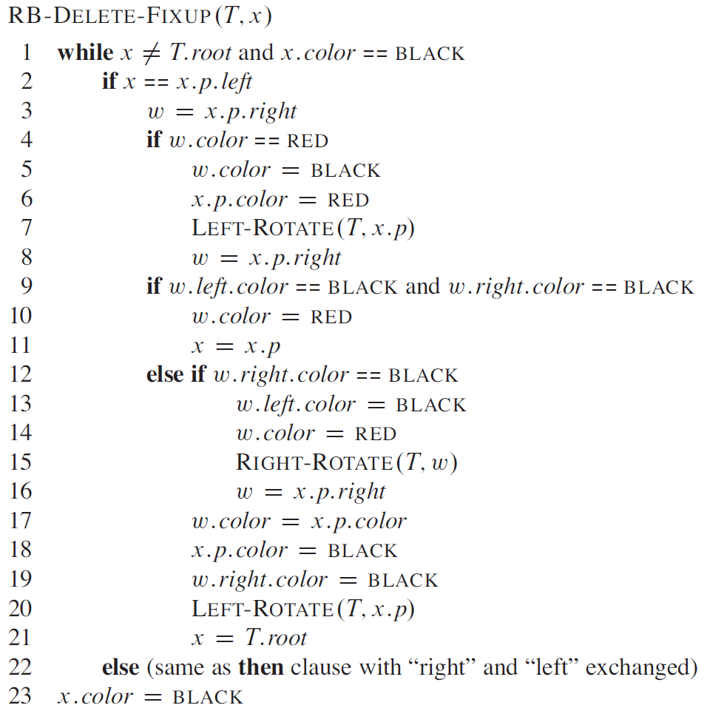
Red-Black Tree: Delete (3)
Notes:
if y was a black 3 problems may rise
If y had been a root and a red node become a new root
if both x and x.p are red
moving y within a tree causes any path containing y to have one fewer black node.

Slide 34
Thank You

