Slide 1
Introduction to Algorithms
Levon Prazyan

Slide 2
Course Overview
Introduction
Sorting and Searching
Arrays and Lists
Stacks and Queues, Double Ended Queue
Heaps
Trees
Hash Tables
Dynamic Programming
Greedy Algorithms
Graph Algorithms
Network Flow
NP-Completeness

Slide 3
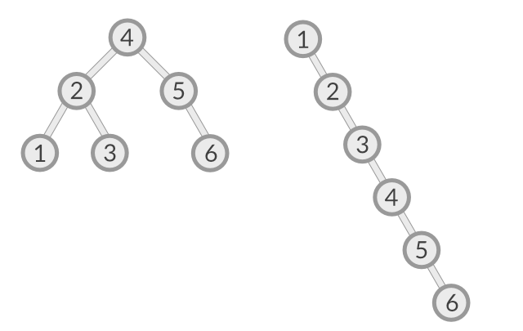
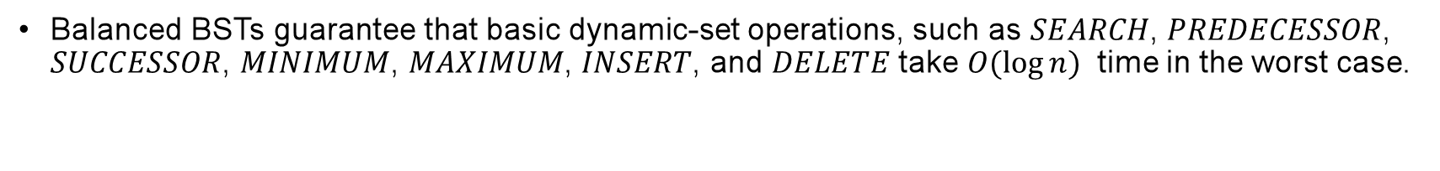
Balanced vs Unbalanced
Balanced BSTs guarantee that basic dynamic-set operations, such as $SEARCH$, $PREDECESSOR$, $SUCCESSOR$, $MINIMUM$, $MAXIMUM$, $INSERT$, and $DELETE$ take $O(\log{n})$ time in the worst case.
Notes:
Balanced Binary Tree: The height of the left and right subtrees of any node differs by at most one.

Slide 4

AVL Tree: Definition
An AVL tree is a binary search tree that is height balanced: for each node $x$, the heights of the left and right subtrees of $x$ differ by at most 1.
The AVL tree implementation maintains an extra attribute in each node: $x.h$is the height of node $x$.
Notes:
Adel’son-Vel’ski˘ı and Landis - AVL

Slide 5
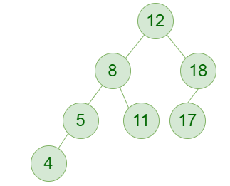
AVL Tree: Example

Slide 6
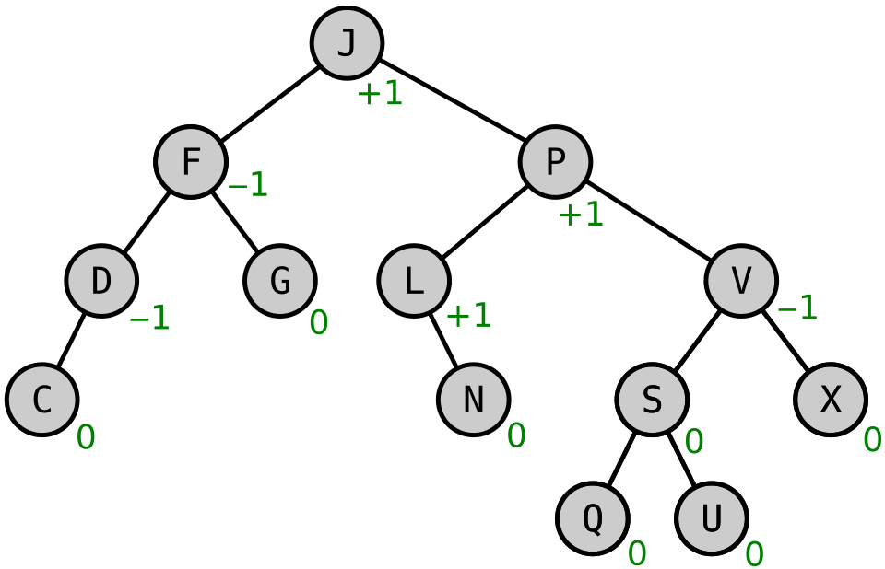
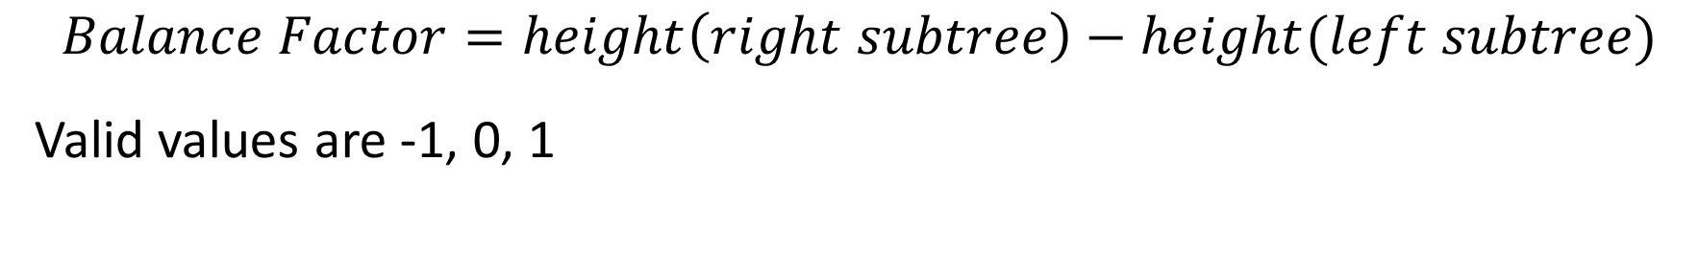
AVL Tree: Balance Factor
$$Balance Factor=height\left(right subtree\right)−height(left subtree)$$
Valid values are -1, 0, 1
BF(X)<0 is called "left-heavy”
BF(X)>0 is called "right-heavy",
BF(X)=0 is sometimes simply called "balanced".
Notes:
BF(X)<0 is called "left-heavy
BF(X)>0 is called "right-heavy",
BF(X)=0 is called "balanced".

Slide 7
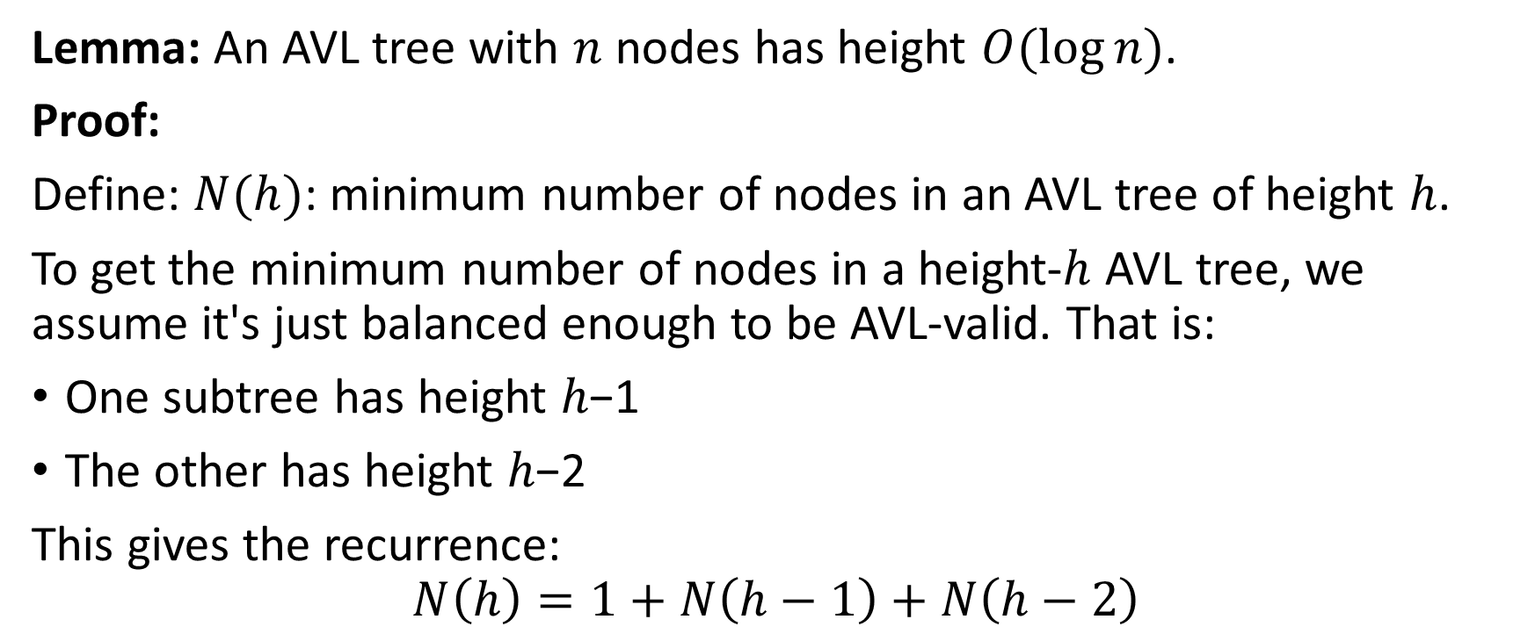
AVL Tree: Height (1)
Lemma: An AVL tree with $n$ nodes has height $O(\log{n})$.
Proof:
Define: $N(h)$: minimum number of nodes in an AVL tree of height $h$.
To get the minimum number of nodes in a height-ℎ AVL tree, we assume it's just balanced enough to be AVL-valid. That is:
One subtree has height ℎ−1
The other has height ℎ−2
This gives the recurrence:
$$N\left(h\right)=1+N\left(h−1\right)+N\left(h−2\right)$$

Slide 8
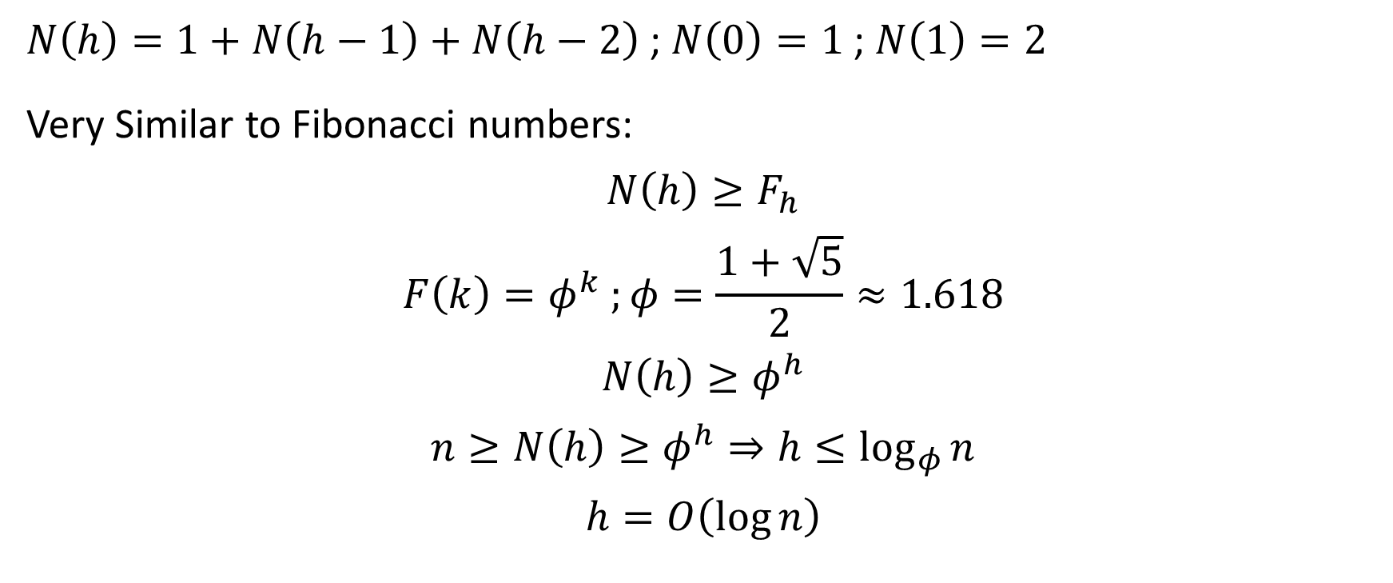
AVL Tree: Height (2)
$N\left(h\right)=1+N\left(h−1\right)+N\left(h−2\right)$ ; $N\left(0\right)=1$ ; $N\left(1\right)=2$
Very Similar to Fibonacci numbers:
$$N\left(h\right)≥F_{h}$$
$$F\left(k\right)=φ^{k} ;φ=\frac{1+\sqrt{5}}{2}≈1.618$$
$$N\left(h\right)≥φ^{h}$$
$$n≥N\left(h\right)≥φ^{h}⇒h≤\log_{φ}{n}$$
$$h=O\left(\log{n}\right)$$

Slide 9
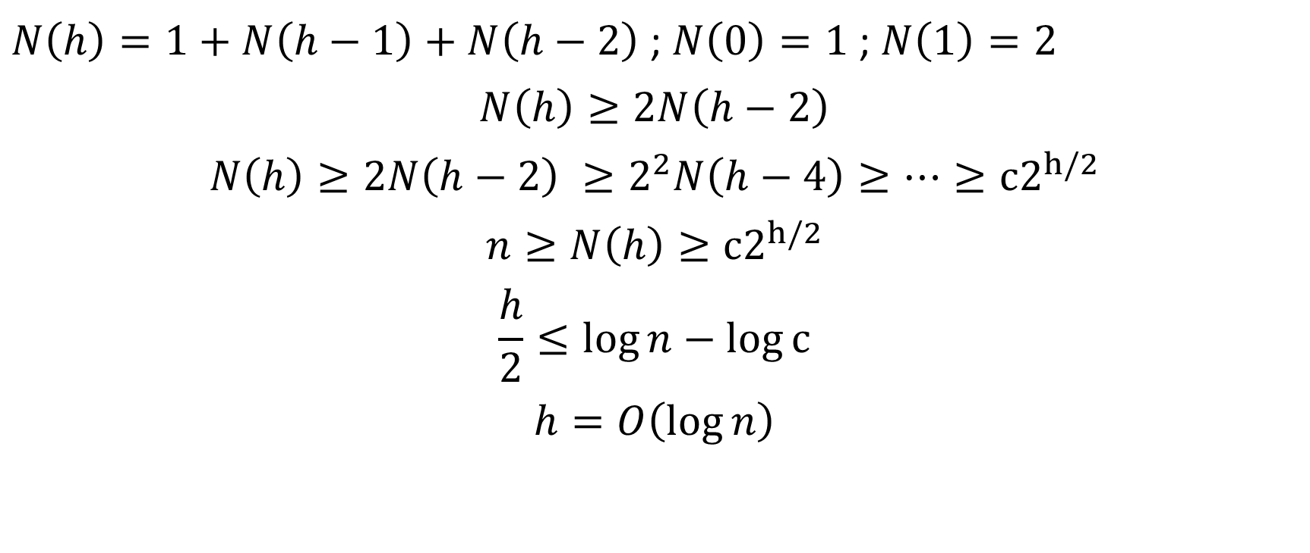
AVL Tree: Height (3)
$N\left(h\right)=1+N\left(h−1\right)+N\left(h−2\right)$ ; $N\left(0\right)=1$ ; $N\left(1\right)=2$
$$N\left(h\right)≥2N\left(h−2\right)$$
$$N\left(h\right)≥2N\left(h−2\right) ≥2^{2}N\left(h−4\right)≥…≥c2^{h/2}$$
$$n≥N\left(h\right)≥c2^{h/2}$$
$$\frac{h}{2}≤\log{n}−\log{c}$$
$$h=O\left(\log{n}\right)$$

Slide 10
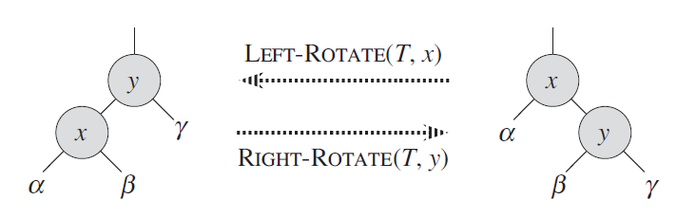
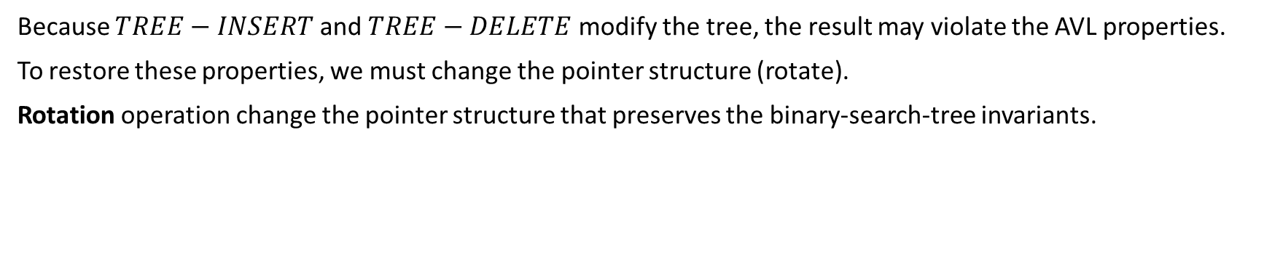
Rotations: Left-Rotate And Right-Rotate
Because $TREE−INSERT$ and $TREE−DELETE$ modify the tree, the result may violate the AVL properties.
To restore these properties, we must change the pointer structure (rotate).
Rotation operation change the pointer structure that preserves the binary-search-tree invariants.

Slide 11
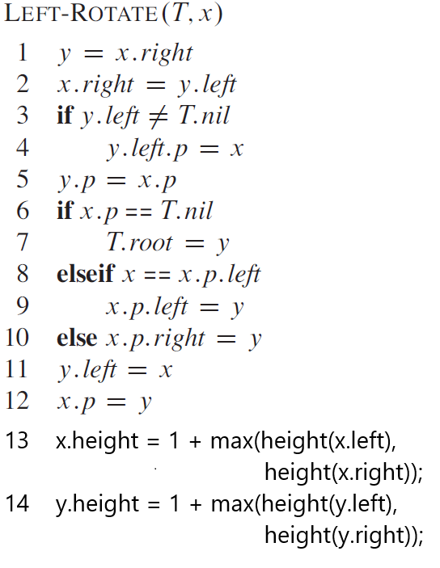
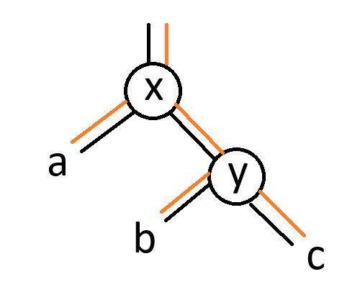
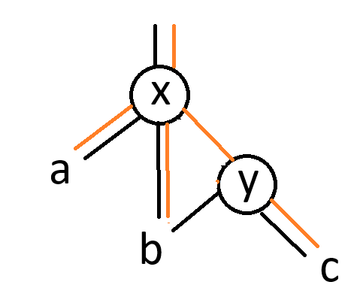
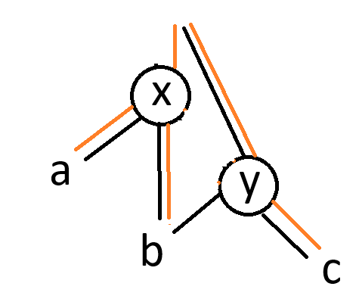
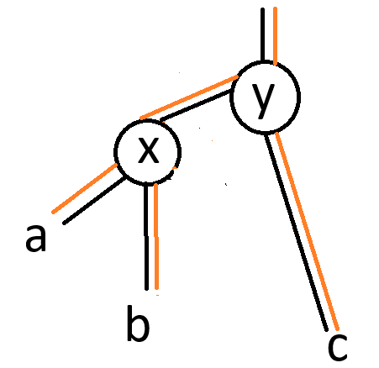
AVL Tree: Left Rotate
Notes:
O(1) time for rotate operations

Slide 12
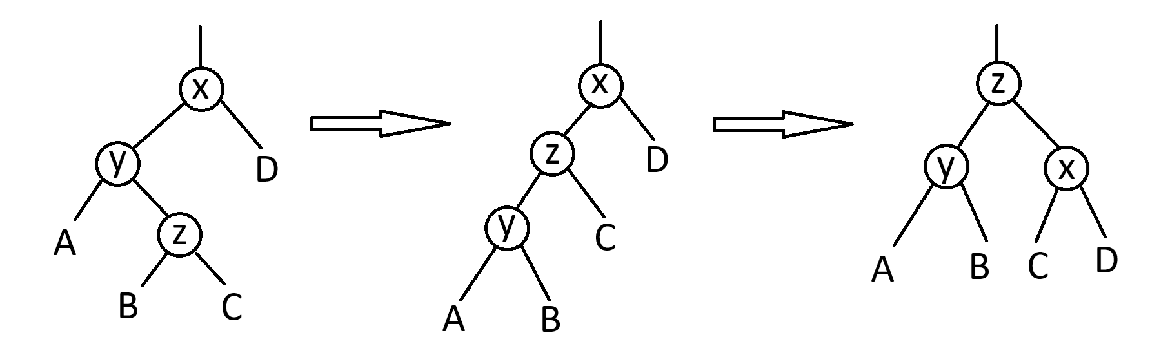
Rotations: Left-Right Rotate
LeftRightRotate(x):
LeftRotate(x.left)
return RightRotate(x)
Notes:
Right-Left Rotate

Slide 13
AVL Tree: Insert (1)
Let the newly inserted node be w
Perform BST insert for w.
Starting from w, travel up and find the first unbalanced node.
Let z be the first unbalanced node,
y be the child of z that comes on the path from w to z and
x be the grandchild of z that comes on the path from w to z.
Re-balance the tree by performing appropriate rotations on the subtree rooted with z. There can be 4 possible cases that need to be handled as x, y and z can be arranged in 4 ways.
y is the left child of z and x is the left child of y (Left Left Case)
y is the left child of z and x is the right child of y (Left Right Case)
y is the right child of z and x is the right child of y (Right Right Case)
y is the right child of z and x is the left child of y (Right Left Case)

Slide 14
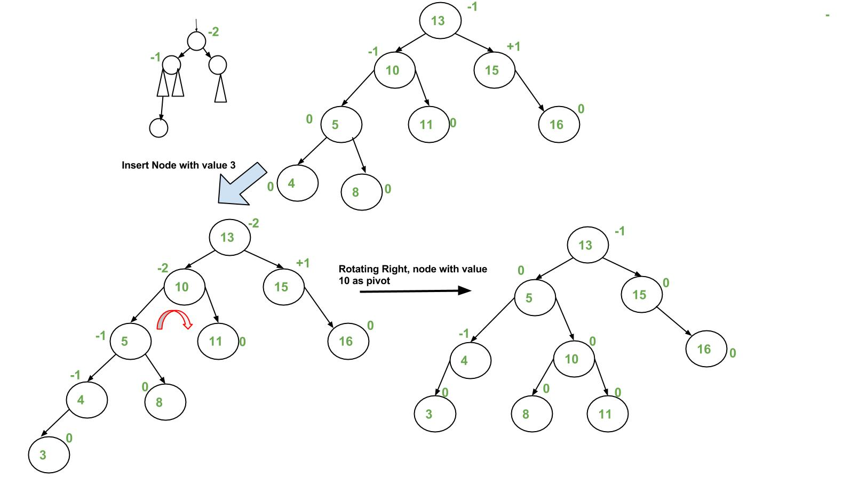
AVL Tree: Insert Example (1)

Slide 15
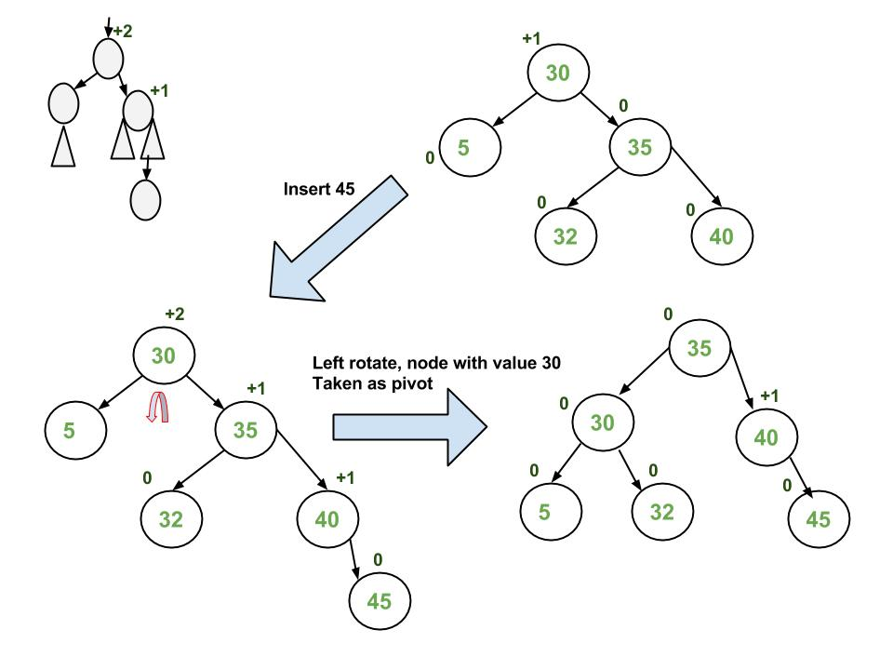
AVL Tree: Insert Example (2)

Slide 16
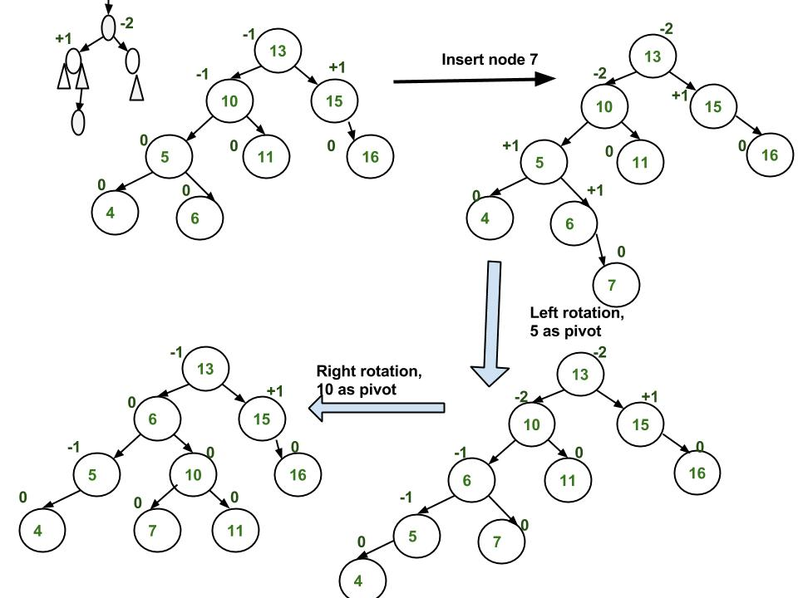
AVL Tree: Insert Example (3)

Slide 17
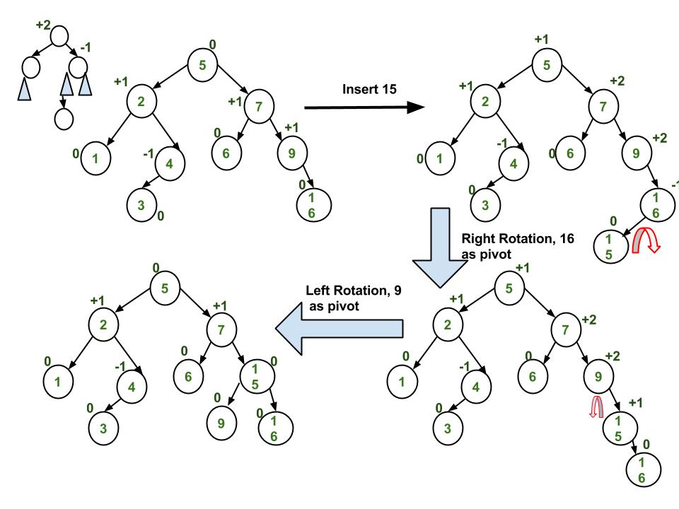
AVL Tree: Insert Example (4)

Slide 18
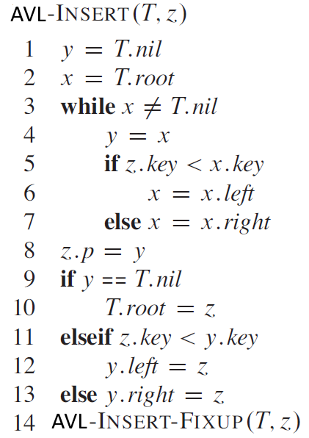
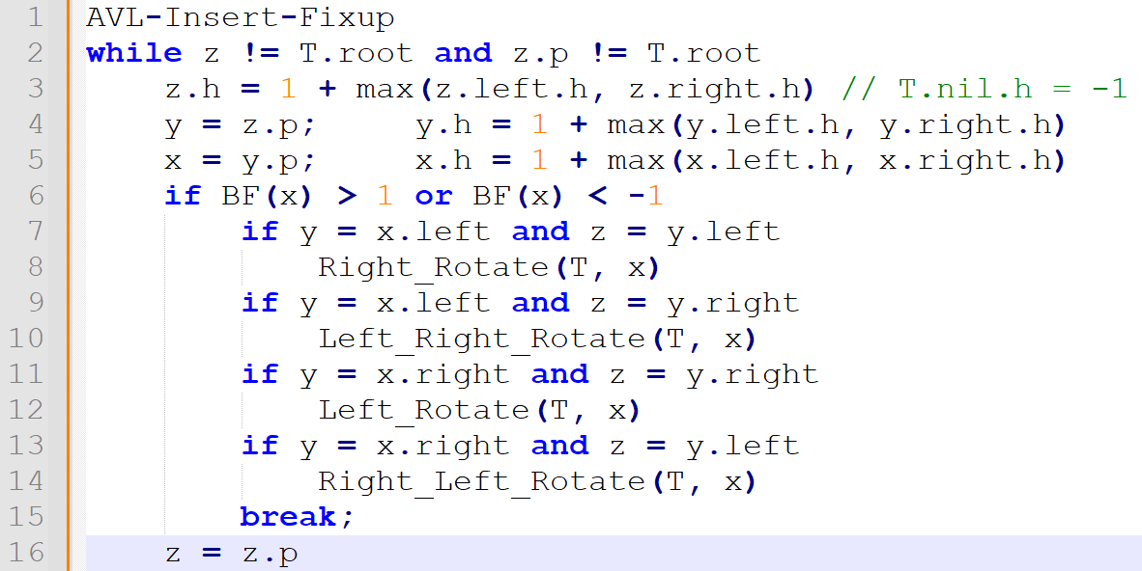
AVL Tree: Insert (2)

Slide 19
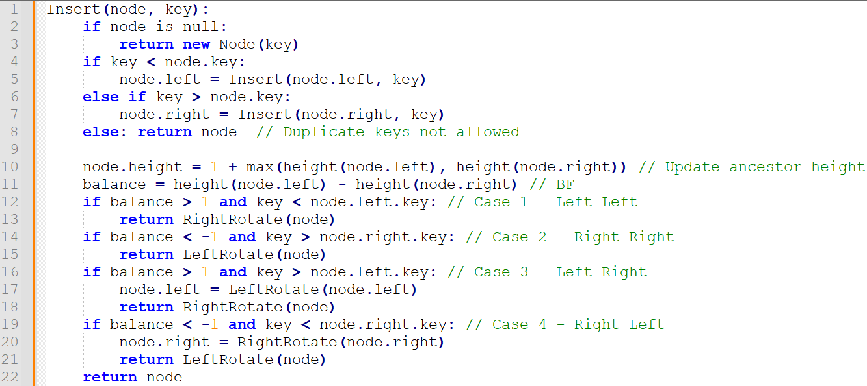
AVL Tree: Insert (3)

Slide 20
AVL Tree: Insert (4)

Slide 21
AVL vs Red-Black
Feature | AVL Tree | Red-Black Tree
Balance Strictness | Stricter (balance factor: -1, 0, +1) | Looser (black height constraints)
Height Guarantee | Lower height ⇒ closer to perfect balance | Higher height ⇒ slightly less balanced
Insert/Delete Speed | Slower (more rotations may be needed) | Faster (fewer rotations)
Search Performance | Better (due to better balance) | Slightly worse
Rotations per Insert | Up to 2 | Up to 2
Rotations per Delete | Up to O(log n) | Often O(1)
Use Case Suitability | Good for read-heavy scenarios | Good for write-heavy scenarios
Implementation | More complex due to multiple rotation cases | Slightly simpler (uses color flips & fewer cases)

Slide 22
AVL Tree: Exercises
Insert the following keys into an empty AVL tree:
10, 20, 30, 25, 28, 27, 5
30, 20, 10, 14, 12, 13, 40
40, 10, 30, 20, 15, 16, 18
1, 2, 3, 4, 5, 10, 9, 8, 7, 6
Explain why at most two rotations are sufficient during insertion in an AVL tree.
Write an AVL delete.
Notes:
Balancing the tree delete if balance > 1:
if height(node.left.left) >= height(node.left.right):
return RightRotate(node)
else:
node.left = LeftRotate(node.left)
return RightRotate(node)
if balance < -1:
if height(node.right.right) >= height(node.right.left):
return LeftRotate(node)
else:
node.right = RightRotate(node.right)
return LeftRotate(node)

Slide 23
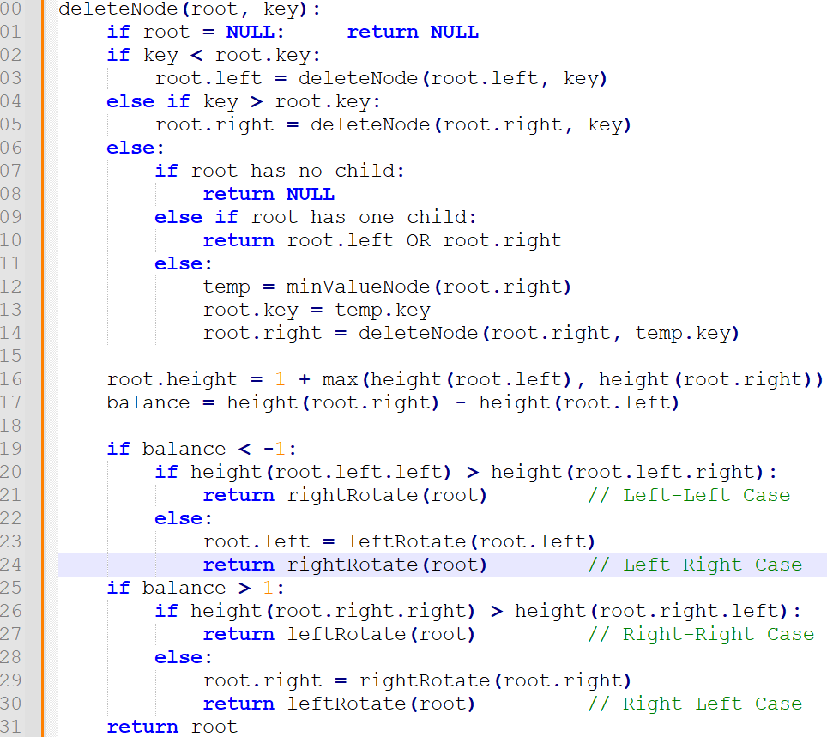
AVL Tree: Delete
Notes:
returns root of the modified subtree
delete root before return

Slide 24
Thank You

