Slide 1
Introduction to Algorithms
Levon Prazyan

Slide 2
Course Overview
Introduction
Sorting and Searching
Arrays and Lists
Stacks and Queues, Double Ended Queue
Heaps
Trees
Hash Tables
Dynamic Programming
Greedy Algorithms
Graph Algorithms
Network Flow
NP-Completeness

Slide 3
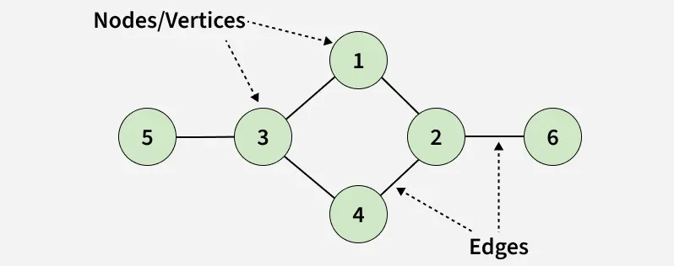
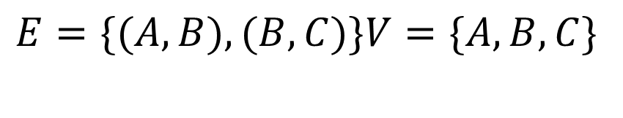
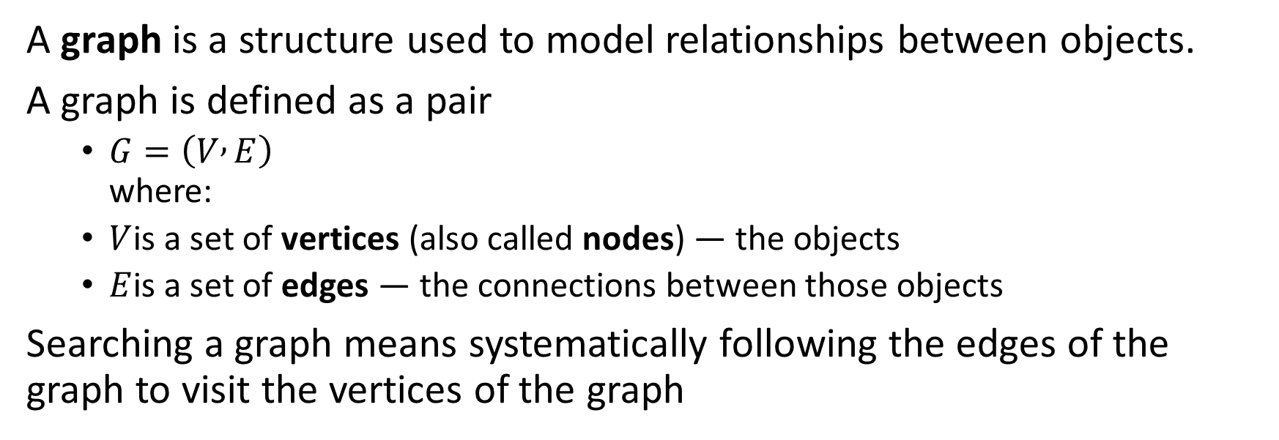
Graph: Definition
A graph is a structure used to model relationships between objects.
A graph is defined as a pair
$G=\left(V , E\right)$ where:
$V$is a set of vertices (also called nodes) — the objects
$E$is a set of edges — the connections between those objects
Searching a graph means systematically following the edges of the graph to visit the vertices of the graph
$$E=\{(A,B),(B,C)\}V=\{A,B,C\}$$

Slide 4
Type of Graphs
Undirected graph
Edges have no direction
Example: friendship (mutual)
Directed graph (digraph)
Edges have direction
Example: Twitter follows (A → B)
Weighted graph
Each edge has a weight (cost, distance, etc.)
Unweighted graph
All edges are equal

Slide 5
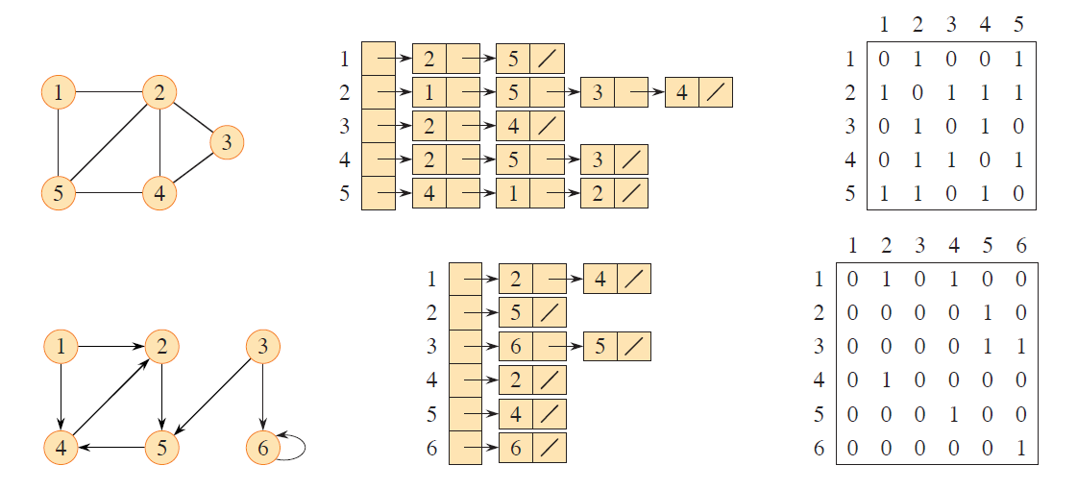
Representations of Graph (1)
Adjacency list
Adjacency matrix

Slide 6
Representations of Graph (2)
Choose adjacency list for sparse graphs.
less memory
Choose adjacency matrix for dense graphs
quick checks for edges

Slide 7
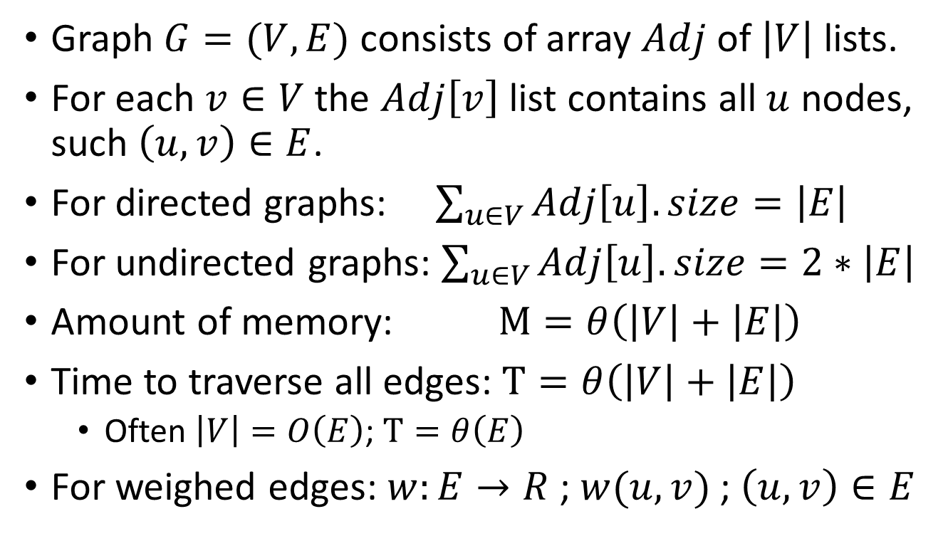
Adjacency List Representation
Graph $G=(V,E)$ consists of array $Adj$ of $\left|V\right|$ lists.
For each $v∈V$ the $Adj\left[v\right]$ list contains all $u$ nodes, such $\left(u,v\right)∈E$.
For directed graphs: $\sum_{u∈V}{Adj\left[u\right].size}=\left|E\right|$
For undirected graphs: $\sum_{u∈V}{Adj\left[u\right].size}=2∗\left|E\right|$
Amount of memory: $M=θ\left(\left|V\right|+\left|E\right|\right)$
Time to traverse all edges: $T=θ\left(\left|V\right|+\left|E\right|\right)$
Often $\left|V\right|=O\left(E\right)$; $T=θ\left(E\right)$
For weighed edges: $w:E→R$ ; $w(u,v)$ ; $\left(u,v\right)∈E$
Notes:
lets miss | | signs.

Slide 8
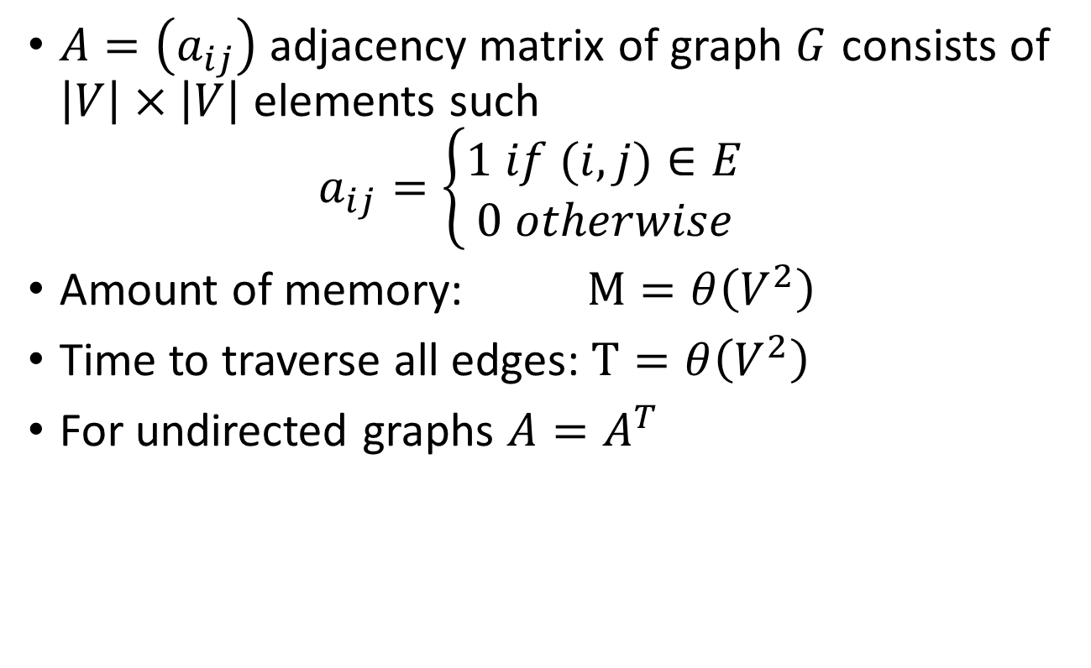
Adjacency Matrix Representation
$A=\left(a_{ij}\right)$ adjacency matrix of graph $G$ consists of $\left|V\right|×\left|V\right|$ elements such $a_{ij}=\left\{\begin{matrix}1 if (i,j)∈E \\ 0 otherwise\end{matrix}\right.$
Amount of memory: $M=θ\left(V^{2}\right)$
Time to traverse all edges: $T=θ\left(V^{2}\right)$
For undirected graphs $A=A^{T}$

Slide 9

Breadth-first Search (BFS)
Given a graph $G=(V,E)$ and a distinguished source vertex $s$. Breadth-first search systematically explores the edges of $G$ to “discover” every vertex that is reachable from $s$.
BFS computes the distance from $s$ to each reachable vertex.
The distance to a vertex $v$ equals the smallest number of edges needed to go from $s$ to $v$.
Notes:
archetype for Prim’s and Dijkstra’s algorithms

Slide 10
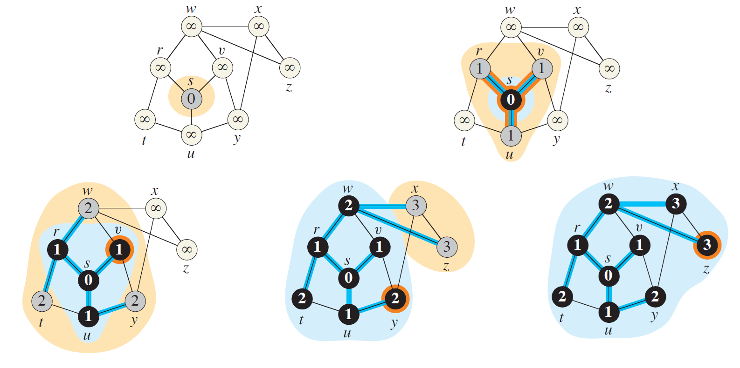
BFS Steps

Slide 11
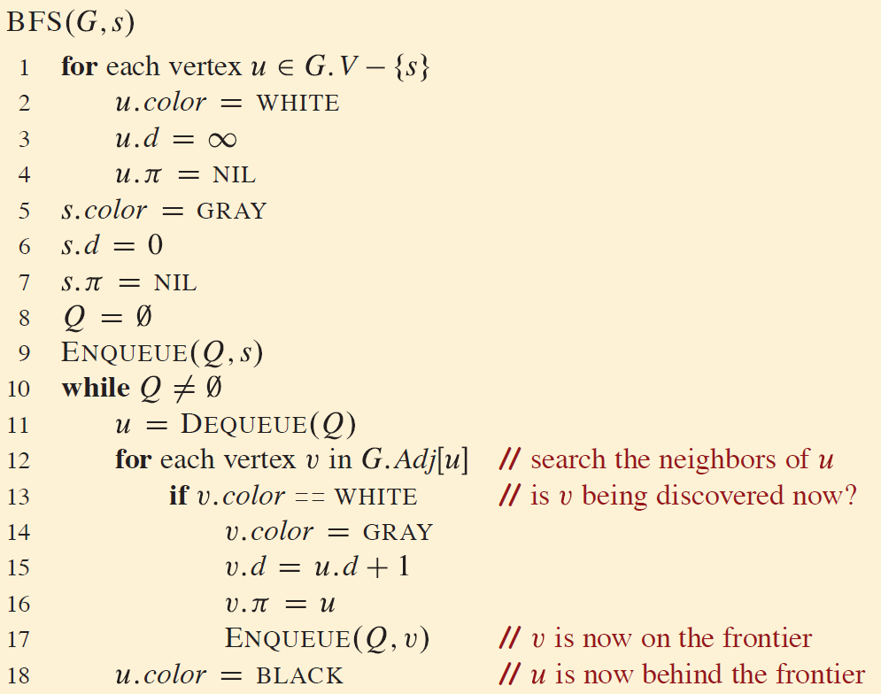
BFS Pseudocode

Slide 12
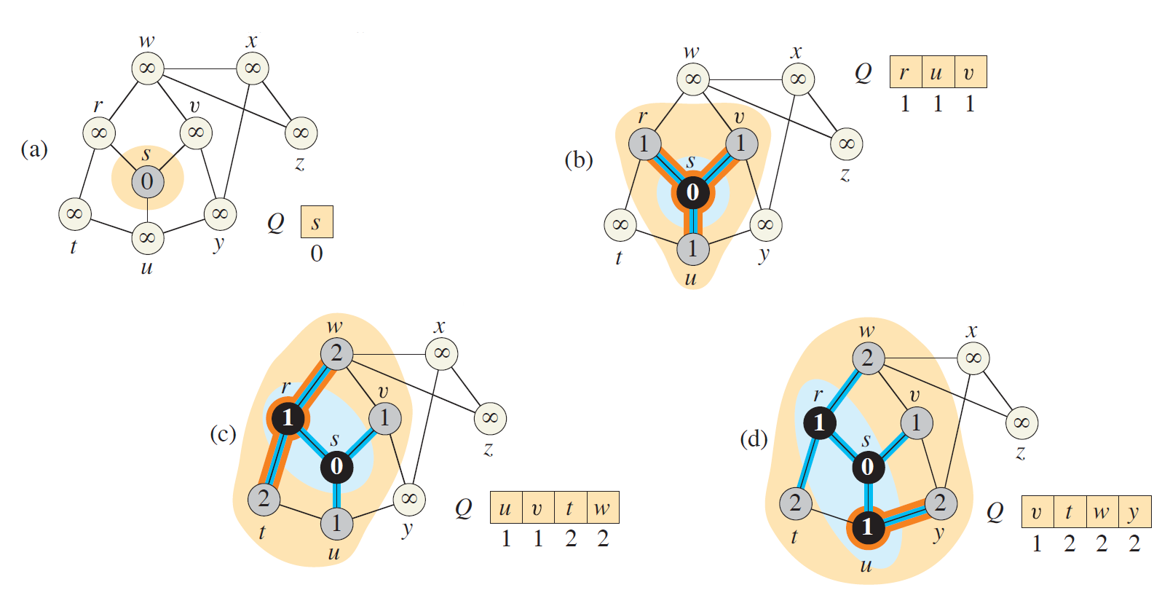
BFS Example (1)

Slide 13
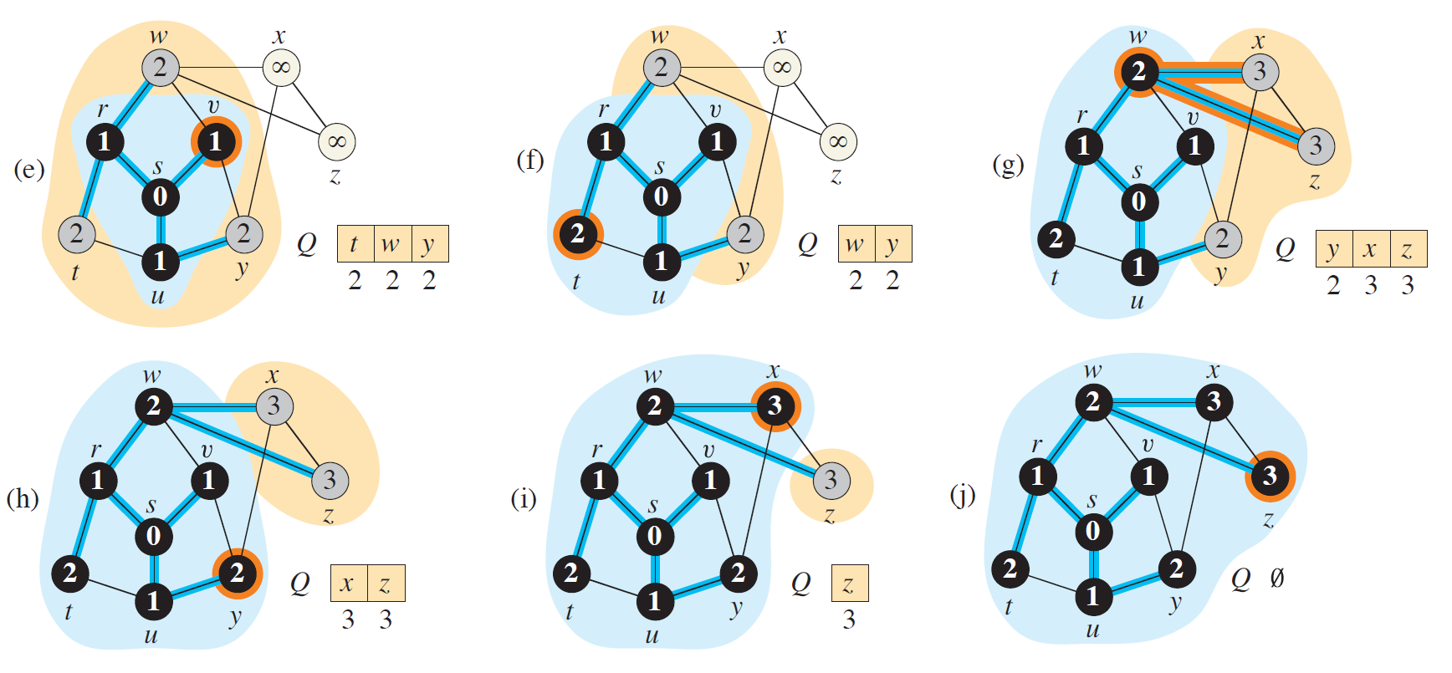
BFS Example (2)

Slide 14

BFS Analysis
$Q$ is a Queue data structure
$Enqueue$ takes $O(1)$ time
$Dequeue$ takes $O(1)$ time
All queue operations time $O(n)$
An adjacency list is scanned when appropriate vertex is removed from $Q$.
Each edge is scanned only once.
Sum of lengths of all $\left|V\right|$ lists is $θ\left(E\right)$
Total time $O\left(V+E\right)$

Slide 15
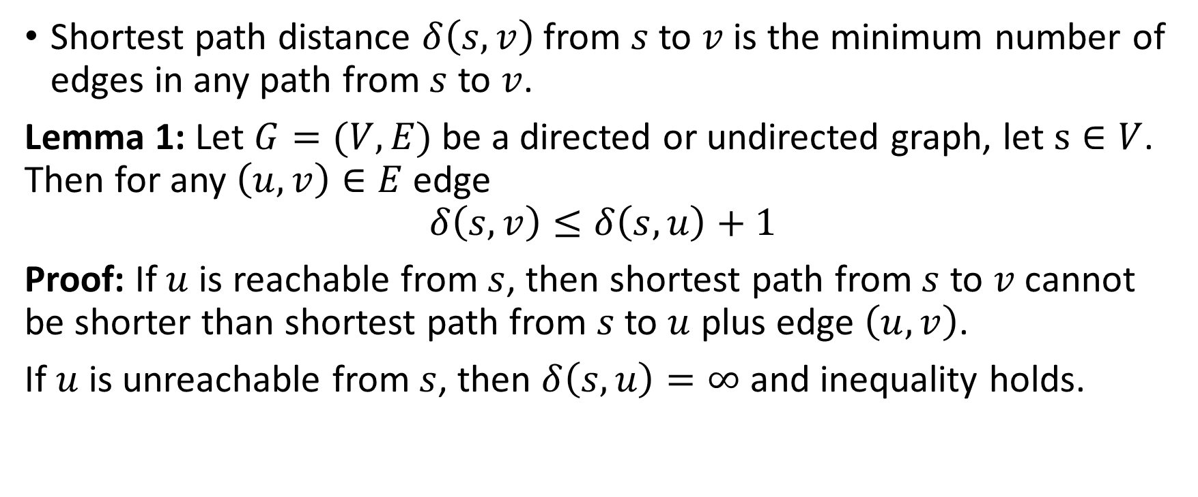
BFS: Shortest Path (1)
Shortest path distance $δ\left(s,v\right)$ from $s$ to $v$ is the minimum number of edges in any path from $s$ to $v$.
Lemma 1: Let $G=(V,E)$ be a directed or undirected graph, let $s∈V$. Then for any $\left(u,v\right)∈E$ edge
$$δ\left(s,v\right)≤δ\left(s,u\right)+1$$
Proof: If $u$ is reachable from $s$, then shortest path from $s$ to $v$ cannot be shorter than shortest path from $s$ to $u$ plus edge $\left(u,v\right)$.
If $u$ is unreachable from $s$, then $δ\left(s,u\right)=∞$ and inequality holds.
Notes:
$δ\left(s,v\right)=inf$ if there is no path from s to v

Slide 16
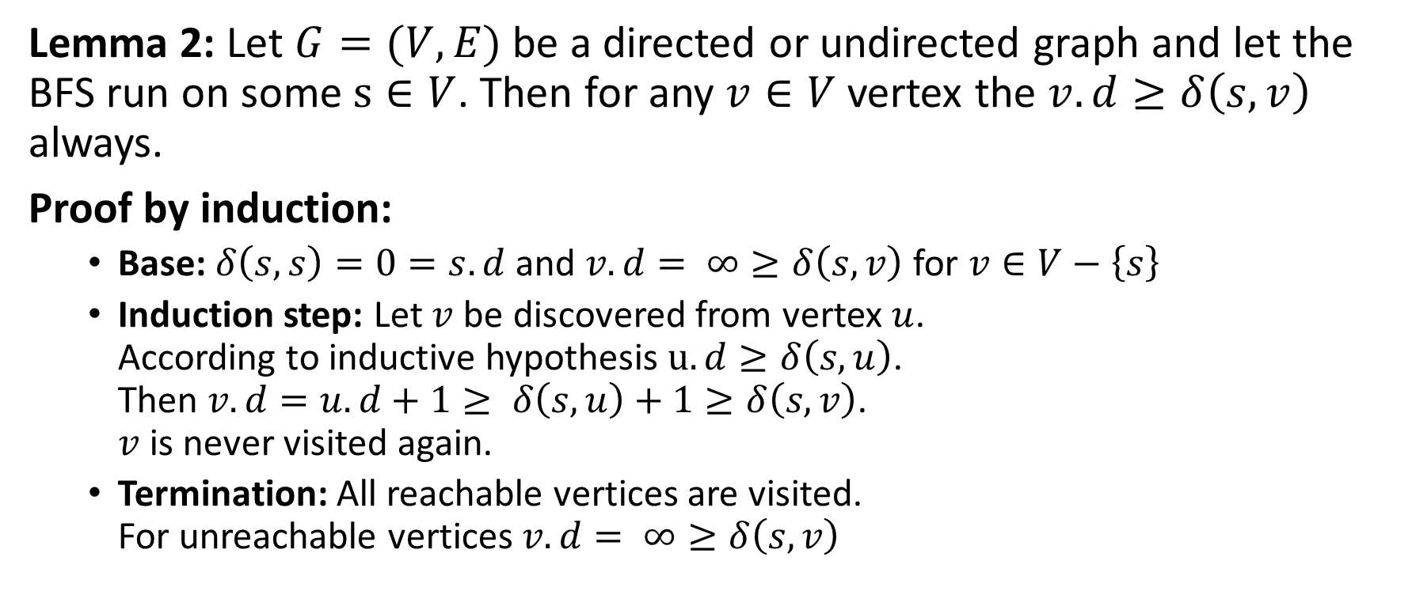
BFS: Shortest Path (2)
Lemma 2: Let $G=(V,E)$ be a directed or undirected graph and let the BFS run on some $s∈V$. Then for any $v∈V$ vertex the $v.d≥δ\left(s,v\right)$ always.
Proof by induction:
Base: $δ\left(s,s\right)=0=s.d$ and $v.d= ∞≥δ\left(s,v\right)$ for $v∈V−\left\{s\right\}$
Induction step: Let $v$ be discovered from vertex $u$. According to inductive hypothesis $u.d≥δ\left(s,u\right)$. Then $v.d=u.d+1≥ δ\left(s,u\right)+1≥δ\left(s,v\right)$. $v$ is never visited again.
Termination: All reachable vertices are visited. For unreachable vertices $v.d= ∞≥δ\left(s,v\right)$
Notes:
$δ\left(s,v\right)=inf$ if there is no path from s to v

Slide 17
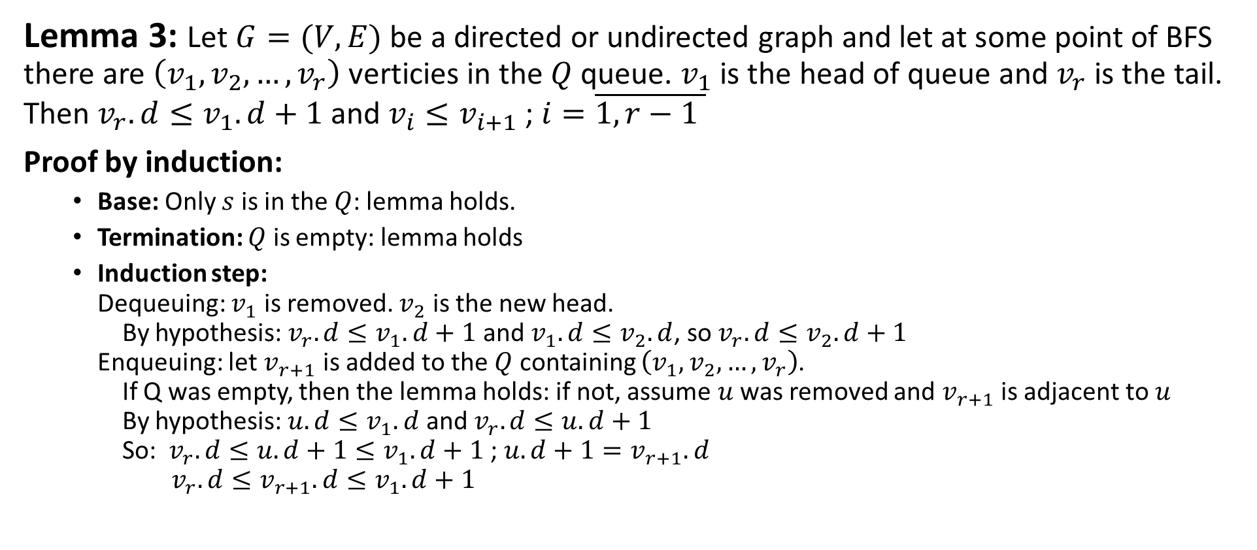
BFS: Shortest Path (3)
Lemma 3: Let $G=(V,E)$ be a directed or undirected graph and let at some point of BFS there are $\left(v_{1},v_{2},…,v_{r}\right)$ verticies in the $Q$ queue. $v_{1}$ is the head of queue and $v_{r}$ is the tail. Then $v_{r}.d≤v_{1}.d+1$ and $v_{i}≤v_{i+1}$ ; $i=\overline{1, r−1 }$
Proof by induction:
Base: Only $s$ is in the $Q$: lemma holds.
Termination: $Q$ is empty: lemma holds
Induction step: Dequeuing: $v_{1}$ is removed. $v_{2}$ is the new head. By hypothesis: $v_{r}.d≤v_{1}.d+1$ and $v_{1}.d≤v_{2}.d$, so $v_{r}.d≤v_{2}.d+1$ Enqueuing: let $v_{r+1}$ is added to the $Q$ containing $\left(v_{1},v_{2},…,v_{r}\right)$. If Q was empty, then the lemma holds: if not, assume $u$ was removed and $v_{r+1}$ is adjacent to $u$ By hypothesis: $u.d≤v_{1}.d$ and $v_{r}.d≤u.d+1$ So: $v_{r}.d≤u.d+1≤v_{1}.d+1$ ; $u.d+1=v_{r+1}.d$ $v_{r}.d≤v_{r+1}.d≤v_{1}.d+1$

Slide 18
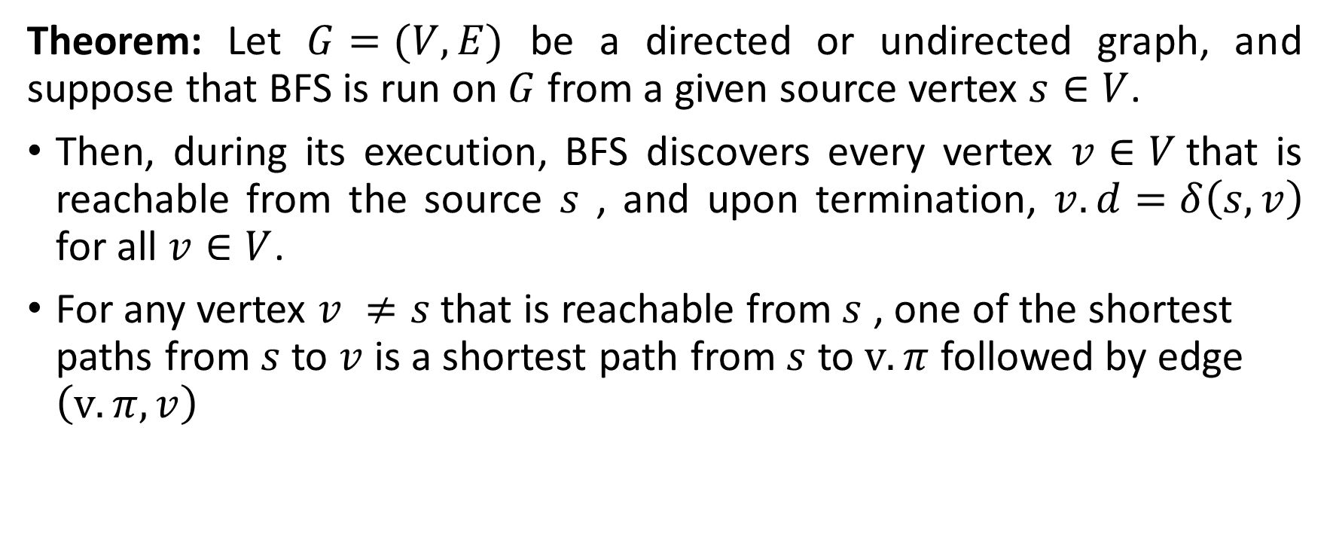
BFS: Correctness (1).
Theorem: Let $G=(V,E)$ be a directed or undirected graph, and suppose that BFS is run on $G$ from a given source vertex $s∈V$.
Then, during its execution, BFS discovers every vertex $v∈V$that is reachable from the source $s$ , and upon termination, $v.d=δ\left(s,v\right)$ for all $v∈V$.
For any vertex $v ≠s$that is reachable from $s$ , one of the shortest paths from $s$ to $v$ is a shortest path from $s$ to $v.π$ followed by edge $\left(v.π, v\right)$

Slide 19
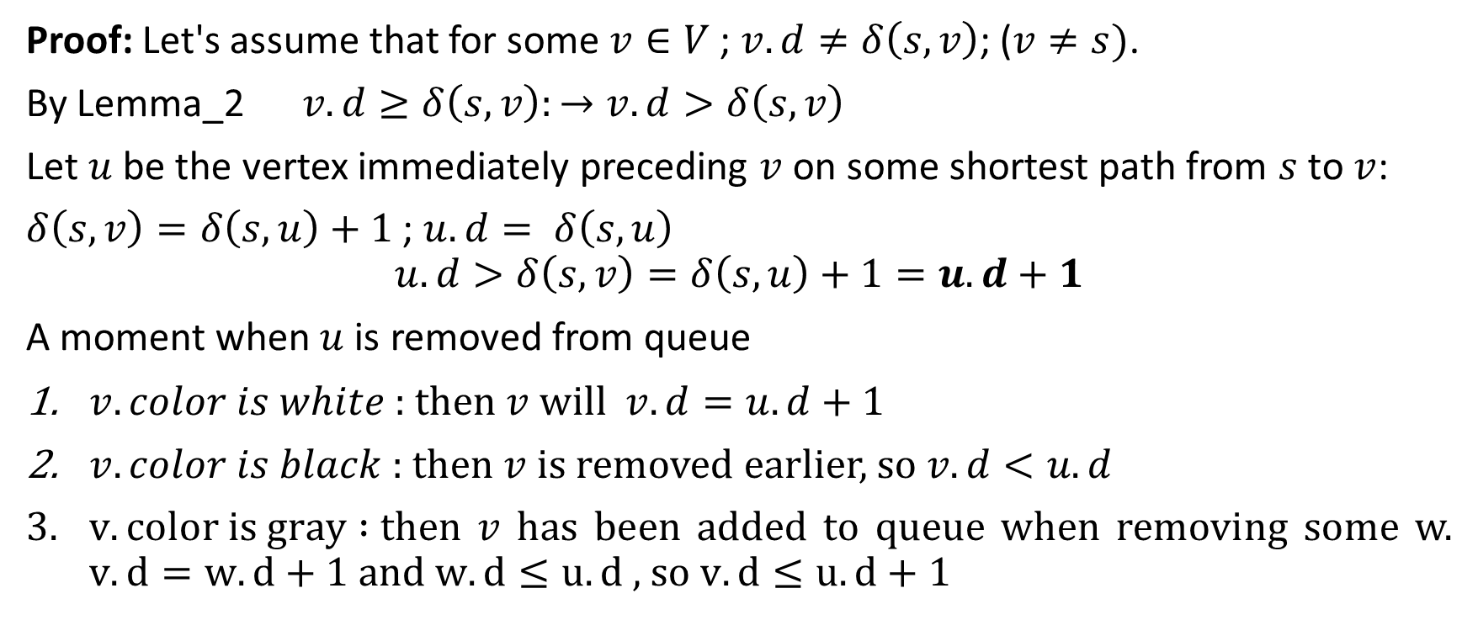
BFS: Correctness (2).
Proof: Let's assume that for some $v∈V$ ; $v.d≠δ\left(s,v\right)$; ($v≠s)$.
By Lemma_2 $v.d≥δ\left(s,v\right):→v.d>δ\left(s,v\right)$
Let $u$ be the vertex immediately preceding $v$ on some shortest path from $s$ to $v$:
$δ\left(s,v\right)=δ\left(s,u\right)+1$ ; $u.d= δ\left(s,u\right)$
$$u.d>δ\left(s,v\right)=δ\left(s,u\right)+1=u.d+1$$
A moment when $u$ is removed from queue
$v.color is white$ : then $v$ will $v.d=u.d+1$
$v.color is black$ : then $v$ is removed earlier, so $v.d<u.d$
$v.color is gray :$then $v$ has been added to queue when removing some w. $v.d=w.d+1$ and $w.d≤u.d$ , so $v.d≤u.d+1$

Slide 20

Depth-first Search (DFS)
Given a graph $G=(V,E)$ and a distinguished source vertex $s$. Depth-first search explores edges out of the most recently discovered vertex $v$ that still has unexplored edges leaving it. Once all of $v$’s edges have been explored, the search “backtracks” to explore edges leaving the vertex from which $v$ was discovered.

Slide 21
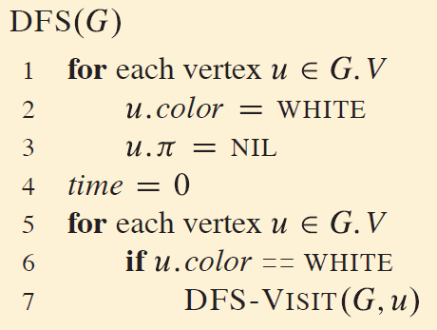
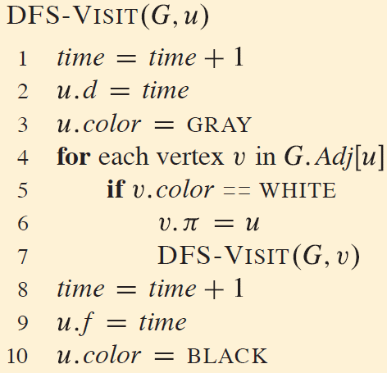
DFS Pseudocode

Slide 22
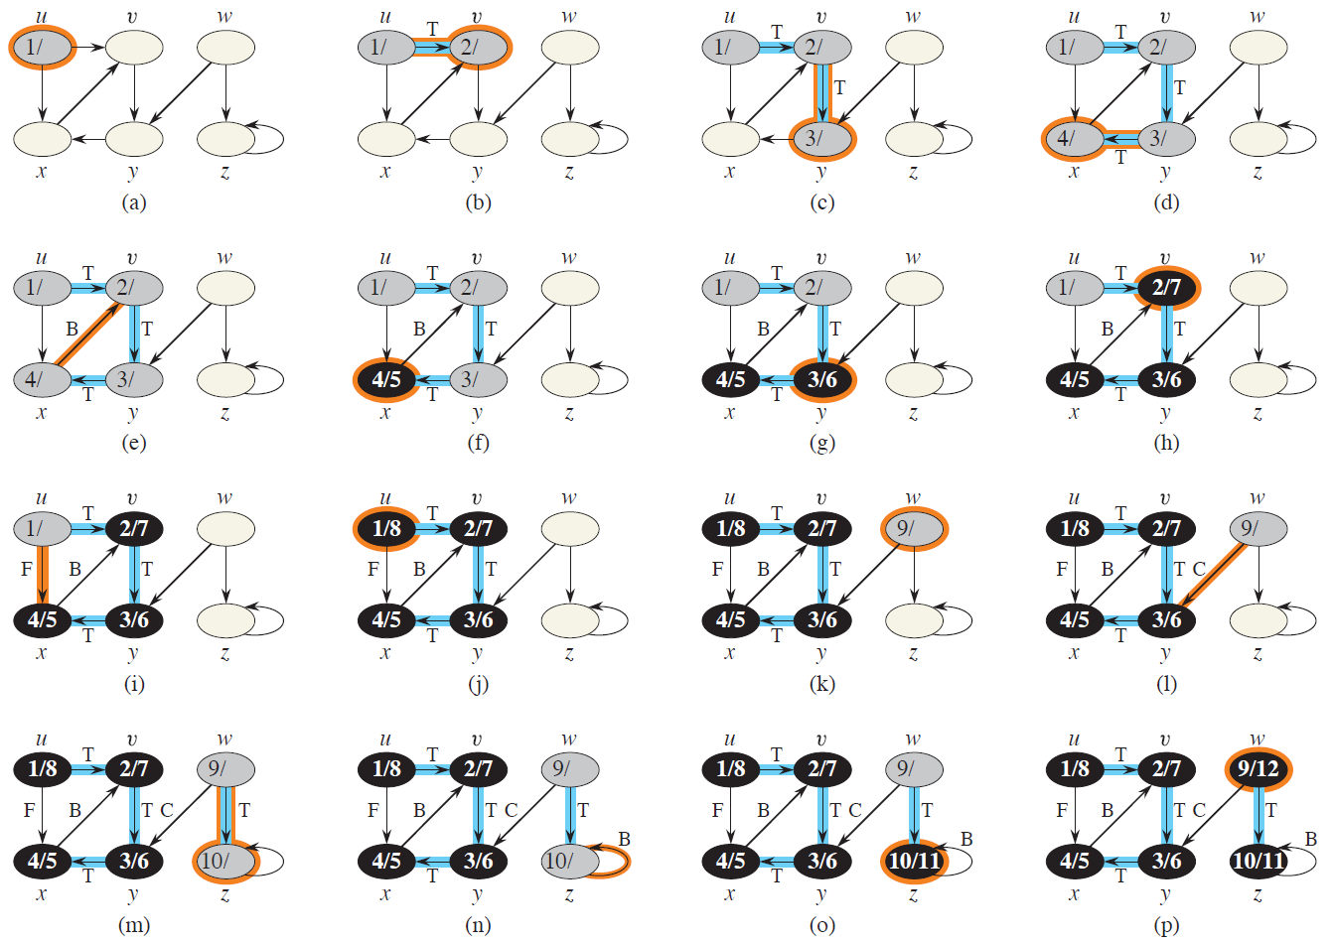
DFS Example (1)

Slide 23
DFS Example

Slide 24
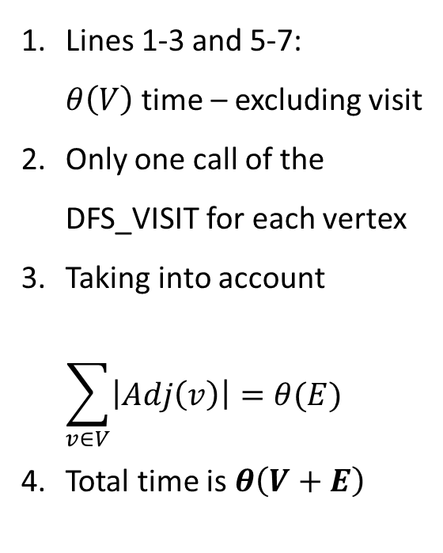
DFS Analysis
Lines 1-3 and 5-7: $θ\left(V\right)$ time – excluding visit
Only one call of the DFS_VISIT for each vertex
Taking into account $\sum_{v∈V}{\left|Adj\left(v\right)\right|}=θ(E)$
Total time is $θ\left(V+E\right)$

Slide 25
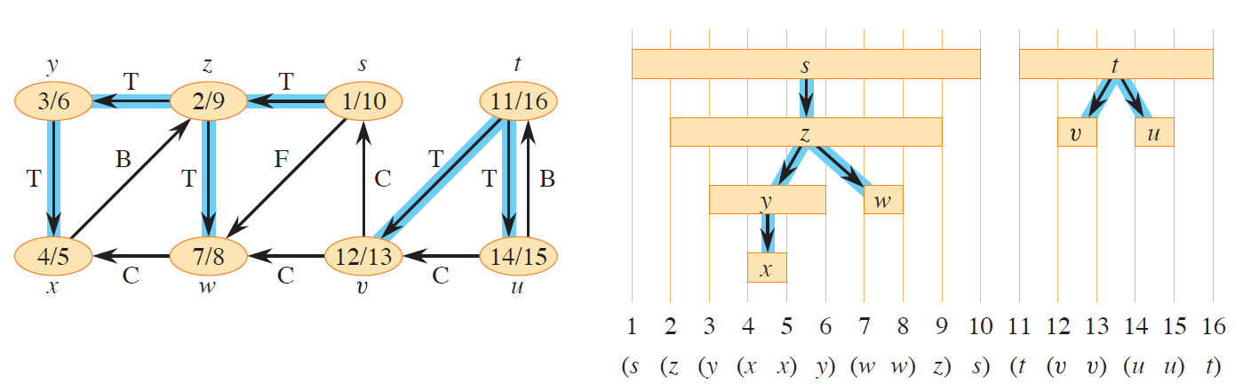
DFS: Predecessor Subgraph
$G_{π}=G(V,E_{π})$ ; $E_{π}=\left\{\left(v.π, v\right) :v∈V and v.π≠NULL\right\}$

Slide 26
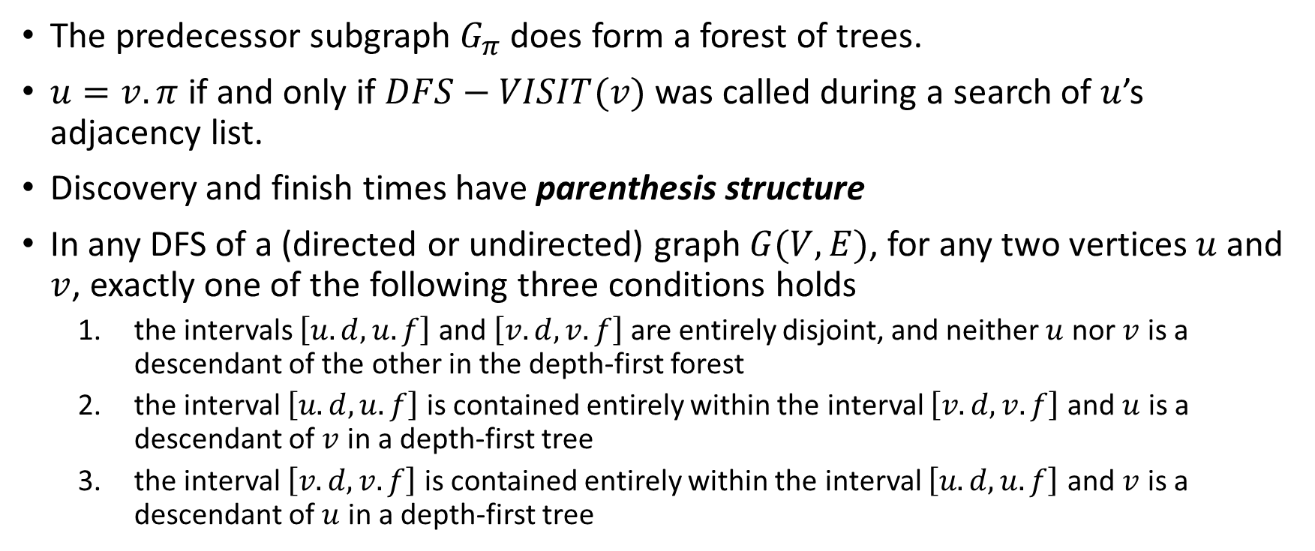
DFS Properties (1)
The predecessor subgraph $G_{π}$ does form a forest of trees.
$u=v.π$ if and only if $DFS−VISIT(v)$ was called during a search of $u$’s adjacency list.
Discovery and finish times have parenthesis structure
In any DFS of a (directed or undirected) graph $G(V,E)$, for any two vertices $u$ and $v$, exactly one of the following three conditions holds
the intervals $\left[u.d, u.f\right]$ and $\left[v.d, v.f\right]$ are entirely disjoint, and neither $u$ nor $v$ is a descendant of the other in the depth-first forest
the interval $\left[u.d, u.f\right]$ is contained entirely within the interval $\left[v.d, v.f\right]$ and $u$ is a descendant of $v$ in a depth-first tree
the interval $\left[v.d, v.f\right]$ is contained entirely within the interval $\left[u.d, u.f\right]$ and $v$ is a descendant of $u$ in a depth-first tree

Slide 27
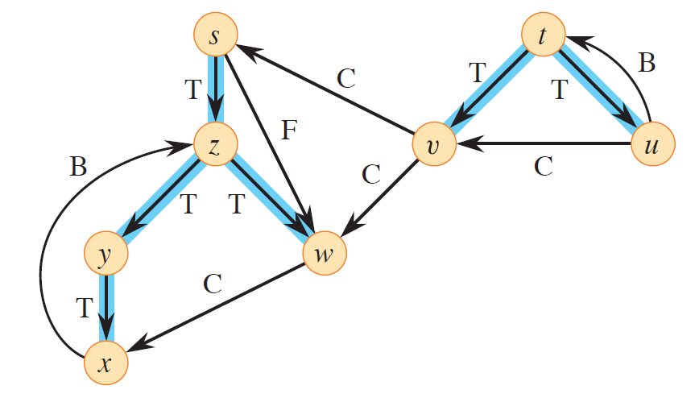
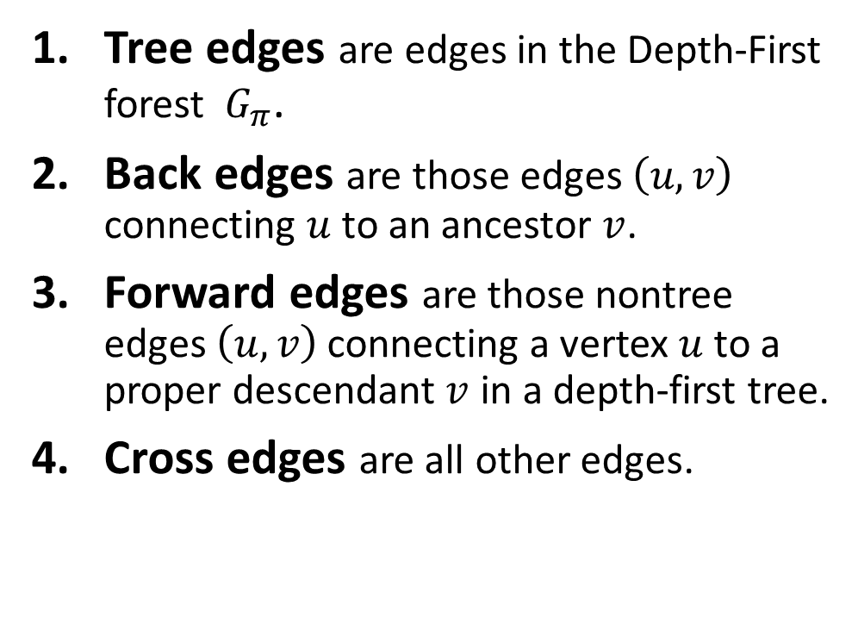
DFS: Classification of Edges
Tree edges are edges in the Depth-First forest $G_{π}$.
Back edges are those edges $\left(u, v\right)$ connecting $u$ to an ancestor $v$.
Forward edges are those nontree edges $\left(u, v\right)$ connecting a vertex $u$ to a proper descendant $v$ in a depth-first tree.
Cross edges are all other edges.

Slide 28
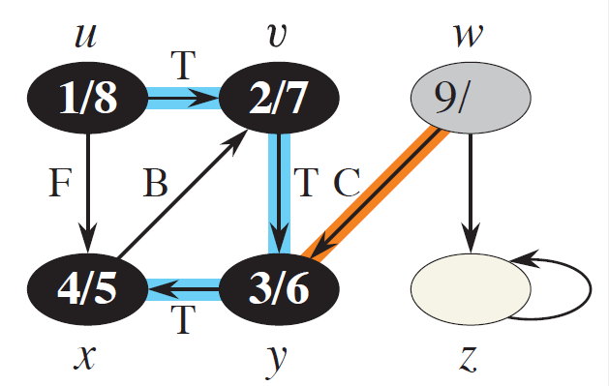
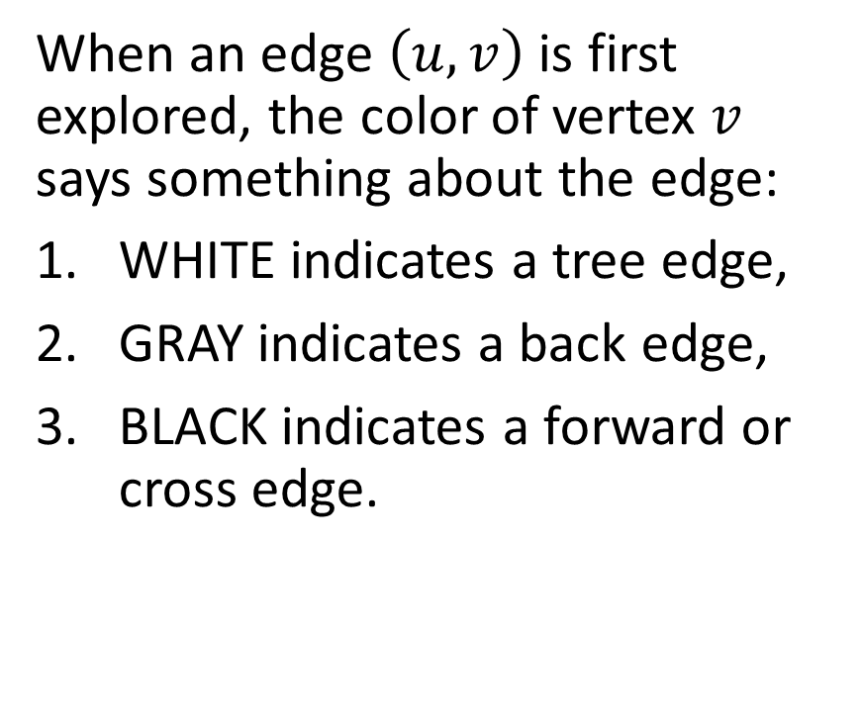
DFS: Discovering Edges
When an edge $\left(u, v\right)$ is first explored, the color of vertex $v$ says something about the edge:
WHITE indicates a tree edge,
GRAY indicates a back edge,
BLACK indicates a forward or cross edge.

Slide 29
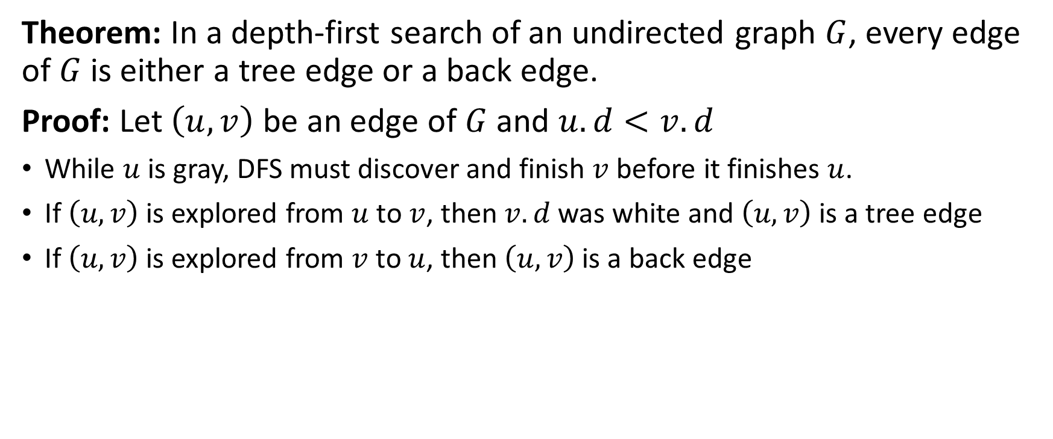
DFS: Edge Classification for Undirected Graph
Theorem: In a depth-first search of an undirected graph $G$, every edge of $G$ is either a tree edge or a back edge.
Proof: Let $\left(u, v\right)$ be an edge of $G$ and $u.d<v.d$
While $u$ is gray, DFS must discover and finish $v$ before it finishes $u$.
If $\left(u, v\right)$ is explored from $u$ to $v$, then $v.d$ was white and $\left(u, v\right)$ is a tree edge
If $\left(u, v\right)$ is explored from $v$ to $u$, then $\left(u, v\right)$ is a back edge

Slide 30

Topological Sort
Topological sort of a directed acyclic graph (dag) $G=(V,E)$ is a linear ordering of all its vertices such that if $G$ contains an edge $\left(u, v\right)$ then $u$ appears before $v$ in the ordering.
Notes:
Topological sorting is defined only on directed graphs that are acyclic;
no linear ordering is possible when a directed graph contains a cycle
Think of a topological sort of a graph as an ordering of its vertices along a horizontal line so that all directed edges go from
left to right.

Slide 31
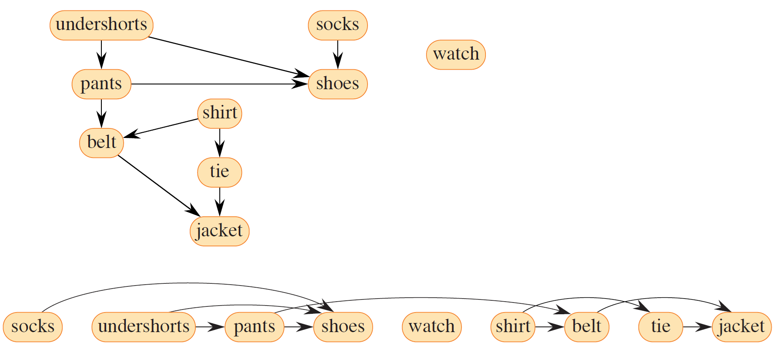
Topological Sort: Example 1

Slide 32
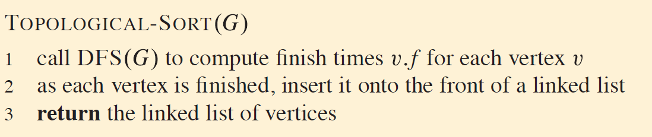
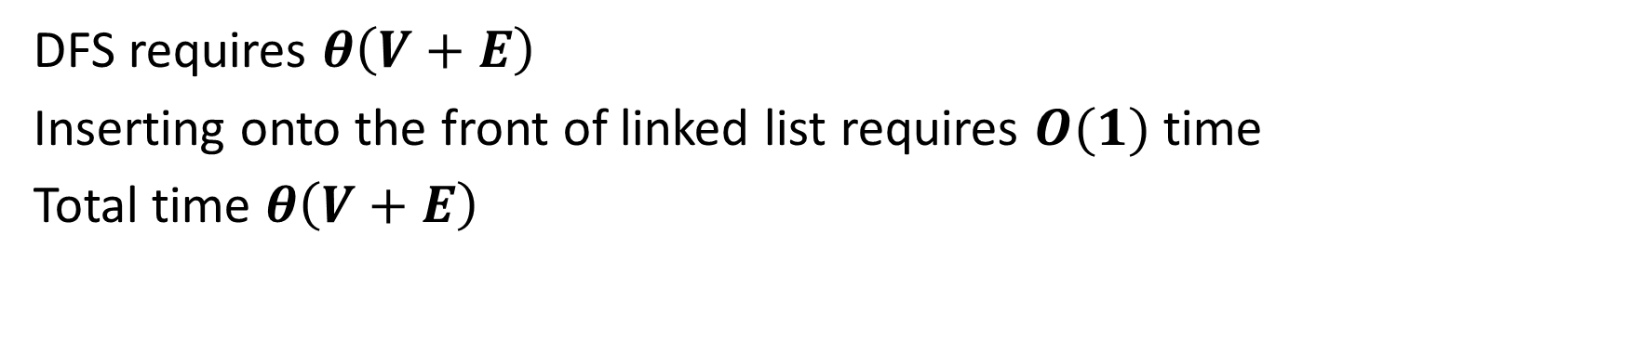
Topological Sort: Pseudocode and Analysis
DFS requires $θ\left(V+E\right)$
Inserting onto the front of linked list requires $O(1)$ time
Total time $θ\left(V+E\right)$

Slide 33
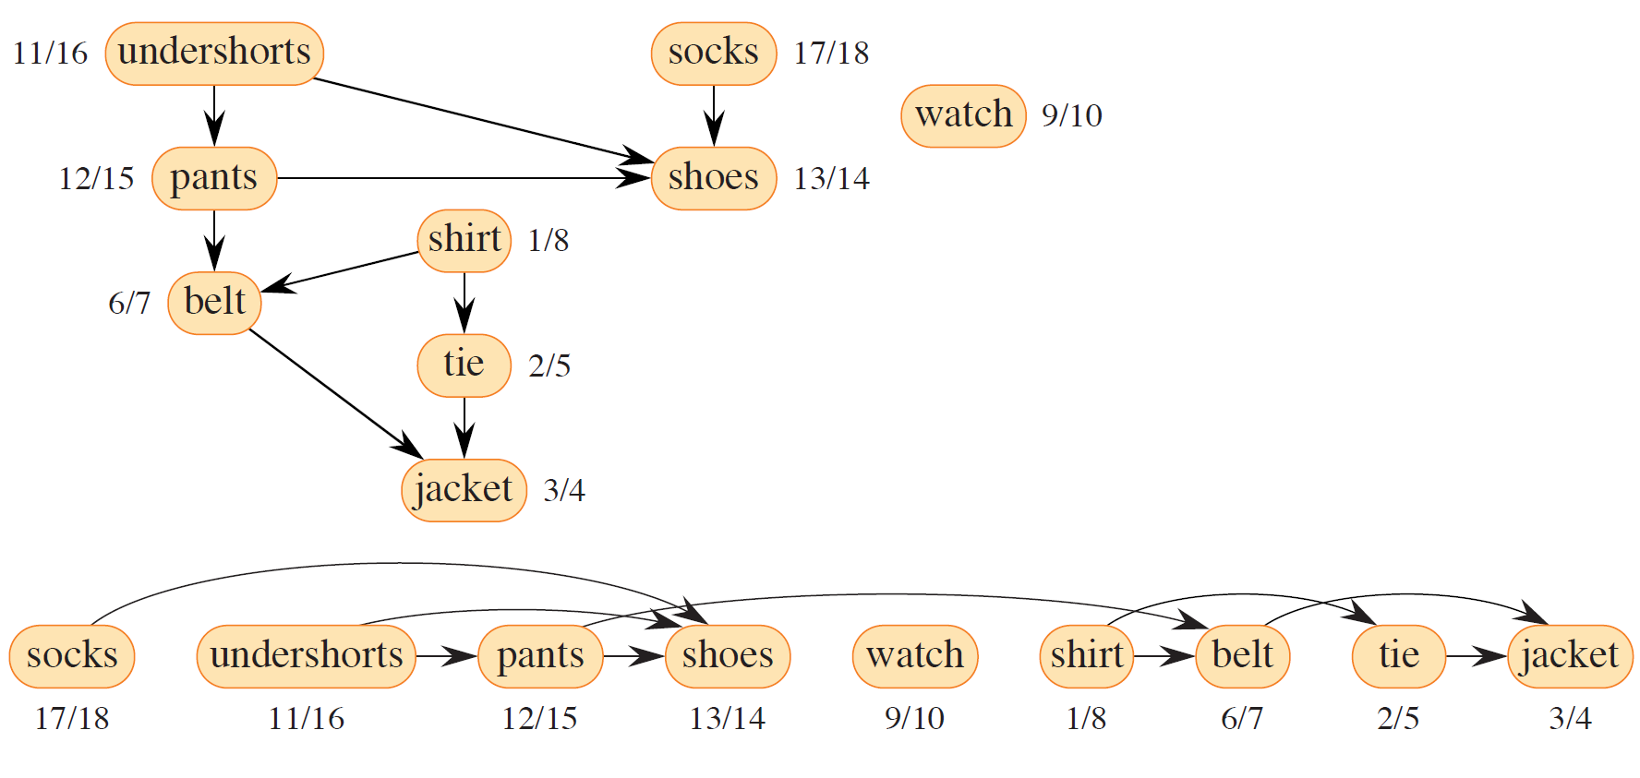
Topological Sort: Example 2

Slide 34
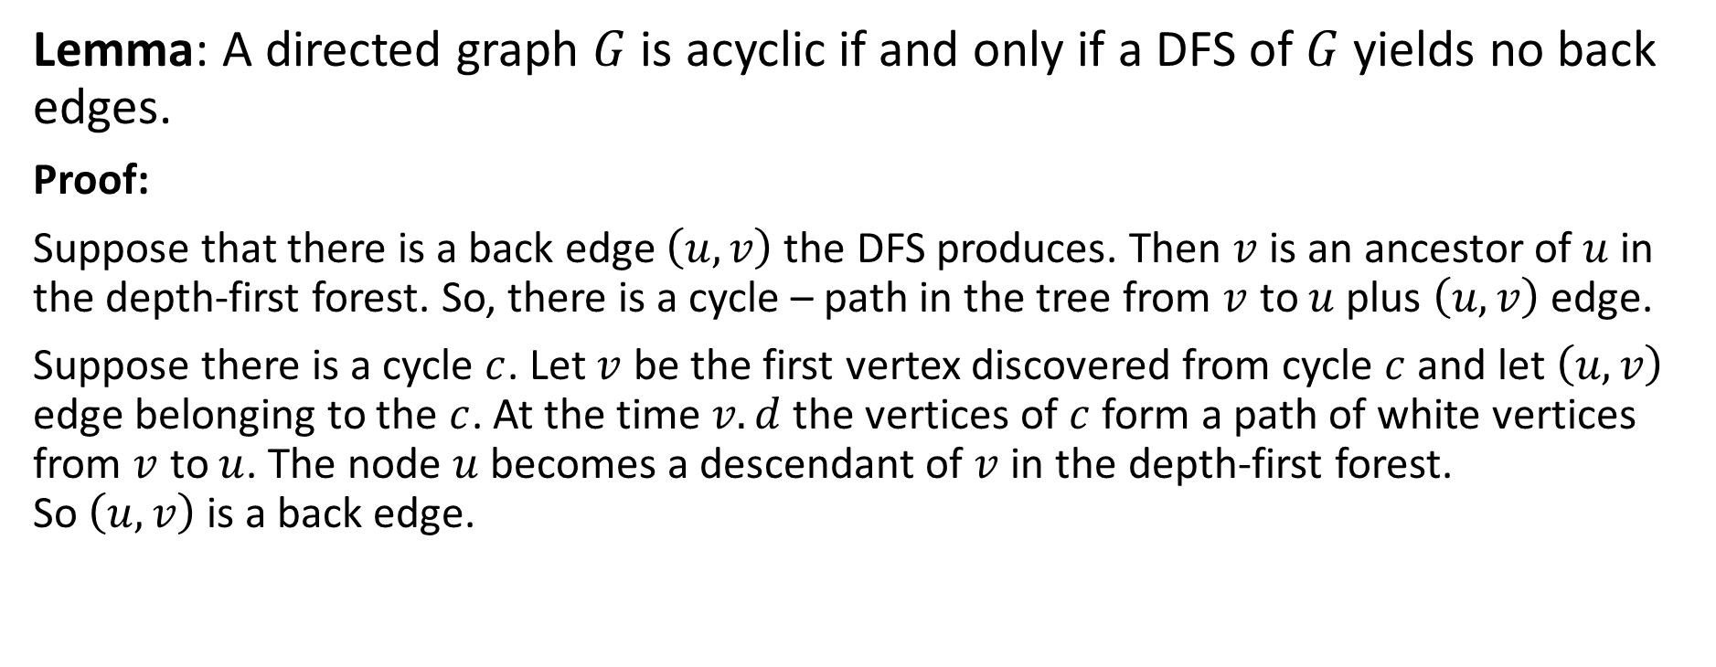
Topological Sort: Correctness (1)
Lemma: A directed graph $G$ is acyclic if and only if a DFS of $G$ yields no back edges.
Proof:
Suppose that there is a back edge $\left(u, v\right)$ the DFS produces. Then $v$ is an ancestor of $u$ in the depth-first forest. So, there is a cycle – path in the tree from $v$ to $u$ plus $\left(u, v\right)$ edge.
Suppose there is a cycle $c$. Let $v$ be the first vertex discovered from cycle $c$ and let $\left(u, v\right)$ edge belonging to the $c$. At the time $v.d$ the vertices of $c$ form a path of white vertices from $v$ to $u$. The node $u$ becomes a descendant of $v$ in the depth-first forest. So $\left(u, v\right)$ is a back edge.

Slide 35
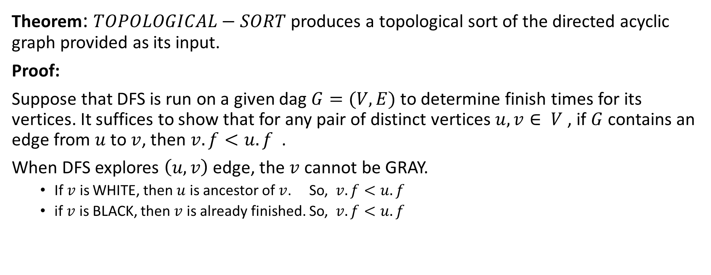
Topological Sort: Correctness (2)
Theorem: $TOPOLOGICAL−SORT$ produces a topological sort of the directed acyclic graph provided as its input.
Proof:
Suppose that DFS is run on a given dag $G=(V,E)$ to determine finish times for its vertices. It suffices to show that for any pair of distinct vertices $u, v∈ V$, if $G$ contains an edge from $u$ to $v$, then $v.f<u.f$ .
When DFS explores $\left(u, v\right)$ edge, the $v$ cannot be GRAY.
If $v$ is WHITE, then $u$ is ancestor of $v$. So, $v.f<u.f$
if $v$ is BLACK, then $v$ is already finished. So, $v.f<u.f$

Slide 36

Strongly Connected Components
Strongly connected component of a directed graph $G=(V,E)$ is a maximal set of vertices $C⊆V$ such that for every pair of vertices $u, v∈C$, both $u→v$ and $v→u$, that is, vertices $u$ and $v$ are reachable from each other.

Slide 37
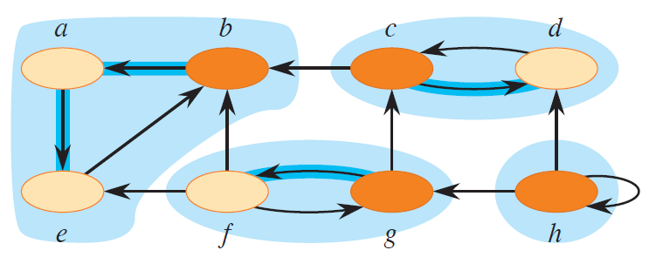
Strongly Connected Components (SCC)

Slide 38
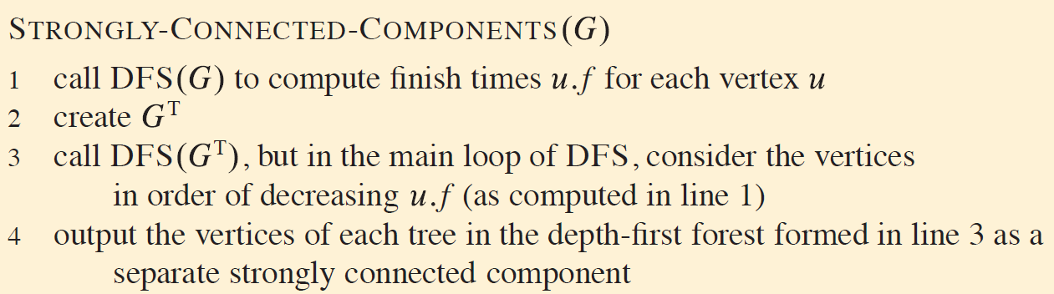
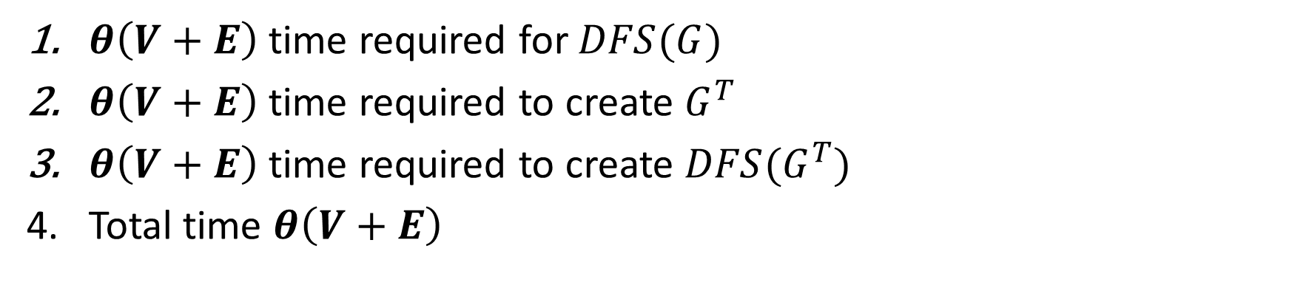
SCC: Pseudocode and Analysis
$θ\left(V+E\right)$ time required for $DFS(G)$
$θ\left(V+E\right)$ time required to create $G^{T}$
$θ\left(V+E\right)$ time required to create ${DFS(G}^{T})$
Total time $θ\left(V+E\right)$

Slide 39
Thank You

