Slide 1
Introduction to Algorithms
Levon Prazyan

Slide 2
Course Overview
Introduction
Sorting and Searching
Arrays and Lists
Stacks and Queues, Double Ended Queue
Heaps
Trees
Hash Tables
Dynamic Programming
Greedy Algorithms
Graph Algorithms
Network Flow
NP-Completeness

Slide 3
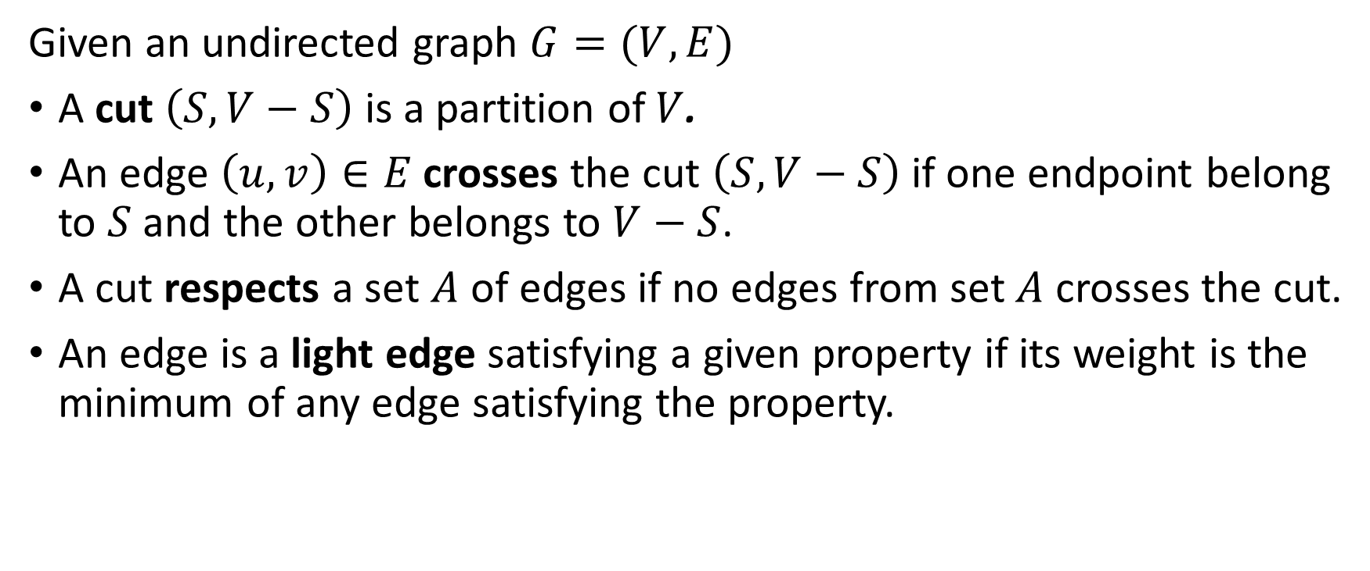
Definitions
Given an undirected graph $G=(V,E)$
A cut $\left(S, V−S\right)$ is a partition of $V$.
An edge $\left(u, v\right)∈E$ crosses the cut $\left(S, V−S\right)$ if one endpoint belong to $S$ and the other belongs to $V−S$.
A cut respects a set $A$ of edges if no edges from set $A$ crosses the cut.
An edge is a light edge satisfying a given property if its weight is the minimum of any edge satisfying the property.

Slide 4
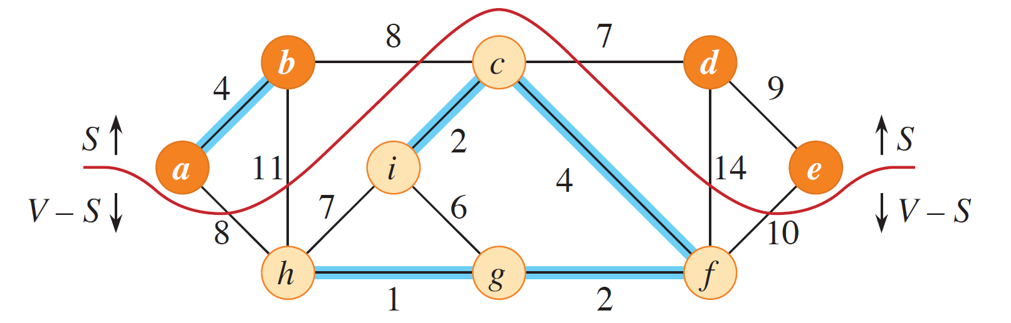
Example

Slide 5

Minimum Spanning Tree (MST)
Given a connected and undirected graph $G=(V,E)$ and for any $\left(u, v\right)∈E$ a weight $w$ specifies a cost to connect $u$ to $v$. The goal is to find an acyclic subset $T⊆E$ that connects all vertices and whose total weigh is minimized.
$$w\left(T\right)=\sum_{\left(u, v\right)∈T}{w(u,v)}$$

Slide 6
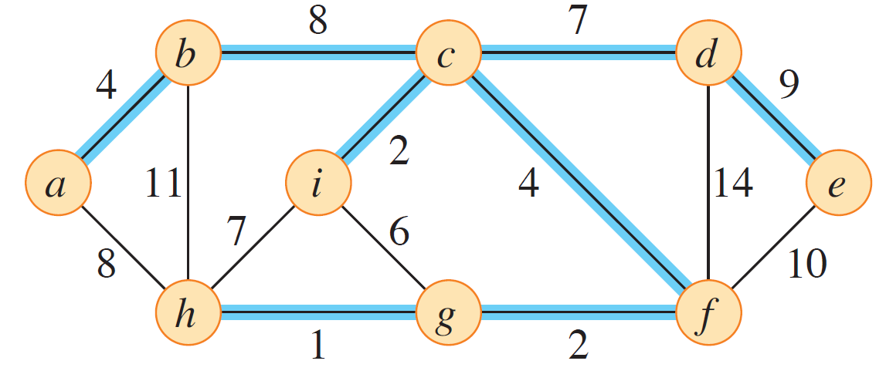
Minimum Spanning Tree Example

Slide 7
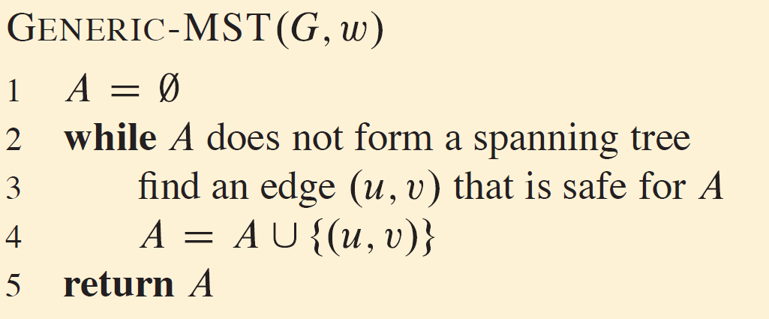
Growing an MST
Notes:
Prior to each iteration, A is a subset of some minimum spanning tree
Each step determines an edge (u,v) that the procedure can add to A without violating this invariant, in the sense that A+(u,v) is also a subset of a minimum spanning tree.
We call such an edge a safe edge for A, since it can be added safely to A while maintaining the invariant.

Slide 8
Growing an MST: Proof
Prior to each iteration, A is a subset of some minimum spanning tree
Initialization: After line 1, the set A trivially satisfies the loop invariant.
Maintenance: The loop in lines 2, 3, 4 maintains the invariant by adding only safe edges.
Termination: All edges added to A belong to a minimum spanning tree, and the loop must terminate by the time it has considered all edges. Therefore, the set A returned in line 5 must be a minimum spanning tree.

Slide 9
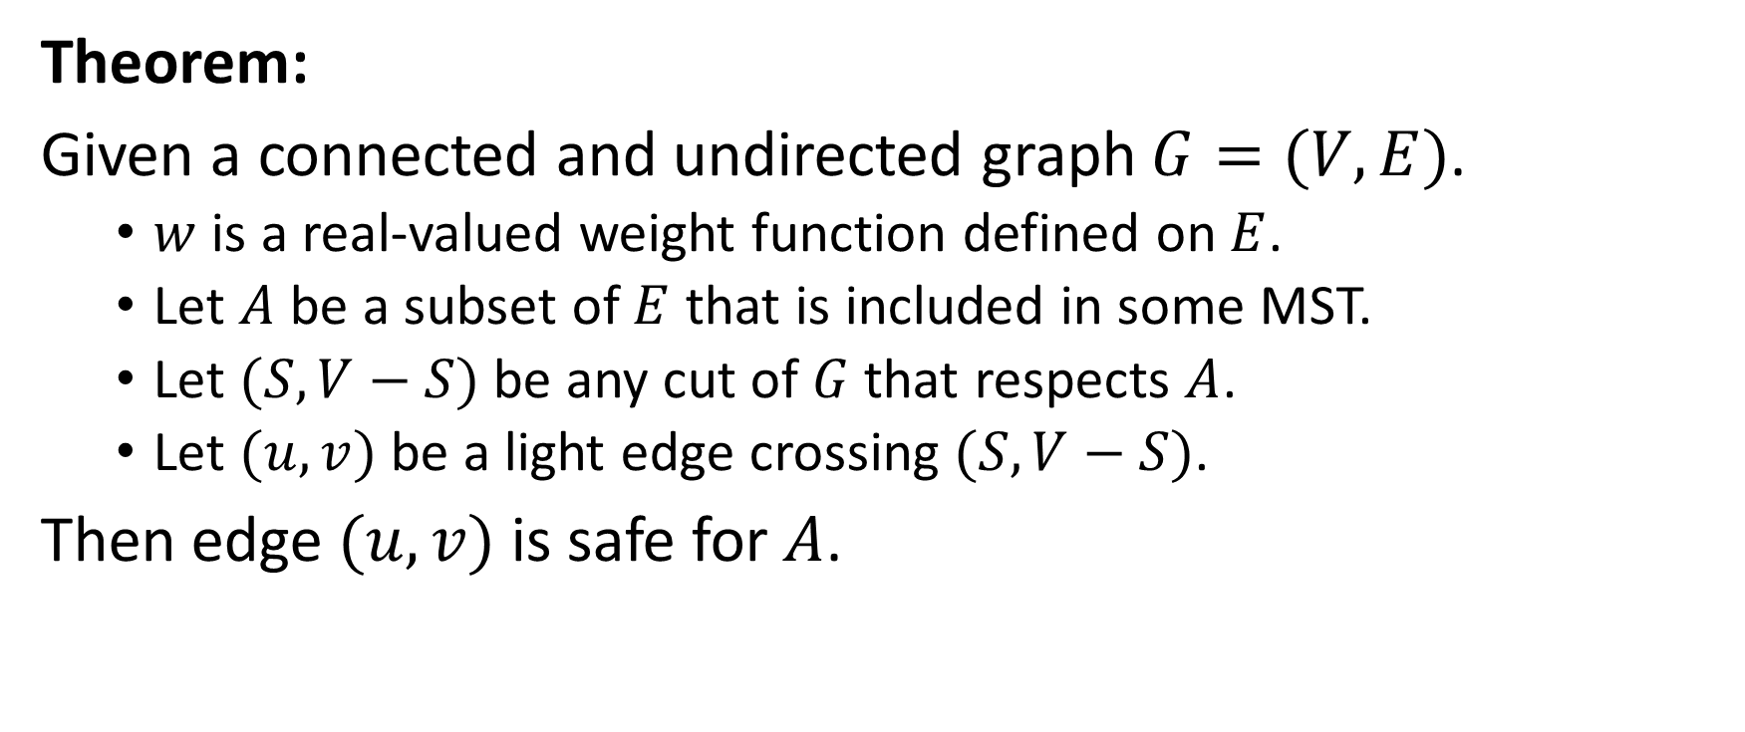
Growing an MST: Safe Edges Theorem
Theorem:
Given a connected and undirected graph $G=(V,E)$.
$w$ is a real-valued weight function defined on $E$.
Let $A$ be a subset of $E$ that is included in some MST.
Let $(S, V−S)$ be any cut of $G$ that respects $A$.
Let $(u,v)$ be a light edge crossing $(S, V−S)$.
Then edge $(u,v)$ is safe for $A$.

Slide 10
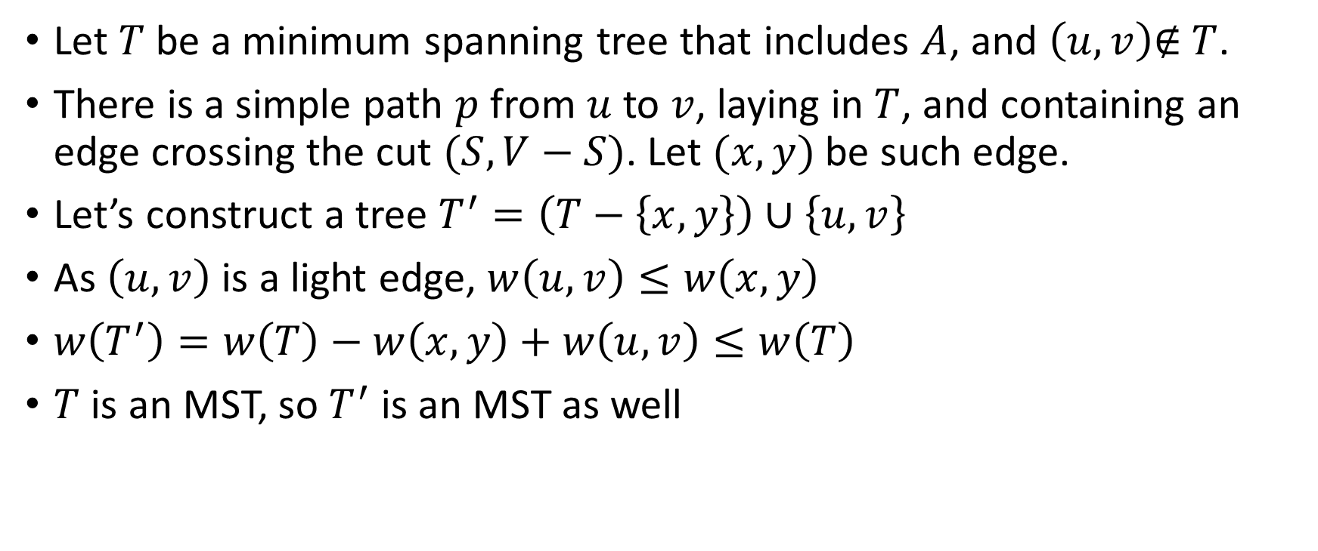
Growing an MST: Safe Edges Theorem: Proof
Let $T$ be a minimum spanning tree that includes $A$, and $\left(u,v\right)\text{∉} T$.
There is a simple path $p$ from $u$ to $v$, laying in $T$, and containing an edge crossing the cut $(S, V−S)$. Let $(x,y)$ be such edge.
Let’s construct a tree $T^{′}=\left(T−\left\{x,y\right\}\right)∪\left\{u,v\right\}$
As $\left(u,v\right)$ is a light edge, $w\left(u,v\right)≤w\left(x,y\right)$
$w\left(T^{′}\right)=w\left(T\right)−w\left(x,y\right)+w\left(u,v\right)≤w\left(T\right)$
$T$ is an MST, so $T^{′}$ is an MST as well

Slide 11
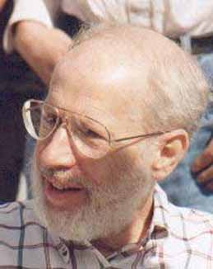
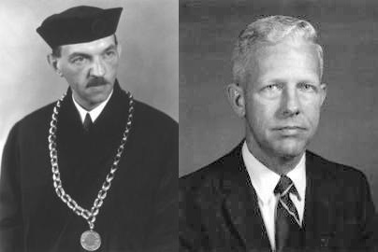
MST Algorithms
Joseph Kruskal
Vojtěch Jarník, Robert Prim

Slide 12
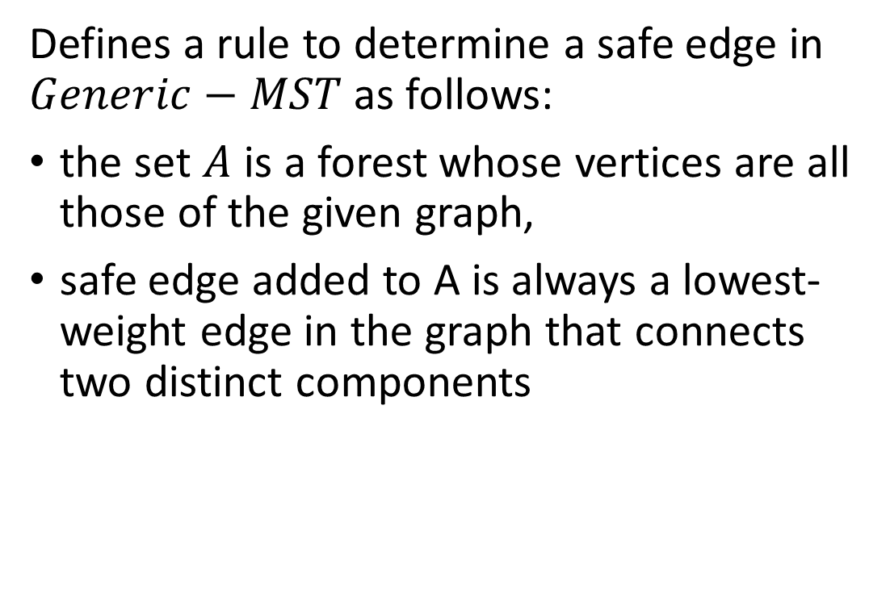
MST: Kruskal Algorithm
Defines a rule to determine a safe edge in $Generic−MST$ as follows:
the set $A$ is a forest whose vertices are all those of the given graph,
safe edge added to A is always a lowest-weight edge in the graph that connects two distinct components

Slide 13
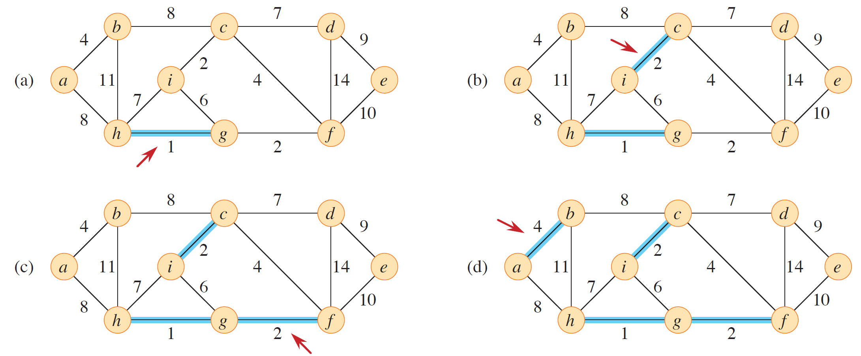
MST: Kruskal Algorithm: Example (1)

Slide 14
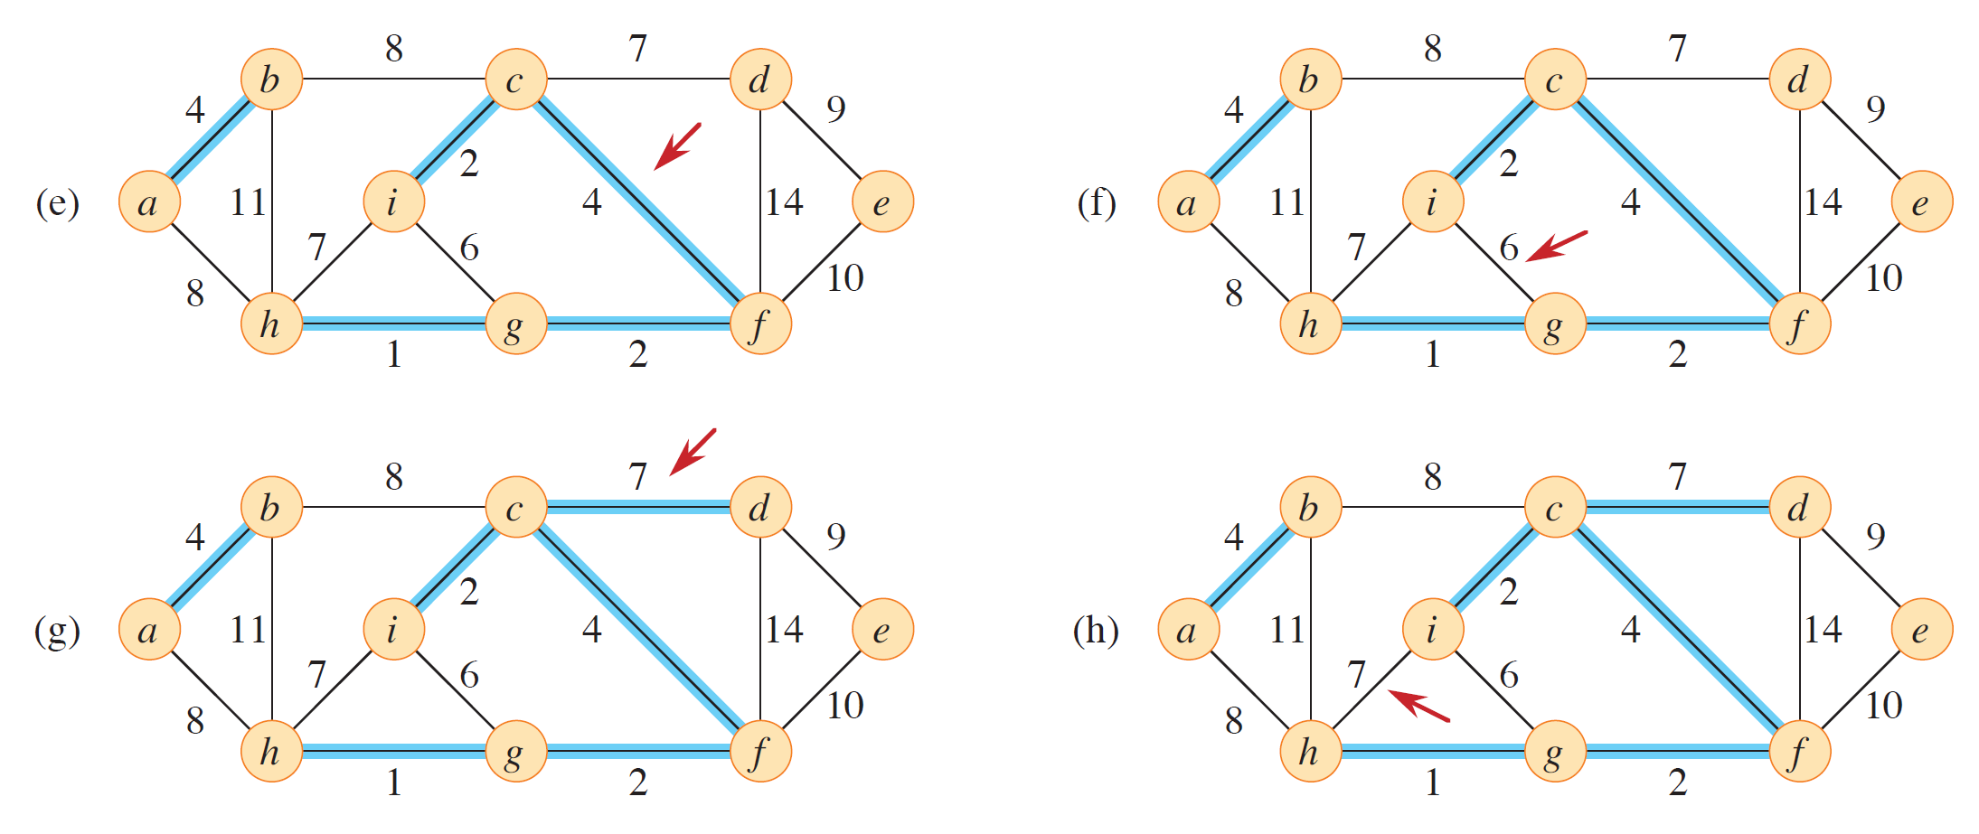
MST: Kruskal Algorithm: Example (2)

Slide 15
MST: Kruskal Algorithm: Example (3)

Slide 16
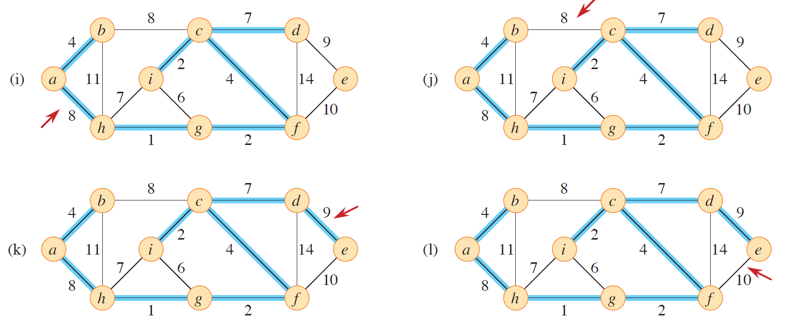
MST: Kruskal Algorithm: Example (4)

Slide 17
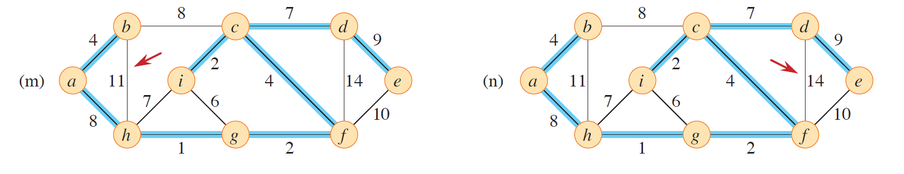
MST: Kruskal Algorithm: Example (5)

Slide 18
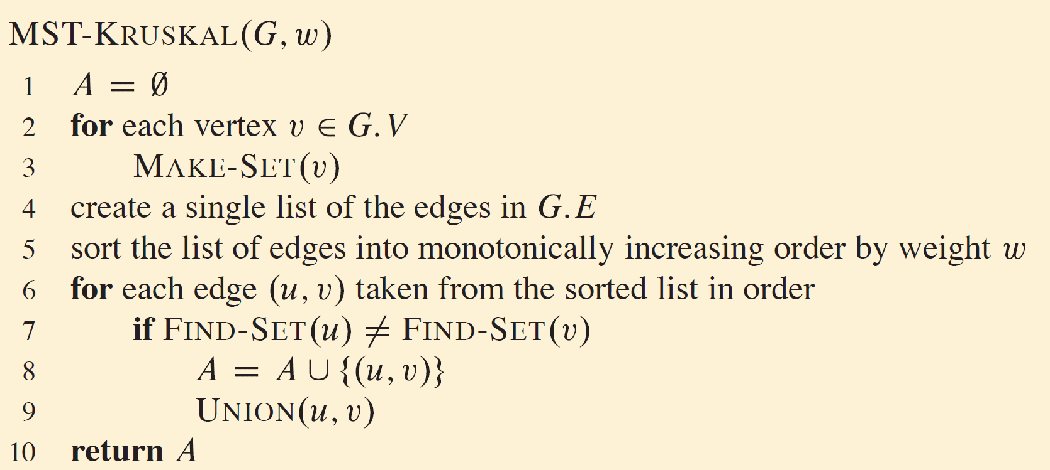
MST: Kruskal Algorithm

Slide 19
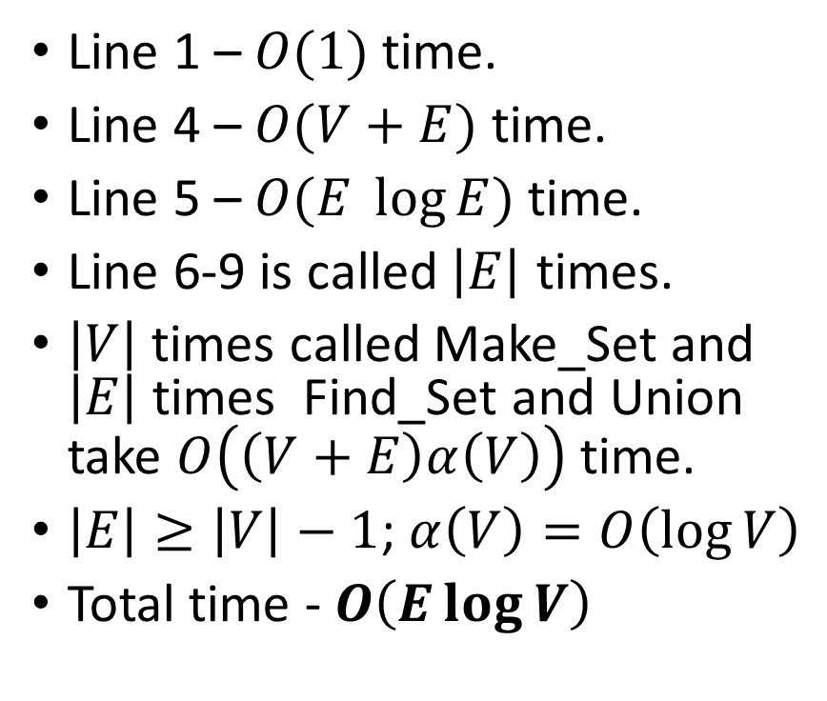
MST: Kruskal Algorithm: Analysis
Line 1 – $O(1)$ time.
Line 4 – $O(V+E)$ time.
Line 5 – $O(E \log{E})$time.
Line 6-9 is called $\left|E\right|$ times.
$\left|V\right|$ times called Make_Set and $\left|E\right|$ times Find_Set and Union take $O\left(\left(V+E\right)α\left(V\right)\right)$ time.
$\left|E\right|≥\left|V\right|−1$; $α\left(V\right)=O\left(\log{V}\right)$
Total time - $O\left(E\log{V}\right)$

Slide 20
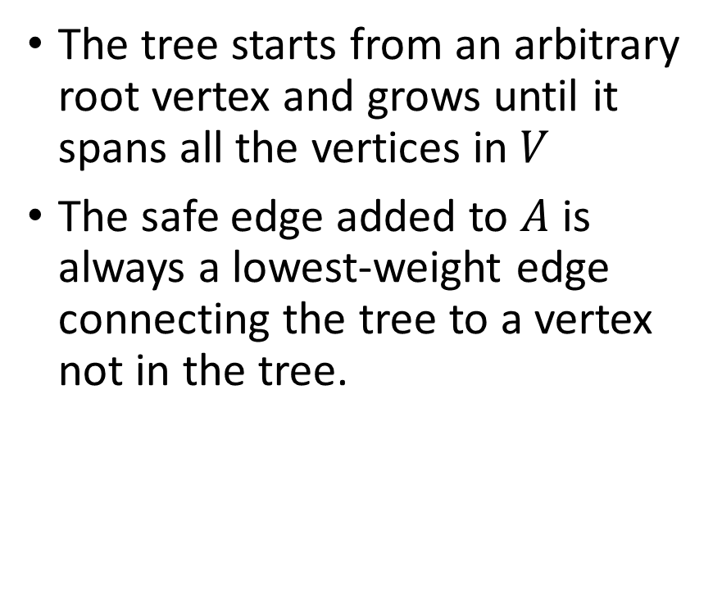
MST: Prim Algorithm
The tree starts from an arbitrary root vertex and grows until it spans all the vertices in $V$
The safe edge added to $A$ is always a lowest-weight edge connecting the tree to a vertex not in the tree.

Slide 21
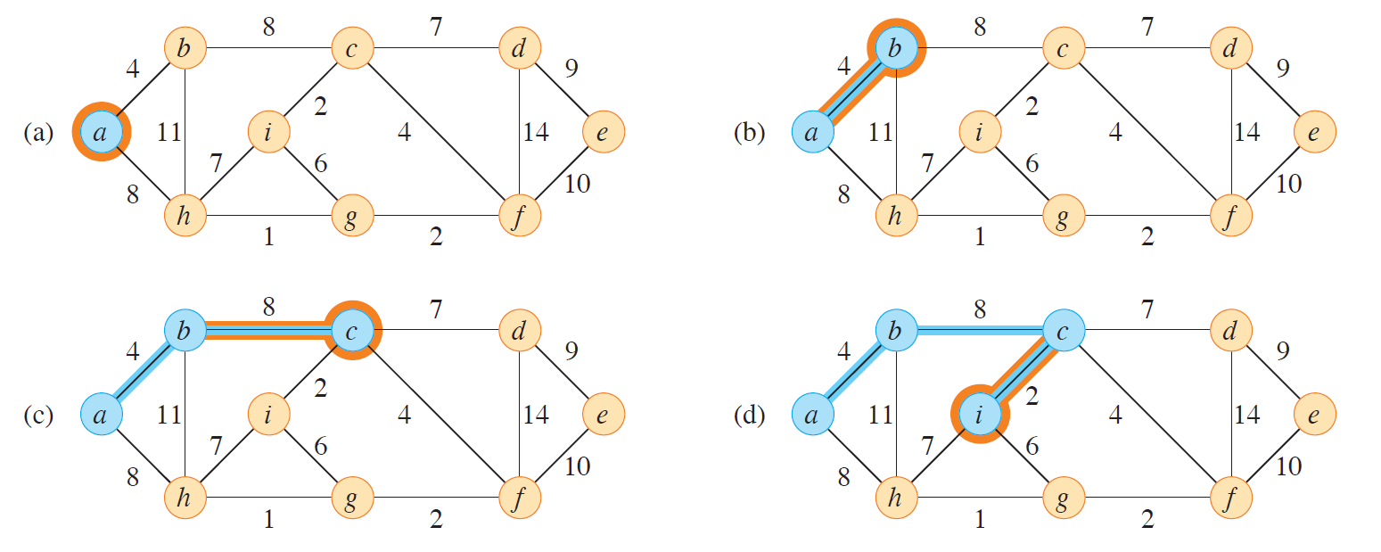
MST: Prim Algorithm: Example (1)

Slide 22
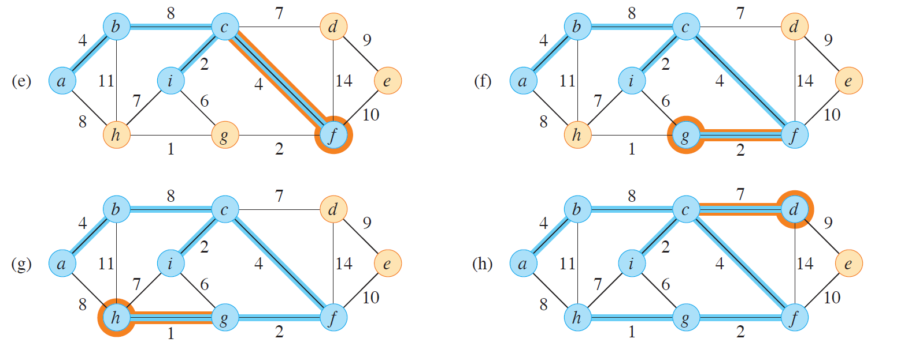
MST: Prim Algorithm: Example (2)

Slide 23
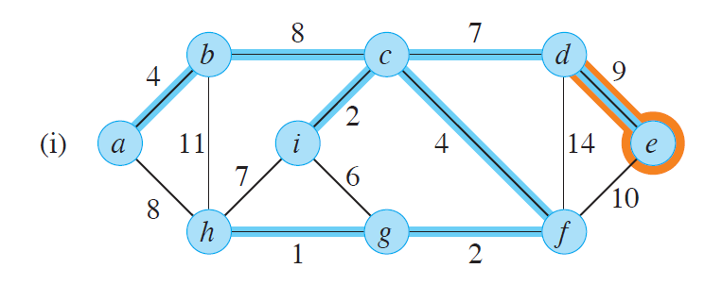
MST: Prim Algorithm: Example (3)

Slide 24
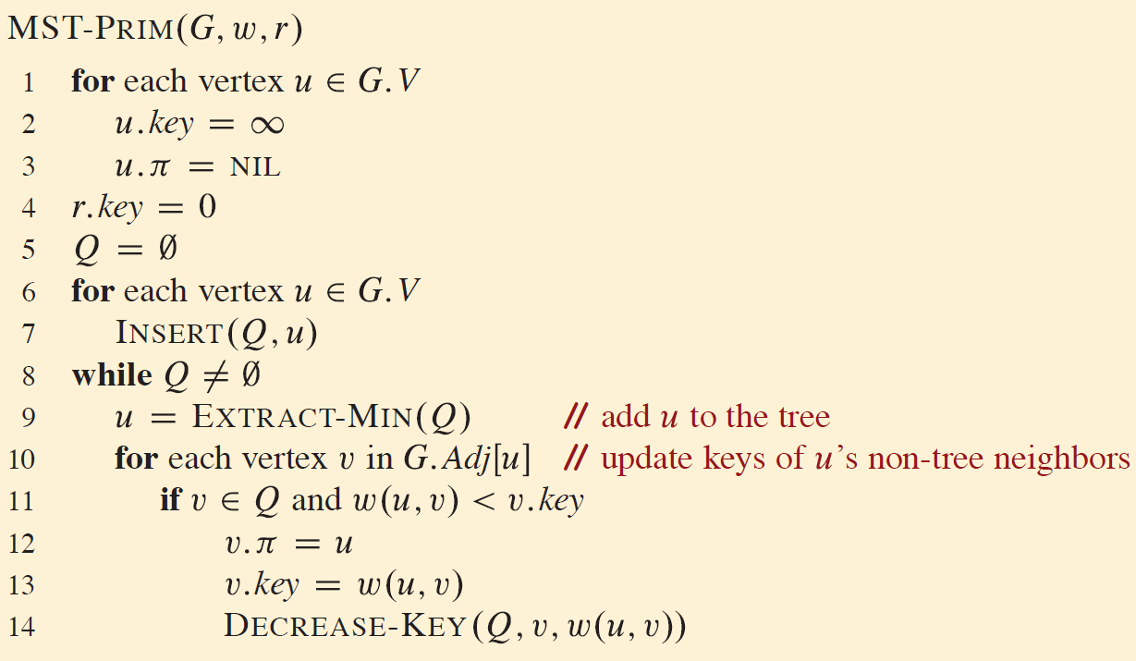
MST: Prim Algorithm
Notes:
Q - min priority queue
Q - contains all vertices of G that are not in set A
v.key – minimum distance (weight) from v to a vertex in the set A

Slide 25
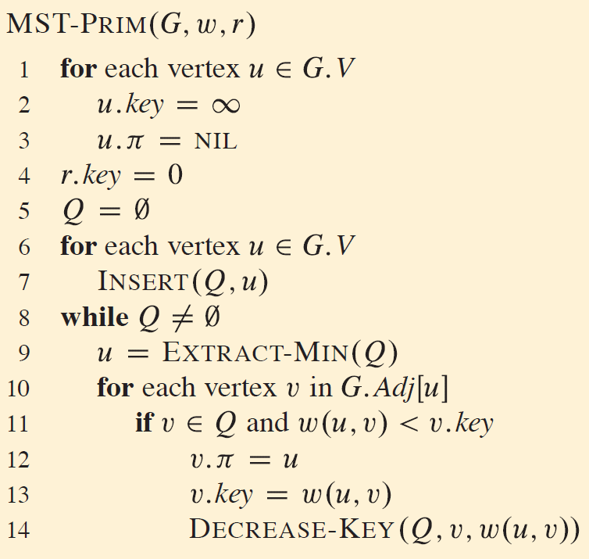
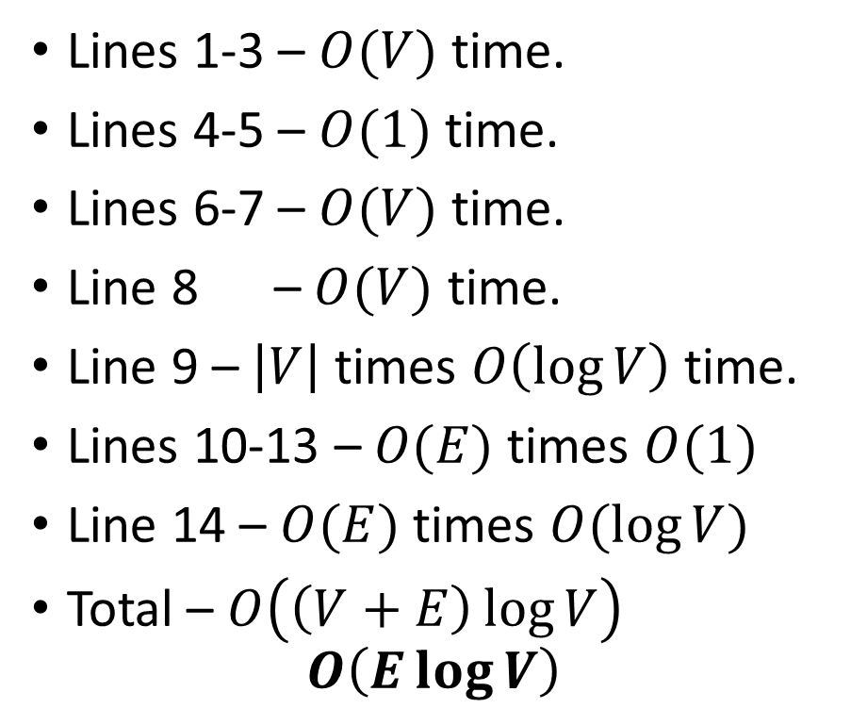
MST: Prim Algorithm Analysis
Lines 1-3 – $O(V)$ time.
Lines 4-5 – $O(1)$ time.
Lines 6-7 – $O(V)$ time.
Line 8 – $O(V)$ time.
Line 9 – $\left|V\right|$ times $O\left(\log{V}\right)$ time.
Lines 10-13 – $O(E)$ times $O(1)$
Line 14 – $O(E)$ times $O(\log{V})$
Total – $O\left(\left(V+E\right)\log{V}\right)$ $O\left(E\log{V}\right)$
Notes:
Q is a min priority queue

Slide 26
Thank You

