Slide 2
Search_Service
RabbitMQ Message Bus
REST API
gRPC
request
reply
request
gRPC
reply
Server_Service
SQL

Slide 3
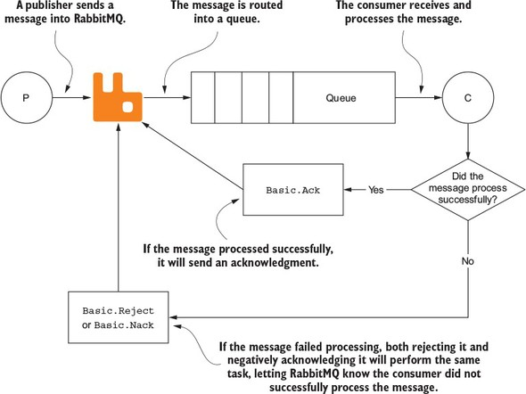

Slide 4
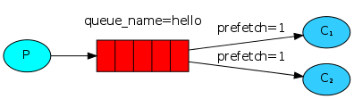
channel.BasicQos(prefetchSize: 0, prefetchCount: 1, global: false);

Slide 5
