Slide 2
Search_Service
RabbitMQ Message Bus
REST API
gRPC
request
reply
request
gRPC
reply
Server_Service
SQL

Slide 3
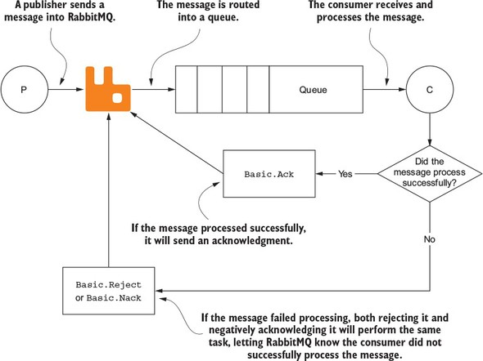

Slide 4
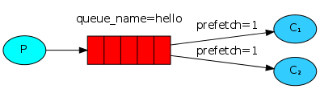
channel.BasicQos(prefetchSize: 0, prefetchCount: 1, global: false);

Slide 5
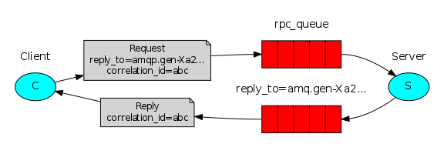
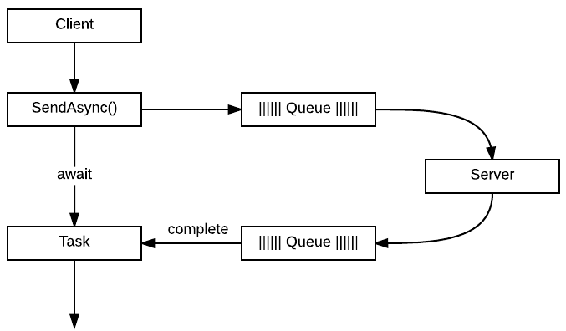

Slide 6
Cluster
Node
Pod
Pod
Pod
Server_Service Container
Server_Service SQL Container
RabbitMQ Container
80
1433
5672
15672
80
1433
15672
15672
Cluster IP
Cluster IP
Cluster IP
Pod
Search_Service Container
Node Port
80
3xxxx
80
80
Cluster IP
Kubernetes (Docker Desktop)
Container Runtime (Docker)
Operating System (Windows 11 with WSL2)
Hardware (PC)

