Slide 1
IMAS on top of the Microsoft Tech Stack

Slide 2

Contents
What is IMAS
Technologies we have used
LabXand & Jinget
Lets have some fun with Jinget
Database concerns
Application server concerns
Role of Azure DevOps
Other technologies we have used
Lessons we have learned

Slide 3
What is IMAS - Modules
Entrance & Exit
Port State Control
Communication
Salvation
Vessel Registration
Salvation
Reports
Environment
Maritime Safety
IMAS

Slide 4
What is IMAS - actors
IMAS
Foreign Ports & PMO
Shipping Agencies & Trading Companies
Presidential Administration
Oil Refining & Distribution Companies
Anti-Trafficking Headquarters
Internal Ports & PMO

Slide 5
Technologies we have used
Front End
Back End
Database
Application Server
AngularJS
TypeScript
ASP. Net Razor
.NET Framework 4.5
C#
MSMQ
SQL Server
IIS
Apache
Oracle
Rest API
SOAP Web Services
Front End
Back End
Database
Application Server
Angular 7
AngularJS
TypeScript
ASP. Net Razor
.NET Framework 4.7
.NET Core 3.1
C#
MSMQ
SQL Server
IIS
ARR
Rest API
SOAP Web Services
What we used
What we are using

Slide 6
Technologies we have used
Front End
Back End
Database
Application Server
Blazor
TypeScript
ASP. Net Razor
.NET 5.0
C#
SQL Server
IIS
ARR
Elastic Search
Angular 11
Rest API
SOAP Web Services
gRPC
Redis/CosmosDB
What we are Thinking

Slide 7
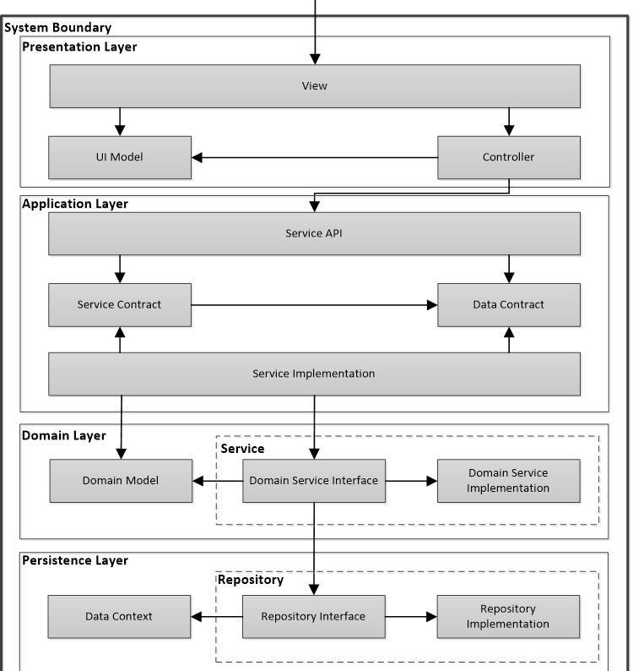
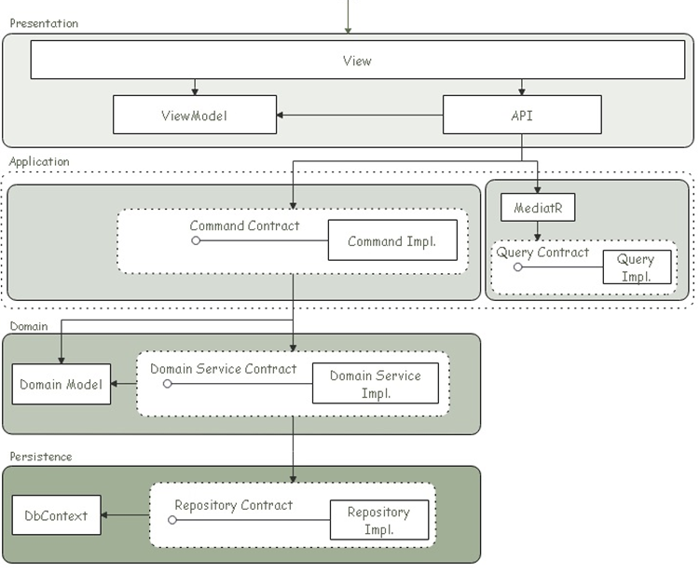
Labxand and Jinget
LabXand Impl. Diagram
Jinget Impl. Diagram

Slide 8
Labxand and Jinget
SQL Server
.NET Framework
Oracle
Record Traceability
Req/Res Logging
Record Versioning
Elastic Search
MSMQ
DDD
LabXand
C#
SQL Server
Record Traceability
.NET Core
C#
Oracle
Req/Res Logging
Record Versioning
Elastic Search
MSMQ
Health Check
Dynamic Code
CQRS+DDD
Jinget

Slide 9
Labxand and Jinget
API
Application Service
Domain Service
Repository
Log req/res
Authentication
Authorization
Cross domain transaction
Business logic container
Work with data
Uses NEST, EF & ADO.Net
How LabXand helps us

Slide 10
Labxand and Jinget
API
Handlers
Domain Service
Repository
Log req/res
Authentication
Authorization
Command Handlers
Business logic container
Supports NEST, EF Core & ADO.Net
Query Handlers
External Service Handlers
How Jinget helps us

Slide 11

Lets have some fun with jinget

Slide 12
Database concerns
Data availability is a key for us!
Performance is vital
Direct access to production DB is a great danger for us
Put development, staging and production databases in sync is important
AlwaysOn
DevOps
Almost all concerns addressed

Slide 13
Application server concerns
ARR
DevOps
Almost all concerns addressed
Stable & reliable release to production
Performance is vital
Direct access to production application server is a great danger for us
Put development, staging and production application servers in sync is important

Slide 14

Role of Azure DevOps
Better team cooperation & collaboration
Better tasks monitoring & tracking
Better package management
Automating build, test & releases
Pre-deployment conditions saves our days
Automating DB script execution

Slide 15
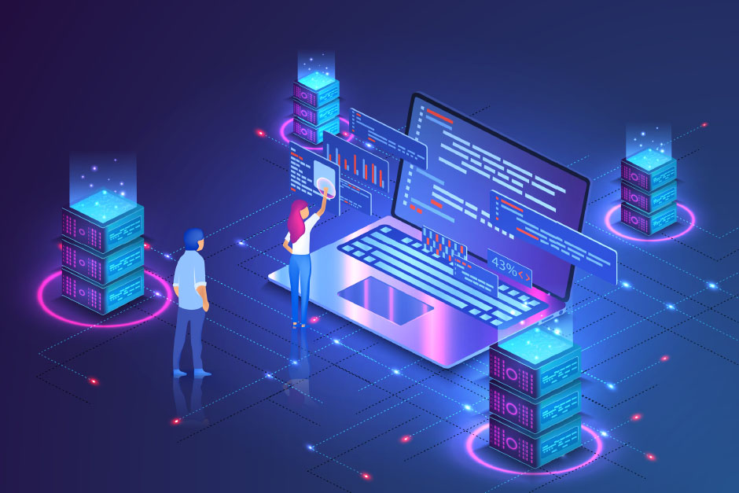
Other technologies we have used
Storing logs in Elastic search
Monitoring servers using Prometheus
Providing better analytics using Kibana & Grafana
TortoiseGit makes life easier for the whole organization

Slide 16

Lessons we have learned
The customer is God!
Team members needs to talk!
Automation is key to success
Success is in simplicity
Make sure that you are building The Right It, before you build It right (Alberto Savoia)

