Slide 1
Environmental Intelligence & Sustainability Analytics Platform
Capstone Project : Team-14
Team details
Vahida Shaik – g25ai1072 Sanaullah Shaik – g25ai0170 Satish G – g25AI1071
Vijibenita Ravi Nadar - Rohit Paliwal – g25ai1069 Manish Kumar – g25ai1068
g25ai1067

Slide 2
About Project
Executive summary
🌍 Problem
📊 Datasets
This project focuses on analyzing global temperature trends and air quality data to understand environmental changes and potential correlations.
To analyze environmental datasets including temperature, air quality and geospatial data to identify trends and patterns related to climate change.
- Temperature Dataset (NASA GISTEMP) - Air Quality Dataset (India AQI Dataset) - Geospatial Dataset (UN Environmental Data)

Slide 3
Week-1
Identified and selected relevant public datasets
Documented dataset structure and attributes
Loaded datasets into Python environment
Performed initial exploratory data analysis (EDA)
A structured data inventory was created
documenting dataset sources, formats, attributes, and temporal coverage.
- Generated visualizations:
Temperature trend over time
Air pollution trend across cities
Environmental indicators from geospatial dataset
- Analyzed dataset characteristics:
Missing values
Data types
Time coverage

Slide 4
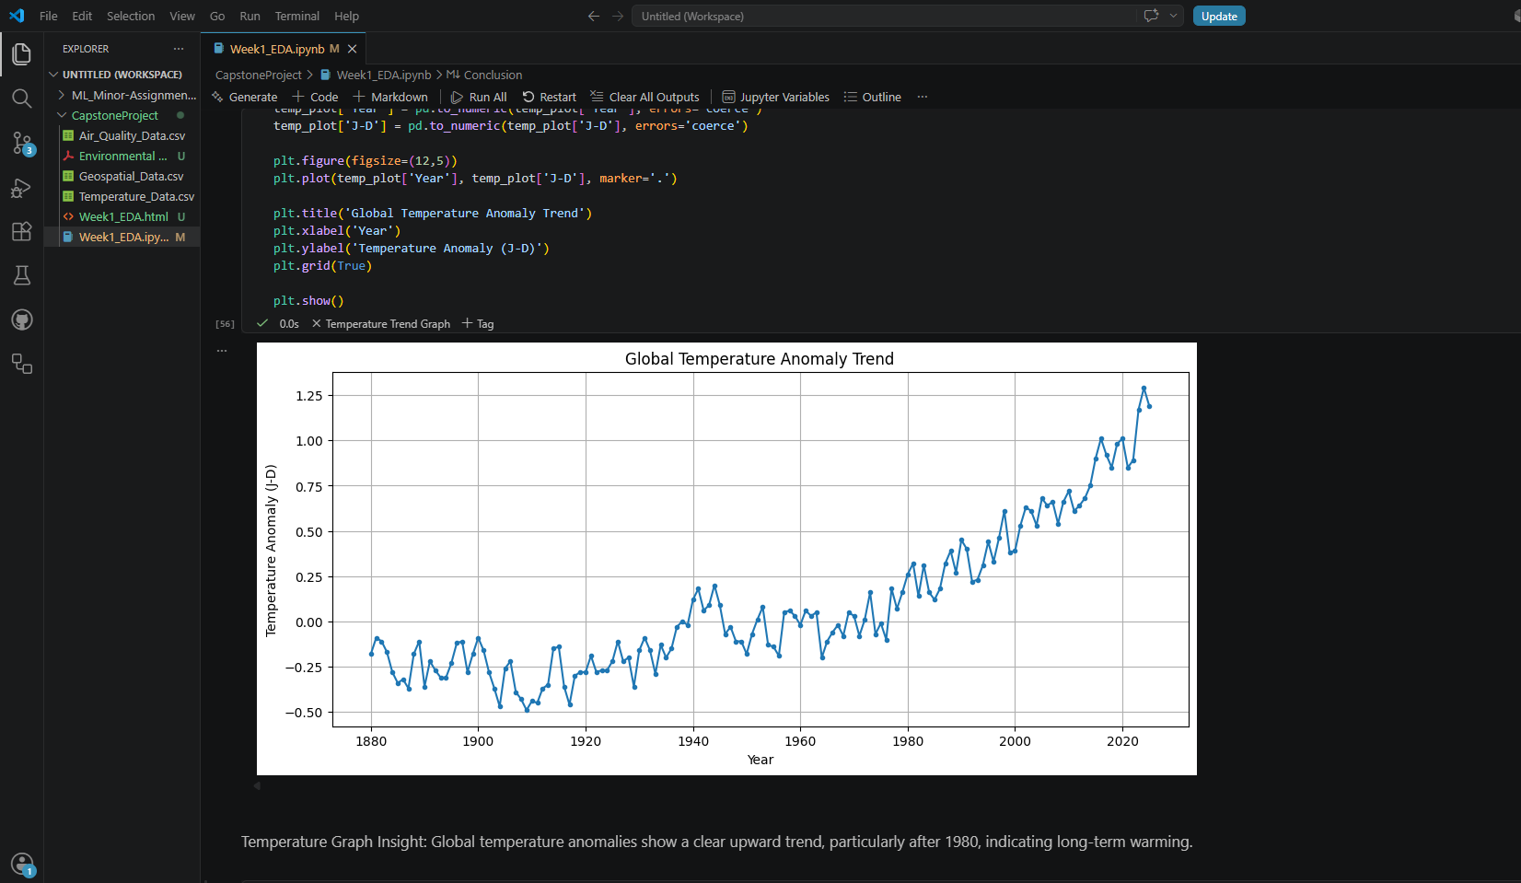
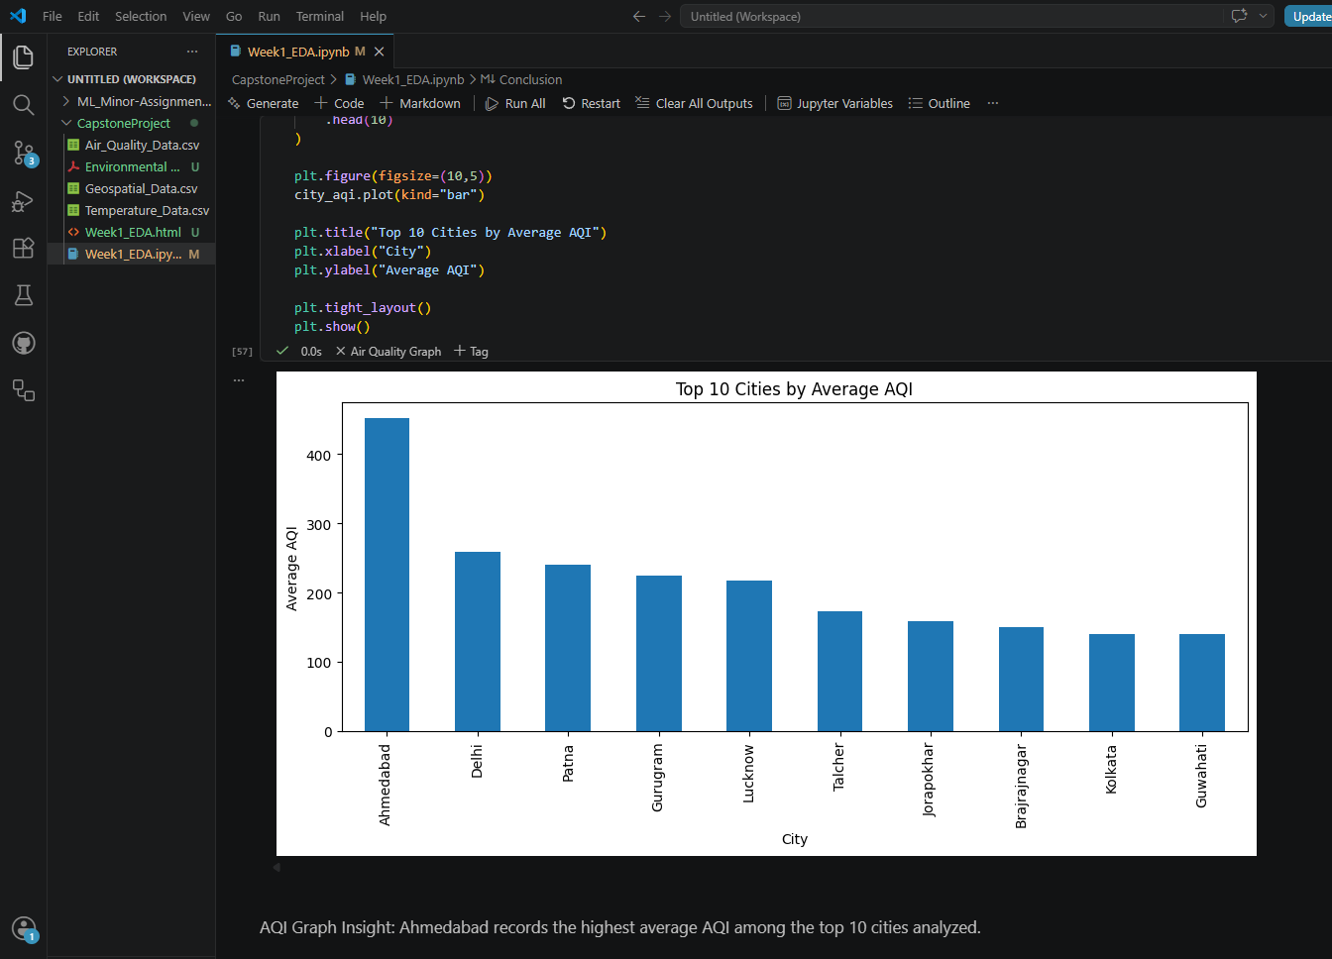
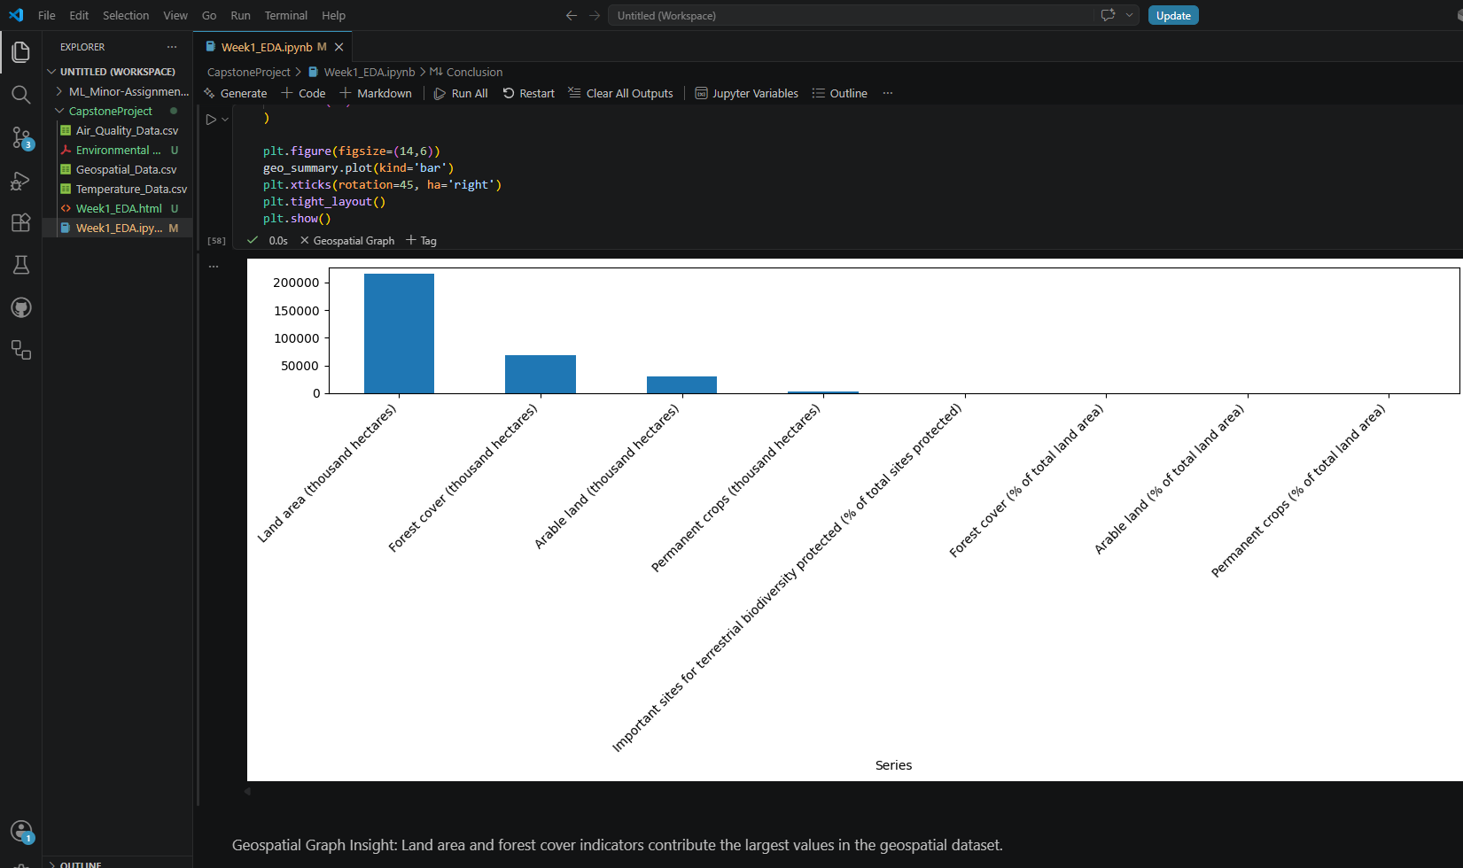
Week-1
Temperature trend graph
- Geospatial bar chart analysis
- Air quality (PM2.5 / AQI) visualization

Slide 5
Week-2
Project objective
What accomplished
In Week 2, the focus was on cleaning, transforming, and preparing environmental datasets for integration and analysis. The datasets included temperature data (NASA), air quality data (India AQI), and geospatial environmental data. The objective was to convert raw and unstructured datasets into a consistent and analysis-ready format, enabling integration across multiple data sources.
Cleaned datasets and handled missing values using appropriate techniques. Converted date formats and extracted Year and Month features from time-series data. Aggregated air quality data from daily observations into monthly and yearly summaries. Filtered and processed geospatial data focusing on forest cover indicators. Applied moving average techniques to smooth trends in temperature and geospatial data.
Standardized formats across datasets to ensure compatibility. Aligned datasets from different sources based on common time periods. Merged processed datasets into a unified environmental dataset. Performed preliminary trend analysis and correlation analysis Generated visualizations including: - Temperature trends. - AQI trends - PM2.5 trends

Slide 6
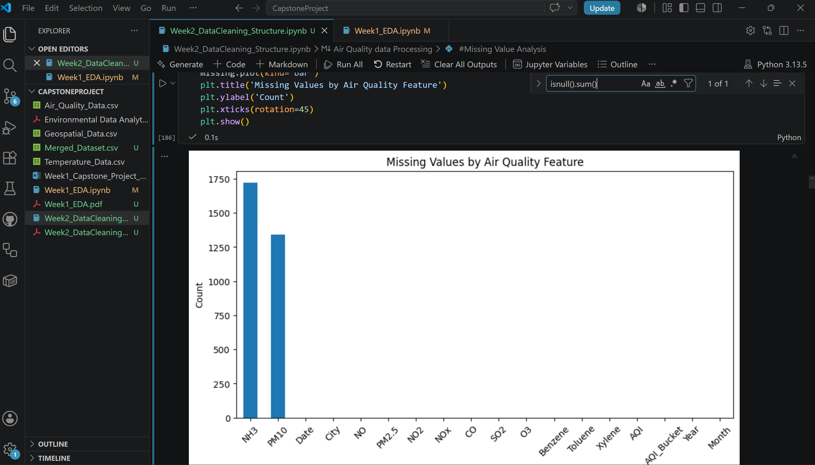
Week-2
Challenges Faced
Handling missing and inconsistent values in the air quality dataset.
Cleaning and restructuring the NASA temperature dataset, which contained metadata rows and non-numeric values.
Aligning datasets with different temporal granularities (daily, monthly, and yearly).
Identifying common years across datasets for meaningful integration.
Managing data consistency and avoiding duplication during merging.
Limited overlapping time period across datasets, which restricted combined analysis.
Results/Visual Outputs
- Missing Value Analysis

Slide 7
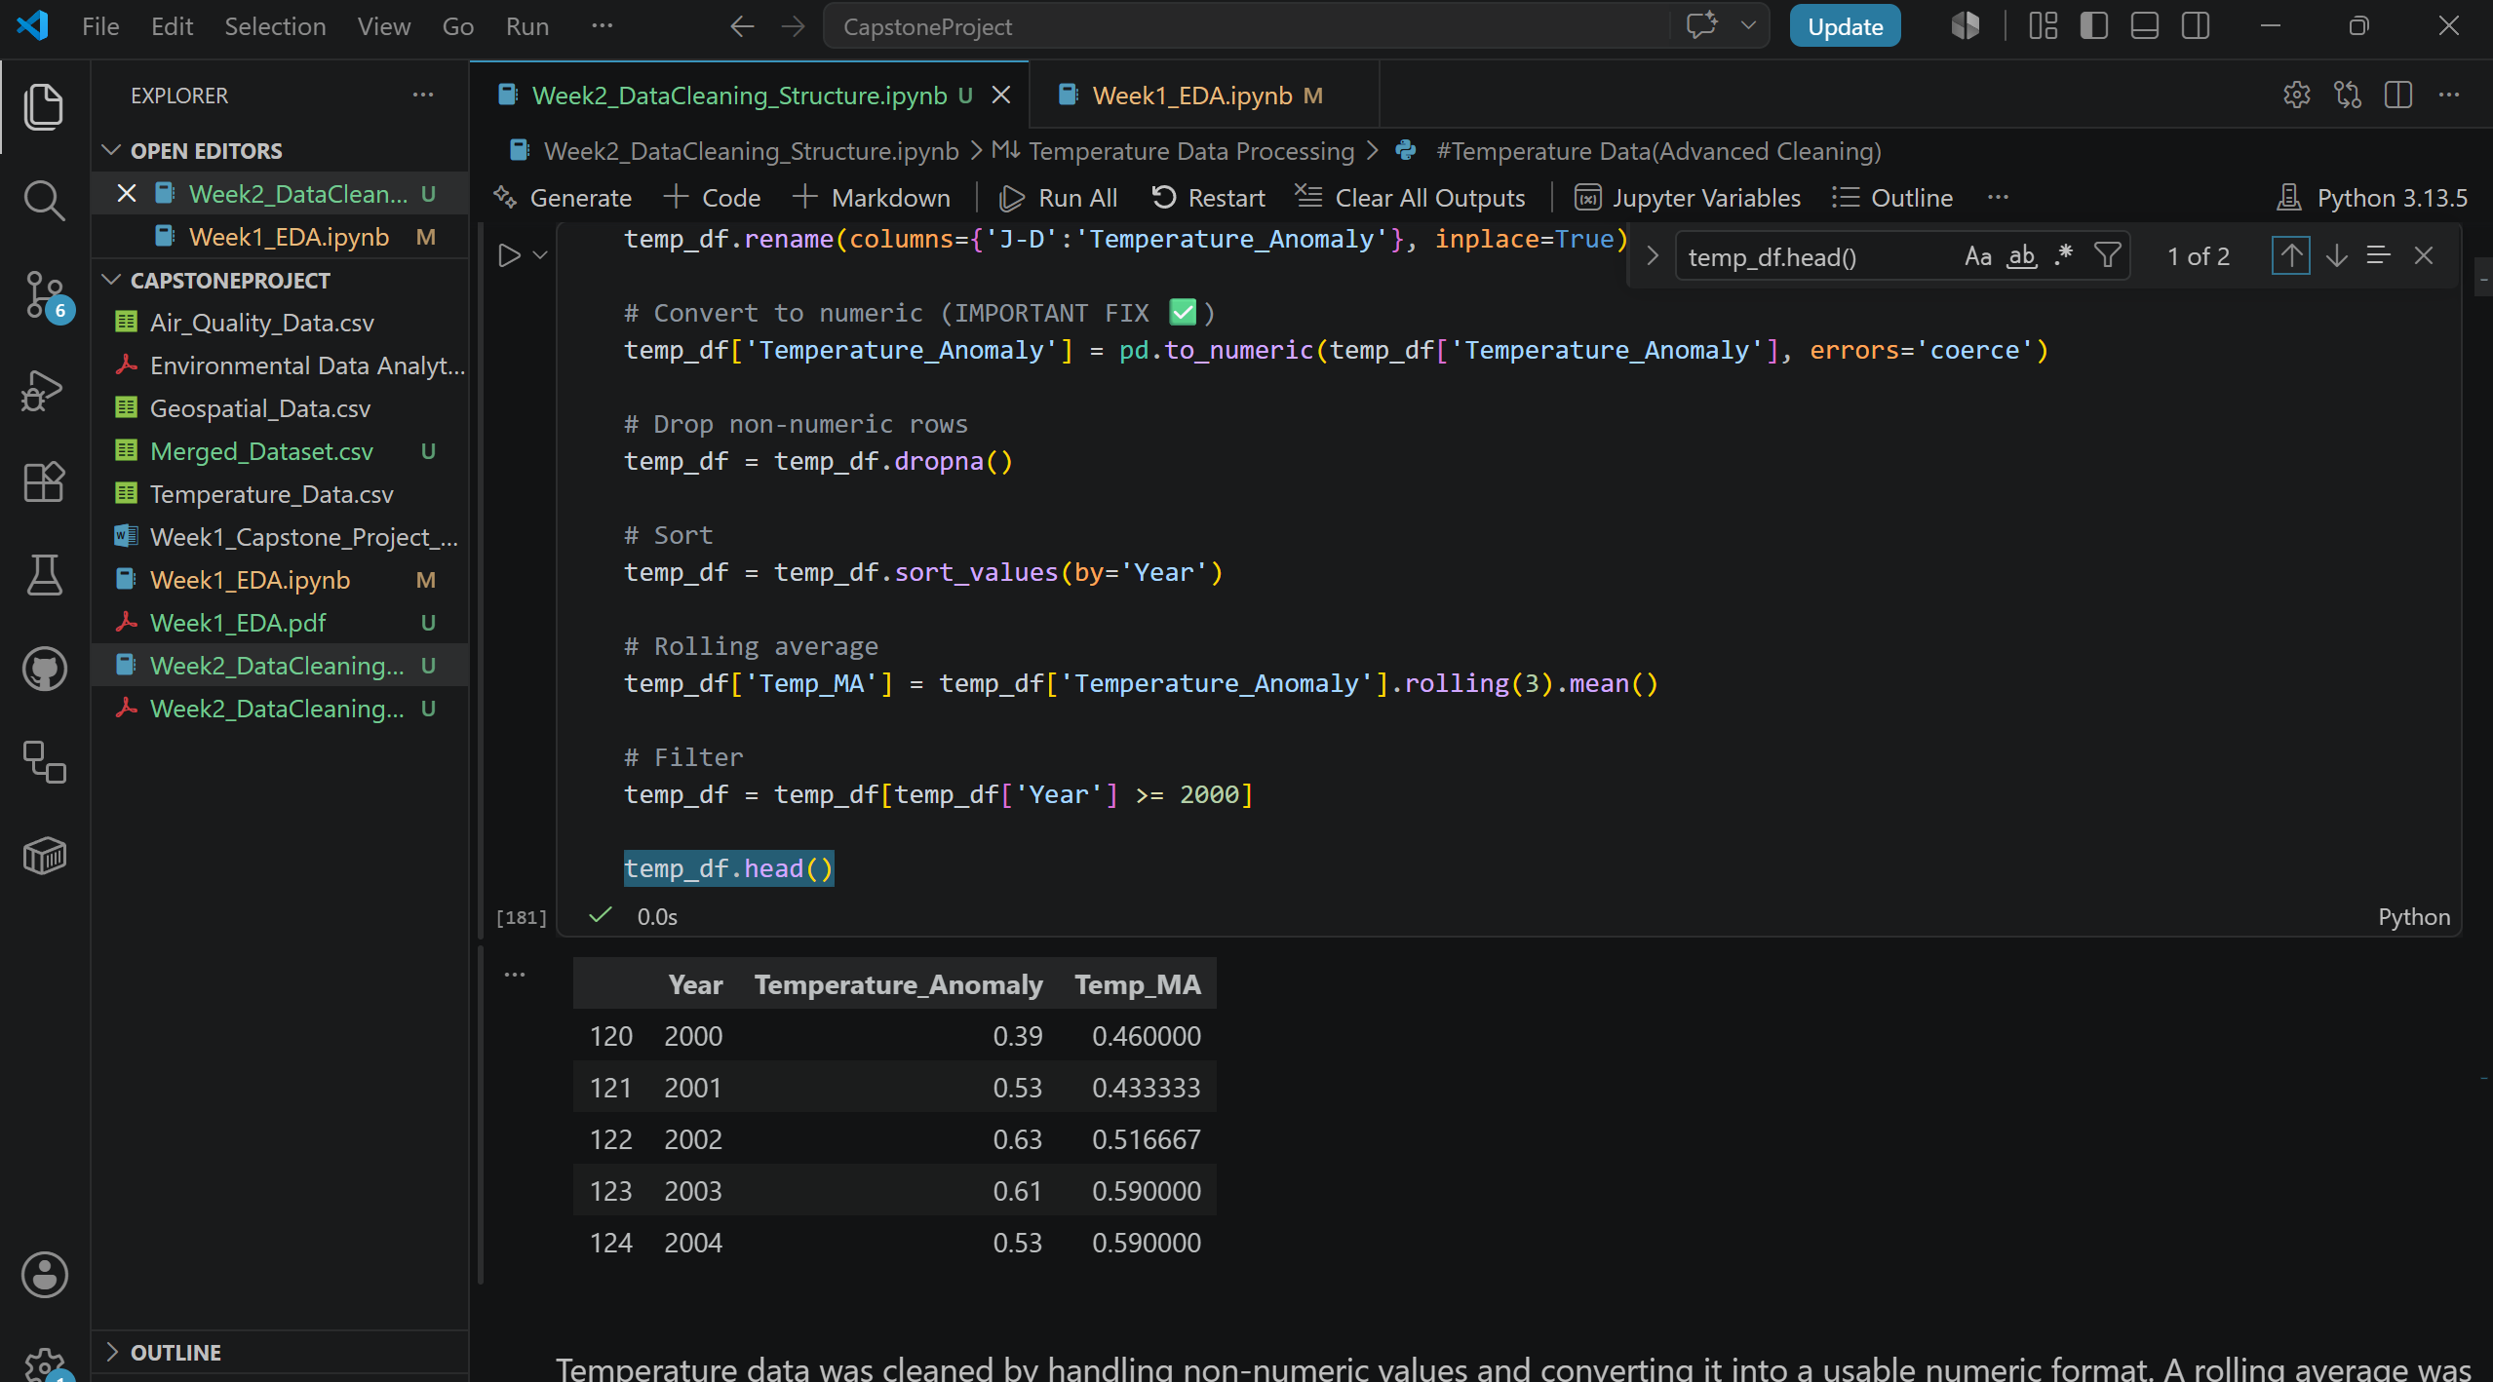
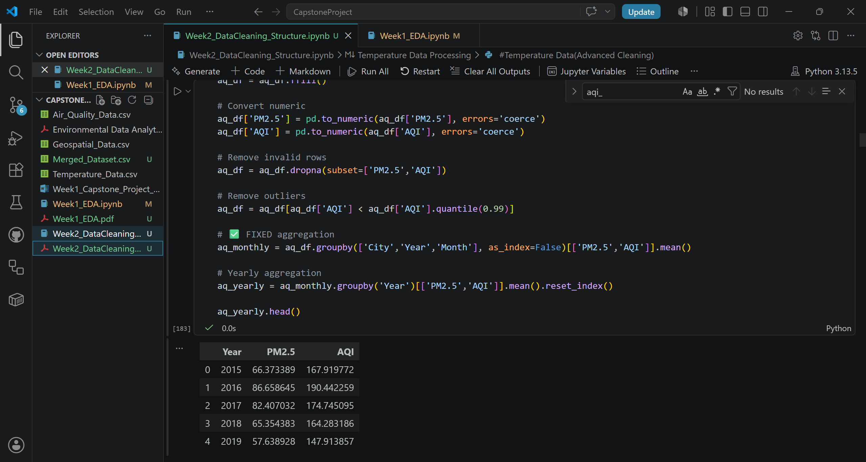
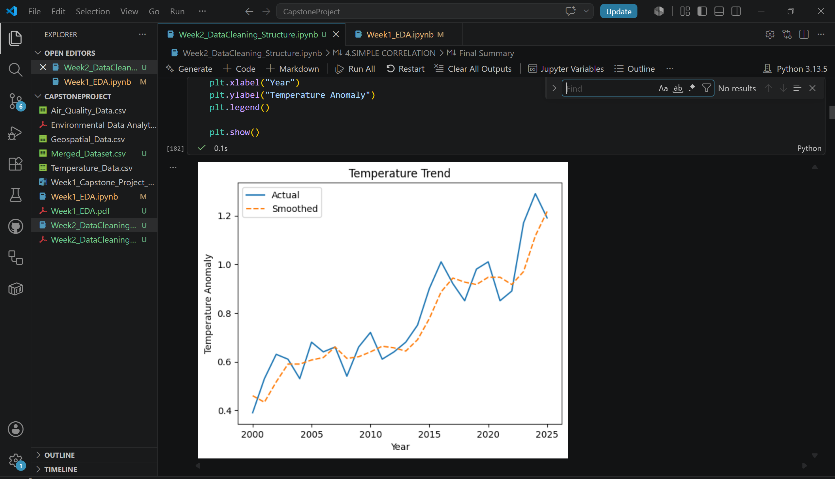
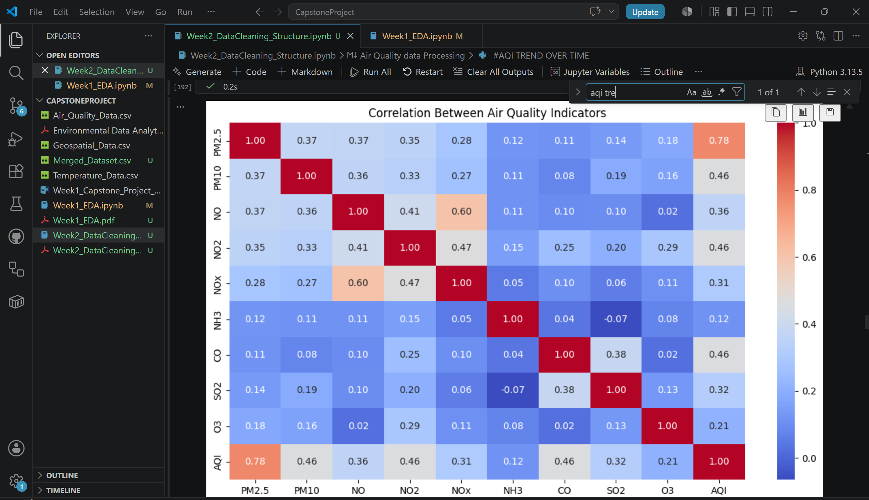
Week-2
Cleaned NASA Temperature Dataset
Air Quality Aggregation
Correlation Heatmap
Temperature Trend

Slide 8
Week-3
Projective objective
What’s accomplished
The objective of Week 3 is to design and implement an automated, scalable, and production-ready data pipeline to handle environmental datasets efficiently. This phase builds upon: Week 1: Data collection and exploratory data analysis Week 2: Data cleaning, transformation, and integration The goal was to convert these processes into a robust, automated pipeline system capable of ingestion, transformation, storage, and monitoring.
Automated Data Pipeline Data ingestion from raw datasets. Data cleaning and preprocessing. Feature extraction (Year, Month). Data transformation Aggregation (daily → monthly → yearly). Dataset alignment and merging.
Modular Pipeline Design The pipeline was modularized into reusable components: load_data() – Data ingestion process_aqi() – Air quality processing process_geo() – Geospatial processing merge_data() – Dataset integration save_to_postgres() – Database storage

Slide 9
Week-3
Results/Visual Outputs
Pipeline Execution

Slide 10
Week-4
Project objective
What’s completed
The objective of Week 4 was to transform the integrated environmental dataset into a feature-rich analytical dataset through a production-inspired feature engineering pipeline. The implementation follows production-oriented software engineering practices including modular programming, configuration management, logging, exception handling, automated validation, and reusable pipeline execution. These practices improve reproducibility, maintainability, scalability, and reliability of the analytical workflow.
Develop a modular Python-based feature engineering pipeline. Read the integrated environmental dataset directly from PostgreSQL. Validate dataset quality before processing. Generate rolling average features representing long-term environmental trends. Generate trend features that capture year-to-year environmental changes. Create lag features representing previous observations. Generate cumulative environmental indicators. Calculate environmental ratios and composite indices.
Datasets used NASA GISTEMP India AQI Dataset UN Environmental Dataset Environment_Merged Configuration steps performed Step 1 – Configuration Loading Step 2 – PostgreSQL Connection Step 3 – Dataset Validation Step 4 – Feature Engineering Step 5 – Feature Normalization Step 6 – Metadata Generation Step 7 – Data Quality Reporting Step 8 – Database Update Step 9 – Validation Step 10 – Execution Reporting

Slide 11
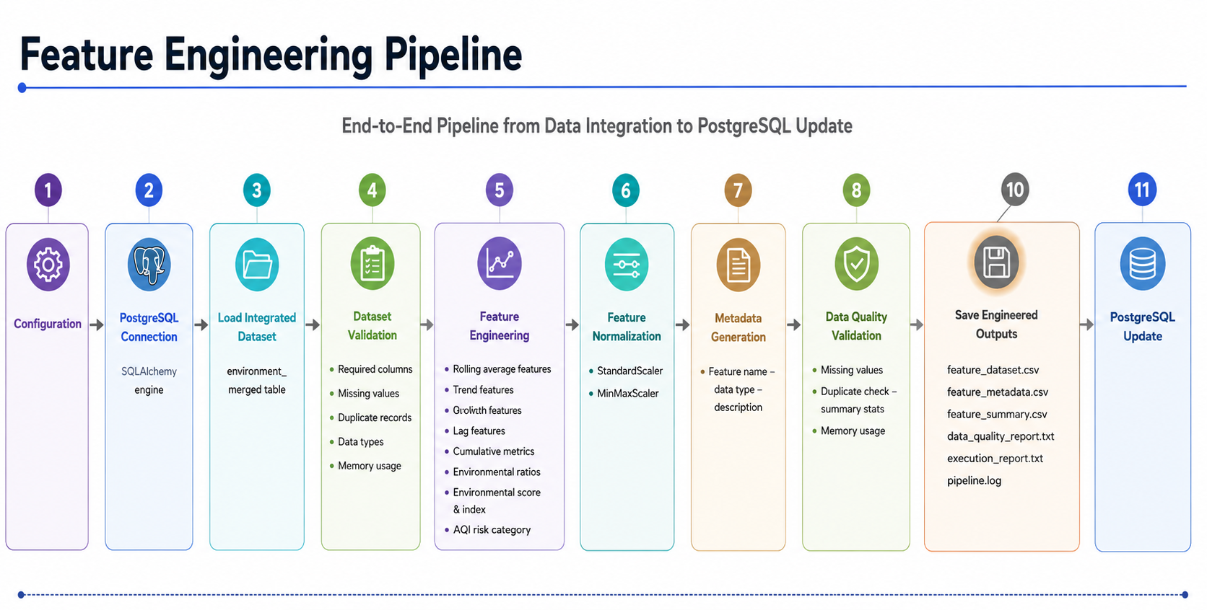
Week-4
Results/Visual Outputs

Slide 12
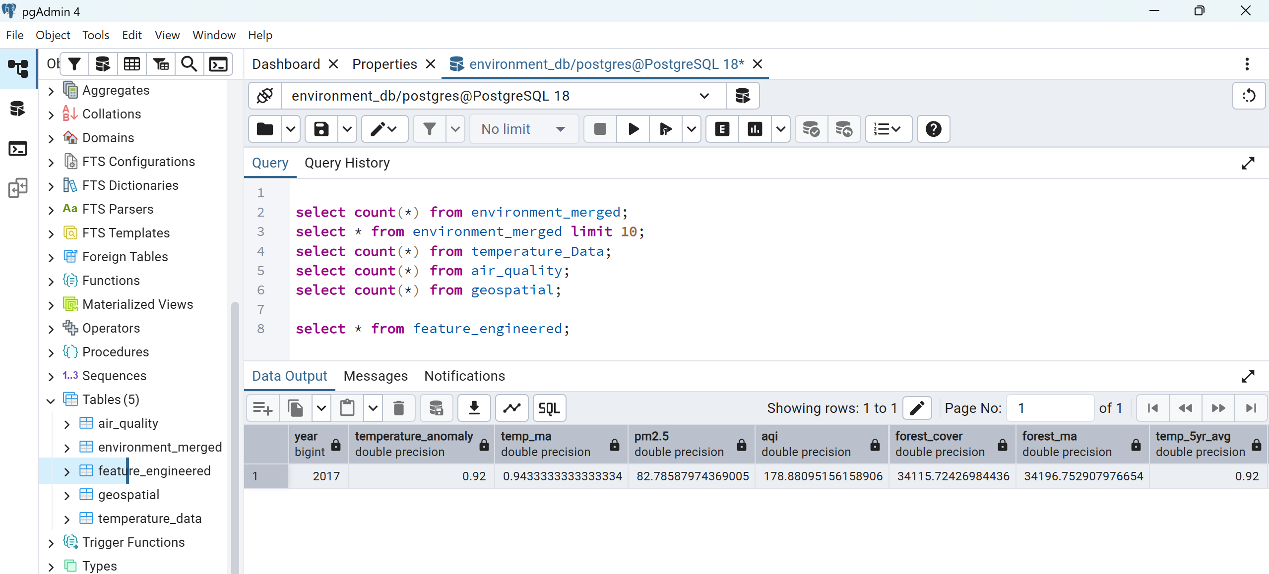
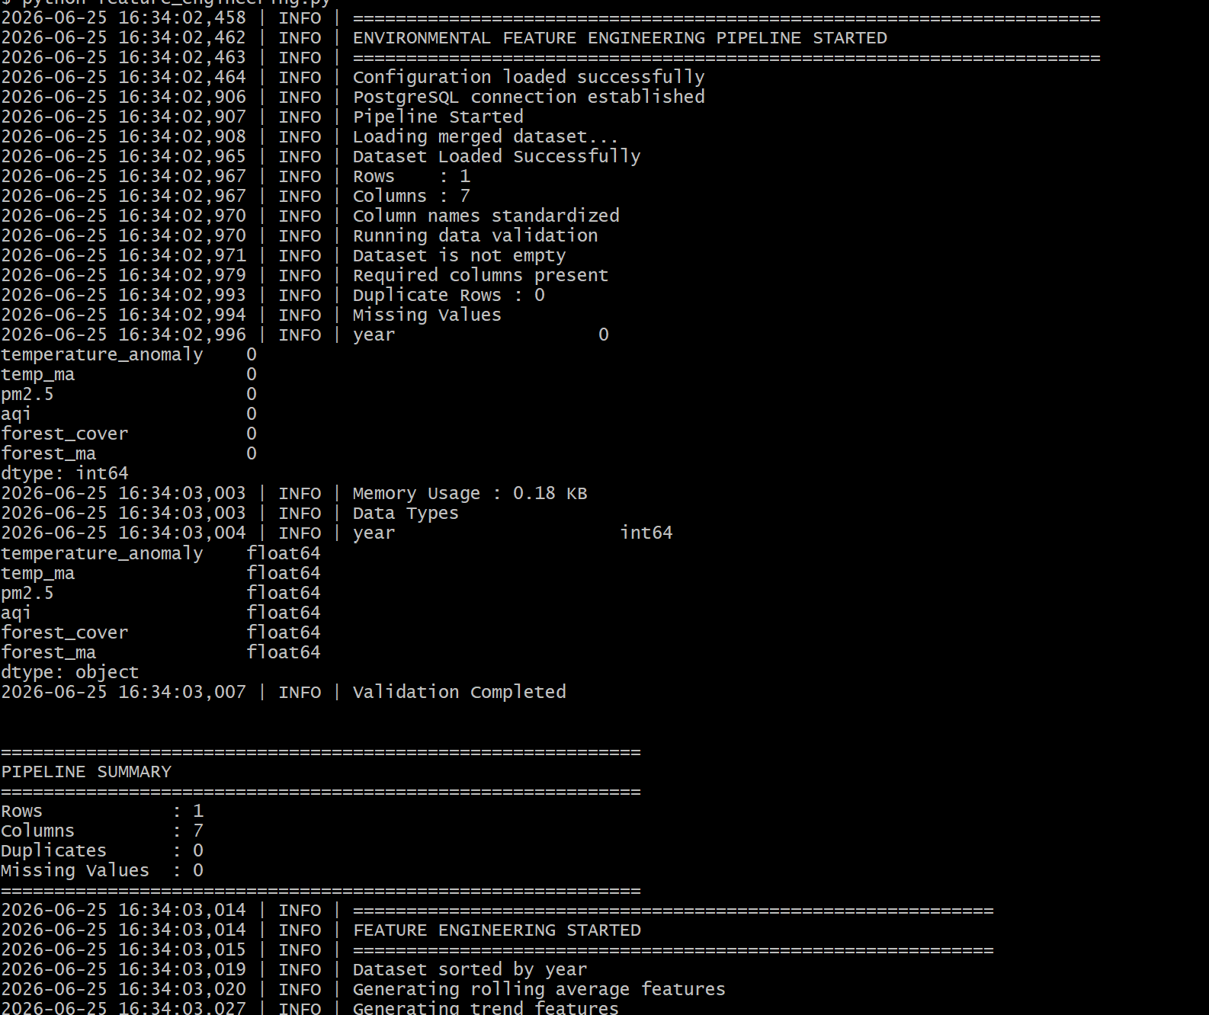
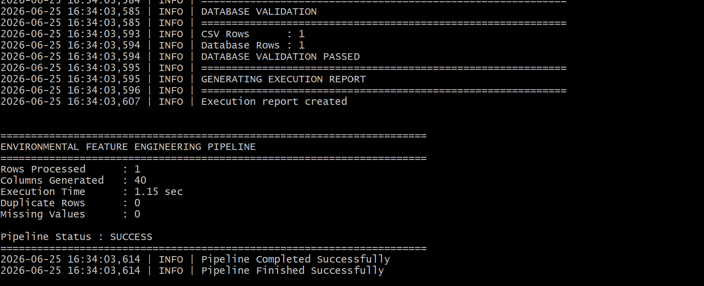
Week-4
Results/Visual Outputs
PostgreSQL Feature Engineered Table
Successful Pipeline Execution
Database Validation

Slide 13
Week-5
Project Objective
Accomplishments
The primary objectives of this project are: Objective 1: Integrate multiple environmental data sources. Objective 2: Perform feature engineering to generate environmental intelligence indicators. Objective 3: Develop machine learning models to forecast future environmental trends. Objective 4: Evaluate model performance using statistical metrics. Objective 5: Conduct scenario analysis for future environmental outcomes. Objective 6: Provide Power BI-ready datasets for business intelligence visualization.
Develop a modular Python-based feature engineering pipeline. Read the integrated environmental dataset directly from PostgreSQL. Validate dataset quality before processing. Generate rolling average features representing long-term environmental trends. Generate trend features that capture year-to-year environmental changes. Create lag features representing previous observations. Generate cumulative environmental indicators. Calculate environmental ratios and composite indices.
Datasets used NASA GISTEMP India AQI Dataset UN Environmental Dataset Environment_Merged Configuration steps performed Step 1 – Configuration Loading Step 2 – PostgreSQL Connection Step 3 – Dataset Validation Step 4 – Feature Engineering Step 5 – Feature Normalization Step 6 – Metadata Generation Step 7 – Data Quality Reporting Step 8 – Database Update Step 9 – Validation Step 10 – Execution Reporting

Slide 14
Week-5
Results/Visual Outputs
Temperature Forecast
Actual vs Predicted value
Forecast Uncertainty Analysis
Residual Distribution

Slide 15
Week-5
Results/Visual Outputs
Environmental Cluster Analysis - 1
Environmental Cluster Analysis - 2
Business Recommendations
Executive Summary

Slide 16
Week-6
Project objective
Business Intelligence Solution Delivered
Week 6 focused on transforming the analytical outputs developed during Week 5 into a comprehensive Business Intelligence solution using Power BI. The Environmental Intelligence & Sustainability Analytics Platform integrates climate, pollution, forest sustainability, forecasting, scenario analysis, and machine learning outputs into an executive-ready dashboard environment. The completed solution includes six interactive dashboards covering environmental trends, climate change impact assessment, future scenario forecasting, environmental health monitoring, machine learning predictions, and executive-level sustainability reporting.
Week 6 represents the visualization and business intelligence phase of the Environmental Intelligence & Sustainability Analytics Platform. Power BI was used to create an integrated environmental analytics platform capable of presenting historical trends, sustainability metrics, forecasting outputs, geographic insights, and machine learning results in a user-friendly format. The objective of Week 6 was to transform analytical outputs into interactive dashboards that support executive decision-making.
Develop interactive Power BI dashboards. Create executive-level KPI dashboards. Build geographic and map visualizations. Implement machine learning result visualization. Present environmental forecasting results. Support executive sustainability decision-making. Create integrated environmental intelligence reporting. Deliver an end-to-end business intelligence solution.

Slide 17
Week-6
Results/Visual Outputs
Architecture Overview

Slide 18
Week-6
Results/Visual Outputs
Executive Command Center
Environmental Trends Dashboard
Climate Change Impact Dashboard
Future Climate Scenario Analysis

Slide 19
Week-6
Results/Visual Outputs
Environmental Health Dashboard
Predictive Analytics & Machine Learning Dashboard
Key findings
Global temperature anomalies have increased consistently over time.
Climate change impacts continue to intensify.
Pollution Growth produces the highest projected temperature outcomes.
Aggressive Green policies result in the lowest projected warming levels.
Forest sustainability remains the strongest environmental component.
Environmental Health Index indicates moderate ecosystem health.
Sustainability performance is currently classified as good.
Random Forest achieved exceptional predictive performance with an R² score of approximately 0.99.
Geographic visualization demonstrates the global nature of environmental challenges.
Data-driven sustainability initiatives can significantly reduce future environmental risks.

Slide 20
Week-6
Results/Visual Outputs
Conclusion :
Week 6 successfully transformed the analytical outputs developed during Week 5 into a fully interactive Environmental Intelligence & Sustainability Analytics Platform.
The completed solution integrates environmental monitoring, sustainability assessment, machine learning forecasting, scenario analysis, geographic visualization, and executive reporting within a unified Power BI environment.
The platform enables environmental stakeholders, policymakers, and sustainability managers to make informed, data-driven decisions through actionable insights and predictive analytics.
The project successfully transformed engineered datasets, predictive models, and scenario analysis into an integrated Business Intelligence platform.
completed dashboards enable interactive exploration of climate trends, environmental health indicators, sustainability metrics, geographic analysis, and predictive forecasting.
This solution demonstrates the practical application of data engineering, machine learning, and visualization techniques for executive decision support.

Slide 21
Reference Links
Github URL – https://github.com/VahidaSS/CapstoneProject
Google Drive URL - https://drive.google.com/drive/folders/15FRK8ErVL9vvUqc0ocuAngPXZdyHZ7h2?usp=sharing

Slide 22
Thank you Team-14

