Slide 1


Firefly algorithm
Khodorchenko M.
mkhodorchenko@corp.ifmo.ru
www.NoavaranGermi.ir

Slide 2
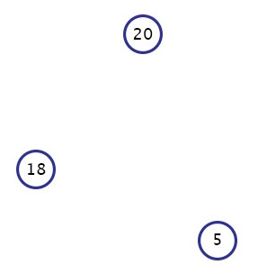
History
Firefly algorithm was proposed in 2008 by Xin-She Yang
One firefly can be attracted to any other fireflies
Attractiveness is proportional to the brightness
The brightness of firefly is determined by the
landscape of objective function
Rules
random
2
www.NoavaranGermi.ir

Slide 3
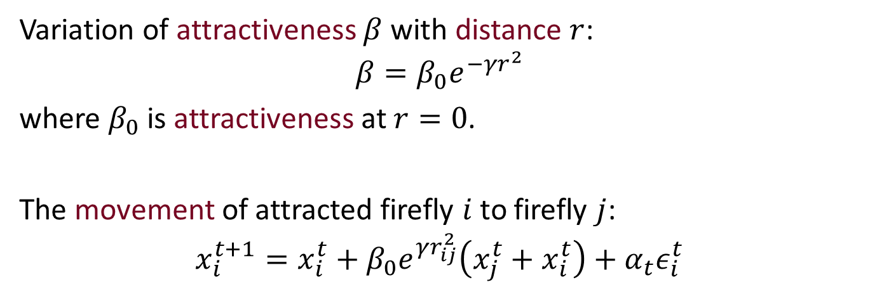

Definitions
Variation of attractiveness $β$ with distance $r$:
$$β=β_{0}e^{−γr^{2}}$$
where $β_{0}$ is attractiveness at $r=0$.
The movement of attracted firefly $i$ to firefly $j$:
$$x_{i}^{t+1}=x_{i}^{t}+β_{0}e^{γr_{ij}^{2}}\left(x_{j}^{t}+x_{i}^{t}\right)+α_{t}ε_{i}^{t}$$
3
www.NoavaranGermi.ir

Slide 4

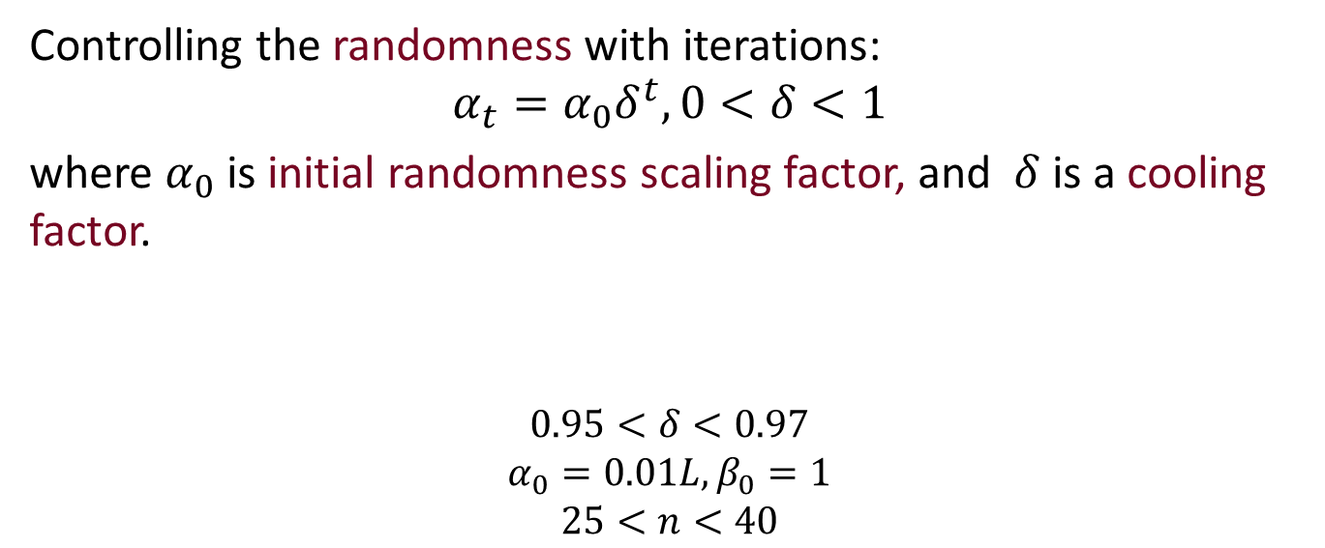
Tuning $α$
Controlling the randomness with iterations:
$$α_{t}=α_{0}δ^{t}, 0<δ<1$$
where $α_{0}$ is initial randomness scaling factor, and $δ$ is a cooling factor.
$$0.95<δ<0.97$$
$$α_{0}=0.01L,β_{0}=1$$
$$25<n<40$$
Parameters that proved to work
4
www.NoavaranGermi.ir

Slide 5
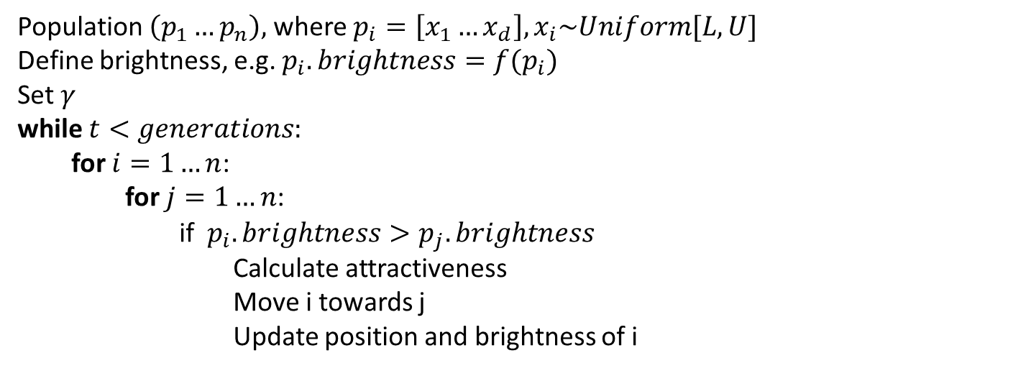
Algorithm
Population $\left(p_{1}…p_{n}\right),$ where $p_{i}=\left[x_{1}…x_{d}\right], x_{i}\sim Uniform[L, U]$
Define brightness, e.g. $p_{i}.brightness=f(p_{i})$
Set $γ$
while $t<generations:$
for $i=1…n$:
for $j=1…n$:
if $p_{i}.brightness>p_{j}.brightness$
Calculate attractiveness
Move i towards j
Update position and brightness of i
5
www.NoavaranGermi.ir

Slide 6

complexity
Extreme case: $O(n^{2}t)$
When $n$ is relatively large: $O(nt∙log(n))$
6
www.NoavaranGermi.ir

Slide 7
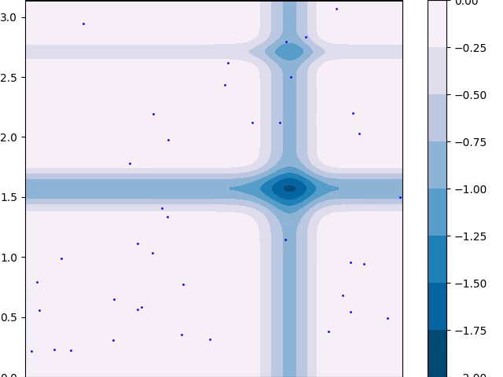
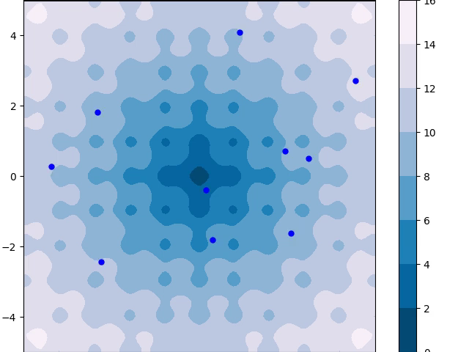
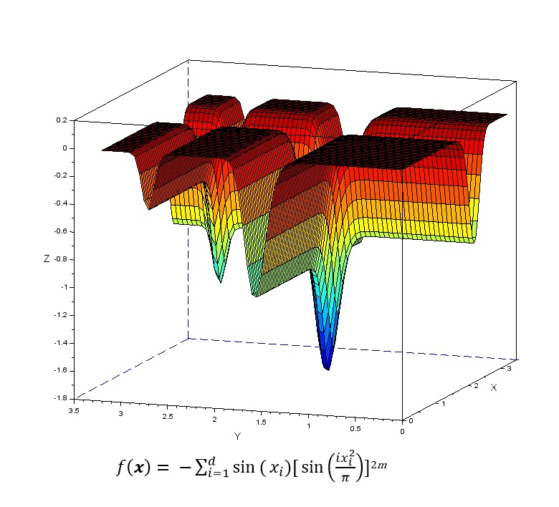
Demo
Ackley’s function
Michalewicz’s function
7
www.NoavaranGermi.ir

Slide 8
Some Applications
Digital image compression
Highly nonlinear, multimodal problems
Engineering design problems
Classification and clustering
modifications
Discrete versions of algorithm
Combinations with other algorithms like DE
8
www.NoavaranGermi.ir

Slide 9
+/-
+ Automatical subdivision
+ Ability of dealing with multimodality
- Possibility to get stuck in local optima in high dimensional problems
9
www.NoavaranGermi.ir

Slide 10

conclusions
Fine-tuning the right amount of randomness and balancing local search and global search are crucially important in controlling the performance of any metaheuristic algorithm.
FA reveals better performance in several tasks like digital image compression, antenna design optimization, etc.
The presentation and demo are available on my Github page: https://github.com/JessikaSmith/OptimisationAlgorithms
10
www.NoavaranGermi.ir

Slide 11

Thank you for attention!
Any questions?
www.NoavaranGermi.ir

