Slide 1
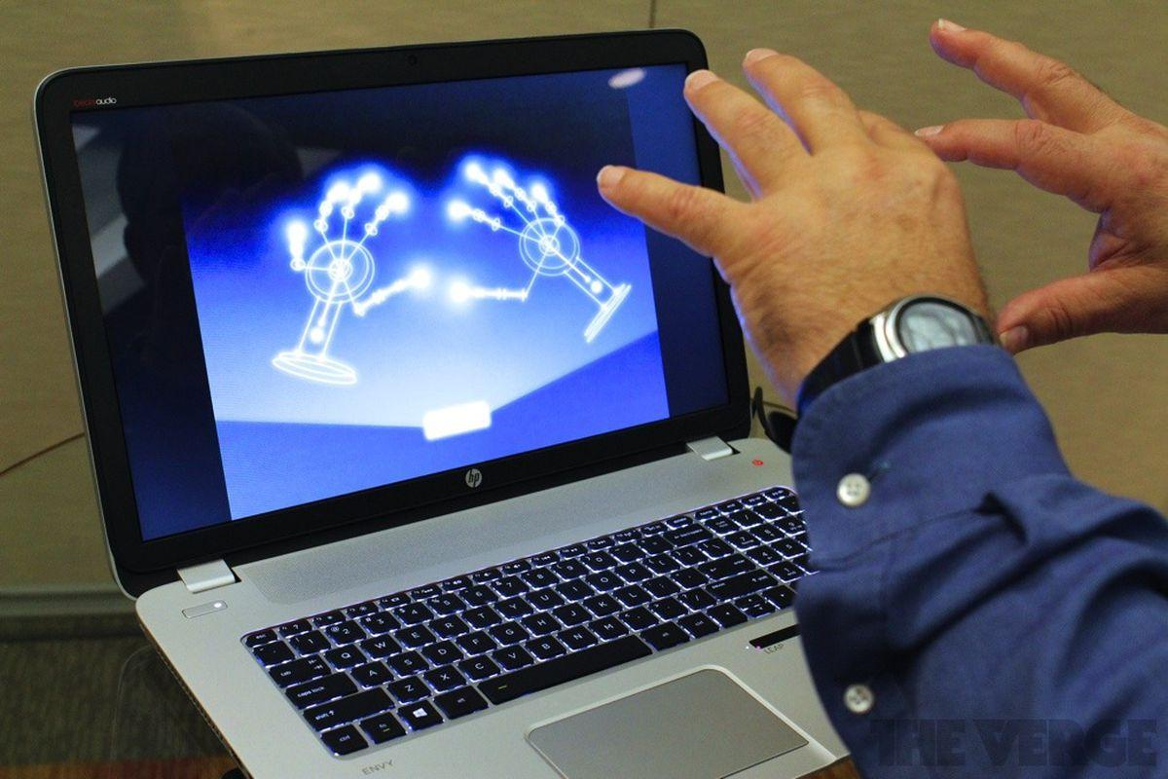
Gesture Recognition and Navigation
Guided By
Mr. D. Nagendra
Batch No : 8
21331A1269 - M.Jai Vardhan
21331A12C0 - V.Hari Prasad
21331A12B6 - Vaibhav Agarwal
Notes:
Entered text
"Unveiling the Future: Harnessing AI-driven Hand Gesture Recognition for Revolutionary PDF Navigation"
In the realm of human-computer interaction, the intersection of artificial intelligence (AI) and gesture recognition technology presents an exciting frontier. This project delves into the transformative potential of incorporating AI-driven hand gesture recognition to redefine the way users interact with PDF documents. The conventional modes of navigating through PDFs, reliant on keyboard and mouse inputs, often fall short in terms of intuitiveness and accessibility. In response to this, our project aims to explore the integration of advanced computer vision algorithms and depth-sensing cameras to interpret and respond to hand gestures, providing users with a more natural and immersive means of controlling the movement and manipulation of PDFs.
The central question guiding this endeavor is: How can AI-driven hand gesture recognition technology enhance PDF navigation, and what are the implications for user experience and accessibility? By leveraging cutting-edge technology, we seek to empower users to perform actions such as scrolling, zooming, and page flipping through a simple and intuitive gestural interface. This innovative approach not only holds the promise of simplifying interactions but also addresses accessibility concerns for individuals with limited dexterity or those seeking a more engaging reading experience.
As we embark on this exploration, our project aims to unravel the intricacies of designing and implementing a robust system that seamlessly integrates AI algorithms with gesture recognition capabilities. Through this process, we anticipate uncovering insights into the technical challenges, user acceptance, and potential applications of this novel approach. Additionally, we aspire to understand the broader implications of AI-enhanced document navigation, offering a glimpse into the future of human-computer interaction and its impact on digital document management systems. This PowerPoint presentation will distill the key aspects of our research, from the underlying technology to the anticipated benefits, providing a comprehensive overview of our project's objectives, methodology, and expected contributions to the evolving landscape of interactive digital experiences."

Slide 2
Abstract
Gesture navigation refers to using hand movements to navigate through web pages or applications. Existing Gesture navigation systems are mostly sensor based which are impractical and expensive for use in everyday environments as they are not portable. The webcam based systems use heavy weight Machine Learning models which are hard to train on basic machines.
Our project aims to design a system that uses hand gestures to navigate through powerpoint presentations which can be useful for uninterrupted learning in classroom environments. The system utilizes deep learning models along with computer vision techniques to track and recognise hand gestures which is then used to control Powerpoint documents using Component Object Model Interfaces and python Libraries. Using COM makes our system portable for any machine and thus offers easy accessibility to the users.

Slide 3
Introduction
Deep learning is a sub domain of Machine learning that uses artificial neural networks to model and understand complex patterns in data. Deep learning models are inspired by human brain and can recognise objects and even classify them with great accuracy. These are essentially interconnection of many layers of nodes that can be trained to create models that can be used for various applications.
Gesture navigation is usage of gestures to navigate through different computer applications. It is a combination of two tasks, Gesture recognition and then navigation. Gesture recognition involves recognising the gesture and classifying it. We use Deep learning models like CNN and LSTM among others can be used to recognise hand gestures with real time with accuracy. The recognised gesture is then be used to navigate by making use of scripting language python’s various libraries and using application programming interfaces provided by microsoft .

Slide 4
Literature Survey
Reference Number | Year | Author(s) | Title | Description | Techniques | Metrics | Observations/Limitations
1 | 2023 | Huynh, V.D., et al. | Real-Time Hand Gesture Recognition System Using MediaPipe and LSTM | System for navigation gestures using MediaPipe and LSTM. | MediaPipe hand landmarks + LSTM | Accuracy, Precision, Recall | 92% accuracy for basic navigation gestures. Limited gesture vocabulary.
2 | 2022 | Kumar, S., et al. | Smart Home Automation-Based Hand Gesture Recognition Using Feature Fusion and Recurrent Neural Network | Hand gesture recognition for home automation using MediaPipe and LSTM. | MediaPipe hand features + LSTM | Accuracy, F1-score | 95% accuracy for home automation gestures. Requires labeled training data.
3 | 2022 | Rao, N.S., et al. | Contactless System Navigation Using Dynamic Hand Gesture Recognition | Dynamic gesture recognition for navigation in virtual environments using MediaPipe and CNN-LSTM. | MediaPipe hand landmarks + CNN-LSTM | Accuracy, Recall, F1-score | 88% accuracy for navigation gestures. Complex network architecture.

Slide 5
Reference Number | Year | Author(s) | Title | Description | Techniques | Metrics | Observations/Limitations
4 | 2022 | Gupta, A., et al. | Lightweight Deep Learning Techniques with Advanced Processing for Real-Time Hand Gesture Recognition | Lightweight deep learning for real-time gesture recognition with MediaPipe. | MediaPipe hand landmarks + GRU network | Accuracy, Speed, Power consumption | Achieves real-time performance with 90% accuracy. Limited dataset size.
5 | 2022 | Nguyen, H.V., et al. | A Real-time Hand Gesture Recognition System for Human-Computer Interaction Using MediaPipe and TensorFlow Lite | Real-time gesture recognition for mobile devices using MediaPipe and TensorFlow Lite. | MediaPipe hand landmarks + LSTM | Accuracy, Speed | 94% accuracy for basic navigation gestures. Optimized for mobile platforms.
6 | 2022 | Kumar, N., et al. | Hand Gesture Recognition for Robot Control Using MediaPipe and Deep Learning LSTM Model | Hand gesture recognition for robot control using MediaPipe and LSTM. | MediaPipe hand landmarks + LSTM | Accuracy, Success rate | 85% success rate for robot control with gestures. Limited robot actions explored.

Slide 6
Reference Number | Year | Author(s) | Title | Description | Techniques | Metrics | Observations/Limitations
7 | 2022 | Wang, W., et al. | MediaPipe's Landmarks with RNN for Dynamic Sign Language Recognition | Sign language recognition using MediaPipe and RNNs (including LSTMs). | MediaPipe hand landmarks + RNN | Accuracy, Word Error Rate | Demonstrates effectiveness of MediaPipe for sign language. Further research needed for complex signs.
8 | 2020 | Yeasin, M.S., et al. | Hand Gesture Recognition Using Convolutional Neural Networks and Long Short-Term Memory Networks | Hand gesture recognition using CNNs and LSTMs. | CNN + LSTM | Accuracy, Precision, Recall | 97% accuracy on benchmark datasets. Not specifically focused on MediaPipe.

Slide 7
Reference Number | Year | Author(s) | Title | Description | Techniques | Metrics | Observations/Limitations
9 | 2020 | Roy, S.K., et al. | A Hybrid Deep Learning Approach for Accurate Hand Gesture Recognition | Hybrid deep learning approach (CNNs & LSTMs) for hand gesture recognition. | CNN + LSTM | Accuracy, F1-score | 98% accuracy on various datasets. Complex model architecture.
10 | 2019 | Wu, Y., et al. | Hand Gesture Recognition with Attention Mechanism and LSTM Network | Hand gesture recognition with attention mechanism and LSTM. | Attention mechanism + LSTM | Accuracy, Precision, Recall | 92% accuracy compared to baseline LSTM. Not focused on MediaPipe or navigation.

Slide 8
Existing System
Existing gesture navigation systems can be broadly classified into two two types.
1.Sensor Based - These are basically wearable devices that use sensors like accelerometer and gyroscopes to track hand movements and perform navigation. While the system offers accurate and fast gesture recognition. There are several limitations with these systems like,
High cost.
Susceptible to errors due to change in environment like temperature etc.
Requires high maintenance.
Addition hardware required.
Lack of portability.
2.Vision Based - These systems use camera’s, mostly sophisticated to detect and classify hand gestures using Machine Learning models. Despite being less expensive than Sensor based model, existing systems still suffer from disadvantages like,
Requires large dataset of training data
Prone to errors due to variation in distance, lightning.
Training the model requires heavy computing capabilities which is often not feasible.

Slide 9
Proposed System
Based on our literature survey and researching potential solutions, we found scope for improvement in existing gesture navigation system which can overcome the limitations.
Our proposed system is a Vision Based gesture navigation system that aims to improve on the limitations of the existing systems. To improve on the existing systems it has the following features.
Uses mediapipe module for the task of hand recognition which saves a lot of computation time involved in gesture recognition.
Can work with varying lighting conditions and from distances upto 5 feet.
Cost expensive - requires virtually no additional hardware as it works with inbuilt webcams.
Our project uses the Component Object Module framework from microsoft which makes the project compatible with different types of system allowing for a more diverse applications of our system.
+

Slide 10
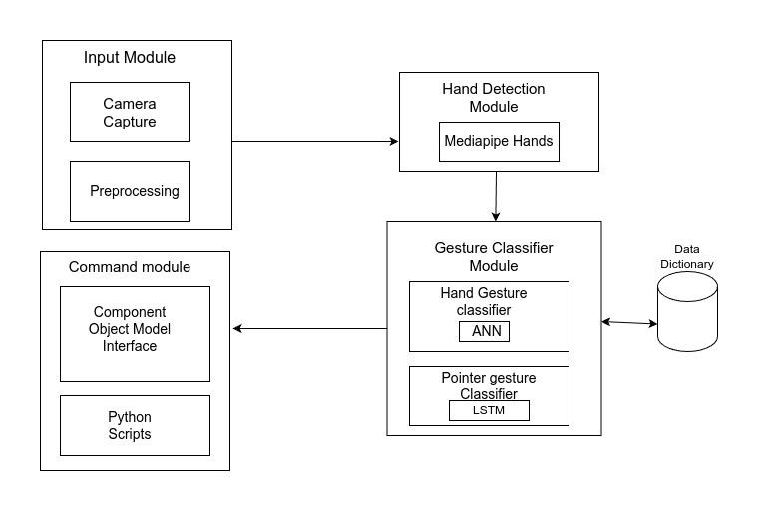
Proposed System - Module Diagram

Slide 11
