Slide 1
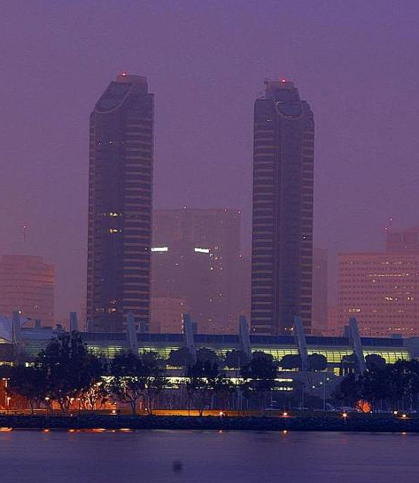
GeoBus
MERN A3

Slide 2
Introduction
We are thrilled to introduce GeoBus, an innovative and intelligent live bus tracking model designed exclusively for KL University. At the intersection of technology and convenience, GeoBus is set to redefine the way you experience campus transportation.

Slide 3
Key Points
Real-Time Tracking: Stay informed with live updates on the exact location of each bus in our fleet. No more waiting in uncertainty—know exactly when your ride will arrive.
Efficient Routing: GeoBus optimizes bus routes in real-time, ensuring the most efficient and timely transportation across the campus. Say goodbye to unnecessary delays and hello to smoother commutes.
User-Friendly Interface: Accessible via web and mobile platforms, our user-friendly interface lets you effortlessly track buses, plan routes, and receive timely notifications, putting you in control of your commute.
Safety First: With built-in safety features, GeoBus ensures the well-being of passengers. Emergency alerts, secure tracking, and proactive monitoring contribute to a secure and reliable transit experience.

Slide 4
How It Works:
Simply visit our GeoBus web app to gain instant access to real-time bus locations, arrival times, and route information. The intuitive interface makes it easy for students, faculty, and staff to navigate the campus with confidence.

Slide 5
Future Scope
This web app can be integrated to our ERP portal so that it is accessible to parents ,staff , Faculty and Students .
Adding features like searching for student location or browsing which route number to take to reach to destination gets easier.
Predictive Analytics for Traffic and Delays using Google Maps.

