Slide 1
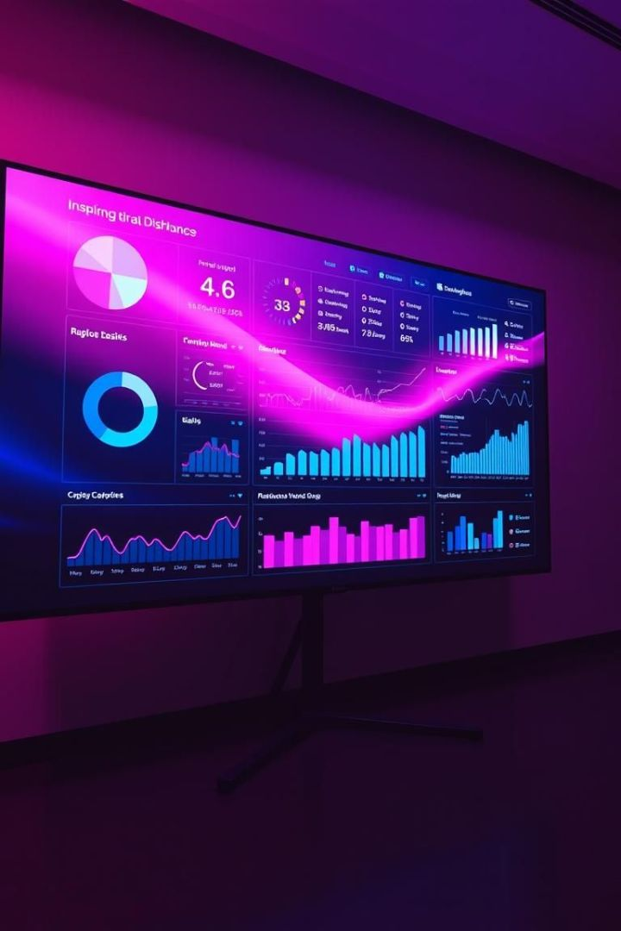
AWS CloudWatch Dashboard for Monitoring Application Metrics
A visually engaging overview of creating interactive dashboards with AWS QuickSight.
Vaibhav Jawalkar - 2210030065

Slide 2




Introduction to AWS CloudWatch
Transforming data into actionable insights.
Interactive Dashboards
Actionable Insights
Scalable and Secure
Visualize key business metrics.
Drive data-driven decisions.
AWS cloud infrastructure.

Slide 3





Core AWS Services for Data Visualization
CloudWatch
S3
Glue
Interactive BI Dashboards
Scalable Data Lake
ETL Data Pipeline
IAM
Secure Access Control

Slide 4




Architecture and Workflow
Data Sources (S3)
Data Transformation (Glue)
Data Visualization (QuickSight)
Raw data storage
ETL processing
Interactive dashboards

Slide 5
Service Interaction
S3 Data Storage
Glue ETL
QuickSight Dashboard
IAM Security
Centralized data lake.
Transforms data.
Secure access
Analyzes and visualizes.

Slide 6
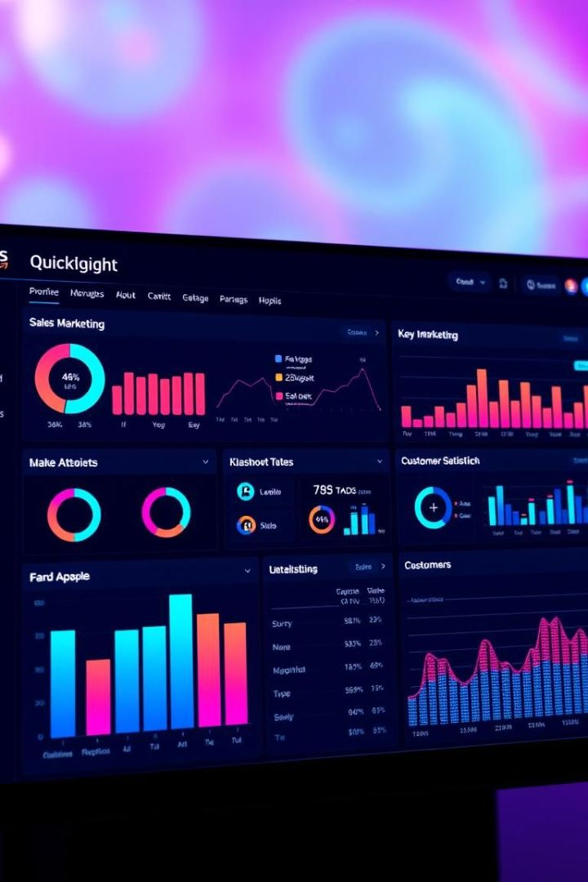
Implementation Steps
Connect to S3
Configure data source.
Prepare Data with Glue
Clean and transform.
Visualize in QuickSight
Create interactive dashboard.

Slide 7






Security Best Practices
Data Encryption
Protect data at rest.
IAM Roles
Network Security
Grant limited permissions.
Secure VPC configuration.

Slide 8

Key Takeaways
Data-Driven Decisions
AWS Integration
Insights from data.
Seamless service.
Enhanced Security
Secure data handling.

