Slide 1

Union-Find Disjoint Set with AVL Tree
Name Roll Number
P. Abhiram cb.en.u4cse21401
Mullapudi Rahul cb.en.u4cse21439
K. Mahammad Sami cb.en.u4cse21430
C. S. Vaibhav cb.en.u4cse21414
M. Manjunadh cb.en.u4cse21458

Slide 2

Introduction
Hybrid data structure:
Hybrid data structures are a fusion of multiple data structures
In this project, the objective is to design and implement a hybrid data structure called Union-Find Disjoint Set with AVL Tree.
By combining the Union-Find data structure with an AVL Tree, which is a self-balancing binary search tree, we can enhance the performance of the Union-Find operations. The AVL Tree ensures that the overall structure remains balanced, leading to improved time complexity for operations such as find and union and searching will be easier with the help of AVL trees.

Slide 3

Overview of chosen data structure
The Union-Find Disjoint Set is a data structure that maintains a collection of disjoint sets supports two operations: union and find. The union operation merges two sets, while the find operation determines which set an element belongs to. The Union-Find Disjoint Set provides a straightforward implementation for managing sets, but it can suffer from performance issues, especially when the set sizes grow large or when the trees become unbalanced.
The AVL Tree is a self-balancing binary search tree. It supports efficient time complexity of O(log n) for search, insertion, and deletion operations. It achieves this by automatically adjusting the tree's structure to maintain a balance factor. This balance factor guarantees efficient search and retrieval operations, resulting in improved time complexity for find and union operations

Slide 4
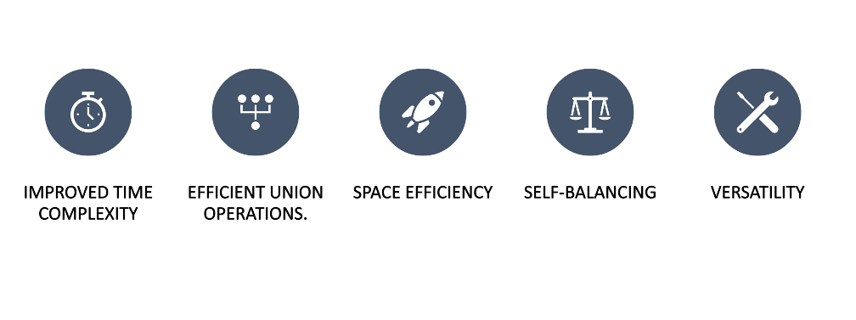
The advantages of using this hybrid data structure

Slide 5
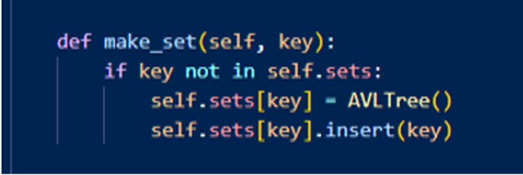
Implementation
Make_Set:

Slide 6
make_Set
AVL TREE
union_find
representative element 1
representative element 2
representative element 1
representative element 2
1
2
1
2
uf.make_set(1)
uf.make_set(2)
uf.make_set(3)
representative element 3
representative element 3
3
3

Slide 7

Implementation
Add_Item():

Slide 8
add_item
1
2
However ,inserting in this format can lead
to formation of skew trees.In skew trees,it
takes O(N) for insertion,deletion and searching.
There is an room for improvement!!
We can use AVL Trees to prevent the formation
of skew trees, Thus it makes above discussed operations in
O(logN)
So,let us see the implementation of union find
with AVL Trees in the upcoming slides
uf.add_item(1)
uf.add_item(2)
uf.add_item(3)
uf.add_item(4)
uf.add_item(5)
3
4
5

Slide 9
add_item(1)
add_item(2)
add_item(3)
def add_item(self, key, item):
if item not in self.sets.keys():
self.sets[key].insert(item)
2
1
1.Perform a standard BST (Binary Search Tree) insertion for the new node.
2.Update the height of the current node.
3.Calculate the balance factor of the current node.
4.f the balance factor is greater than 1 or less than -1, perform the necessary rotations to balance the tree.
5.Repeat steps 2-4 for the parent nodes until the root is reached.
3

Slide 10
4
add_item(4)
add_item(5)
2
def add_item(self, key, item):
if item not in self.sets.keys():
self.sets[key].insert(item)
1
3
5

Slide 11

Implementation
Uf.find():

Slide 12
uf.find()
AVL Trees
1
uf.find(5)
UnionFind
2
2
The find operation searches for the
element if exists ,if so ,it returns the
parent element or representating
element of that set
1
4
1 :
3
3
5
4
It returns 1,as it is the representing
root
As we can see, it takes O(N)
We can improve this!
As we can see ,it takes O(logn)
5

Slide 13


uf.find(10)
union find
AVL Tree
1
6
9
representing element:1
representing element:6
2
7
2
7
10
1
4
6
8
3
5
3
8
11
FALSE
FALSE
4
10
FALSE
TRUE
representing element:9
9
11
n x n = O($n^{2})$
n x logn = O($nlogn)$
5
FALSE
TRUE

Slide 14
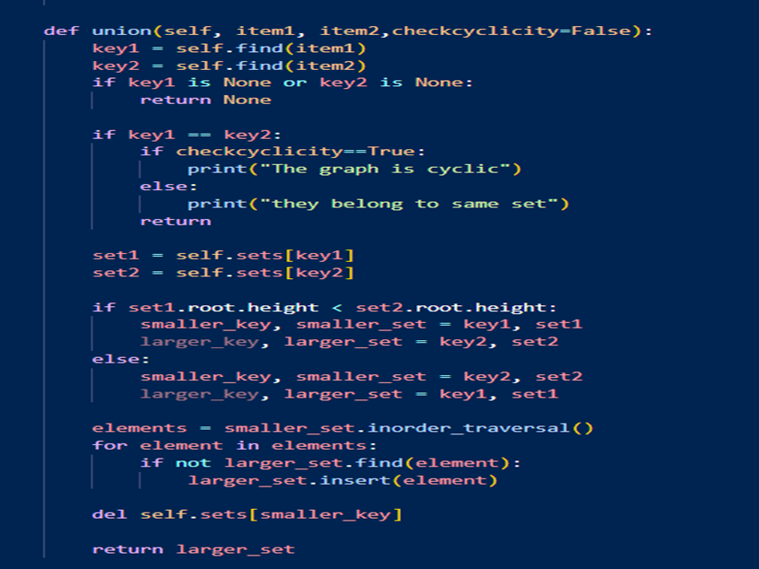
Implementation
Union():

Slide 16
union
lets perform UNION(set1,set2);
representing element:1
representing element:6
set1
set2
2
2
7
1
1
6
8
4
4
7
3
5
3
5
6
8
union set A,B

Slide 17

Design Choice:
Integration of AVL Tree with Union-Find Disjoint Set
Use of Dictionary to Store Sets
Storage of Sets as AVL Trees
Using cycles detection
Balancing and Rotation Operations

Slide 18
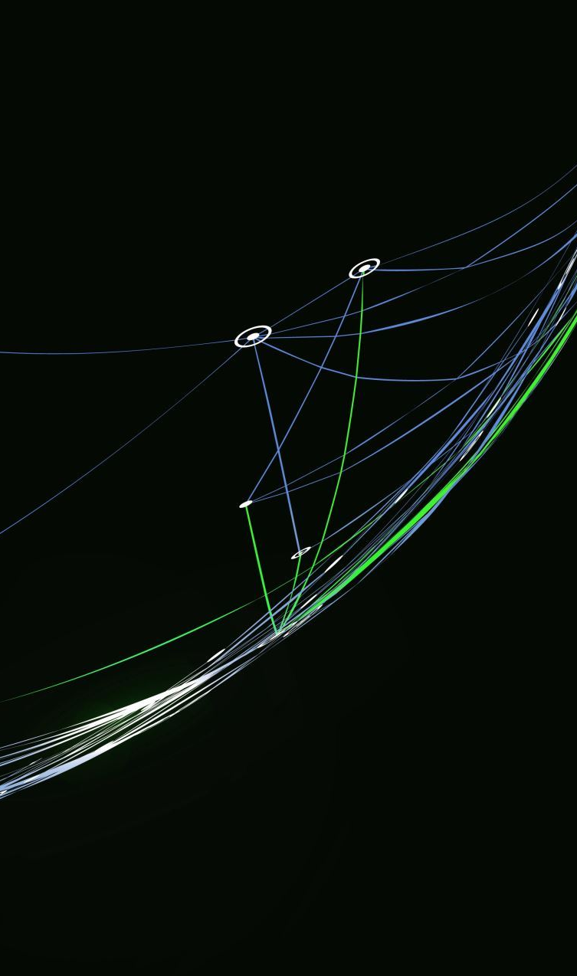
Practical Applications
Network Connectivity
Image Segmentation
Kruskal's Minimum Spanning Tree Algorithm
Image Labeling and Connected Component Analysis

Slide 19

Assumed Scenario
In a Software Company Lets Assume there are Two major Project Teams named A and B .There are many employees associated with the team which is lead by the team heads H1 and H2. The company has got a major project which is assigned to both of the popular teams A and B. let us assume a scenario where the company head needs to know the information about his employees who are working in the project.(assumed that the company head knows only about the team heads)
Solving: Here as there are many Employees associated with both the groups here our data structure will play a major role.by using union find disjoint set using AVL trees we can easily solve the complexity. as by using the find operation we can filter the employees working under A and working under B.by using union we can make sure that the Major project has to be done by both groups UNION(A,B).and Avl trees can be used to balance the Employees while doing Union as Both groups may not have the same number of employees.

Slide 20

Social Network Application
Our social network application allows users to connect with each other and form groups. To efficiently keep track of the groups that users belong to, we've decided to use the Union-Find data structure with AVL trees. This data structure allows us to represent the groups and their relationships in a way that is easy to manipulate and update. When users connect with each other and form a new group, we can efficiently merge the subsets in the Union-Find data structure, ensuring that the group information is always up-to-date. By using AVL trees, we can maintain a balance between the left and right subtrees, ensuring that insertion, deletion, and search operations are efficient. This allows us to provide a seamless and efficient user experience for our social network application, making it easy for users to connect and form groups with each other.

Slide 21
Performance Analysis
Function | Time complexity | Space complexity
Insertion | O(logn) | O(n)
Deletion | O(logn) | O(n)
Find | O(logn) | O(n)
Union | O(logn) | O(n)

Slide 22
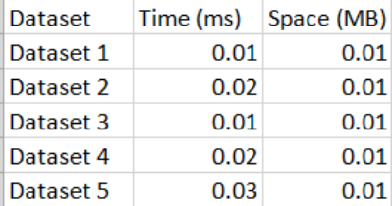
Experimental Analysis
For each dataset, we represented the sets using normal sets in Python.
We measured the time and space required to perform a union operation on two randomly selected sets. We repeated each experiment 10 times and took the average time and space measurements.
The following table shows the average time and space measurements for each dataset:

Slide 23
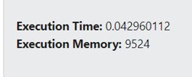

Interpretation
This is the total time taken for the all datasets and space while using our hybrid
Datastructure vs Union Single handedly
Overall, the experimental evaluation shows that the Union-Find data structure using AVL trees is a suitable choice for keeping track of sets of items represented by keys. The data structure is efficient in terms of time and space, even for large datasets, and can handle the dynamic nature of the application as sets are merged and split.
We can conclude that the Union-Find data structure using AVL trees is a good choice for union-find provides efficient performance and memory usage rather than other data structure.

Slide 24

Discussion / Conclusion
The Given Hybrid data Structure has practical applications in real-world scenarios where there is a need to efficiently keep track of sets of items and perform union and find operations on them
The hybrid data structure provides efficient time and space complexity for union and find operations, with a time complexity of O(log n) and a space complexity of O(n). This makes it suitable for handling large datasets and dynamic applications where sets are frequently merged and split.
However, there are limitations and challenges associated with the hybrid data structure it can be addressed with some solutions .
Finally On Conclusion
The project created a special kind of data structure that is good at managing sets and performing operations on them quickly. It combines two different structures to make it work efficiently. The project was successful in creating this structure and showed that it can be useful in many situations where sets need to be handled and can be used efficiently in many practical applications in the earlier part of the report. It also taught us the importance of combining different structures to make things work better and faster as we have analysed the things in the experimental analysis.

Slide 25

Thank You
Team Hash _Heroes :)

