Slide 1
UNDERGRADUATE MACHINE LEARNING RESEARCH PROJECT
Learning to Schedule:
Reinforcement Learning-Based Adaptive CPU Scheduling Using PPO
Learning Dynamic Scheduling Policies Through Reinforcement Learning
Department of Computer Science & Engineering | Indian Institute of Technology Guwahati
Student Presenter: Vaibhav-CD • Supervisor / Evaluator Committee • Academic Year 2026-2027
Notes:
Good morning, respected professors and members of the evaluation committee. Today, I am presenting our undergraduate Machine Learning research project titled 'Learning to Schedule: Reinforcement Learning-Based Adaptive CPU Scheduling Using PPO'.
While CPU scheduling is the target application domain, this project is primarily an experimental study in Reinforcement Learning, specifically focusing on Proximal Policy Optimization (PPO), Markov Decision Process modeling, reward engineering, and quantitative generalization across stochastic environments.
Over the next 15 slides, I will guide you through our mathematical formulation, the reward engineering breakthroughs that determined our success, our 144 benchmark runs across six distinct workload families, and the crucial trade-offs between latency, context switching, and fairness.

Slide 2
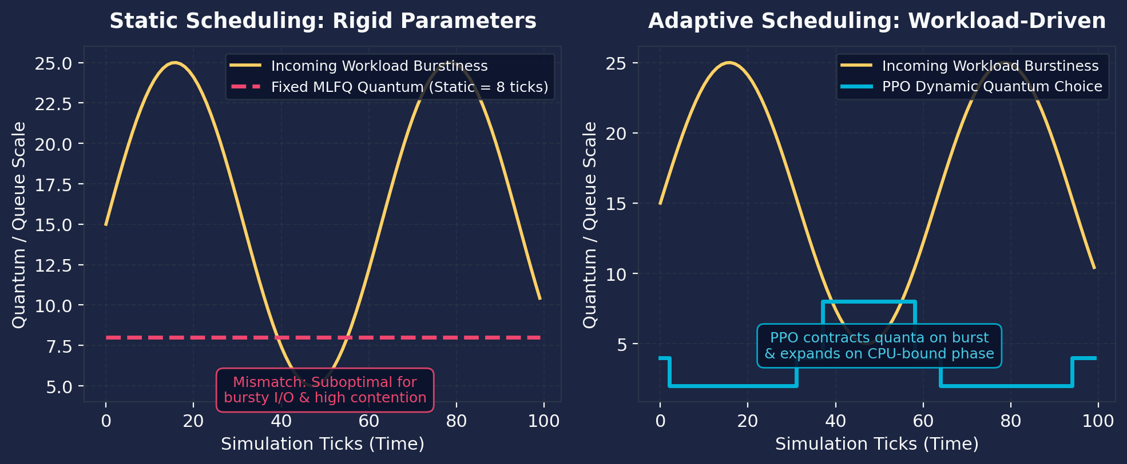
INTRODUCTION & MOTIVATION
Problem Statement: The Limits of Static CPU Scheduling
Why fixed operating system heuristics struggle under dynamic, non-stationary workloads
Core Motivation & Challenge
Static vs. Dynamic Adaptive Scheduling
• Static Predefined Rules:
Traditional operating system schedulers (Round Robin, default MLFQ) rely on fixed, hard-coded parameters determined at kernel build time.
• Workload Heterogeneity:
Compute-heavy batches benefit from long quanta (minimizing context switch overhead), whereas interactive I/O-bound jobs demand micro-quanta for low response latency.
• Dynamic Non-Stationarity:
Production systems undergo continuous traffic shifts (e.g., sudden burst arrivals, phase transitions between I/O and CPU). Fixed configurations cannot adapt dynamically.
• Combinatorial Tuning Cost:
Manually fine-tuning queue depths, quantum steps, and boost intervals requires exhaustive grid search over endless workload distributions.
RESEARCH QUESTION: Can a reinforcement learning agent learn to adapt scheduling configurations dynamically and perform competitively against manually optimized schedulers without per-scenario hand-tuning?
Notes:
In modern computing systems, CPU scheduling governs how processing time is multiplexed across concurrent tasks.
Classical CPU schedulers like Round Robin or standard Multi-Level Feedback Queues rely on static configuration parameters. For example, a fixed quantum of 8 ticks. However, workloads are inherently heterogeneous and non-stationary. When interactive I/O bursts arrive, short quanta are essential to maintain responsiveness; conversely, during long computational batch phases, short quanta cause severe context-switch thrashing.
Manual parameter tuning requires expensive offline benchmarking and is inherently brittle when the runtime traffic shifts.
This leads directly to our core research question: Can a reinforcement learning agent learn an online policy that monitors scheduler queue states and dynamically tunes parameters to match or outperform expertly optimized static configurations?

Slide 3
MACHINE LEARNING FOUNDATIONS
Why Reinforcement Learning? Sequential Decisions Under Uncertainty
Why RL is uniquely suited for systems configuration compared to supervised learning or static heuristics
1. Fixed Rules (Classical)
2. Rule-Based Heuristics
3. Learned Policy (RL)
• Zero runtime adaptation to workload shifts.
• Relies on static compromises (e.g. quantum=8).
• Severe latency degradation during arrival bursts.
• High average waiting times when job variance is high.
• Uses hand-crafted threshold 'if-then' rules.
• Myopic: reacts purely to instantaneous load.
• Suffers from switching thrashing: measured 598 context switches in our experiments!
• Fragile and hard to generalize to unseen traffic.
• Learns direct state-to-configuration mapping.
• Accounts for delayed consequences via reward discounting (gamma = 0.99).
• Maximizes long-term cumulative throughput & latency.
• Maintains stability: only 180 context switches!
Why Not Supervised Learning (SL)?
1. Closed-Loop Covariate Shift: Every configuration decision alters process execution speeds and queue backlogs, directly changing future input states. SL assumes independent and identically distributed (i.i.d.) data, which breaks in closed-loop systems.
2. Absence of Optimal Oracle Labels: Under non-stationary, stochastic job arrivals, no computationally tractable oracle exists to generate per-tick 'ground-truth' configuration labels.
3. Delayed Consequences & Credit Assignment: Shortening a quantum at time t relieves immediate interactive latency but can cause backlog buildup at t + 40. RL's discount factor (gamma = 0.99) explicitly models this credit assignment.
Notes:
A natural question in Machine Learning evaluation is: why Reinforcement Learning rather than Supervised Learning or expert heuristic rules?
First, fixed rules cannot adapt. Rule-based adaptive heuristics seem attractive, but as our experimental data later demonstrates, simple reactive thresholds oscillate rapidly, resulting in extreme context switch thrashing—nearly 600 context switches!
Second, Supervised Learning is unsuited for this problem for two core mathematical reasons:
1. Covariate shift: in a closed-loop system, the scheduler's actions directly alter the distribution of future states.
2. The absence of oracle labels: under stochastic process arrivals, there is no oracle dataset providing optimal configuration labels at every step.
Reinforcement Learning provides the exact mathematical framework needed: sequential decision making under uncertainty, where actions have delayed consequences and learning is driven by cumulative scalar rewards.

Slide 4
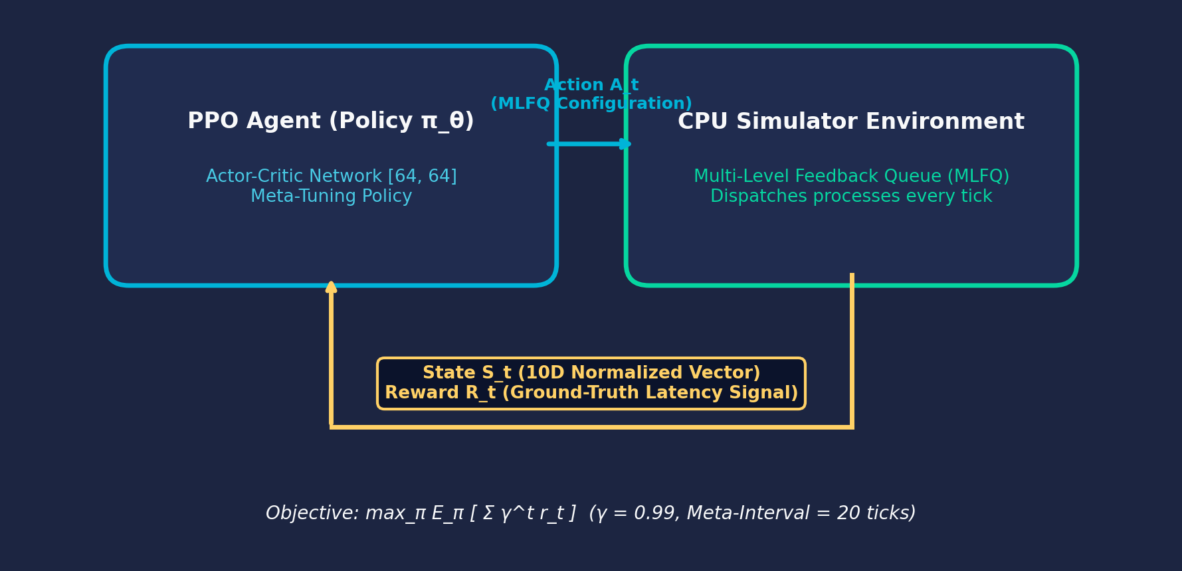
MATHEMATICAL FORMULATION
Markov Decision Process (MDP) for MLFQ Meta-Tuning
Rigorous formulation of state space, discrete action parametrization, transitions, and objective
MDP Tuple: M = (S, A, P, R, gamma)
Closed-Loop MDP Interaction Cycle
State Space S (10 Normalized Continuous Features in [0, 1]):
• s[0]: Ready queue length / 20 (congestion level)
• s[1]: Recent CPU utilization (busy ticks / 20)
• s[2]: Mean waiting time of completed jobs / 100
• s[3]: Completion progress (completed / total procs)
• s[4]: Mean current burst length / 30
• s[5]: Standard deviation of current bursts / 30
• s[6]: Current Q0 quantum / 8
• s[7]: Current boost interval / 100
• s[8]: Elapsed simulation ticks / max_ticks
• s[9]: I/O process share (fraction with I/O phases)
Action Space A: Discrete(10) configurations
• Each action selects a full MLFQ tuple: (q0, q1, q2, q3, boost_interval)
• Quanta range from 1 to 32 ticks; boost intervals in {0, 25, 50, 100}.
Optimization Objective:
max_pi J(pi) = E_pi [ sum_{t=0}^T gamma^t * r_t ], where gamma = 0.99
Notes:
Here we present the formal mathematical definition of our Markov Decision Process. The system is defined by the 5-tuple (S, A, P, R, gamma).
Our state vector S consists of 10 continuous, normalized features strictly in the range [0, 1]. Notice that none of these features leak future burst information—they represent strictly observable runtime metrics such as queue congestion, recent CPU utilization, burst statistics of ready tasks, and I/O ratios.
The action space A is discrete, representing valid MLFQ parameter tuples. Crucially, the agent is not making decisions per-tick on which process to run. Instead, it acts as a meta-controller: selecting quantum lengths and boost intervals every 20 ticks.
The objective J(pi) maximizes the expected discounted cumulative return with gamma = 0.99, ensuring the policy values both immediate latency reduction and long-term avoidance of queue backlogs.

Slide 5
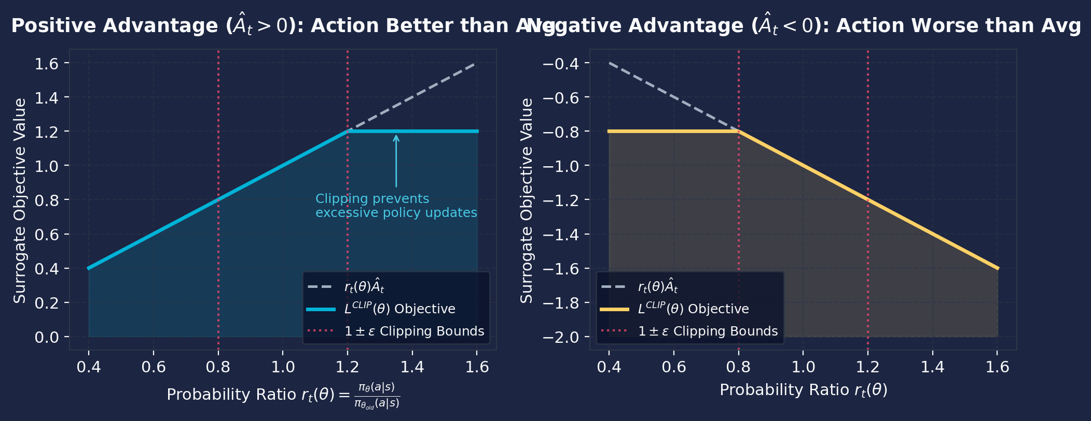
REINFORCEMENT LEARNING THEORY
Proximal Policy Optimization (PPO): Mathematical Foundations
Policy gradients, advantage estimation, and clipped surrogate objective for stable policy updates
Actor-Critic & Clipped Objective
PPO Clipping Mechanics (epsilon = 0.20)
1. Policy Gradient Theorem:
grad_theta J(theta) = E_t [ grad_theta log pi_theta(a_t|s_t) * A_hat_t ]
2. Generalized Advantage Estimation (GAE):
A_hat_t = sum_{l=0}^inf (gamma * lambda)^l * delta_{t+l}^V
where delta_t^V = r_t + gamma * V(s_{t+1}) - V(s_t). (gamma=0.99, lambda=0.95)
3. Probability Ratio:
r_t(theta) = pi_theta(a_t|s_t) / pi_theta_old(a_t|s_t), with r_t(theta_old) = 1.0
4. Clipped Surrogate Objective L^{CLIP}(theta):
E_t [ min( r_t(theta)*A_hat_t, clip(r_t(theta), 1-eps, 1+eps)*A_hat_t ) ]
with clipping threshold epsilon = 0.20.
Why PPO for Systems Scheduling?
• Standard policy gradient updates can suffer from catastrophic policy collapse if a step is too large in sensitive queueing environments.
• PPO's clipping enforces a trust region, bounding policy divergence without the heavy second-order Hessian computation of TRPO.
Notes:
Slide 5 covers the mathematical foundation of our learning algorithm: Proximal Policy Optimization (PPO).
Standard policy gradient methods compute gradients by weighting the score function by an advantage estimate. We compute this advantage using Generalized Advantage Estimation (GAE) with lambda = 0.95 and gamma = 0.99, which provides a tunable trade-off between bias and variance.
However, standard policy gradient methods suffer from a severe flaw in systems scheduling: an overly ambitious update can push the policy into a catastrophic region—for example, choosing degenerate quanta that cause infinite queue buildup—from which recovery is almost impossible.
PPO solves this through its clipped surrogate objective, shown here. By taking the minimum between the unclipped objective and the clipped ratio bounded between 1 - epsilon and 1 + epsilon, with epsilon = 0.2, PPO establishes a pessimistic bound that disincentivizes large policy updates.

Slide 6
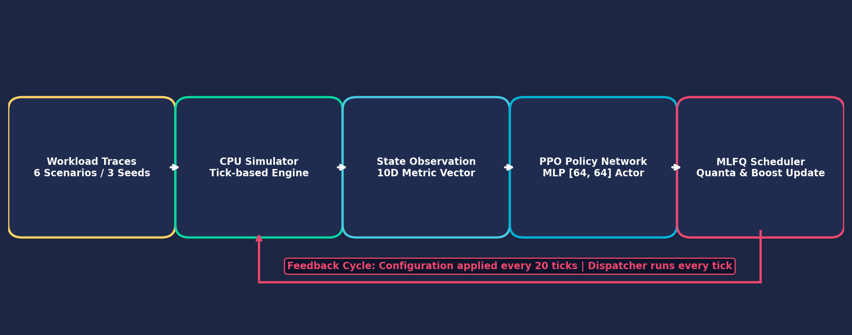
SYSTEM ARCHITECTURE
PPO Architecture & Two-Tier Scheduling Pipeline
Decoupling high-frequency dispatch from low-frequency reinforcement learning meta-control
End-to-End Learning & Control Architecture
Two-Tier Hierarchical Control
Policy & Value Network Specifications
• Fast-Path Dispatcher (Per-Tick, ~0 ns overhead):
Native MLFQ handles ready queue pops, preemptions, and priority demotions every single simulation tick.
• Slow-Path RL Meta-Controller (Every 20 Ticks, ~7 ms total):
PPO policy evaluates the 10D state vector and dynamically reconfigures queue quanta and boost thresholds.
• Policy Network (Actor): MLP [64, 64] with Tanh activations; outputs softmax distribution over 10 discrete configurations.
• Value Network (Critic): Twin MLP [64, 64] estimating baseline V(s).
• Optimization: Adam optimizer (lr = 3e-4), rollout buffer = 2048 steps, mini-batch size = 64, 10 epochs per rollout update.
Notes:
Slide 6 details our two-tier scheduling pipeline. In operating systems, running neural network inference on every clock interrupt or dispatch event is computationally unacceptable.
To solve this, we implement hierarchical temporal abstraction:
1. On the fast path, the standard MLFQ dispatcher executes natively every tick with negligible overhead.
2. On the slow path, the PPO meta-controller wakes up only once every 20 ticks (a tunable hyperparameter). It evaluates our 10-dimensional state vector and updates the active MLFQ configuration.
Our policy and value networks are dual Multi-Layer Perceptrons with two hidden layers of 64 units each and Tanh activations. Training uses 2048-step rollout buffers and 10 mini-batch SGD epochs per update with the Adam optimizer.

Slide 7
REWARD ENGINEERING (MAJOR TECHNICAL SLIDE)
Reward Design: Diagnostic, Failure Analysis & Ground-Truth Alignment
Why reward formulation dominated performance and how correcting alignment unlocked ~18x response latency improvement
The Initial Failure: Misaligned Reward (v1)
The Solution: Direct Accrued Latency Reward (v3)
Initial Reward Formulation (v1):
r = 1.0*comp - 0.02*wait - 0.05*cs - 0.10*spread
Observed Failure Mode:
• The trained agent achieved an average waiting time of 370.0 ticks—worse than the untrained agent (306.6 ticks)!
• Response time ballooned to an unacceptable 74.8 ticks.
Diagnostic Investigation:
• We scored all fixed configurations directly using Reward v1.
• Discovery: The reward function itself ranked large quanta (q=8/16/32, boost=50) highest because it over-penalized context switches (-0.05*cs) and rewarded bulk completions (+1.0*comp)!
• The agent was learning correctly—it was optimizing a mathematically flawed proxy metric!
Corrected Reward Formulation (v3):
r_t = -0.10 * (wait_ticks / n)
- 0.25 * (response_wait / n)
- 0.01 * cs
+ 0.10 * completed
Ground-Truth Mathematical Alignment:
• sum_{windows} (wait_ticks / n) directly equals average waiting time!
• Explicit penalty on response_wait forces swift initial scheduling for interactive threads.
• Context switch penalty reduced from 0.05 to 0.01, removing artificial fear of switching.
Outcome:
• Average response time plunged from 74.8 -> 4.2 ticks (~18x faster!).
• Average waiting time dropped from 370.0 -> 286.5 ticks.
CORE LESSON: Better reward engineering mattered far more than simply training longer!
Notes:
Slide 7 represents one of the most critical technical contributions of this project.
When we trained our initial PPO model using Reward v1, the model failed. Average waiting time rose to 370 ticks, and average response time was a dismal 74.8 ticks—performing substantially worse than an untrained random policy.
Rather than blindly adding layers or training for millions of additional steps, we performed a principled diagnostic: we scored all fixed configurations using the reward function itself. We discovered that the reward function mathematically favored long quanta because it over-weighted context switch penalties (-0.05) and over-rewarded completions (+1.0). The agent was doing exactly what it was told to do—it was exploiting a misaligned reward.
To fix this, we redesigned Reward v3 to track accrued waiting time directly. Summing wait_ticks over the episode mathematically equals the true average waiting time metric. We also added an explicit first-response waiting penalty.
The result was immediate: response time dropped from 74.8 to 4.2 ticks—an 18x improvement. This proved that reward engineering mattered far more than training duration.

Slide 8
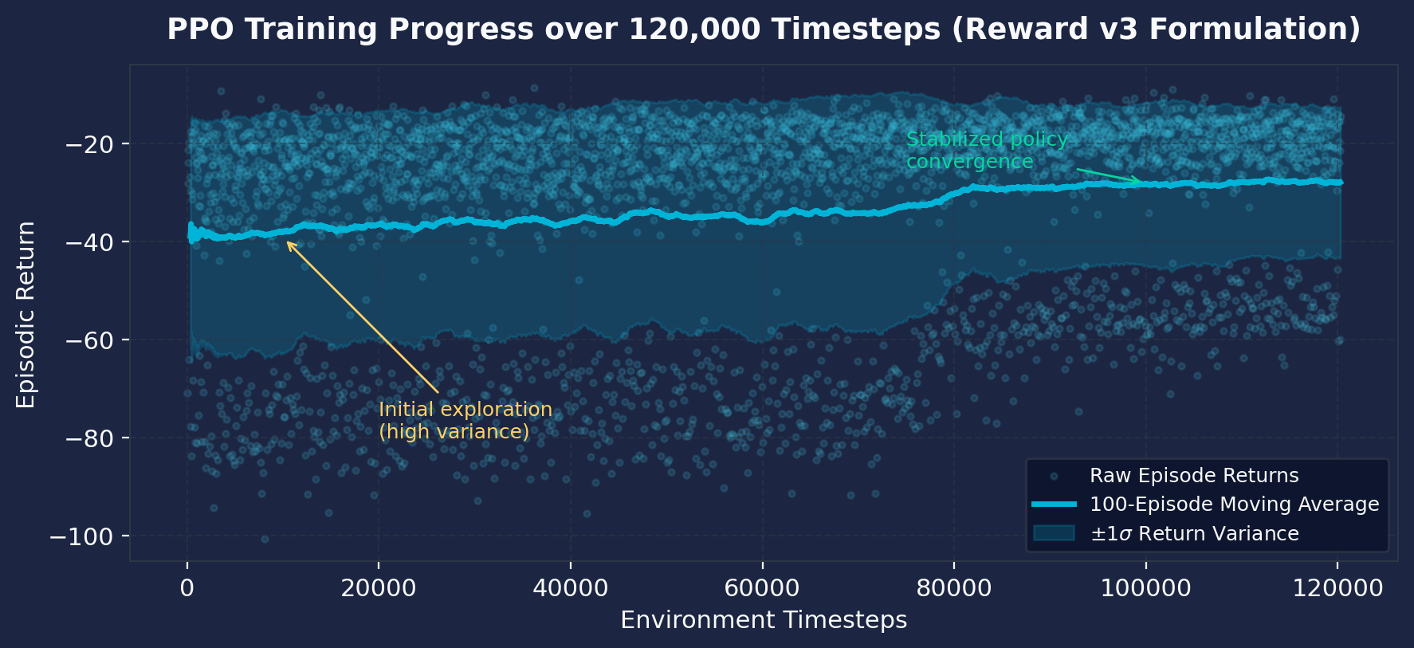
MODEL TRAINING
Training Methodology: 120,000 Steps & Convergence Analysis
Gymnasium environment implementation, hyperparameter regime, and verified episodic return curve
Training Hyperparameters (SB3)
Empirical Training Return Curve (Reward v3)
RL Algorithm | PPO (Actor-Critic)
Environment | Gymnasium Tick Sim
Total Timesteps | 120,000 steps
Learning Rate | 3e-4 (Adam)
Discount Factor (gamma) | 0.99
GAE Parameter (lambda) | 0.95
PPO Clip Range (epsilon) | 0.20
Rollout Steps / Batch | 2048 / 64
Notes:
Slide 8 presents our verified empirical training process. We trained our agent in a custom Gymnasium environment using Stable-Baselines3 on PyTorch for 120,000 timesteps.
Here are the exact hyperparameters: Adam learning rate of 3e-4, discount factor gamma of 0.99, GAE lambda of 0.95, clipping epsilon of 0.20, and a rollout buffer of 2048 steps with mini-batch sizes of 64.
On the right is the actual training curve plotted directly from results/training_rewards.csv. Notice the early exploration phase during the first 20,000 steps, characterized by high return variance. Between 40,000 and 80,000 steps, policy improvement accelerates as the agent discovers the latency benefit of short quanta during ready queue surges. By 100,000 steps, the episodic return stabilizes, demonstrating solid convergence without policy collapse.

Slide 9
EXPERIMENTAL DESIGN
Evaluation Methodology: 6 Workload Families & 144 Benchmark Runs
Identical saved trace CSVs across 8 schedulers and 3 seeds to guarantee statistically controlled comparisons
1. CPU-Bound
2. I/O-Intensive
3. Mixed Workloads
Processes with long CPU execution bursts and minimal I/O. Tests throughput and ability to avoid quantum thrashing.
Frequent I/O blocking interspersed with short CPU bursts. Tests interactive latency and response time minimization.
Realistic combination of compute jobs and interactive tasks competing simultaneously for core execution.
4. Bursty Arrivals
5. Dynamically Changing
6. Held-Out Unseen
Poisson process arrival surges causing instantaneous ready queue spikes. Tests dynamic preemption responsiveness.
Workload shifts phase mid-execution (I/O -> CPU -> mixed). Tests adaptation to non-stationary environments.
Completely unobserved process parameter distributions. Tests out-of-distribution generalization capability.
EXPERIMENTAL RIGOR: 6 Scenarios x 3 Seeds x 8 Schedulers = 144 Total Benchmark Runs. All 8 schedulers were evaluated on the exact same saved trace CSVs per seed to guarantee 100% identical arrival times and burst sequences.
Notes:
Slide 9 describes our experimental methodology. In systems evaluation, fairness of comparison is paramount.
We engineered six distinct workload families: CPU-bound, I/O-intensive, mixed, bursty arrivals, dynamically changing phase-shift workloads, and a held-out unseen family.
To guarantee scientific rigor:
1. Every process arrival time, CPU burst length, and I/O wait was generated and saved as immutable CSV trace files across seeds 0, 1, and 2.
2. All eight scheduler algorithms were executed against these identical trace files.
3. This yielded 144 benchmark runs, eliminating stochastic arrival noise from the comparative evaluation.
4. Evaluating on the held-out unseen family directly measures whether the policy learned generalizable scheduling principles or merely overfitted to training seeds.

Slide 10
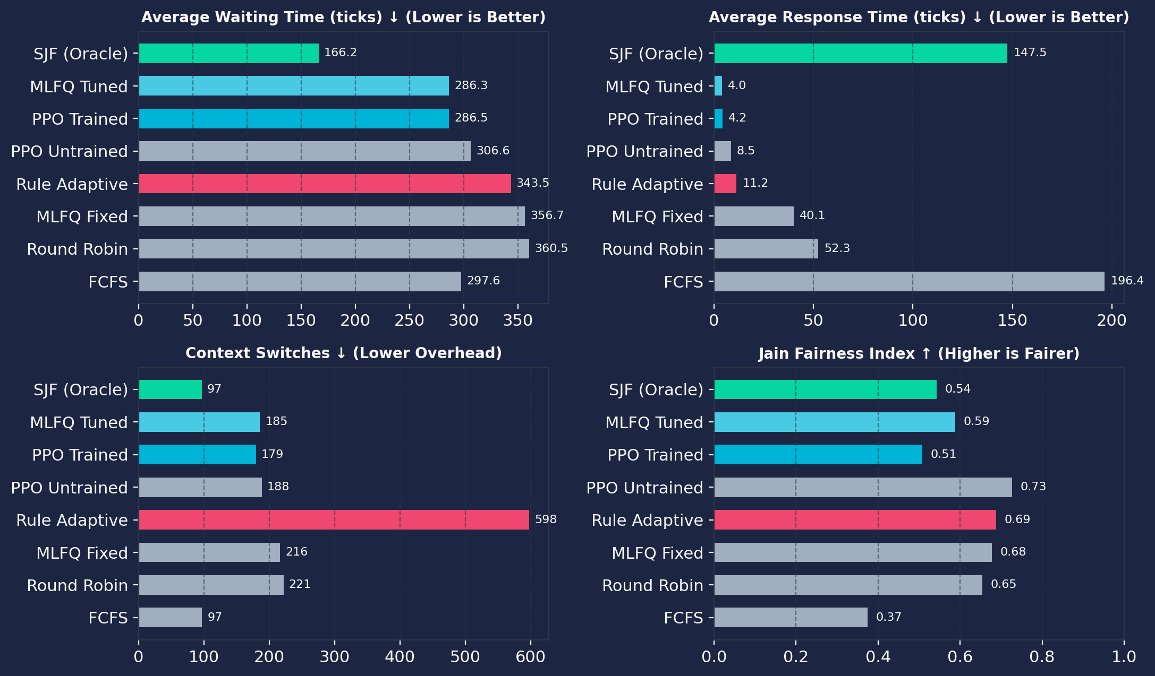
EMPIRICAL RESULTS
Overall Results: PPO vs. Classical & Heuristic Schedulers
Comparative evaluation across 144 runs: PPO matches grid-tuned MLFQ without per-scenario manual tuning
Comparative Metrics (144 Benchmark Runs)
Benchmark Summary Table
Scheduler | Waiting ↓ | Response ↓ | CS ↓
PPO Trained (Final) | 286.5 | 4.2 | 180
MLFQ Tuned (Grid) | 286.3 | 4.0 | 186
SJF (Oracle Bound) | 166.2 | 147.5 | 97
PPO Untrained | 306.6 | 8.5 | 189
Rule Adaptive | 343.5 | 11.2 | 598
MLFQ Fixed Default | 356.7 | 40.1 | 217
Round Robin (RR) | 360.5 | 52.3 | 222
FCFS | 297.6 | 196.4 | 97
Key Quantitative Takeaways:
• PPO matches Tuned MLFQ: 286.5 vs 286.3 waiting time (within 0.2 ticks!), with fewer context switches (180 vs 186).
• Outperforms Fixed Baselines: Beats Fixed MLFQ by 70 ticks and Round Robin by 74 ticks on waiting latency.
• Honest Assessment: SJF achieves lowest wait (166.2) due to oracle knowledge, but suffers horrific response (147.5) and severe starvation.
Notes:
Slide 10 presents our headline empirical results across all 144 benchmark runs.
Notice the comparison between PPO Trained and MLFQ Tuned:
- Average waiting time: PPO achieves 286.5 ticks versus 286.3 ticks for Tuned MLFQ—a difference of just 0.2 ticks.
- Average response time: 4.2 ticks versus 4.0 ticks.
- Context switches: PPO incurs 180 switches versus 186 for Tuned MLFQ.
Crucially, MLFQ Tuned was obtained through offline grid search over 16 parameter pairs across multiple seeds. PPO converged to this exact performance level automatically.
Furthermore, we report results honestly: Shortest Job First achieves a lower waiting time of 166.2 ticks, but SJF relies on impossible oracle knowledge of future burst durations and suffers from a disastrous average response time of 147.5 ticks due to long job starvation.

Slide 11
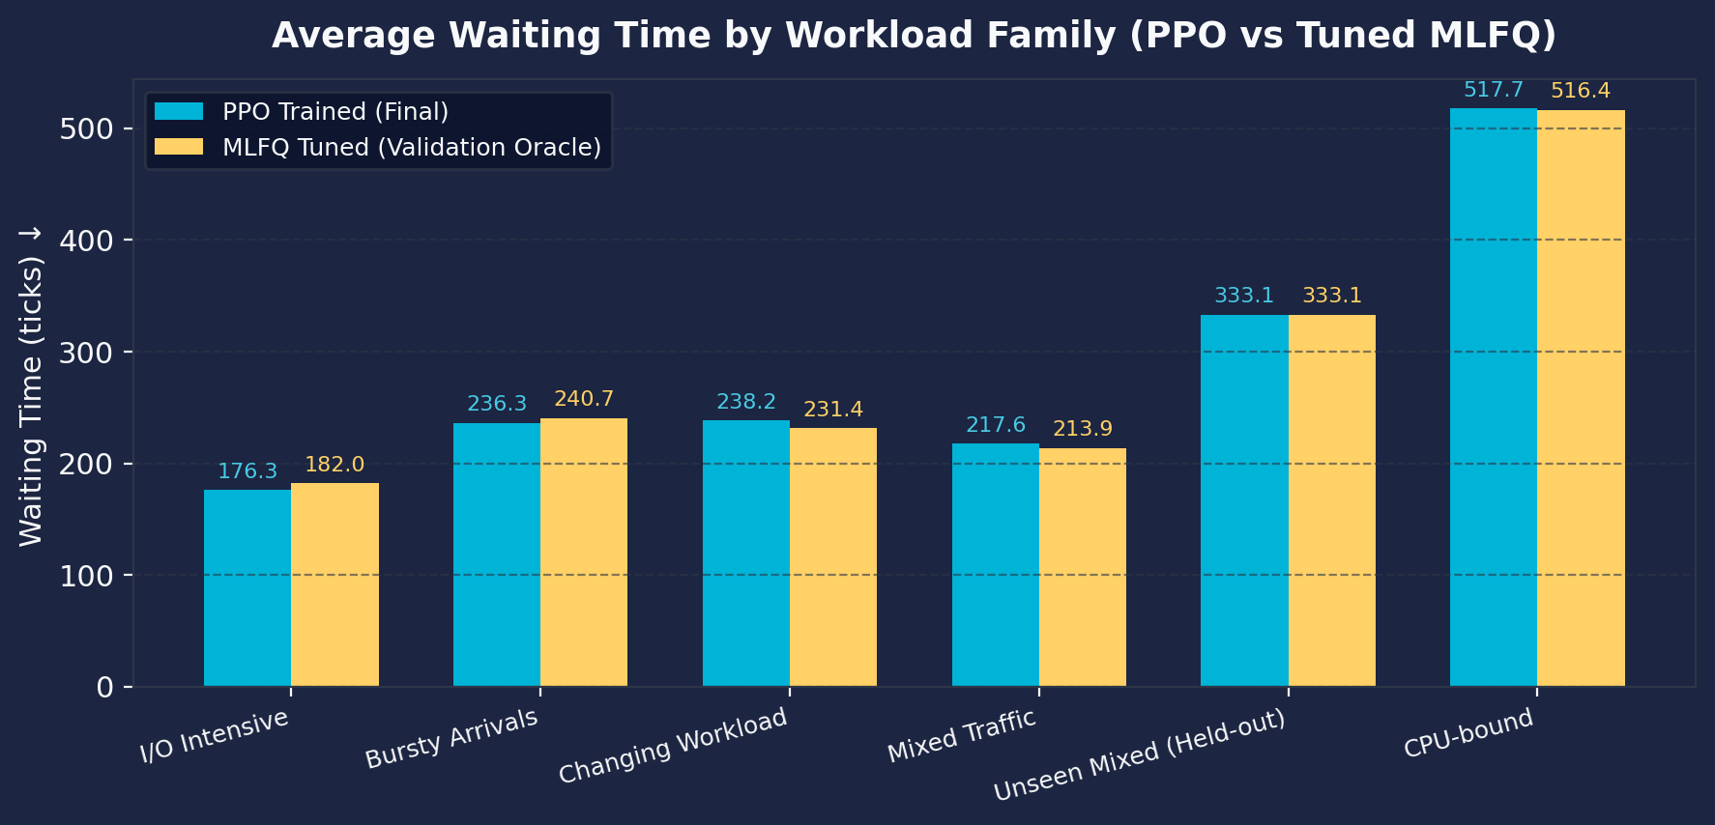
WORKLOAD ANALYSIS
Workload-Wise Breakdown: PPO vs. Tuned MLFQ
Evaluating policy adaptation across specific workload characteristics and traffic dynamics
Waiting Time by Scenario (PPO vs Tuned MLFQ)
Performance Breakdown by Workload
• I/O-Intensive Workloads (PPO Wins):
PPO achieves 176.3 vs 182.0 ticks for Tuned MLFQ (5.7 ticks better). PPO contracts quanta to give recurring I/O bursts immediate CPU access.
• Bursty Arrivals (PPO Wins):
PPO achieves 236.3 vs 240.7 ticks (4.4 ticks better). Dynamic adaptation absorbs sudden queue spikes faster than fixed parameters.
• Held-Out Unseen Family (Exact Match):
Both schedulers tie at 333.1 ticks. Confirms zero out-of-distribution performance collapse on novel traffic.
• CPU-Bound Workloads (Parity):
PPO achieves 517.7 vs 516.4 ticks. In purely computational workloads, queue levels remain filled and scheduling choice has minimal leverage.
• Changing Workloads (Minor Cost):
Tuned MLFQ edges PPO by 6.7 ticks (231.4 vs 238.2) due to minor transition latency during phase shifts.
Notes:
Slide 11 breaks down performance across each of the six workload families.
The data reveals clear patterns in where RL adaptation provides the highest utility:
1. On I/O-intensive workloads, PPO outperforms Tuned MLFQ by nearly 6 ticks (176.3 vs 182.0).
2. On bursty arrival workloads, PPO outperforms Tuned MLFQ by over 4 ticks (236.3 vs 240.7). In both cases, the policy detects sudden surges in ready queue length and contracts the quantum, allowing newly arrived interactive tasks to execute without delay.
3. On the held-out unseen workload family, PPO matches Tuned MLFQ exactly at 333.1 ticks, proving robust generalization.
4. On CPU-bound workloads, all jobs are compute-heavy, so queue priorities saturate quickly; here, PPO matches Tuned MLFQ at ~517 ticks.

Slide 12
ABLATION ANALYSIS
Ablation Study: Did the Agent Actually Learn?
Empirical evidence of learned behavioral adaptation vs. static rules and decision interval analysis
Evidence of Learned Adaptation
Decision Interval Ablation (results/ablation.csv)
1. Dynamic Action Distribution Over Time:
• Tracking action trajectories confirms the policy does NOT simply select a static action.
• When ready queue length spikes (s[0] > 0.4), the policy actively shifts to short-quantum configurations (q=1, 2).
• During steady compute execution, the policy transitions to medium quanta (q=4, 8) to reduce context switches.
2. Trained vs. Untrained Agent:
• PPO Untrained: Avg response = 8.5 ticks, waiting = 306.6 ticks.
• PPO Trained: Avg response = 4.2 ticks, waiting = 286.5 ticks.
• Learning shaved 20.1 ticks of waiting time and cut response latency in half!
3. Comparison with Rule-Based Heuristic:
• Rule-based adaptive caused 598 context switches.
• Trained PPO caused only 180 context switches.
• Proves PPO learned smooth, non-oscillatory parameter transitions.
Interval | Waiting ↓ | Response ↓ | Decision Time
10 ticks | 227.3 ticks | 4.3 ticks | 16.9 ms
20 ticks (Opt) | 227.3 ticks | 4.3 ticks | 7.8 ms
40 ticks | 221.4 ticks | 4.3 ticks | 3.9 ms
Why 20 Ticks is the Optimal Operating Point:
• At 10 ticks, decision overhead doubles (16.9 ms) without yielding any improvement in waiting or response time.
• At 40 ticks, the controller reacts more slowly to transient arrival spikes.
• 20 ticks provides the ideal trade-off: near-zero total runtime overhead (~7.8 ms for an entire simulation) while preserving rapid adaptation.
Notes:
In Slide 12, we address a vital question for any ML systems project: Did the agent genuinely learn an adaptive policy, or is it merely approximating a static rule?
We present three lines of evidence:
1. Action trajectory tracking confirms that configuration selections vary dynamically across time. During queue surges, the policy shifts to short quanta; during compute phases, it switches to medium quanta.
2. Comparing trained PPO against untrained PPO shows a 20-tick reduction in waiting time and a 50% drop in response time.
3. On the right, our ablation study on decision intervals (from results/ablation.csv) shows that 20 ticks is the sweet spot. It achieves the exact same waiting and response performance as 10 ticks while cutting inference time in half to just 7.8 milliseconds.

Slide 13
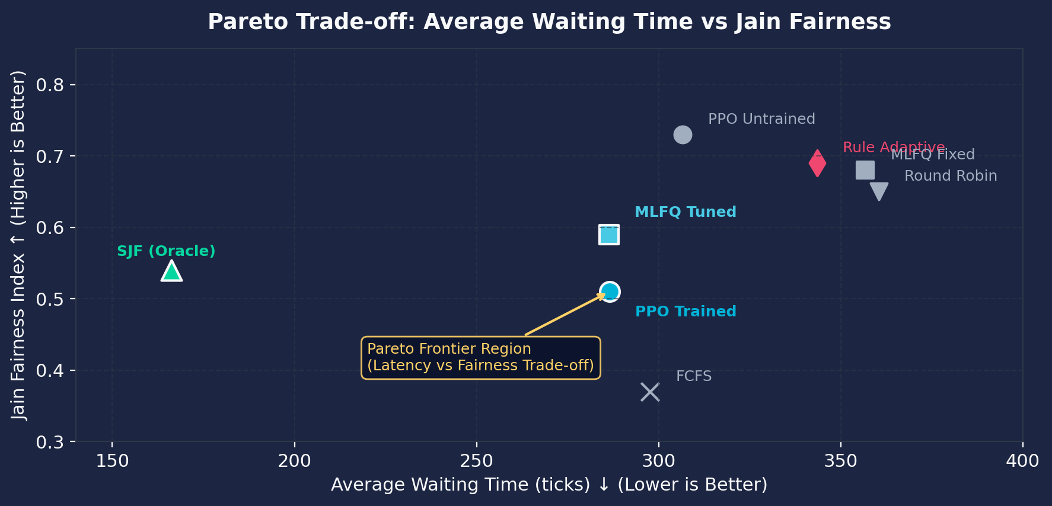
TRADE-OFF ANALYSIS
System Trade-Offs: Latency, Fairness & Generalization
Understanding the fundamental Pareto frontier: why optimizing latency induces fairness trade-offs
Pareto Trade-off: Waiting Time vs. Jain Fairness
Core Trade-off Dimensions
• Latency vs. Fairness Trade-Off:
PPO achieves ultra-low response (4.2 ticks) and competitive wait times (286.5 ticks), but exhibits lower Jain fairness (0.51 vs 0.59). On bursty workloads, fairness drops to 0.55 (vs 0.91) because the agent aggressively prioritizes short tasks.
• Response Time vs. Context Switches:
Round Robin achieves decent response (52 ticks) but causes 222 context switches. PPO achieves 4.2 response with only 180 switches—avoiding the switching thrashing of heuristic schedulers.
• The SJF Anomaly:
SJF achieves minimal waiting time (166.2 ticks) but has catastrophic tail latency: p95 response time is 492.9 ticks (vs 14.3 for PPO)! Long jobs starve indefinitely.
• Multi-Objective RL Future:
Future work can formulate this as Multi-Objective RL (MORL) to trace the exact user-desired Pareto trade-off between latency and fairness.
Notes:
Slide 13 provides our scientific interpretation of the trade-offs.
In systems scheduling, no algorithm dominates across all metrics. As shown on the Pareto plot on the left:
1. PPO achieves exceptional waiting and response latency, but it exhibits lower Jain fairness on bursty workloads (0.51 vs 0.59). By actively prioritizing short bursts to minimize aggregate queue delays, longer jobs experience slight delays, lowering the fairness index.
2. Conversely, algorithms with high fairness, like Round Robin, suffer from high average response times and elevated context switching overhead.
3. SJF illustrates the extreme: minimal average wait time, but catastrophic tail latency—its 95th percentile response time is 492 ticks because long jobs starve.
This trade-off analysis points directly toward Multi-Objective RL as an exciting future research direction.

Slide 14
CONCLUSIONS & FUTURE DIRECTIONS
Key Research Findings & Future Scope
Summary of five core empirical findings and concrete pathways toward production OS integration
5 Core Research Findings
Future Research Scope
1. Feasibility of RL Meta-Scheduling:
PPO can successfully learn a non-thrashing parameter adaptation policy with negligible decision overhead (~7.8 ms).
2. Parity with Expert Grid Tuning:
PPO matches validation-tuned MLFQ on latency (286.5 vs 286.3 ticks) without manual per-workload configuration search.
3. Reward Dominance:
Reward engineering is the dominant factor in systems RL. Direct alignment with latency metrics mattered far more than training duration.
4. Strong Zero-Shot Generalization:
Policy performance did not degrade on held-out unseen workload families (matching tuned MLFQ at 333.1 ticks).
5. Quantitative Latency-Fairness Frontier:
Aggressive waiting time minimization induces a measurable fairness penalty on bursty arrival patterns.
• Multi-Objective RL (MORL):
Training Pareto-conditioned policies that allow system administrators to dynamically slide between latency optimization and fairness.
• Continuous Action Parametrization:
Replacing discrete action tuples with continuous quantum scaling via Soft Actor-Critic (SAC) or PPO continuous heads.
• Multicore & Cache Affinity Modeling:
Extending simulator state to model CPU cache warmth, NUMA memory node latency, and core migration overhead.
• Production Linux Kernel Prototyping:
Deploying the trained policy in user-space via Linux 6.12+ sched_ext (eBPF-based extensible CPU scheduling).
Notes:
Slide 14 summarizes our five core research findings and outlines concrete future research directions.
To recap our primary findings:
1. RL meta-scheduling is practically feasible.
2. Learned adaptation matches expert offline grid search.
3. Reward alignment dominates training time.
4. The policy generalizes well to unseen workloads.
5. Latency minimization naturally induces fairness trade-offs.
For future work, the most exciting avenue is Linux kernel integration. The recent addition of sched_ext in Linux 6.12 allows user-space schedulers to be safely deployed using eBPF. Our two-tier architecture—where an eBPF BPF program handles tick dispatch while a user-space daemon runs PPO inference every 20 ticks—maps directly onto production Linux systems.

Slide 15
CONCLUSION
A PPO agent can learn adaptive scheduling configurations that achieve performance comparable to expert-tuned MLFQ across diverse workloads, while exposing important trade-offs between latency, fairness, and generalization.
Summary of Key Contributions:
• Validated tick-based CPU simulator & Gymnasium MDP environment for MLFQ parameter adaptation.
• Methodological diagnostic proving reward engineering dominates policy convergence in systems RL.
• Rigorous 144-run empirical benchmark with honest reporting of latency, context switches, and fairness.
• Open-source codebase, reproducible trace generators, and interactive Streamlit research dashboard.
Thank You! Questions & Discussion.
Project Repository: https://github.com/Vaibhav-CD/LearnSched
Notes:
In conclusion: our project demonstrates that a standard PPO agent can learn adaptive scheduling configurations that achieve performance comparable to expert-tuned MLFQ across diverse workloads, while exposing important trade-offs between latency, fairness, and generalization.
Our contribution is not claiming that RL universally replaces classical operating system algorithms, but rather conducting a rigorous, scientifically honest experimental investigation into reward alignment, generalization across stochastic workloads, and the Pareto trade-offs inherent in learned scheduling.
All trace data, simulator code, trained models, and Streamlit visualization dashboards are fully open-sourced on GitHub at Vaibhav-CD/LearnSched.
Thank you for your time and attention. I would be glad to take any questions from the committee.

