Slide 1

PROF. RAM MEGHE INSTITUTE OF TECHNOLOGY AND RESEARCH BADNERA, AMRAVATI A PRESENTATION ON “Job Recommendation Based on Job Profile Clustering and Job Seeker Behavior”
GUIDED BY DR. V. H. DESHMUKH
VAIBHAV SANJAYRAO DHARMIK
SANKET RAMBHAU GULHANE
DEVENDRA BABASAHEB TALHANDE
GIRISH SUDAKAR SAWSUNDAR
PRESENTED BY
C11 BATCH
2021-2022

Slide 2
Introduction
The highly competitive and dynamic nature of the job market as well as personal preferences and goals lead individuals to change their jobs at some point in their lives.
Moving to a new job, however, is not an easy decision, which may depend on many factors, such as salary, job description, and geographical location.
Making successful job transitions is essential for a successful professional career. In this work, we build an automated system that can recommend jobs to people based on their past job histories in order to facilitate the process of selecting a new job. We believe that such a system can successfully exploit the job transitions performed by other employees.

Slide 3
Problem Definition
According to Narendra Nathan that the identification of the parameters of interest is achieved by a priori specification of the distribution of wage-vacancies
In existing job recommendation sites, job offers which are matching with user’s profile used to recommend user.
To improve this recommendation, we proposed machine learning algorithms which will find user’s preferences and recommend job offers as per the preferences, profile and requirements of the recruiters.

Slide 4
Problem Objectives
According to Narendra Nathan that the identification of the parameters of interest
To implement K means clustering algorithm.
To develop an online job recommendation application for job seekers .
To implement recommendation model.

Slide 5
Software Requirements
Deployment platform: Windows
Development tool: Eclipse Software
Application Server: Apache Tomcat Server
Database Technology: MySQL Database
Technology: Java EE
Language: Java, Python
Web Development: HTML, JavaScript, Bootstrap
MVC Framework: Spring boot
Development tool (Server side): Servlets & JSP, MySQL Connector

Slide 6
System Architecture
K-MEANS CLUSTERING:
1: An initial clustering is created by choosing k random centroids from the dataset.
2: For each data point, calculate the distance from all centroids, and assign its membership to the nearest centroid.
3: Recalculate the new cluster centroids by the average of all data points that are assigned to the clusters.
4: Repeat step 2 until convergence.

Slide 7
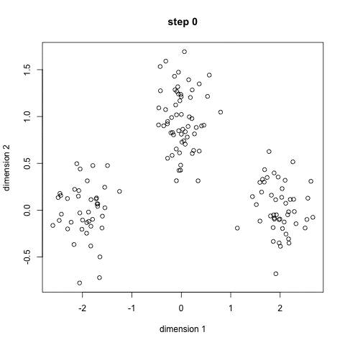
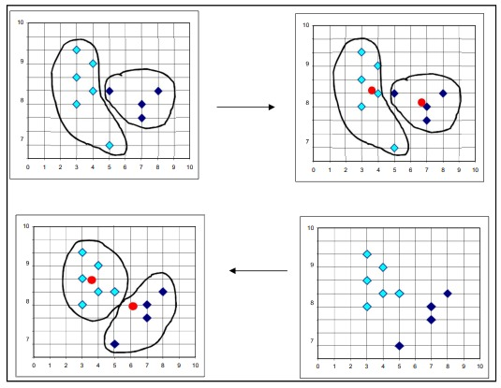
K-Means Clustering
Working of K-means clustering algorithm

Slide 8
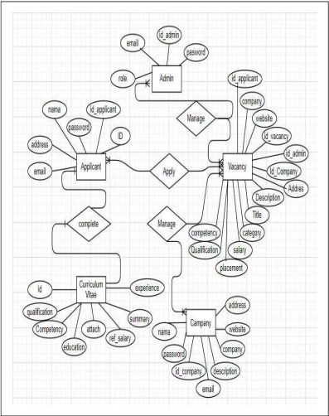
Entity Relationship Diagram

Slide 9
Why K-means ?
The K-Means algorithms are superior to other data mining methods.
Although the K-Means algorithms do not guarantee the accuracy, their speed and simplicity make them superior to other data clustering algorithms.
Their fast speed enables them to run on large datasets.
Also, K-Means algorithms generate tighter clusters.
The K-Means are also memory efficient.
Notes:
1. K-means Clustering Algorithm
2. Mean-Shift Clustering Algorithm
3. DBSCAN – Density-Based Spatial Clustering of Applications with Noise
Best Clustering Algorithms in Data Mining
There are various types of clustering algorithms in data mining. Here are some clustering algorithms in data mining with examples.
Data Mining Connectivity Models – Hierarchical Clustering
Data Mining Centroid Models – K-means Clustering algorithm
Data Mining Distribution Models – EM algorithm
Data Mining Density Models – DBSCAN

Slide 10
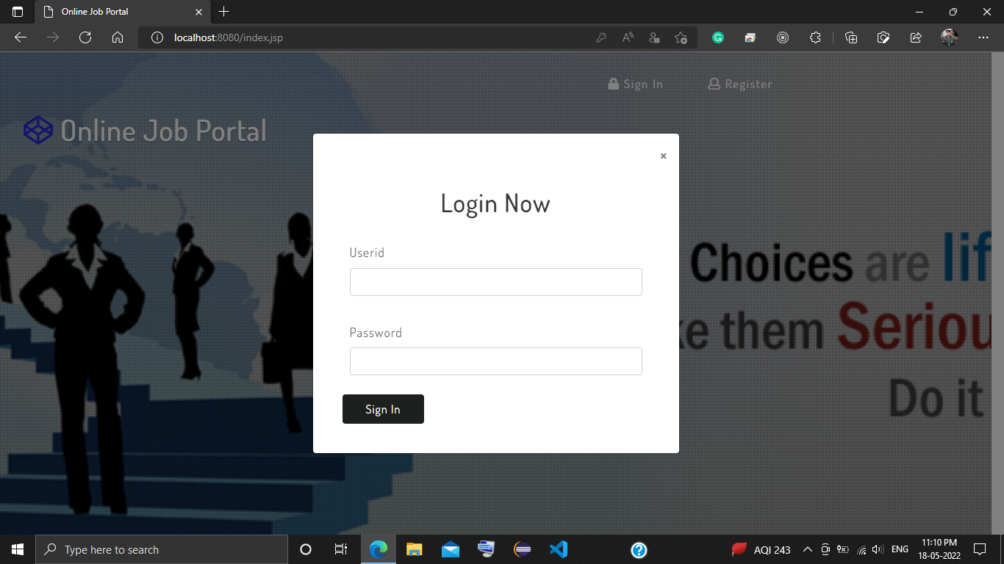
Result
Login (User and Admin)

Slide 11
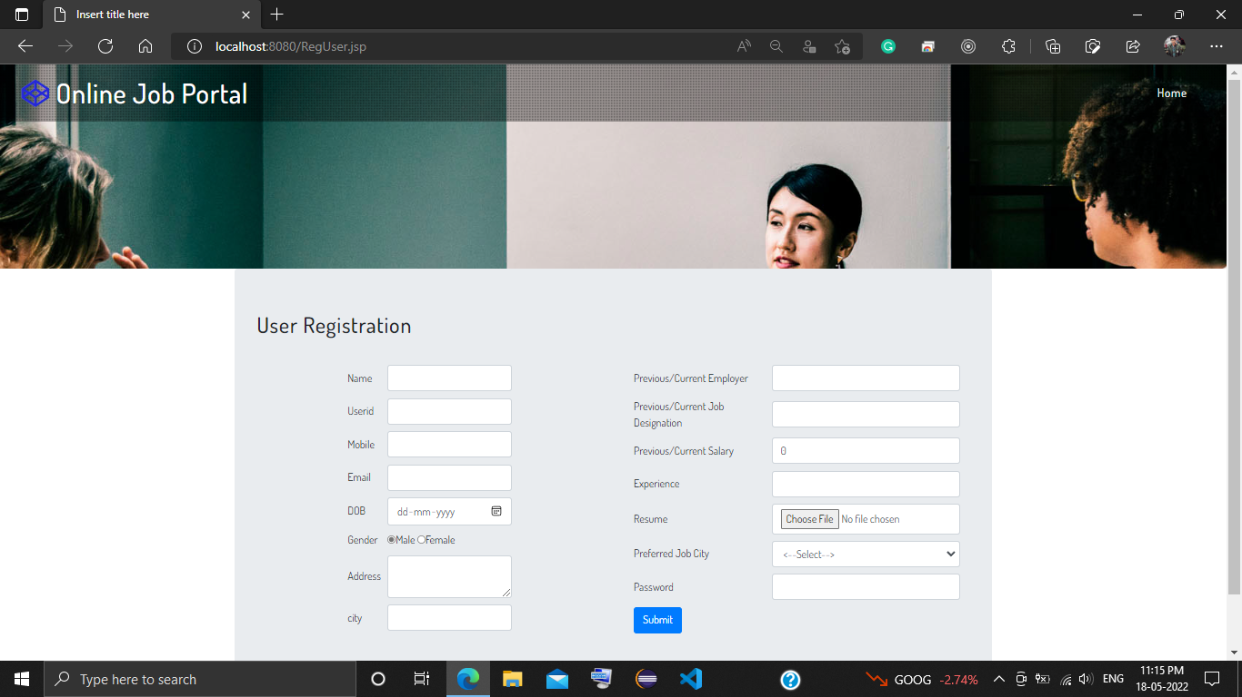
User Registration

Slide 12
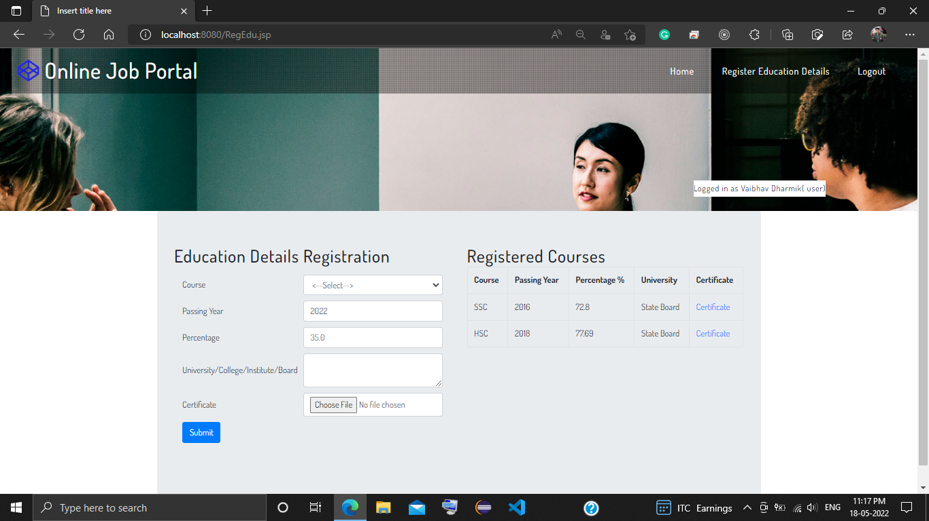
User Educational Details

Slide 13
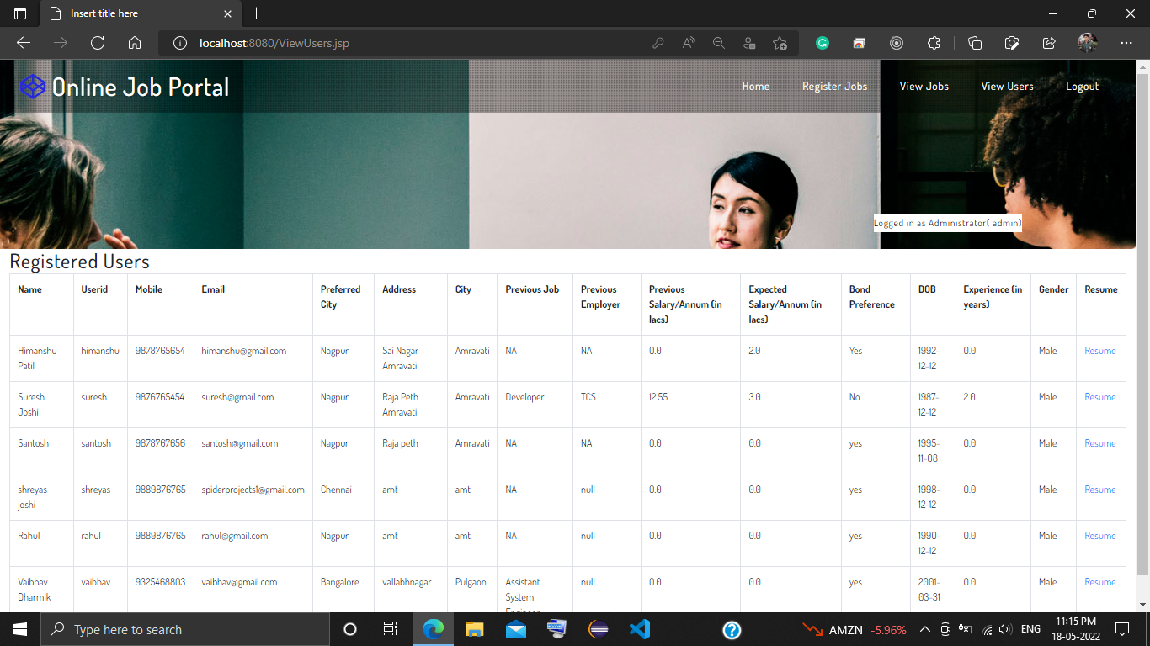
Admin Registered Users

Slide 14
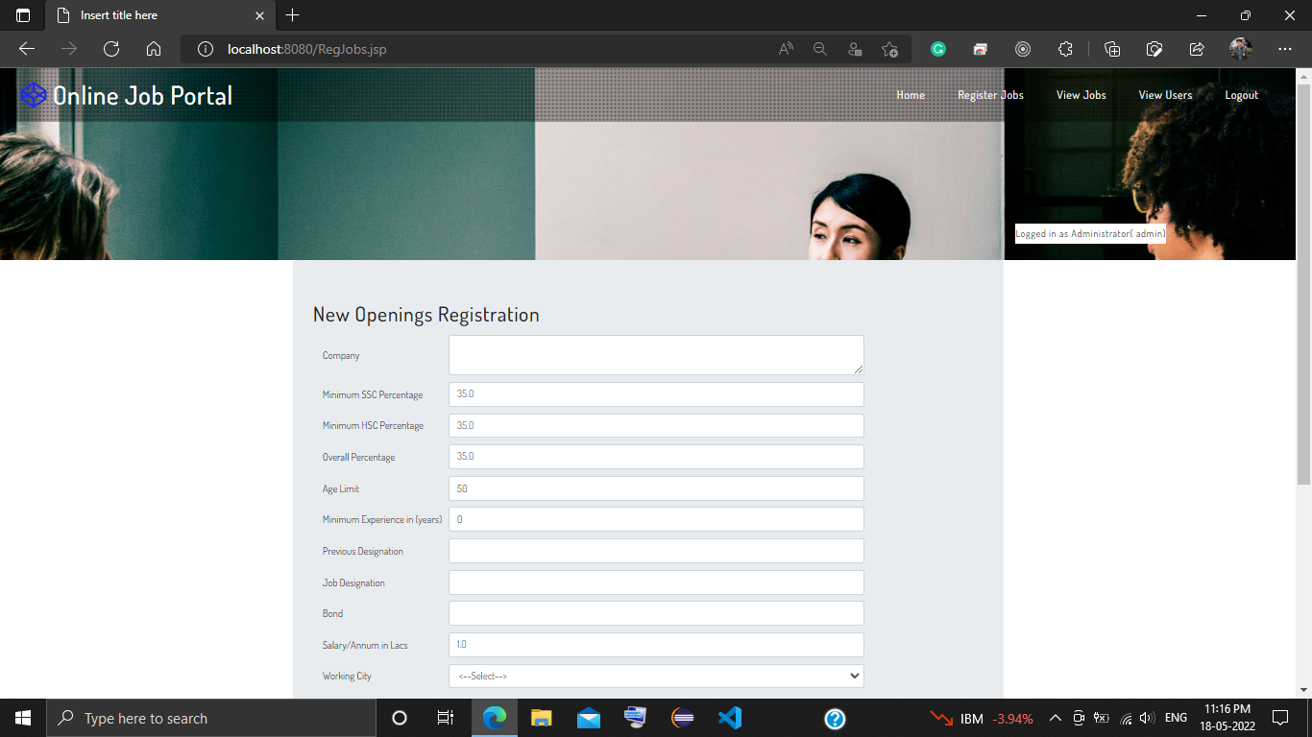
Admin Jobs Registration

Slide 15
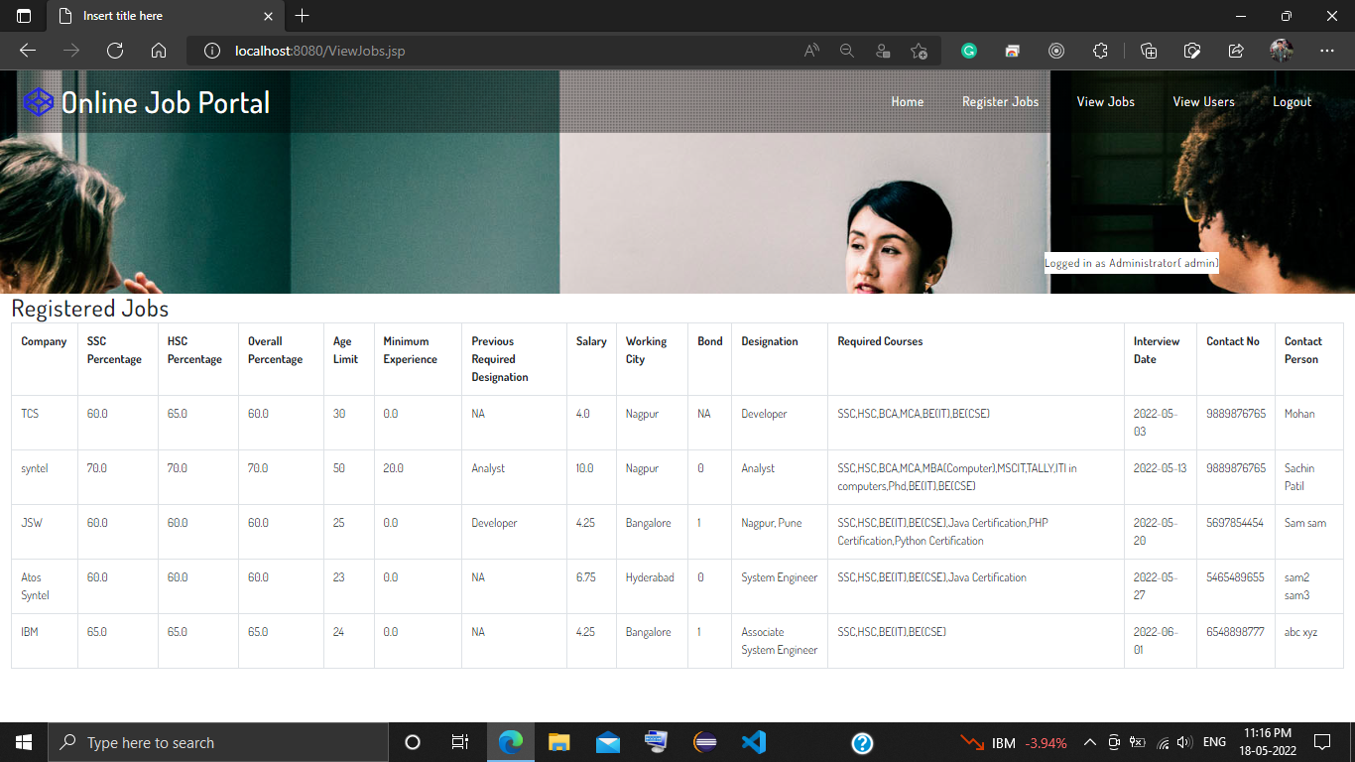
Admin Registered Jobs

Slide 16
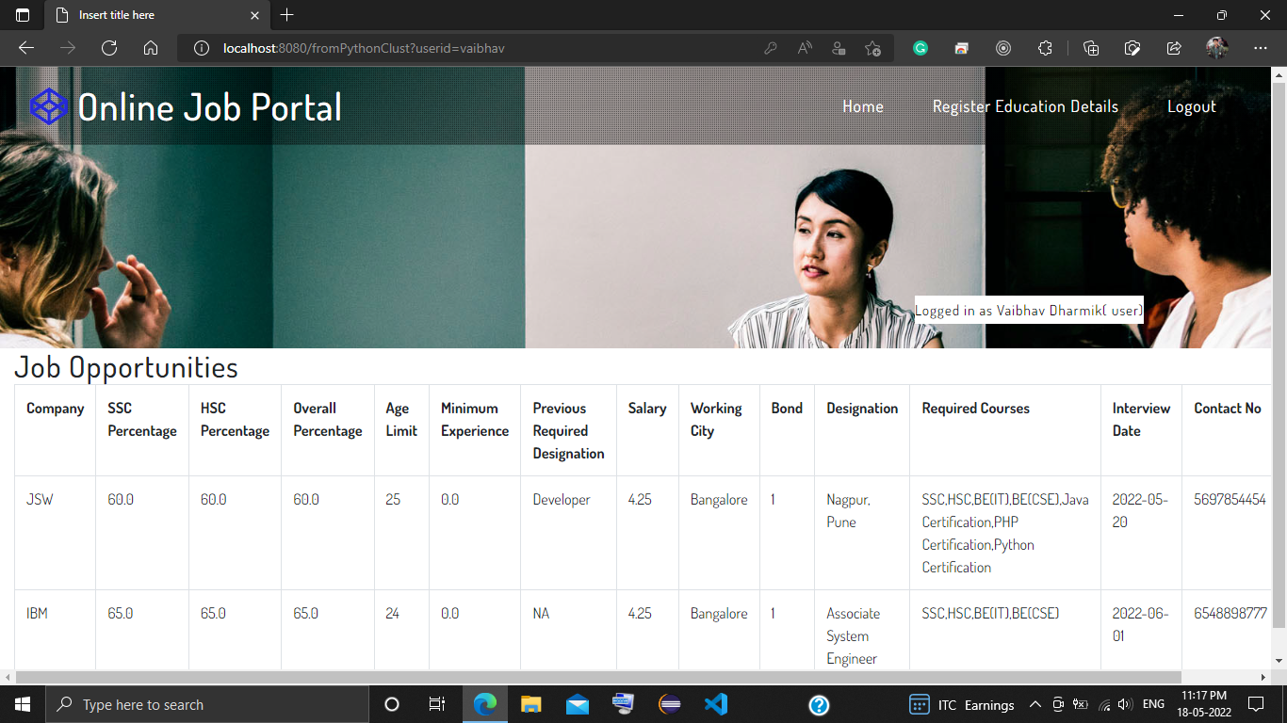
Recommended Jobs to User

Slide 17
Conclusion
In this Project, we presented a job recommender model aiming to extract meaningful data from job postings using data-clustering methods. As a result, job offers are divided into job clusters based on their common features and job offers are matched to job seekers according to their interactions.

Slide 18
Future Scope
Our future Work will focus on training and evaluating our model using Word2vec method and k -means clustering algorithms used to capture and represent the context of job profiles. Subsequently, it will be easy to match set of job offers to a given job seeker based on its past interactions toward specific job offers. The dataset that will be used is built from scraping job search websites.

Slide 19
References
A. Kumar, R. Sinha, V. Bhattacherjee, D. S. Verma, S. Singh, “modeling using K-means clustering algorithm”, IEEE 2012, 1st international conference on recent advances in information technology(RAIT).
A. K. Jain, prof. S. Maheshwari, “survey of recent clustering techniques in data mining”, international journal of computer science and management research, vol 1 issue 1 Aug 2012.
A. Saurabh, A. Naik, "Wireless sensor network based adaptive landmine detection algorithm, " 2011 3rd International Conference on Electronics Computer Technology (ICECT), vol.1, no., pp.220, 224, 8-10 April 2011.
B. Biggio, I. Pillai, S. R. Bulò, D. Ariu, M. Pelillo, F. Roli,” is data clustering in adversial settings secure?”, Proceedings of the 2013 ACM workshop on Artificial intelligence and security, Pages 87-98.
B. K. Mishra, N. R. Nayak, A. Rath, S. Swain, “far efficient K-means clustering algorithm”, Proceedings of the 2012 ACM’s International Conference on Advances in Computing, Communications and Informatics, Pages 106-110.
B. K Tripathy, A. Ghosh, G.K. Panda, "Kernel based K-means clustering using rough set, " 2012 International Conference on Computer Communication and Informatics (ICCCI), vol., no., pp.1, 5, 10-12 Jan. 2012.

Slide 20
D. Jimenez, E. Ferretti, V. Vidal, P. Rosso, and C. F. Enguix, “The influence of semantics in IR using LSI and K-means clustering techniques”, ACM Proceedings of the 1st international symposium on Information and communication technologies, Pages 279-284.
D. Napoleon, P.G. Lakshmi, "An efficient K-Means clustering algorithm for reducing time complexity using uniform distribution data points, " Trendz in Information Sciences & Computing (TISC), IEEE 2010, vol., no., pp.42, 45, 17-19 Dec. 2010.
D. Sisodia, L. Singh, S. Sisodia, K. Saxena, “Clustering Techniques: A Brief Survey of Different Clustering Algorithms”, International Journal of Latest Trends in Engineering and Technology (IJLTET), Vol. 1 Issue 3 September 2012.
D. S. Modha, W. S. Spangler, “Feature Weighting in k-Means Clustering”, ACM Journal of Machine Learning, Volume 52 Issue 3, September 2003, Pages 217 – 237.
D. T. Pham, S. S. Dimov, and C. D. Nguyen, “Selection of K in K-means clustering”, Proc. IMechE Vol. 219 Part C: J. Mechanical Engineering Science, IMechE 2005.
For More References Please Refer Project Report.

Slide 21
Thank you!!!

