Slide 1

PROF. RAM MEGHE INSTITUTE OF TECHNOLOGY AND RESEARCH BADNERA, AMRAVATI A PRESENTATION ON “Job Recommendation Based on Job Profile Clustering and Job Seeker Behavior”
GUIDED BY DR. V. H. DESHMUKH
VAIBHAV SANJAYRAO DHARMIK
SANKET RAMBHAU GULHANE
DEVENDRA BABASAHEB TALHANDE
GIRISH SUDAKAR SAWSUNDAR
PRESENTED BY
C11 BATCH
2021-2022

Slide 2

Table of contents
History
Introduction
Working Principle
5 functions
Block Diagram
How it takes input
Connectivity 802.11B/G and Blue tooth
Merits
Demerits
Applications
Conclusion
References

Slide 3
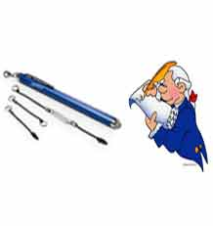
History
"Pen-style Personal Networking Gadget" created in 2012 by Japanese technology company NEC.
Its designer Tour Ichihash.
P-ISM was first featured at the 2011 ITU Telecom world held in
Geneva, Switzerland.

Slide 4
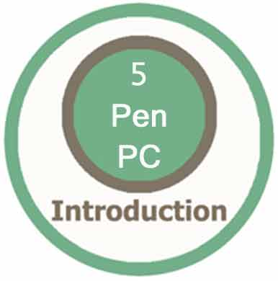
Introduction
P-ISM (“Pen-style Personal Networking Gadget Package”).
Connected With A Wireless Technology.
Whole Set Is Connected To Internet Through Cellular Phone Function.

Slide 5
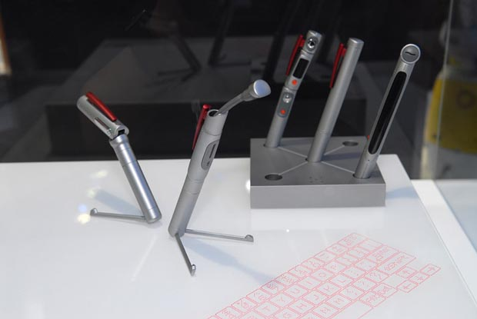
This 'pen sort of instrument' produces both the monitor as well as the keyboard on any flat surfaces from where you can carry out functions you would normally do on your desktop computer.

Slide 6
Working Principle
A computer that utilizes an electronic pen (called a stylus) rather than a keyboard for input. Pen computers generally require special operating systems that support handwriting recognition so that users can write on the screen or on a tablet instead of typing on a keyboard.
Most pen computers are hand-held devices, which are too small for a full-size keyboard.

Slide 7
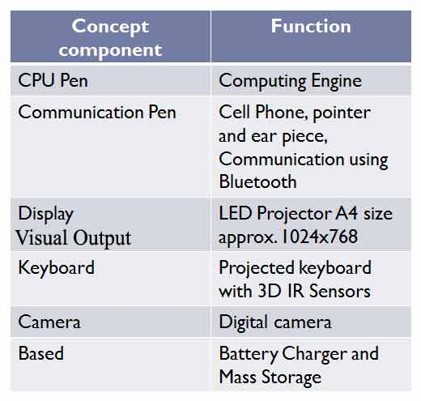
P-ISM includes 5 functions
CPU PEN
COMMUNICATION PEN
VISUAL OUTPUT
VIRTUAL KEYBOARD
CAMERA

Slide 8
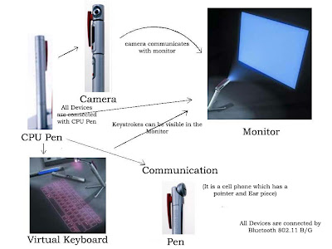
Block diagram of P- ISM

Slide 9
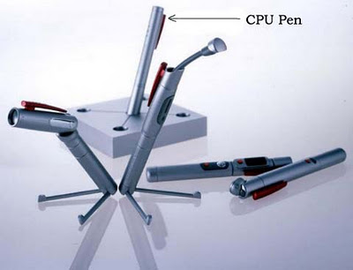
CPU Pen
The functionality of the CPU is done by
one of the pen.
It is also known as computing engine.
Dual Core processor
is used.
Works with windows operating system.

Slide 10

Communication Pen
Wireless Bluetooth Technology.
Connected to internet
through cellular phone
function.
Uses Wi-Fi technology.
Exchange information
with wireless connection.

Slide 11
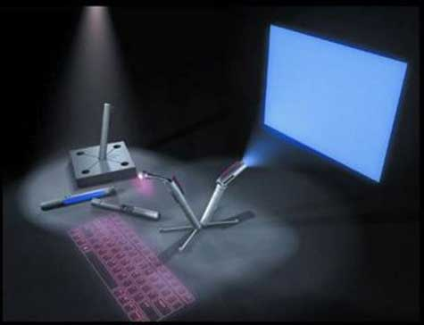
LED Projector
Monitor is LED Projector.
Size is A4.
Resolution capacity is1024x768 approx.
It gives more clarity and good picture.
Notes:
LED Projector:
The role of monitor is taken by LED Projector which projects on the screen. The size of the projector is of A4 size. It has the approximate resolution capacity of 1024 X 768. Thus it is gives more clarity and good picture.

Slide 12
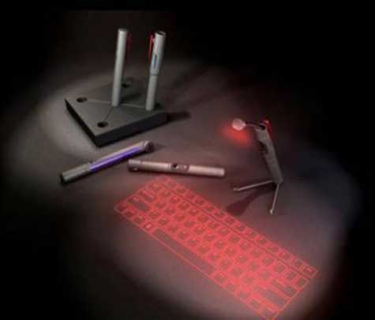
Virtual Keyboard
Virtual laser keyboard is a new gadget.
It emits laser on desk.
Uses laser beam to generate full-size perfect keyboard.
VKB settings can be changed.
Notes:
Features of virtual keyboards are:
VKB settings can be changed by Sound: Controllable Virtual Keyboard sound effects (key clicks) Connection: Connection to the appropriate Laptop/PC port Intensity: Intensity of the projected Virtual Keyboard Timeouts: coordinated timeouts to conserve the Virtual Keyboard's battery life Sensitivity: adjustable sensitivity of the Virtual Keyboard Auto-repeat: Allows the VKB to automatically repeat a key based on prescribed parameters.

Slide 13

Digital Camera
It is useful in video recording , video conferencing simply as a webcam.
Connected with other devices.
portable.
360 degree visual communication device.
Notes:
Digital Camera:
We had digital camera in the shape of pen. It is useful in video recording, video conferencing, simply it is called as web cam. It is also connected with other devices through Bluetooth. The major advantage it is small which is easily portable. It is a 360-Degree Visual Communication Device. We have seen video phones hundreds of times in movies. However, why can't we act naturally in front of videophone cameras? Conventional visual communications at a distance have been limited due to the display devices and terminals. This terminal enables showing of the surrounding atmosphere and group-to-group communication with a round display and a central super-wide-angle camera.

Slide 14
Battery
It is the most important part in the portable type of computers.
Usually batteries are small in size and work for a long time.
It comes with a battery life of 6+ (i.e. 6 days).
For normal use it can be used for 2 weeks.
Notes:
Battery:
The most important part in the portable type of computer is its battery. Usually batteries must be small in size and work for longer time. It comes with a battery life of 6+. For normal use it can be used for 2 weeks.
This 'pen sort of instrument' produces both the monitor as well as the keyboard on any flat surfaces from where you can carry out functions you would normally do on your desktop computer.

Slide 15
How it takes input
It has two methods for input
With the virtual keyboard.
With digital camera.

Slide 16
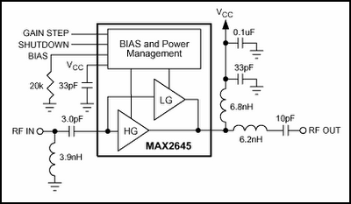
Connectivity 802.11B/G and Bluetooth

Slide 17
Merits
Portable
Feasible
Ubiquitous computing is done
Wi-Fi technology
Pens produces both the monitor as well as the keyboard on any flat surfaces from where you can carry out functions.
Notes:
Advantage of this 5 pen pc technology:
It is Portable i.e can be carried
It is Feasible i.e workable, executable
Ultimate ubiquitous(being present everywhere at once)
Support WiFi technology
Pens produces both the monitor as well as the keyboard on any flat surfaces from where you can carry out functions.

Slide 18
Demerits
Cost
Battery
Keyboard concept is not new
Positioning is main
Currently un-clear.

Slide 19
Applications
Many researches has been made but there is no clear result so far.
Only One that uses it is E-fingerprinting the gadget will be more secure, which allows only owner to activate the Pc. So even if we loose it, no one else cal access the gadget.

Slide 20

Conclusion
The communication devices are becoming smaller and compact.
5 Pen PC is only an example for the start of this new technology.
We can expect more such developments in the future.
Notes:
The communication devices are becoming smaller and compact. This is only an example for the start of this new technology.
We can expect more such developments in the future.

Slide 21
REFERENCES
www.google.com
https://ieeexplore.ieee.org/
https://www.ijser.org/researchpaper/5-Pen-PC-Technology.pdf
www.studymafia.org

Slide 22
Thank you!!!

