Slide 1

PROF. RAM MEGHE INSTITUTE OF TECHNOLOGY AND RESEARCH BADNERA, AMRAVATI A PRESENTATION ON “Job Recommendation Based on Job Profile Clustering and Job Seeker Behavior”
GUIDED BY DR. V. H. DESHMUKH
VAIBHAV SANJAYRAO DHARMIK
SANKET RAMBHAU GULHANE
DEVENDRA BABASAHEB TALHANDE
GIRISH SUDAKAR SAWSUNDAR
PRESENTED BY
C11 BATCH
2021-2022

Slide 2

Table of contents
Introduction
Literature Review
Problem Statement
Problem Objective
Objectives
Software Requirements
Dataflow Diagram
Implementation
Results
Conclusion
Future Scope
References

Slide 3
Introduction
The highly competitive and dynamic nature of the job market as well as personal preferences and goals lead individuals to change their jobs at some point in their lives.
Moving to a new job, however, is not an easy decision, which may depend on many factors, such as salary, job description, and geographical location.
Making successful job transitions is essential for a successful professional career. In this work, we build an automated system that can recommend jobs to people based on their past job histories in order to facilitate the process of selecting a new job. We believe that such a system can successfully exploit the job transitions performed by other employees.

Slide 4
Literature Review
According to Narendra Nathan that the identification of the parameters of interest is achieved by a priori specification of the distribution of wage-vacancies, as required by the applicants.
Previous research related to applications such as the Puspasari research, where the use of applications can increase efficiency and data information on special processes that are displayed.
Data Clustering is one of the Data Mining methods that is unsupervised. There are two types of data clustering that are often used in the data grouping process, namely hierarchical (hierarchical) data clustering and non-hierarchical (nonhierarchical) data clustering.
This method partitions data into clusters so that data with the same characteristics are grouped into the same cluster and data with different characteristics are grouped into other groups.

Slide 5
Problem Definition
According to Narendra Nathan that the identification of the parameters of interest is achieved by a priori specification of the distribution of wage-vacancies
In existing job recommendation sites, job offers which are matching with user’s profile used to recommend user.
To improve this recommendation, we proposed machine learning algorithms which will find user’s preferences and recommend job offers as per the preferences, profile and requirements of the recruiters.

Slide 6
Problem Objectives
According to Narendra Nathan that the identification of the parameters of interest
To implement K means clustering algorithm.
To develop an online job recommendation application for job seekers .
To implement recommendation model.

Slide 7
Software Requirements
Deployment platform: Windows
Development tool: Eclipse Software
Application Server: Apache Tomcat Server
Database Technology: MySQL Database
Technology: Java EE
Language: Java, Python
Web Development: HTML, JavaScript, Bootstrap
MVC Framework: Spring boot
Development tool (Server side): Servlets & JSP, MySQL Connector

Slide 8
System Architecture
K-MEANS CLUSTERING:
1: An initial clustering is created by choosing k random centroids from the dataset.
2: For each data point, calculate the distance from all centroids, and assign its membership to the nearest centroid.
3: Recalculate the new cluster centroids by the average of all data points that are assigned to the clusters.
4: Repeat step 2 until convergence.

Slide 9
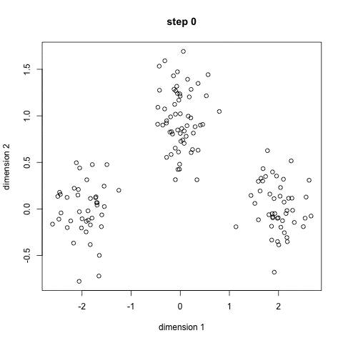
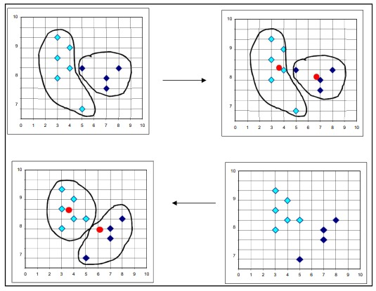
K-Means Clustering
Working of K-means clustering algorithm

Slide 10
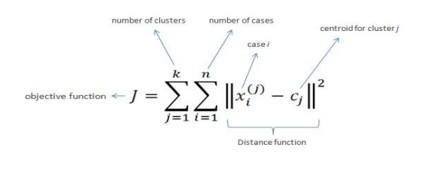
Implementation
Database Connectivity to JAVA Application
Web Scrapping
User’s Data / Job’s Comparison
K-Means Clustering Algorithm for Segmentation:

Slide 11
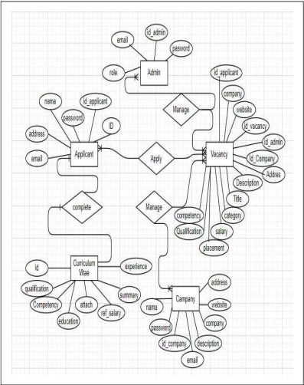
Entity Relationship Diagram

Slide 12
Why K-means ?
The K-Means algorithms are superior to other data mining methods.
Although the K-Means algorithms do not guarantee the accuracy, their speed and simplicity make them superior to other data clustering algorithms.
Their fast speed enables them to run on large datasets.
Also, K-Means algorithms generate tighter clusters.
The K-Means are also memory efficient.

Slide 13
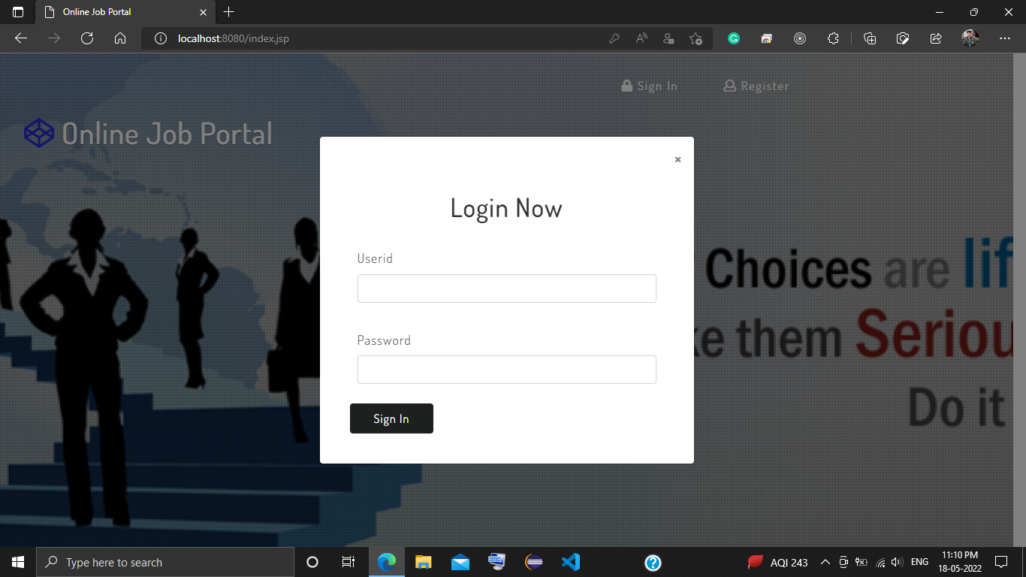
Result
Login (User and Admin)

Slide 14
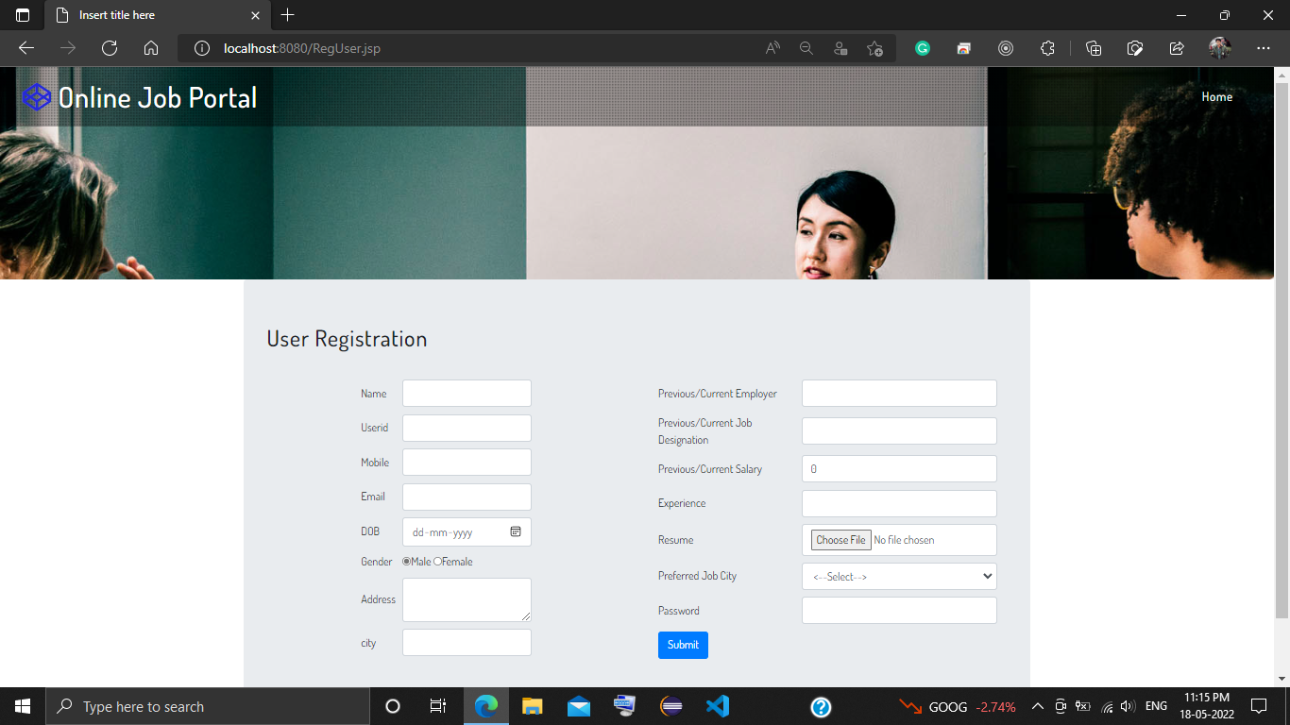
User Registration

Slide 15
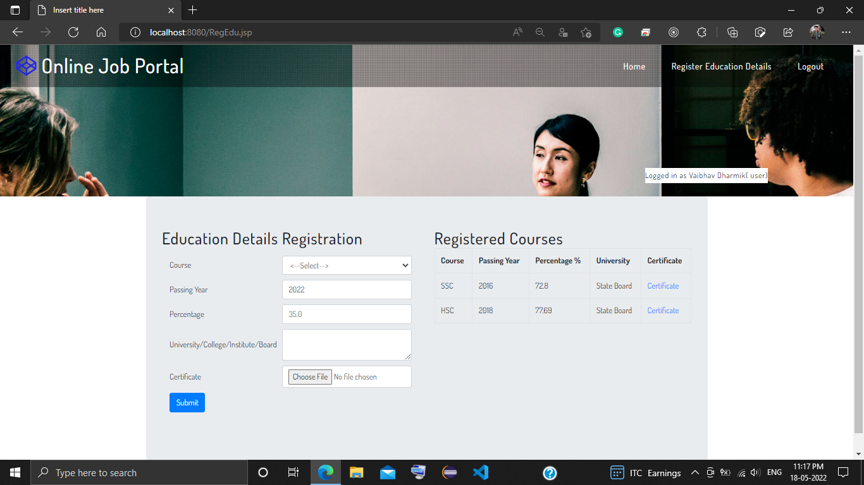
User Educational Details

Slide 16
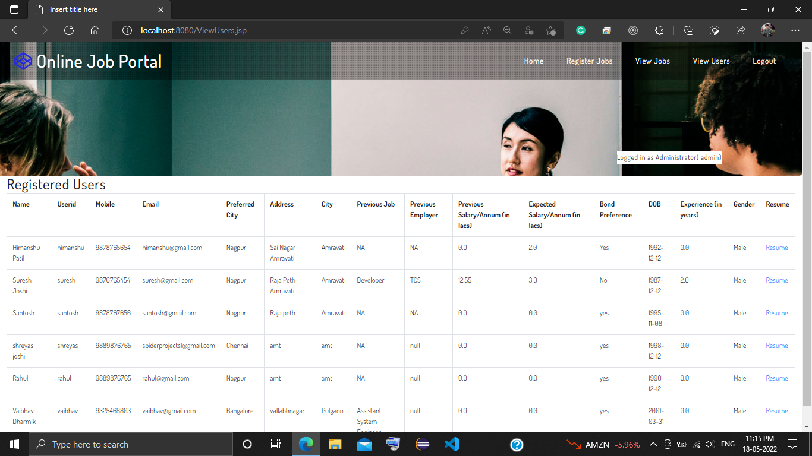
Admin Registered Users

Slide 17
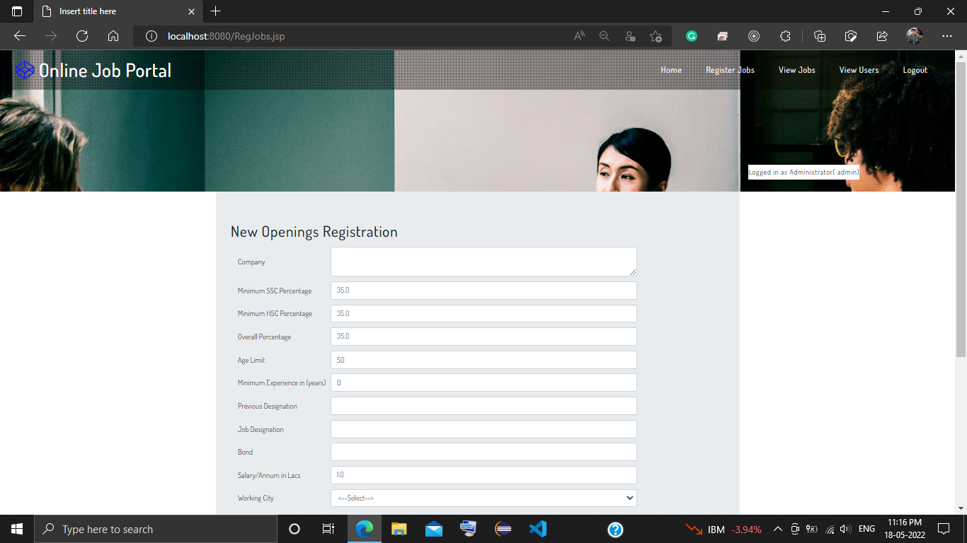
Admin Jobs Registration

Slide 18
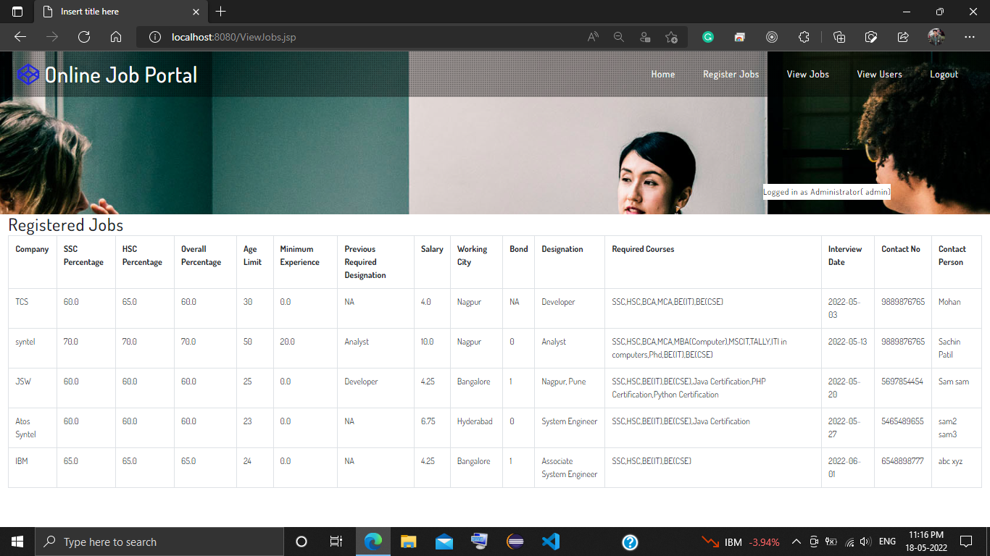
Admin Registered Jobs

Slide 19
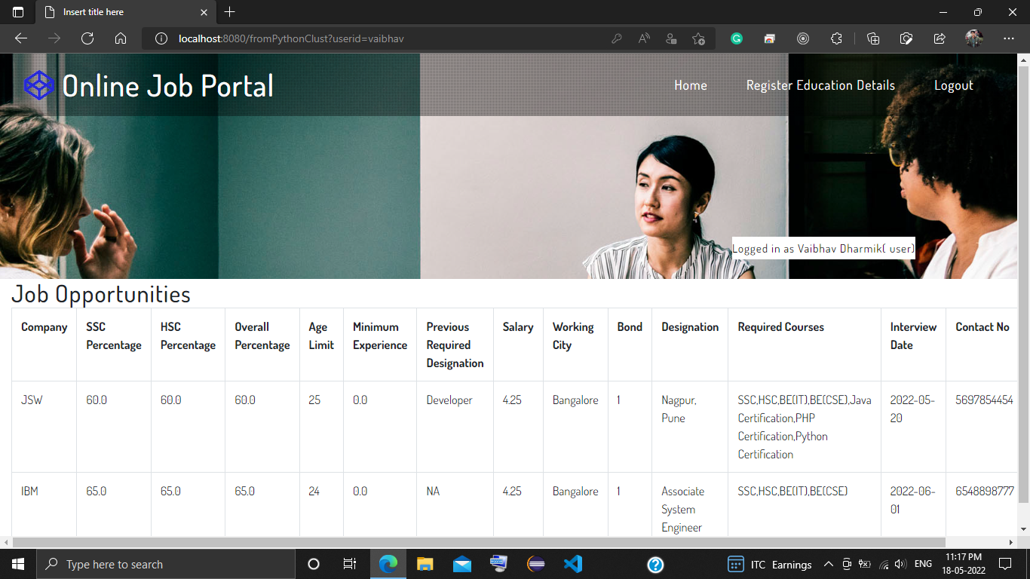
Recommended Jobs to User

Slide 20
Conclusion
In this Project, we presented a job recommender model aiming to extract meaningful data from job postings using data-clustering methods. As a result, job offers are divided into job clusters based on their common features and job offers are matched to job seekers according to their interactions.

Slide 21
Future Scope
Our future Work will focus on training and evaluating our model using Word2vec method and k -means clustering algorithms used to capture and represent the context of job profiles. Subsequently, it will be easy to match set of job offers to a given job seeker based on its past interactions toward specific job offers. The dataset that will be used is built from scraping job search websites.

Slide 22
References
For References Please Refer Project Report.

Slide 23
Thank you!!!

