Slide 1

PROF. RAM MEGHE INSTITUTE OF TECHNOLOGY AND RESEARCH BADNERA, AMRAVATI A PRESENTATION ON “Job Recommendation Based on Job Profile Clustering and Job Seeker Behavior”
GUIDED BY DR. V. H. DESHMUKH
VAIBHAV SANJAYRAO DHARMIK
SANKET RAMBHAU GULHANE
DEVENDRA BABASAHEB TALHANDE
GIRISH SUDAKAR SAWSUNDAR
PRESENTED BY
C11 BATCH
2021-2022

Slide 2

Table of contents
Introduction
Literature Review
Problem Statement
Problem Objective
Objectives
Software Requirements
Dataflow Diagram
Implementation
Results
Conclusion
Future Scope
References

Slide 3
Introduction
The highly competitive and dynamic nature of the job market as well as personal preferences and goals lead individuals to change their jobs at some point in their lives.
Moving to a new job, however, is not an easy decision, which may depend on many factors, such as salary, job description, and geographical location.
Making successful job transitions is essential for a successful professional career. In this work, we build an automated system that can recommend jobs to people based on their past job histories in order to facilitate the process of selecting a new job. We believe that such a system can successfully exploit the job transitions performed by other employees.

Slide 4
Literature Review
According to Narendra Nathan that the identification of the parameters of interest is achieved by a priori specification of the distribution of wage-vacancies, as required by the applicants.
Previous research related to applications such as the Puspasari research, where the use of applications can increase efficiency and data information on special processes that are displayed.
Data Clustering is one of the Data Mining methods that is unsupervised. There are two types of data clustering that are often used in the data grouping process, namely hierarchical (hierarchical) data clustering and non-hierarchical (nonhierarchical) data clustering.
This method partitions data into clusters so that data with the same characteristics are grouped into the same cluster and data with different characteristics are grouped into other groups.

Slide 5
1.1 Problem Definition
In existing job recommendation sites, job offers which are matching with user’s profile used to recommend user.
To improve this recommendation, we proposed machine learning algorithms which will find user’s preferences and recommend job offers as per the preferences, profile and requirements of the recruiters.

Slide 6
1.2 Problem Objectives
To implement K means clustering algorithm.
To develop an online job recommendation application for job seekers .
To implement recommendation model .

Slide 7
SYSTEM REQUIREMENTS:
1 Eclipse Software:
2 Apache Tomcat Server:
3 MySQL
4 Jakarta Server Pages (JSP):
5 Bootstrap:
6 JavaScript
7 Spring MVC

Slide 8
SYSTEM ARCHITECTURE
1 K-MEANS CLUSTERING:
1: An initial clustering is created by choosing k random centroids from the dataset.
2: For each data point, calculate the distance from all centroids, and assign its membership to the nearest centroid.
3: Recalculate the new cluster centroids by the average of all data points that are assigned to the clusters.
4: Repeat step 2 until convergence.

Slide 9
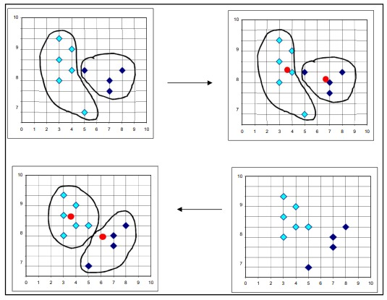
Algorithm 1 K-Means Clustering
Working of K-means clustering algorithm

Slide 10
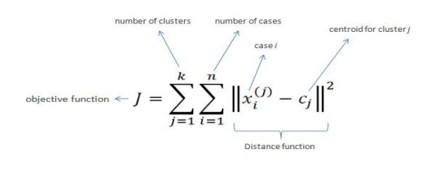
IMPLIMENTATION AND RESULT
5.1 IMPLEMENTATION
5.1.1 Database Connectivity to JAVA Application:
5.1.2 Web Scrapping:
5.1.3 User’s Data / Job’s Comparison:
5.1.4 K-Means Clustering Algorithm for Segmentation:

Slide 11
• Steps in K-Means algorithm:
Choose the number of clusters K.
2. Select at random K points, the centroids (not necessarily from your dataset).
3. Assign each data point to the closest centroid → that forms K clusters.
4. Compute and place the new centroid of each cluster.
5. Reassign each data point to the new closest centroid. If any reassignment took place, go to step 4, otherwise, the model is ready.
Notes:
LED Projector:
The role of monitor is taken by LED Projector which projects on the screen. The size of the projector is of A4 size. It has the approximate resolution capacity of 1024 X 768. Thus it is gives more clarity and good picture.

Slide 12
• Key Features of k-means Clustering Algorithm:
It is very smooth in terms of interpretation and resolution.
2. For a large number of variables present in the dataset, K-means operates quicker than Hierarchical clustering.
3. While re-determining the cluster center, an instance can modify the cluster.
4. K-means reforms compact clusters.
5. It can work on unlabeled numerical data.
Notes:
Features of virtual keyboards are:
VKB settings can be changed by Sound: Controllable Virtual Keyboard sound effects (key clicks) Connection: Connection to the appropriate Laptop/PC port Intensity: Intensity of the projected Virtual Keyboard Timeouts: coordinated timeouts to conserve the Virtual Keyboard's battery life Sensitivity: adjustable sensitivity of the Virtual Keyboard Auto-repeat: Allows the VKB to automatically repeat a key based on prescribed parameters.

Slide 13
• Limitations with K-means:
Sometimes, it is quite tough to forecast the number of clusters, or the value of k.
2. The output is highly influenced by original input, for example, the number of clusters.
3. An array of data substantially hits the concluding outcomes.
4. In some cases, clusters show complex spatial views, then executing clustering is not a good choice.
5. Also, rescaling is sometimes conscious, it can’t be done by normalization or standardization of data points, the output gets changed entirely
Notes:
Digital Camera:
We had digital camera in the shape of pen. It is useful in video recording, video conferencing, simply it is called as web cam. It is also connected with other devices through Bluetooth. The major advantage it is small which is easily portable. It is a 360-Degree Visual Communication Device. We have seen video phones hundreds of times in movies. However, why can't we act naturally in front of videophone cameras? Conventional visual communications at a distance have been limited due to the display devices and terminals. This terminal enables showing of the surrounding atmosphere and group-to-group communication with a round display and a central super-wide-angle camera.

Slide 14
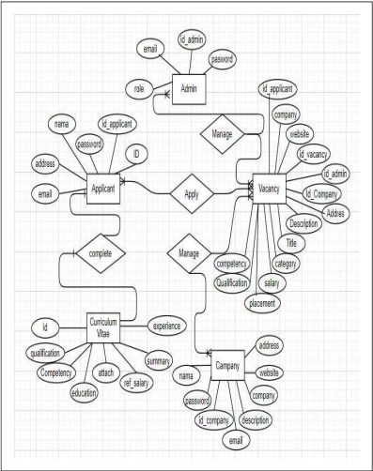
Entity Relationship Diagram
Notes:
Battery:
The most important part in the portable type of computer is its battery. Usually batteries must be small in size and work for longer time. It comes with a battery life of 6+. For normal use it can be used for 2 weeks.
This 'pen sort of instrument' produces both the monitor as well as the keyboard on any flat surfaces from where you can carry out functions you would normally do on your desktop computer.

Slide 15
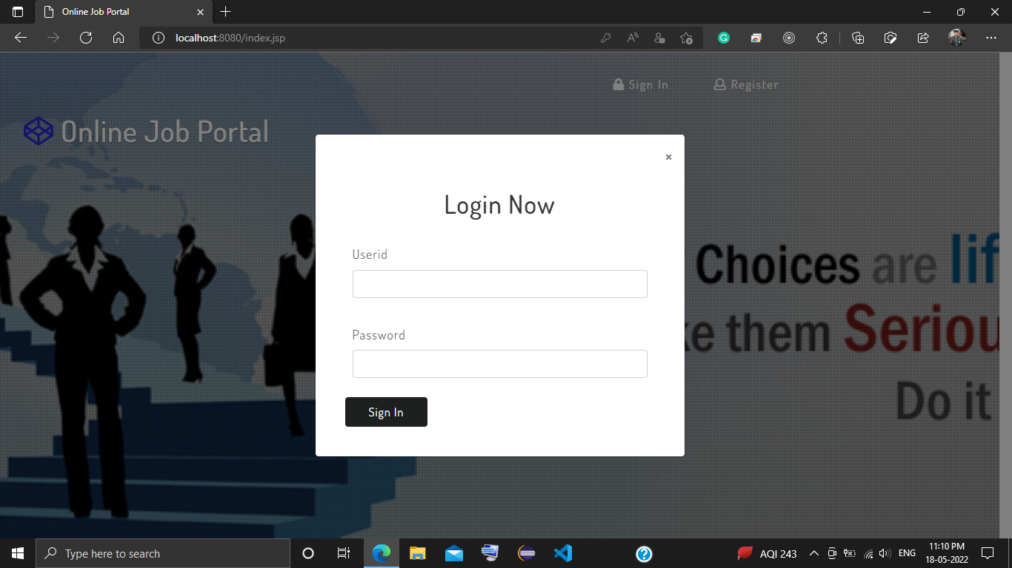
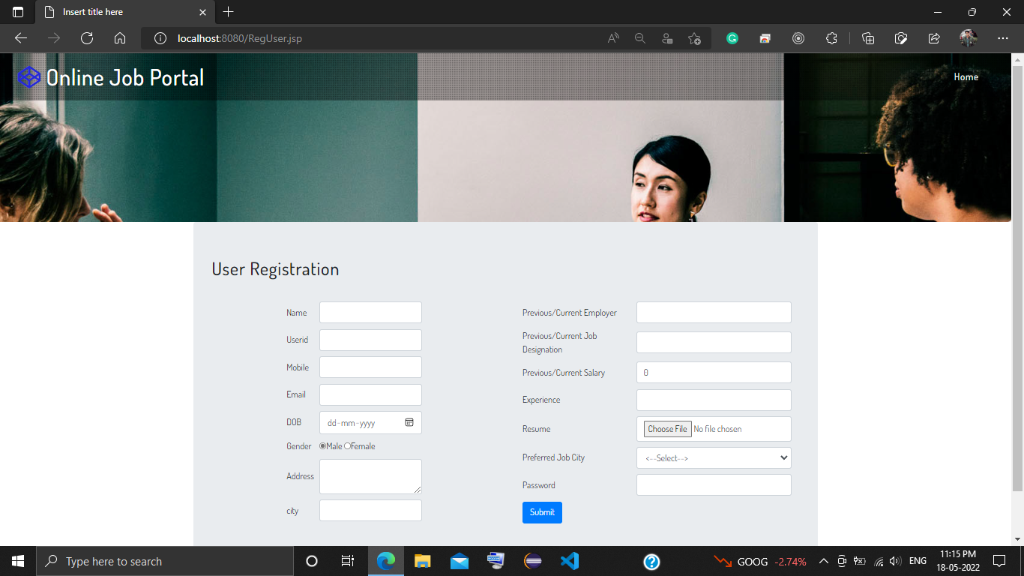
RESULT
Login (User and Admin)
User Registration

Slide 16
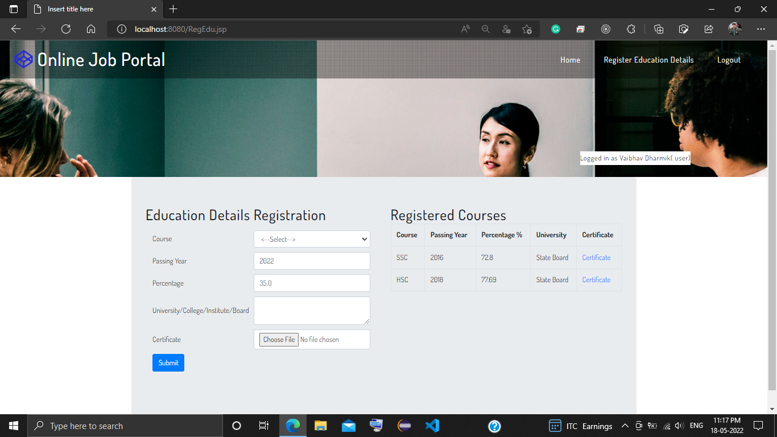
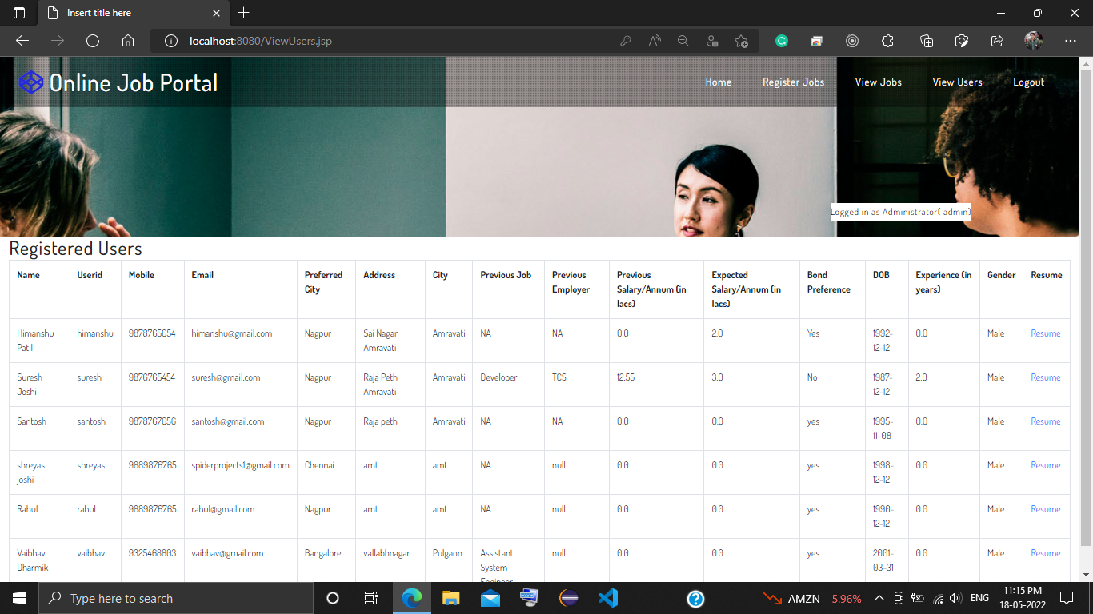
User Educational Details
Admin Registered Users

Slide 17
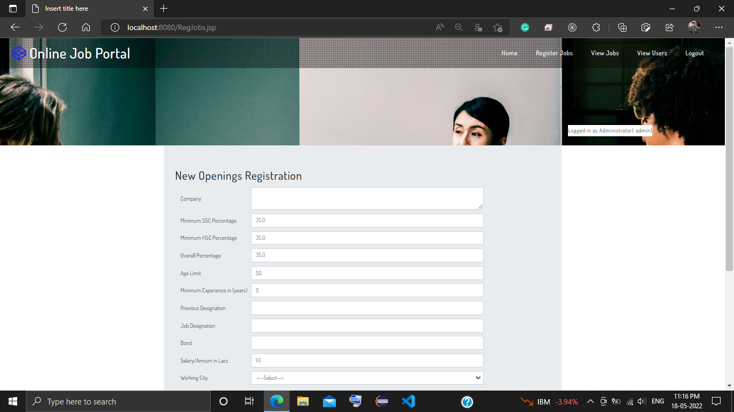
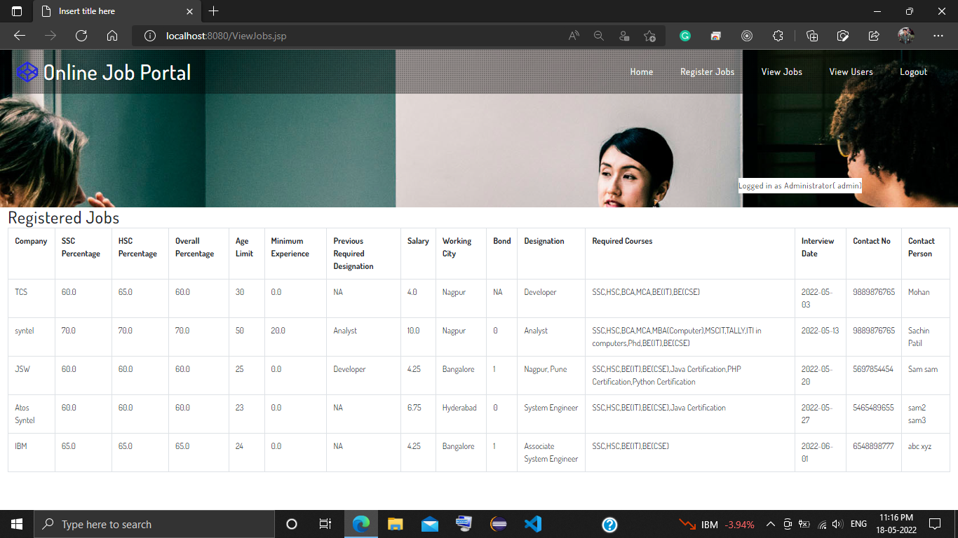
Admin Jobs Registration
Admin Registered Jobs
Notes:
Advantage of this 5 pen pc technology:
It is Portable i.e can be carried
It is Feasible i.e workable, executable
Ultimate ubiquitous(being present everywhere at once)
Support WiFi technology
Pens produces both the monitor as well as the keyboard on any flat surfaces from where you can carry out functions.

Slide 18
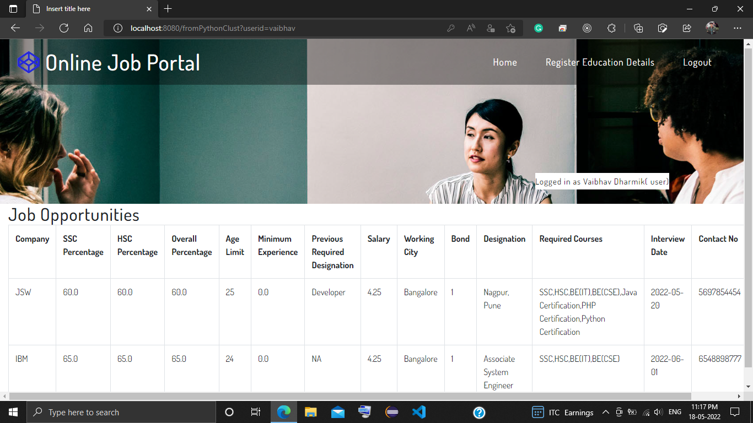
Recommended Jobs to User

Slide 19
CONCLUSION
In this Project, we presented a job recommender model aiming to extract meaningful data from job postings using data-clustering methods. As a result, job offers are divided into job clusters based on their common features and job offers are matched to job seekers according to their interactions.

Slide 20
FUTURE SCOPE
Our future Work will focus on training and evaluating our model using Word2vec method and k -means clustering algorithms used to capture and represent the context of job profiles. Subsequently, it will be easy to match set of job offers to a given job seeker based on its past interactions toward specific job offers. The dataset that will be used is built from scraping job search websites.
Notes:
The communication devices are becoming smaller and compact. This is only an example for the start of this new technology.
We can expect more such developments in the future.

Slide 21
Thank you!!!

