Slide 1

Digital Communication
Project
Group 2

Slide 2
Median based clustering for underdetermined blind signal processing

Slide 3
Objective
Given an observed m-dimensional mixture random vector x, which allows an unknown decomposition x = As, the goal is to identify the mixing matrix A and the unknown n-dimensional source random vector s.

Slide 4
Understanding of the Problem
Blind Source Separation (BSS) is the separation of a set of source signals from a set of mixed signals, without the aid of information (or with very little information) about the source signals or the mixing process.
Underdetermined or Overcomplete BSS is the type of BSS in which the total number of mixtures is less than the total number of sources.

Slide 5
The most commonly used overcomplete algorithms rely on sparse sources , which can be identified by clustering, usually by k-means or some extension.
However, apart from the fact that mean-based clustering lacks theoretical justiﬁcations, it only identiﬁes the correct A if the data density approaches a delta distribution and hence, at times converges to the wrong solution. Also, Mean based clustering does not possess any equivariance property which suggests that performance will be independent of A.
The figure in the following slide indicates the deficiency of mean based clustering.

Slide 6
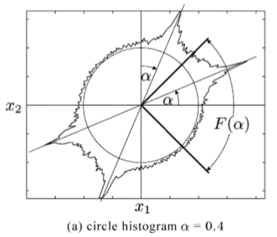
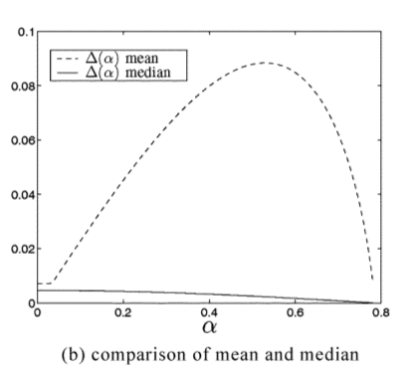
Here a mixture x of two independent gamma-distributed sources using a mixing matrix A with columns inclined by α and (π/2 - α) respectively have been considered.
Figure ‘a’ represents the mixture density for α = 0.4 after the projection onto the circle.
For α ∊ [0; π/4), we compare the error when estimating A by the mean and the median of the projected density in the receptive ﬁeld F(α) = (-π/4 π/4) of the known column a1 of A.
Figure ‘b’ clearly indicates that median-based clustering performs much better as compared to mean based clustering.

Slide 7
Blind Source Separation
x=As
where,
x = m-dimensional mixture random vector
s = n-dimensional source random vector with component density p(s)
A = mixing matrix having independent columns each of unit norm

Slide 8
B is said to be equivalent to A, B ~ A, if B can be written as:
B = APL
where -
L = An invertible diagonal matrix known as the Scaling Matrix.
P = An invertible matrix comprising of unit vectors in each row. It is also known as Permutation Matrix.
Hence, it can be assumed that the columns a_{i} of A have unit norm.

Slide 9
Blind Source Separation (BSS) follows a two step approach:
1. Geometric matrix recovery of A (Blind Mixing Model Recovery - BMMR) - Tries to identify A in x = As given x , where s is assumed to be statistically independent.
2. Blind source recovery (BSR) - Once A is estimated, BSR is used to find s.

Slide 10
Independent Component Analysis
Independent component analysis (ICA) is a computational method for separating a multivariate signal into additive subcomponents. This is done by assuming that the subcomponents are non-Gaussian signals and that they are statistically independent from each other.
We have assumed to s to be statistically independent, n-dimensional, symmetric random vector with density p_{s} describing the sources.
Since, s is independent,
p_{s}(s₁, s₂, s₃, s_{n}) = p_{s1}(s₁)*p_{s2}(s₂)*p_{s3}(s₃).....p_{sn}(s_{n})
And, s is symmetric,
and p(s_{i})=p(-s_{i}). Hence making E(s) = 0.

Slide 11
Geometric Matrix recovery
For Geometric Matrix Recovery of A we assume the following:
1) Underdetermined or over-complete systems - m ≤ n (fewer mixtures than sources).
2) A has pairwise linearly independent columns.
3) The source vector s is statistically independent.

Slide 12
Geometric Blind Mixing Model Recovery (BMMR) algorithm
Pick 2n starting vectors w₁,w₁’,w₂,w₂’,......,w_{n},w_{n}’ such that w_{i} are pairwise linearly independent and w_{i} = -w_{i}’. These wi are called Neurons.
Fix a learning rate η : N -> R
Iterate the following steps until an appropriate abort condition has been met:
Choose a sample x(t) according to the distribution of x. If x(t) = 0 , pick a new one — note that this case happens with probability zero.

Slide 13


Project x(t) onto the unit sphere, and get where where ∊ S^{m-1}.
Then set

Slide 14
Blind source recovery
An estimate of A was obtained as a result of BMMR. In order to solve the overcomplete BSS problem, we are therefore left with the task of reconstructing the sources using the mixtures and the estimated matrix(BSR).
Since A has full rank, the equation x=As yields the n-m dimensional vector space A​⁻¹​{x} as solution space for s. Hence, if n>m the source-recovery problem is ill-posed without further assumptions. An often used assumption is derived using a maximum likelihood approach.

Slide 15
The maximum-likelihood algorithm states that the probability of observing x given A and s can be written as P(x|s,A).
Using Bayes Theorem the posterior probability of S is -
P(s|x,A) = (P(x|s,A)*P(s))/P(x)(such that x=As)
For reconstructing s, we will maximize the posterior probability-
s = arg max P(s|x,A)= arg max P(x|s,A)*P(s)

Slide 16
K-Means Clustering
K-means clustering is a type of unsupervised learning, which is used when you have unlabeled data (i.e., data without defined categories or groups). The goal of this algorithm is to find groups in the data, with the number of groups represented by the variable K. The algorithm works iteratively to assign each data point to one of K groups based on the features that are provided. Data points are clustered based on feature similarity. The results of the K-means clustering algorithm are:
The centroids of the K clusters, which can be used to label new data
Labels for the training data (each data point is assigned to a single cluster)

Slide 17
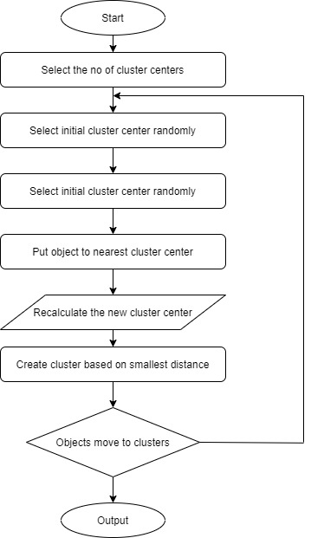

Slide 18
K-Medoids Clustering
Partitioning Around Medoids or the K-medoids algorithm is a partitional clustering algorithm which is slightly modified from the K-means algorithm. They both attempt to minimize the squared-error but the K-medoids algorithm is more robust to noise than K-means algorithm. In K-means algorithm, they choose means as the centroids but in the K-medoids, data points are chosen to be the medoids/centroids.
A medoid can be defined as that object of a cluster, whose average dissimilarity to all the objects in the cluster is minimal.

Slide 19
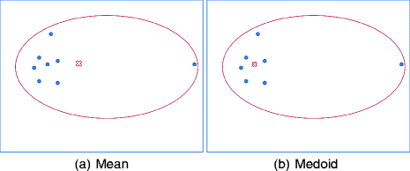

Slide 20
Simulation Results

Slide 21
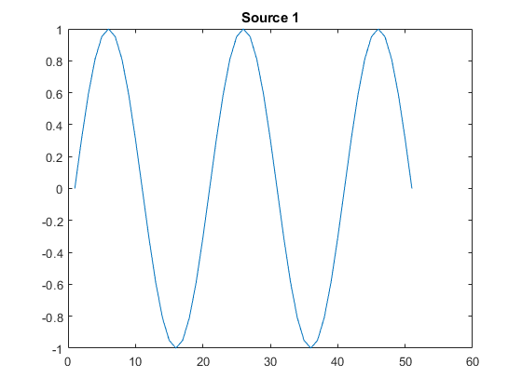
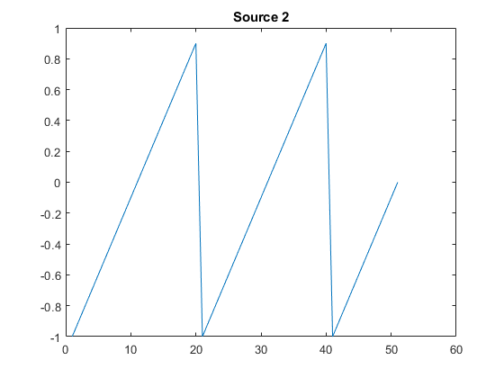
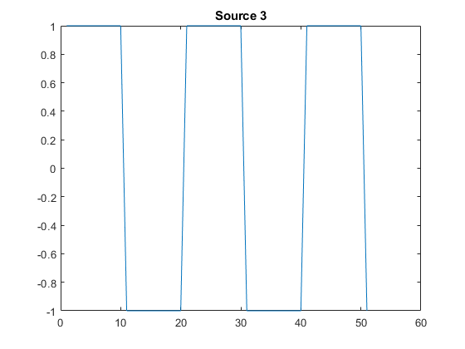
Source Signals

Slide 22
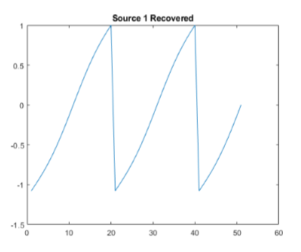
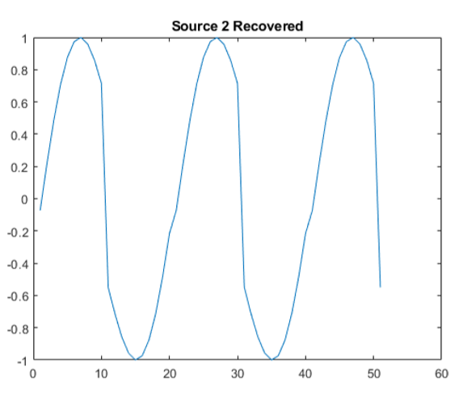
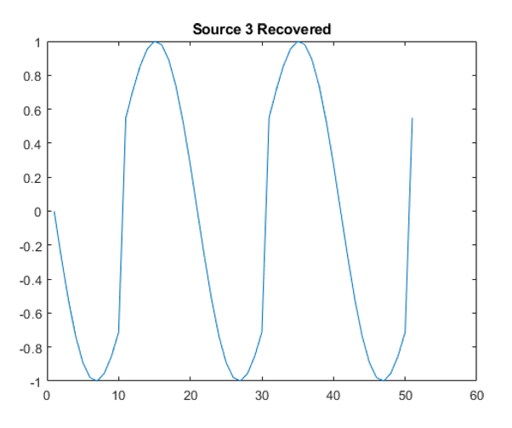
In-paper Algorithm Results

Slide 23
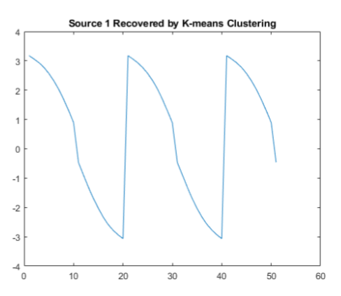
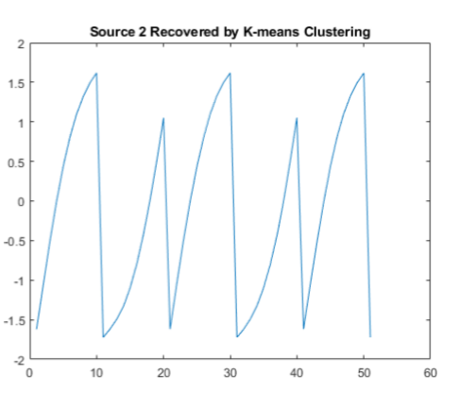
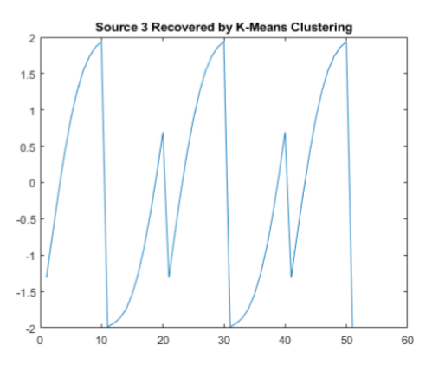
K-Means Simulation Results

Slide 24
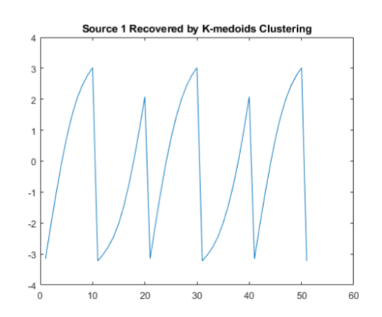
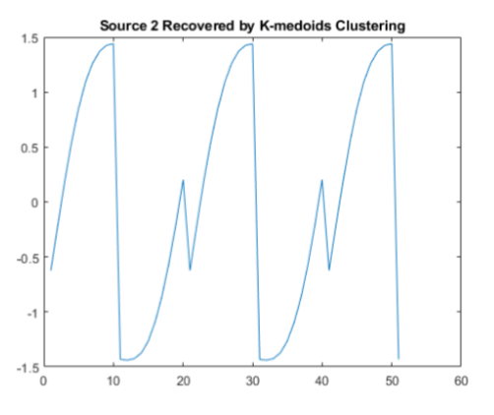
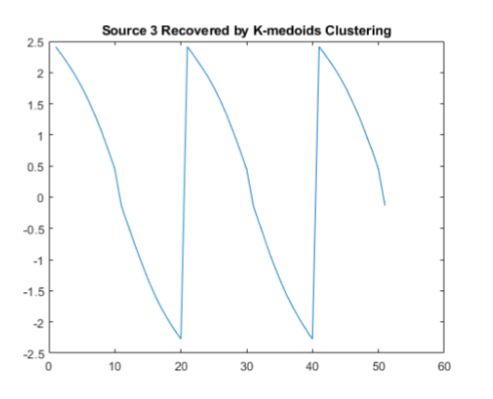
K-Medoids Simulation Results

Slide 25
Error Calculation
Our algorithm approximates the matrix well with E(A, A_cap) = 1.5097. The paper mentions the mean error range when using random 2x3 -matrices with coefficients uniformly taken from [-1,1] as E = 1.9 ± 0.73, which our implementation justifies.
In-Paper Algorithm - 1.5097
K-Means Algorithm - 1.5631
K-medoids Algorithms - 1.5496

Slide 26
Results
Our main focus here was to develop a self-organising map with an improved weight update algorithm than the existing ones.
The algorithm hence developed gives us less mean error when reconstructing source waveforms as compared to existing clustering methods like K-means and K-medoids.
We can also see that the weight update through K-medoids gives us better results than weight update through K-means, though the error in results vary a little since we are taking a random samples here.

