Slide 1
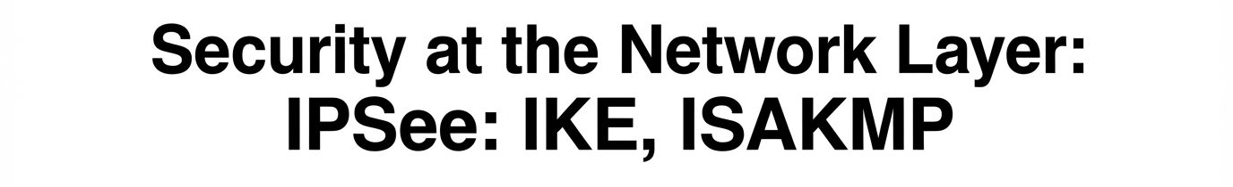
Presented by : Vaibhav Sonkusare
Roll No: 206125030

Slide 2
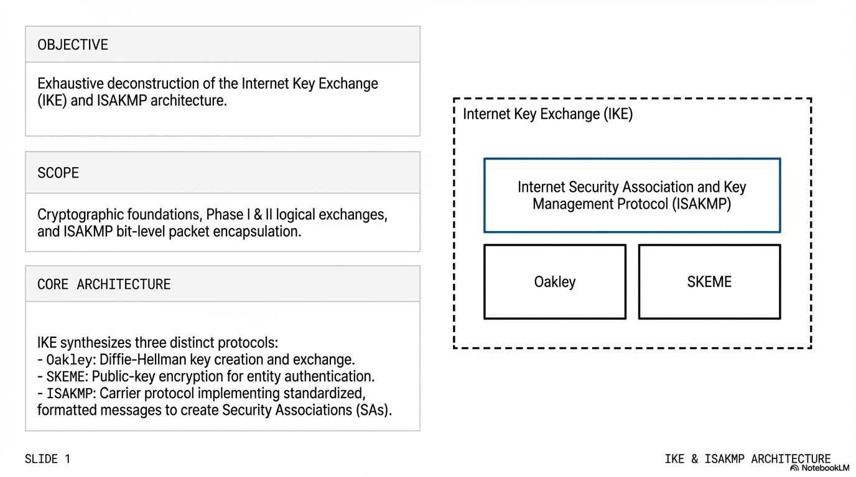

Slide 3
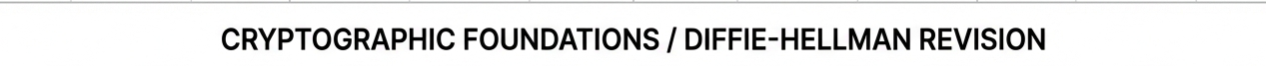
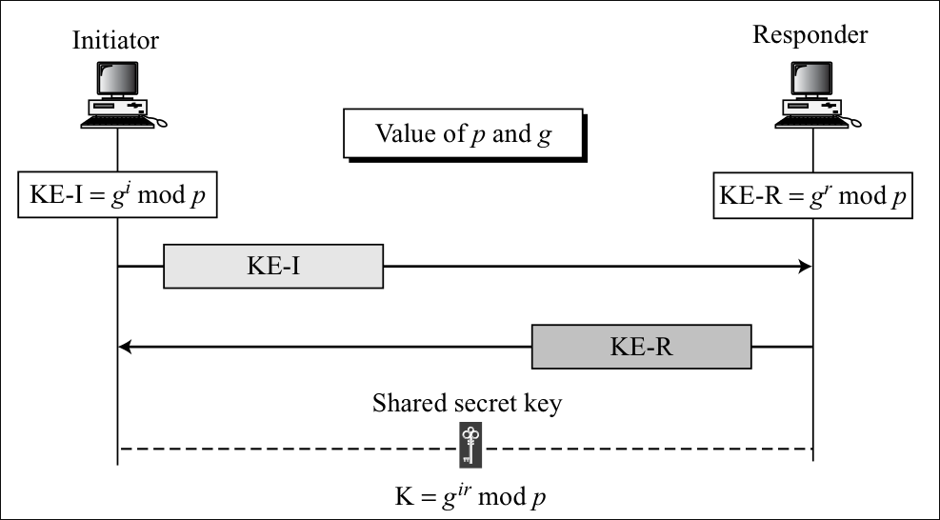

Slide 4
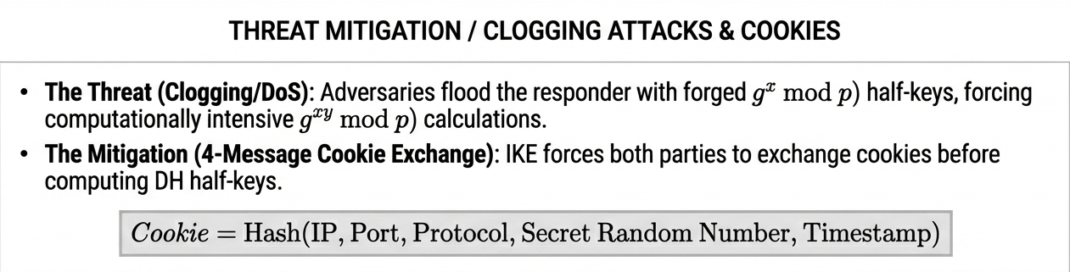
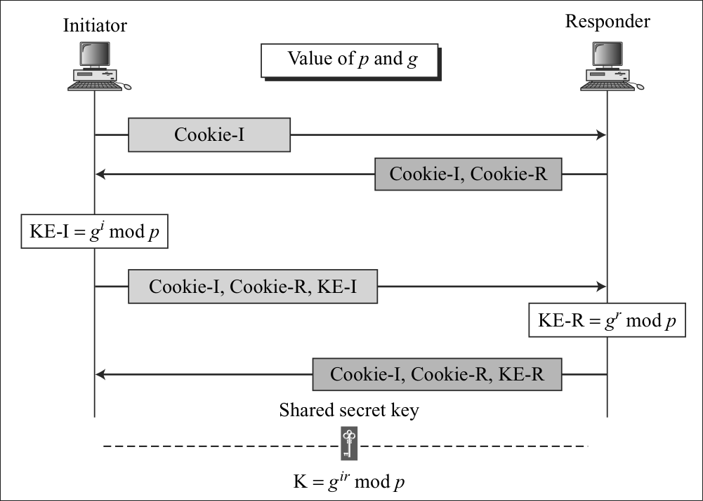

Slide 5
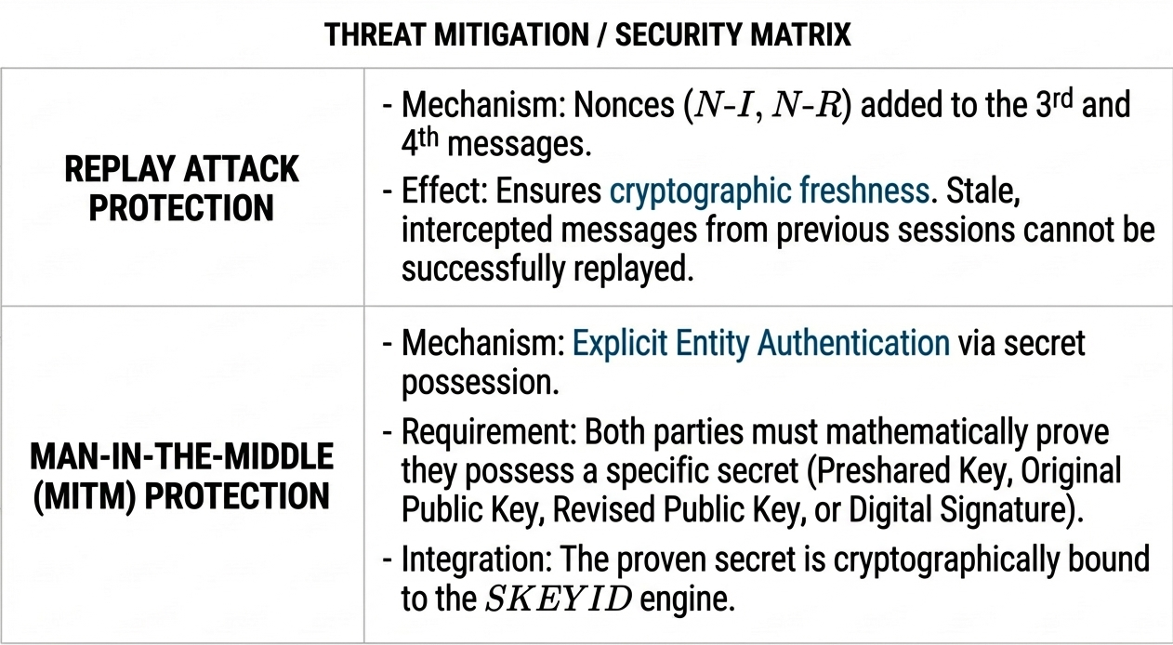

Slide 6
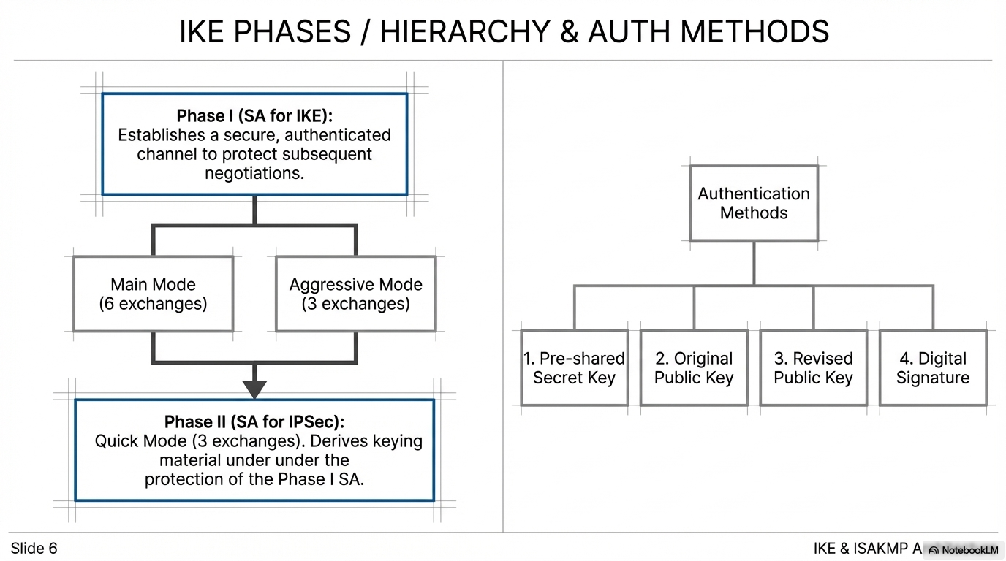
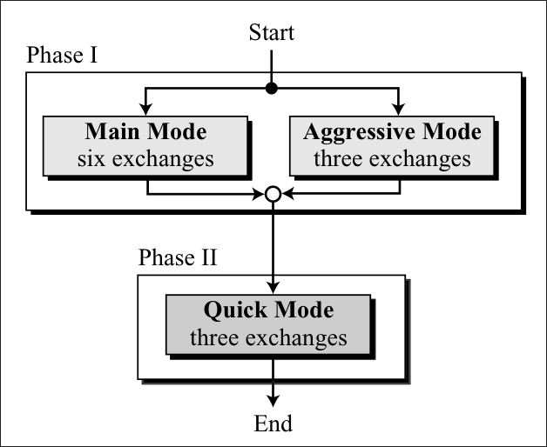

Slide 7
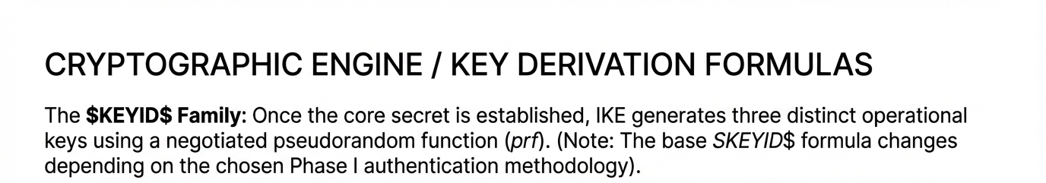



Slide 8
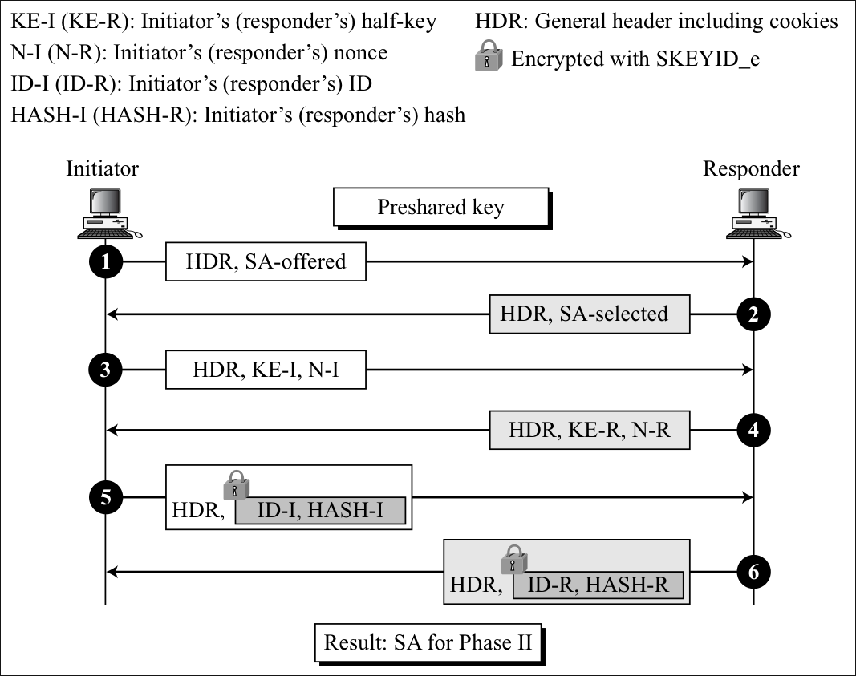
Phase I
Main Mode
Pre-Shared Key Method

Slide 9
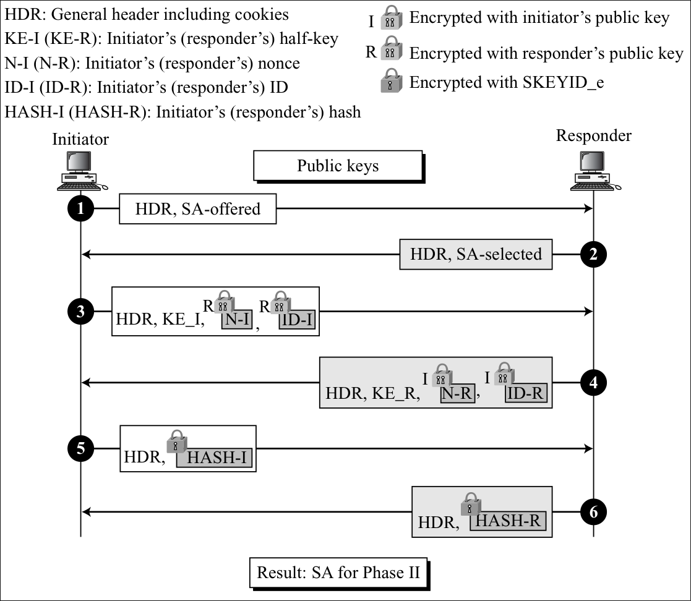
Phase I
Main Mode
Original Public Key-Method

Slide 10
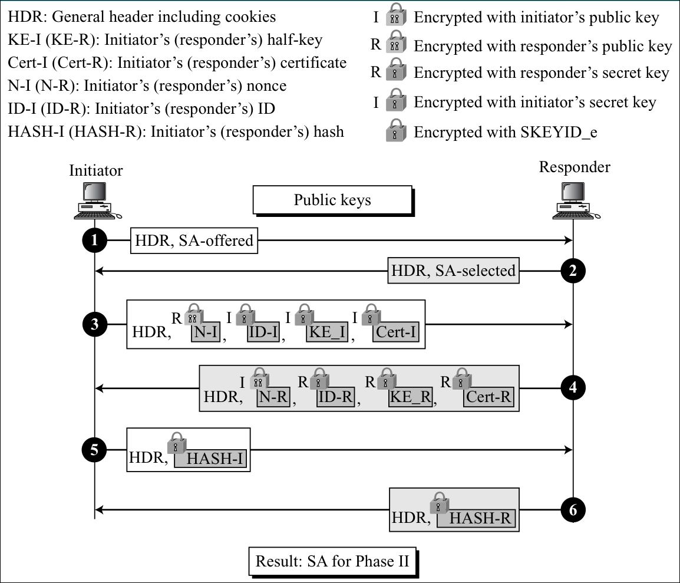
Phase I
Main Mode
Revised Public Key-Method

Slide 11
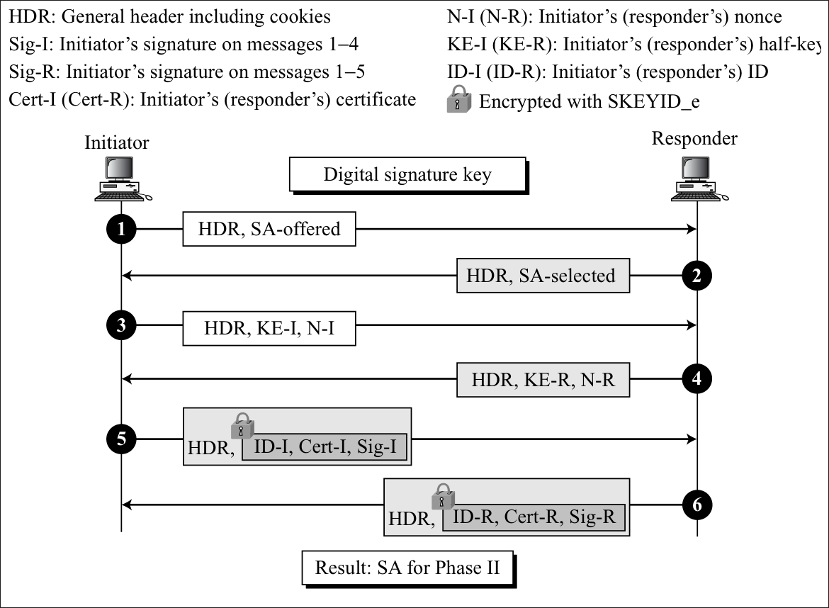
Phase I
Main Mode
Digital Signature Method

Slide 12
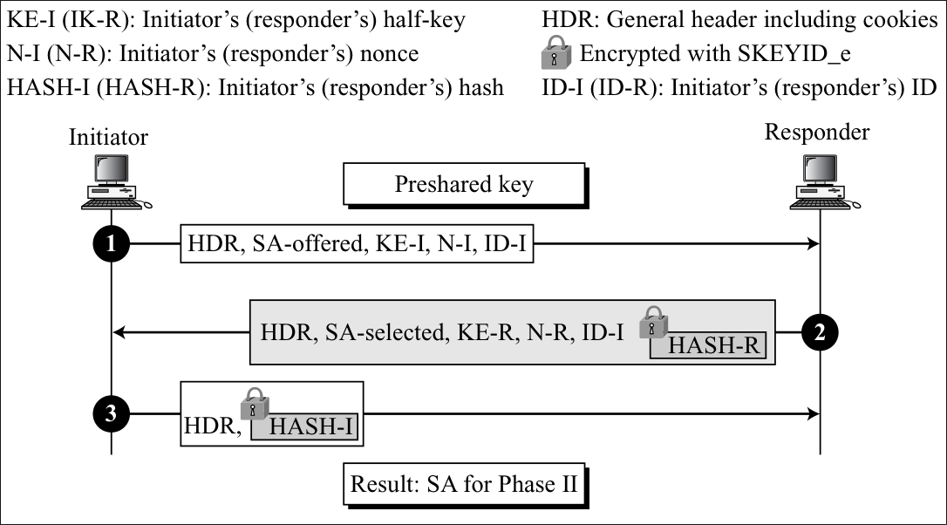
Phase I
Aggressive Mode
Pre-Shared Key Method

Slide 13
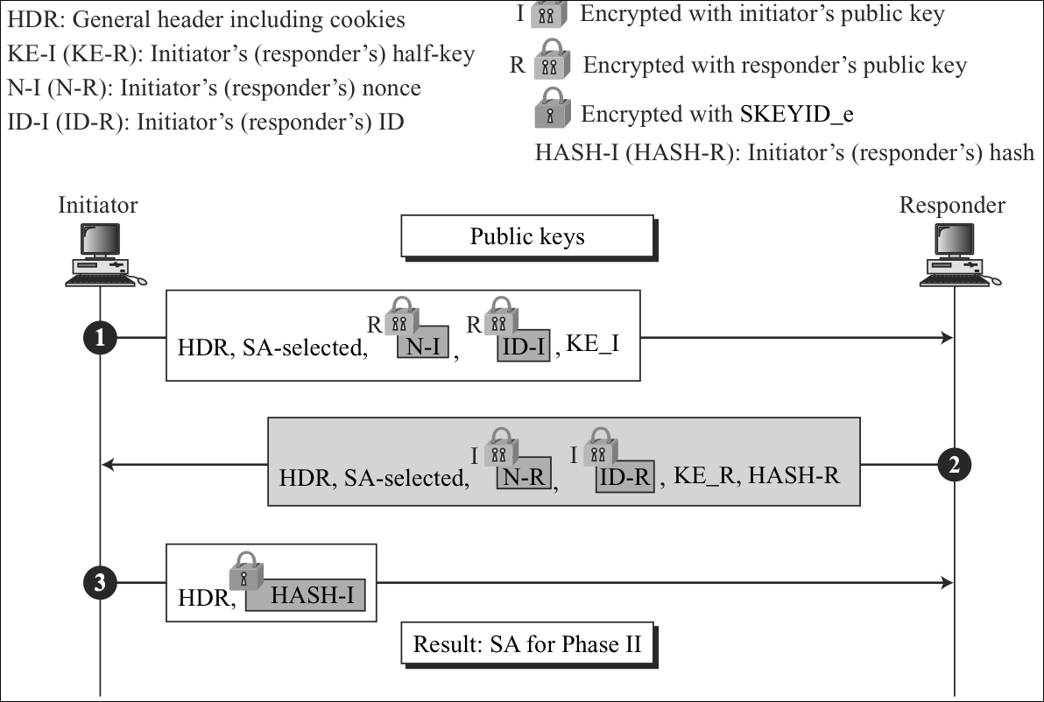
Phase I
Aggressive Mode
Original Public Key-Method

Slide 14
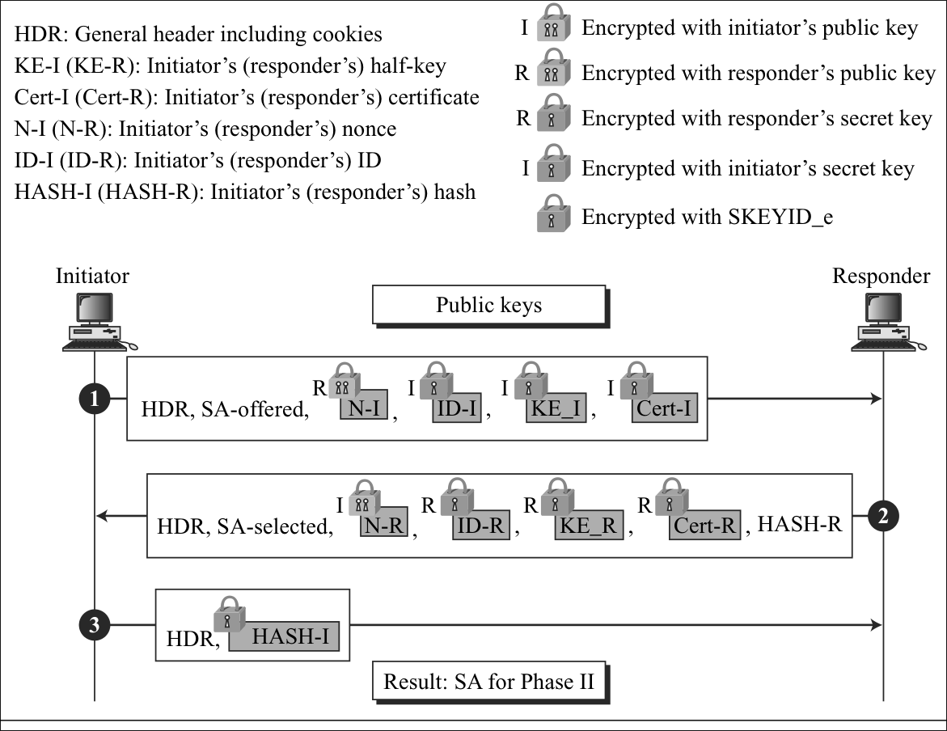
Phase I
Aggressive Mode
Revised Public Key-Method

Slide 15
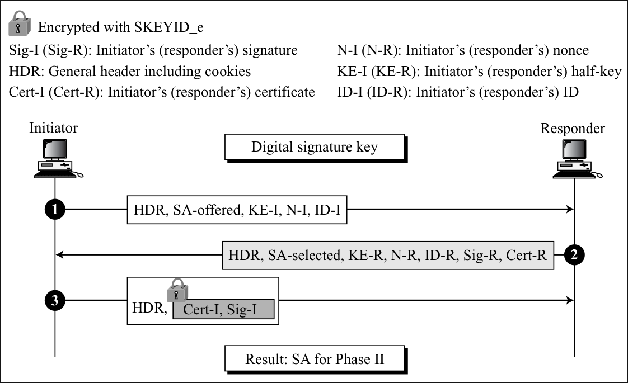
Phase I
Aggressive Mode
Digital Signature Method

Slide 16
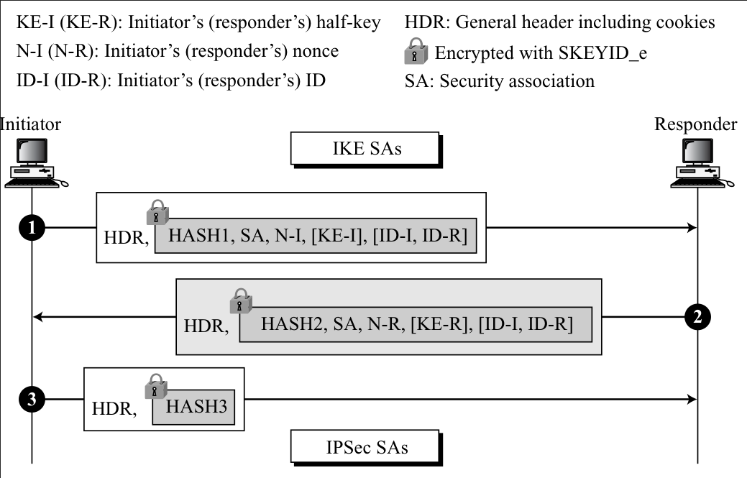
Phase II
Quick Mode

Slide 17
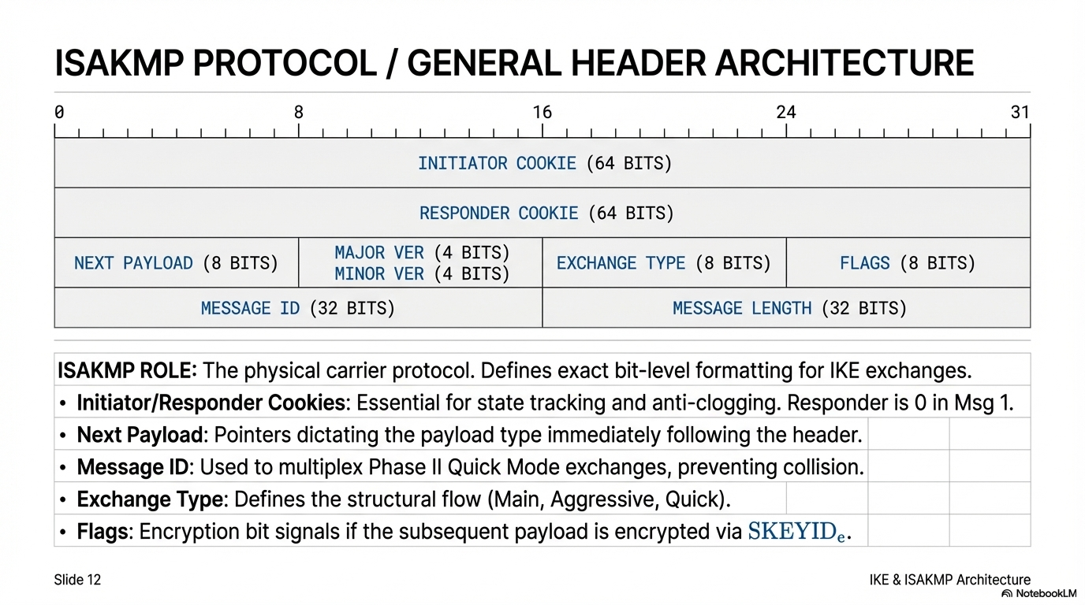
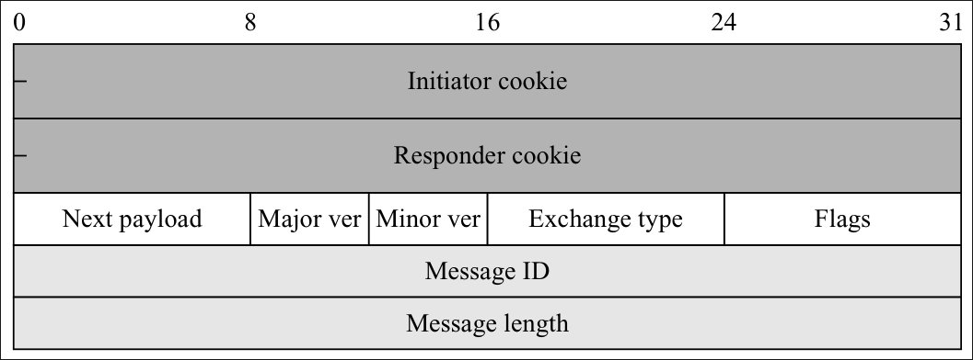

Slide 18
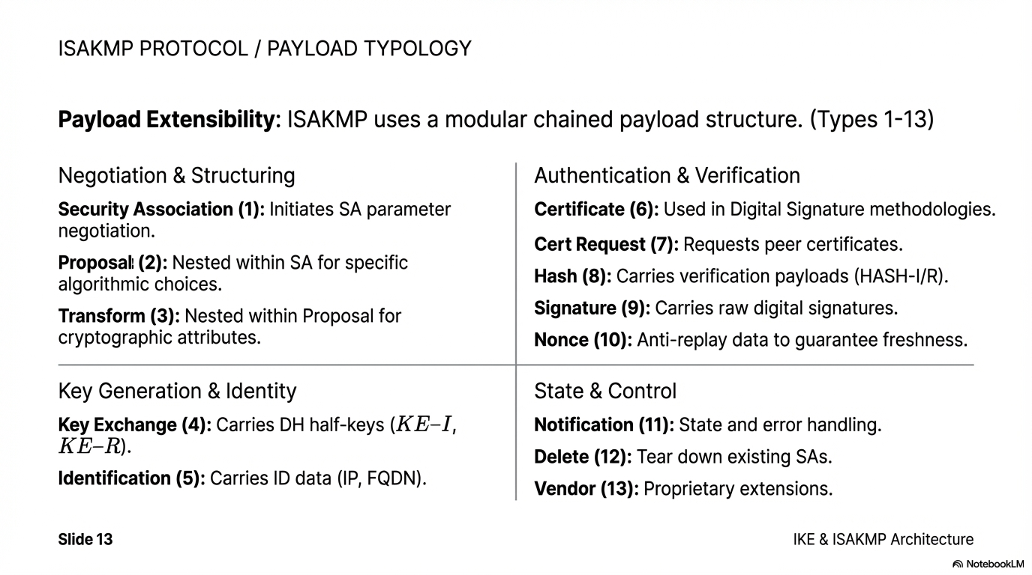

Slide 19
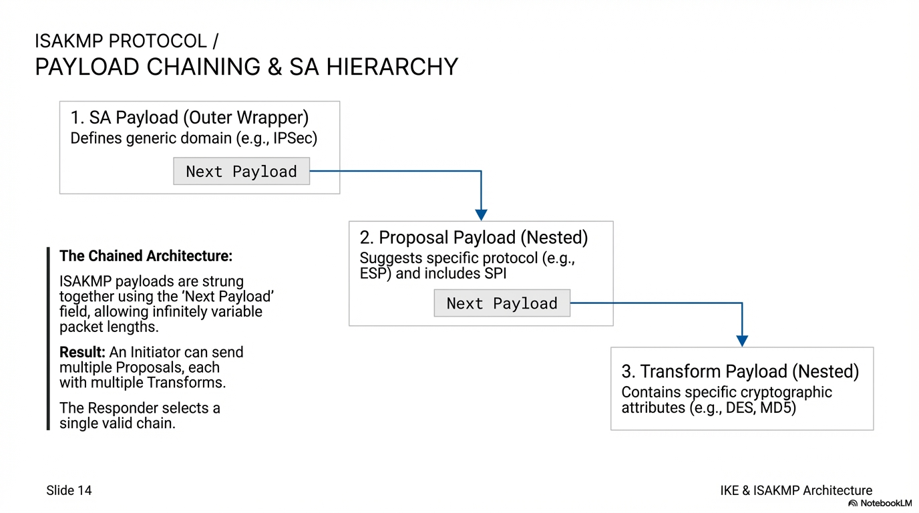

Slide 20
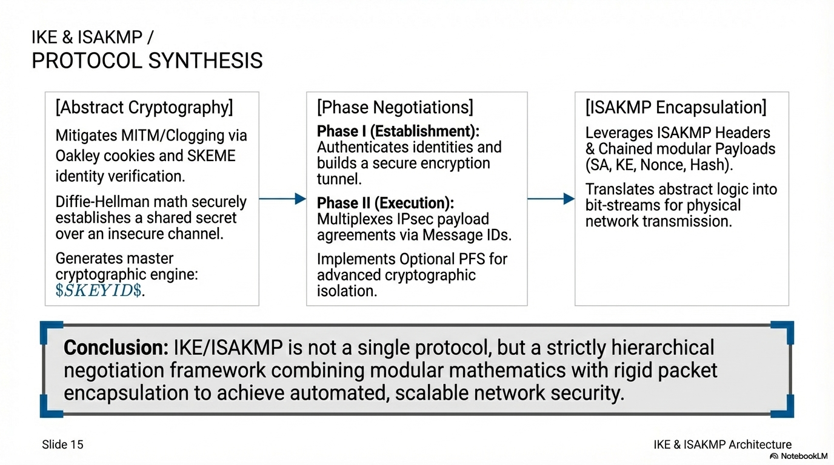

Slide 21
Thank you!
Any Doubts?

