Slide 1
Shakti overview
RISE Lab
IITM

Slide 2
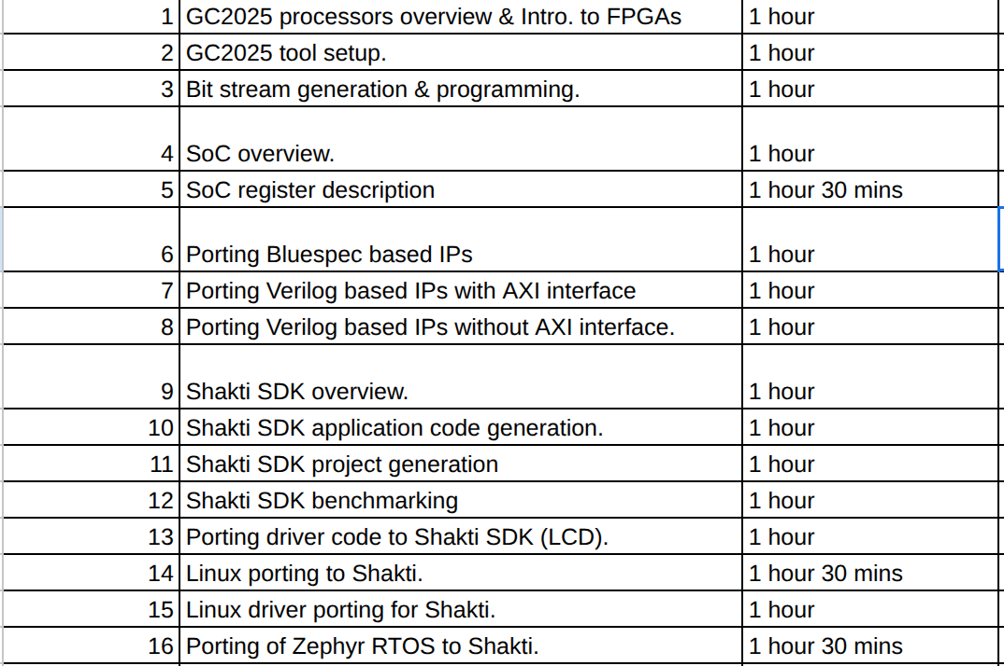
Webinar Schedule

Slide 3
Genesis of SHAKTI
SHAKTI - family of open source RISC-V processors ranging from simple single core processors to server-grade multi-core processors.
Today the SHAKTI initiative has grown into a comprehensive ecosystem that will provide industry-grade open source processors, AI/ML accelerators, communication fabrics, interconnects, peripherals and storage controllers.
This initiative has resulted in 7 startups so far.

Slide 4
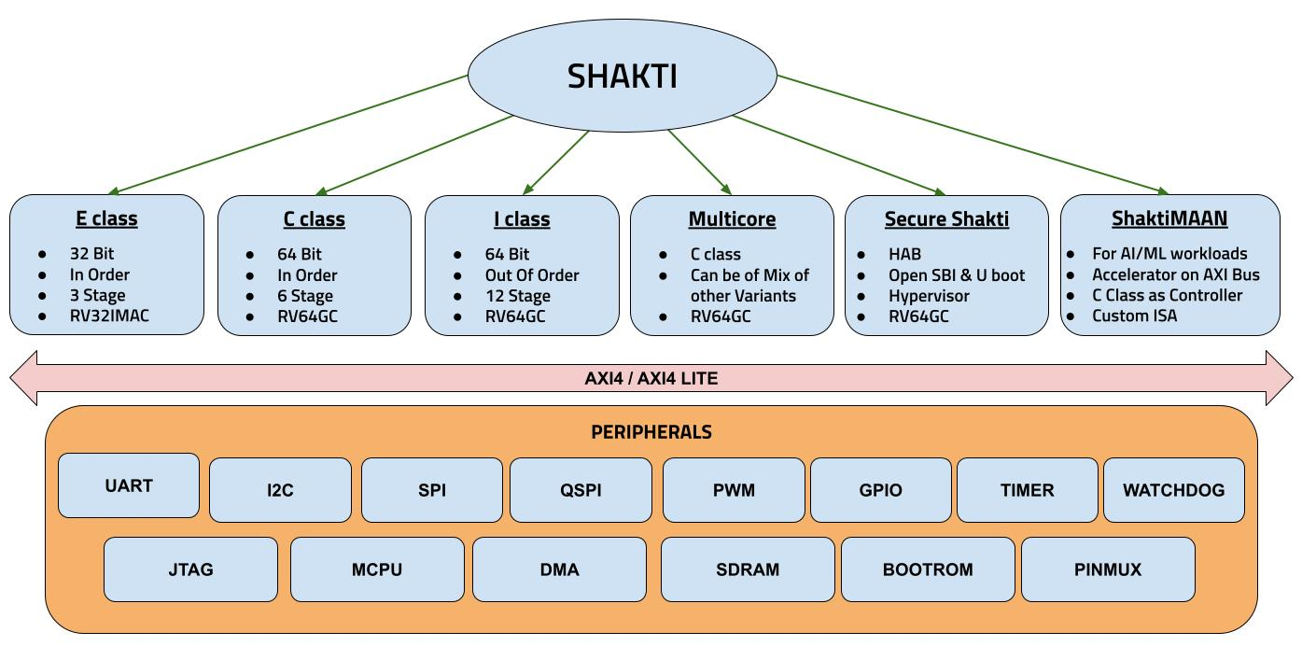
SHAKTI Ecosystem
SHAKTI Design Portfolio
Notes:
Base Processors
▫ E-Class : 3 stage micro-controller
▫ C-Class : 5 stage micro-processor
▫ I-Class : 12 stage OoO processor
Core IP blocks
▫ Single and Double IEEE 754 FPU
▫ Parameterized Branch Predictors
▫ Parameterized Caches.

Slide 5
E Class vs C Class vs I Class
Operating frequency: Upto 400 MHz
Positioned against ARM’s Cortex Mx class cores
Target: IoT devices, Edge Devices, Robotic Control, Smart cards
Operating frequency: > 1+ GHz
Positioned against ARM’s Cortex A35/A55
Target: Reliable Computing, Secure Computing, IoT & Edge Computing hubs, Auto/Aerospace/Industrial Controls
Operating frequency: 1-2 GHz
Positioned against ARM’s Cortex A76 (Work in Progress)
Target: High Performance Compute, Mobile, Storage and Networking segments
E-Class
C-Class
I-Class

Slide 6
GC2025 Shakti Based Configurable Systems

Slide 7
Yamuna
32 bit C class core
6 stage Pipeline
In order core
RV32IMAC
16kB $I & 16kB$D
256MB DDR
8kB boot ROM.
32 x GPIOs
4 x General Purpose Timers
2 x SPI controller.
3 x UART
6 x PWM
2 x I2C
1 x PLIC
1 x CLINT
Pinmux support.
On board xADC
Arduino compatible pins
FTDI based debugging.
Ethernet Lite IP
RTOS Booted.

Slide 8
Ganga
64 bit C class core
6 stage Pipeline
In order core
RV64IMAC
16kB $I & 16kB$D
256MB DDR
8kB boot ROM.
16 GPIOs
2x General Purpose Timers
2 x SPI controller.
2 x UART
1 x I2C
1 x PLIC
1 x CLINT
Pinmux support.
Arduino compatible pins
FTDI based debugging.
Ethernet Lite IP
Linux Booted.

Slide 9
Applications

Slide 10
Yamuna Applications
Cater to Low power and low speed applications.
  Wireless sensor networks.
  Smart card reader.
  RFID tags.
  Home automation.
  Agriculture equipments
  Robotic Control
  Edge Devices.
  Simple Data Acquisition Systems.
  Personal tracking systems.
  Vehicle Tracking systems
  Motor control applications.
  Light control systems.

Slide 11
Ganga Applications
Cater to Low/Medium power, high performance and higher speed applications.
  Industrial Automation.
  Reliable computing
  Edge computing
  Secure computing
  Automobile control
  Aerospace applications
  Critical Monitoring systems.
  IoT Gateways
  Image/Video processing.
  Unmanned vehicle systems.
  Speech Processing Systems.

Slide 12
FPGA Based SoC Templates

Slide 13
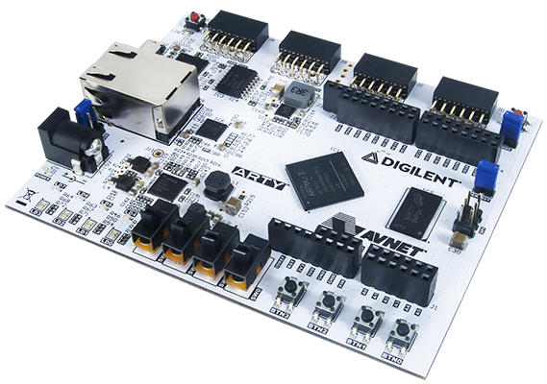
Board Support
Shakti based SoCs are supported on Multiple Boards
Nexys Video
AC701
VCU118
Aldec
proFPGA
ZC702.
Arty 100T & Arty 35T
Genesys 2
VC707

Slide 14
Shakti Peripherals

Slide 15
SHAKTI PERIPHERALS
UART
Configurable Baud rate
  Upto 3Mbps.
Complete UART support with RTS, CTS, DTR, DSR, CD,RI.
Programmable character size.
Programmable stop bits, parity bits.
16 byte FIFO.
Read / Write options
  Polling based
  Interrupt based
Integrated with ESP chip, 4G Modem, Lora & Zigbee.
I2C
Supports Standard (100kHz) and Fast mode I2C (400kHz).
Master Mode support.
Configurable clock speed.
7 bit addressing.
Supports
  Polling based
  Interrupt based
FIFO based implementation as well available (32 Byte)
Notes:
TAlk abt default uart
Uart baud rates
Driver suppor
tApplications

Slide 16
SHAKTI PERIPHERALS
SPI
Standard SPI.
Configurable clock speed (Tested upto 12.5MHz).
Master and Slave mode support.
Multi slave support
Supports both 3 wire and
4 wire interface.
Programmable clock polarity(CPOL) and phase (CPHA)
32 Byte FIFO depth.
Programmable set up time and hold time.
PWM
FPGA board Clock speed - 50MHz
Configurable PWM
  Clock divisor
  Period
  Duty Cycle
Tested upto 7.5 MHz.
Complementary Output support.
Timer mode support.
Programmable interrupts.
Notes:
TAlk abt default uart
Uart baud rates
Driver suppor
tApplications

Slide 17
SHAKTI PERIPHERALS
GPTimer
32 bit General Purpose Timer.
Supports Up/Down/Up-down Counters.
Also supports PWM.
Captures the input.
Continuous Counter mode.
External reference clock can be used.
Underflow/Overflow interrupts can be configured.
Watchdog Timer
32 bit Watchdog timer.
Prevents the core from Stalling during code execution.
Supports hard reset as well as interrupt mode.
When the active bit is not triggered, the SoC will get reset on timeout.
Watchdog timeout and external reset period can be configured in software.

Slide 18
SHAKTI PERIPHERALS
GPIO
General Purpose Input / Output.
No of ports can be configurable (customizable).
Separate SET, CLEAR & TOGGLE registers can be used to configure the individual port values.
DATA register can be used to read the GPIO port values.
DIRECTION register can be used to configure the GPIO port as input or output.
Few GPIO pins can be configured for external interrupt.
Interrupts can be configured either as active high or active low.
Manys sensors verified and examples present in SDK.

Slide 19
SHAKTI PERIPHERALS
PLIC
RISC-V compatible interrupt controller.
Registers editable at bit level.
Default and vector interrupts supported.
Priority can be configured.
Complete driver support with examples
CLINT
Core Local Interrupt Timer.
Machine Mode timer.
Configure timer at tick level.
MTIME & MTIMECMP registers.
Interrupt mode supported.
Complete driver support with examples.
Notes:
Clint - scheduler
Plic - interrupt cotroller

Slide 20
SHAKTI PERIPHERALS
PMP
Allows physical memory access privileges to specified for each physical memory region.
Can specify up to 64 regions
Granularity can be as small as 4
PMP checks by default applied to S and U memory/instruction access
PMP checks may apply to M mode, if the regions are locked at reset, preventing even M mode SW to change it.

Slide 21
PinMux
Used to configure and select the hardware pin configured for multiple functions based on the configured value.
Pin mux register has to be configured to enable a peripheral function on a pin.
Pin mux register is 32 bits.
By default all pins are configured as GPIO.
Different values can be configured in pin mux register to assign different functions to each and every pin.
GPIO pins can be assigned to different peripheral devices
Pinmux configuration can be increased for adding more functionality to each pin.

Slide 22
PinMux USED IN SP2020
PinMux Config Value |  | Bit Position
 |  | 15 | 14 | 13 | 12 | 11 | 10 | 9 | 8 | 7 | 6 | 5 | 4 | 3 | 2 | 1 | 0
00 |  | GP10 |  | GP9 |  | GP6 |  | GP5 |  | GP3 |  | GP2 |  | GP1 |  | GP0
01 |  | S2_CS |  | - |  | - |  | - |  | U2TX |  | U2RX |  | U1TX |  | U1RX
10 |  | PWM4 |  | PWM3 |  | PWM2 |  | PWM1 |  | PWM0 |  | - |  | - |  | -
PinMux Config Value |  | Bit Position
 |  | 31 | 30 | 29 | 28 | 27 | 26 | 25 | 24 | 23 | 22 | 21 | 20 | 19 | 18 | 17 | 16
00 |  | - |  | - |  | - |  | - |  | - |  | GP13 |  | GP12 |  | GP11
01 |  | - |  | - |  | - |  | - |  | - |  | S2CK |  | S2SO |  | S2SI
10 |  | - |  | - |  | - |  | - |  | - |  | - |  | - |  | PWM5

Slide 23
Shakti Cryptographic Accelerators

Slide 24
AES
Symmetric key encryption standard
Support for multiple key lengths: 128b, 192b or 256b
Support for various modes
  ECB: Electronic Code Book
  CBC: Cipher Block Chaining
  CFB: Cipher FeedBack
  OFB: Output FeedBack
  CTR: Counter
AES-256 Design
  16 unified SBoxes
  AXI-4 slave
  Buffers of depth 4 at input and output
  Supports DMA with automatic flow control
Notes:
TAlk abt default uart
Uart baud rates
Driver suppor
tApplications

Slide 25
SHA
One-way function
Typically used
  To verify integrity of data
  For digital signatures
Various digest sizes -
  256 and 512
A small change in input results in significant change in output.
Engine Variants (SHA256) -
  Sequential (64 clock cycles)
  Sequential Unrolled (32 clock cycles)
  Pipelined (64 stages)

Slide 26
FPGA - Field Programmable Gate Arrays

Slide 27
What is an FPGA?
Field Programmable Gate Array (FPGA)
Reconfigurable Hardware – FPGAs enable dynamic hardware customization.
HDL Programmability – Designed using HDLs to model chip behavior.
Post-Deployment Adaptability – Modify functionality even after deployment.

Slide 28
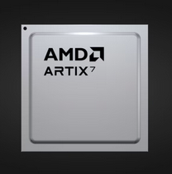
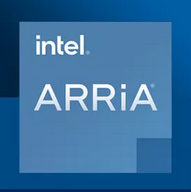
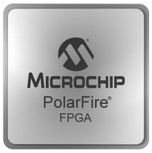
FPGA Technology Giants
AMD (Xilinx)[1]
Intel (Altera)[2]
Microchip (Microsemi)[3]
[1] https://www.amd.com/en/products/adaptive-socs-and-fpgas/fpga.html
[2] https://www.intel.com/content/www/us/en/products/details/fpga/arria.html
[3] https://www.microchip.com/en-us/products/fpgas-and-plds/fpgas

Slide 29
Why FPGA
ASIC - Application specific Integrated Circuit i.e. IC designed for a specific application.
ASIC fabrication is a tapeout
A costly process which involves millions of Dollars i.e. huge cost investment.
Verification process is a must.
Simulation & FPGA verification.
Simulation - Will not guarantee on timing.
FPGA - will provide both timing & functional validation i.e. at low frequencies.

Slide 30
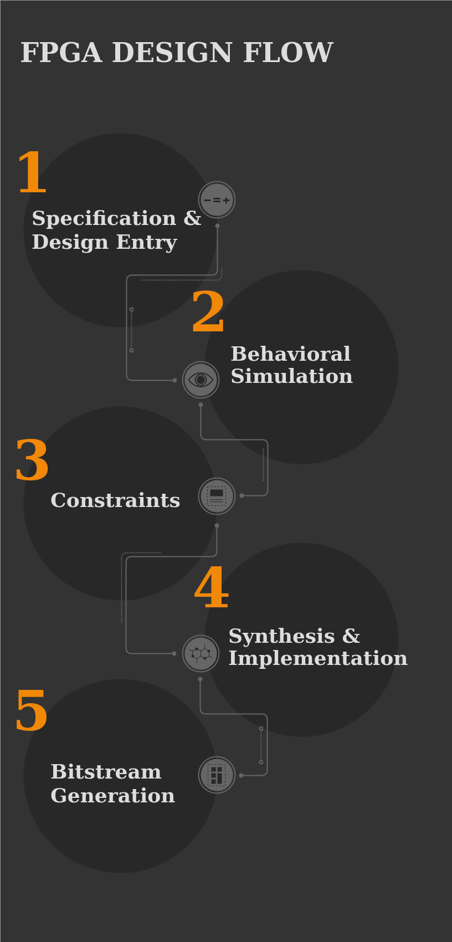
FPGA Design Flow

Slide 31
FPGA Design Flow
Specification & Design Entry: Getting the requirements/specifications & low/high level design.
Behavioral Simulation: Writing the code (verilog, vhdl, system verilog & BSV).
Synthesis: Converting the hdl to a netlist i.e. list of logic elements with connections along with optimization.
Simulation: verification of the specification with simple test benches.

Slide 32
FPGA Design Flow
Implementation: Process of converting the netlists to FPGA specific pattern
  Translate - collects and merge netlists into a single net list & verify the constraints.
  Map: Mapping the resources with net lists
  Place & Route: physical placement of the netlist to the FPGA physical resources
Bitstream generation: converting the implementation design into a FPGA understandable format.

Slide 33
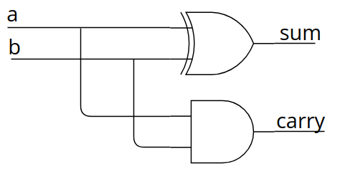
A Step-by-Step Walkthrough in Nexys Video
1. Design Entry - HDL Coding
(Verilog or VHDL or System Verilog)
module half_add (
input a,b,
output sum,carry
);
assign sum = a ^ b;
assign carry = a & b;
endmodule
Notes:
Center this slide

Slide 34
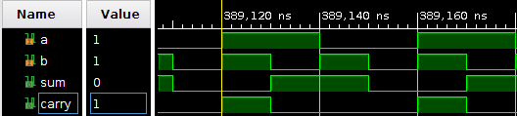
A Step-by-Step Walkthrough in Nexys Video
2. Behavioral Simulation

Slide 35
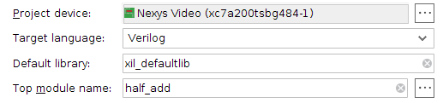
A Step-by-Step Walkthrough in Nexys Video
3. Project Device
(Board Selection)

Slide 36
A Step-by-Step Walkthrough in Nexys Video
4. Constraints
(Xilinx Design Constraints)
## Switches
set_property -dict { PACKAGE_PIN E22 IOSTANDARD LVCMOS12 } [get_ports { a }]; #sw[0]
set_property -dict { PACKAGE_PIN F21 IOSTANDARD LVCMOS12 } [get_ports { b }]; #sw[1]
## LEDs
set_property -dict { PACKAGE_PIN T14 IOSTANDARD LVCMOS25 } [get_ports { sum }]; #led[0]
set_property -dict { PACKAGE_PIN T15 IOSTANDARD LVCMOS25 } [get_ports { carry }]; #led[1]
Inputs are mapped to switches & Outputs are mapped to LEDs.

Slide 37
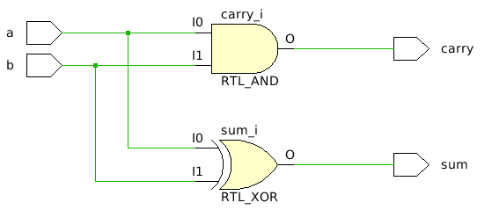
A Step-by-Step Walkthrough in Nexys Video
5. Synthesis
(Translation)

Slide 38
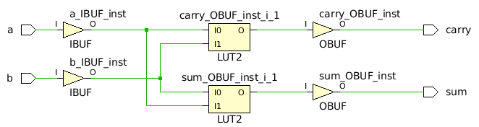
A Step-by-Step Walkthrough in Nexys Video
6. Place & Route
(Implementation)
Each LUT will have 6 inputs in Nexys Video.

Slide 39
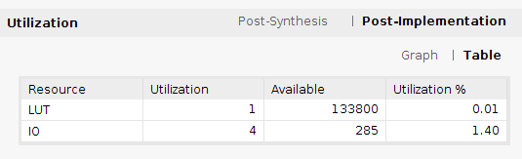
A Step-by-Step Walkthrough in Nexys Video
LUT Utilization

Slide 40
Shakti SDK

Slide 41
Outline
Shakti SDK Features
Shakti SDK Architecture
Shakti Tools
Drivers for Peripherals
Pinmux
OS
Manuals

Slide 42
Shakti SDK Features
Open-source software development platform for SHAKTI.
Clean separation between boot, drivers, core and application layers.
Driver support for PWM, QSPI, SPI, PLIC, CLINT, UART, I2C, GPIO, RTC, Watchdog, GPTimer and XADC.
Multiple sensors connected and proven with SHAKTI-SDK.
Standalone and Debug mode supported.

Slide 43
Shakti SDK Features
Multilevel logging, Flash programming & Dynamic memory management supported.
Single place for bare-metal application development, projects and benchmarks.
SDK extendable for any FPGA board.
SDK can be adapted to RTOS.
Visual Studio Code IDE
  Using Platform IO Extension

Slide 44
OS
RTOS
  Free RTOS
  Zephyr
  Nuttx.
Linux OS
Debian Linux

Slide 45
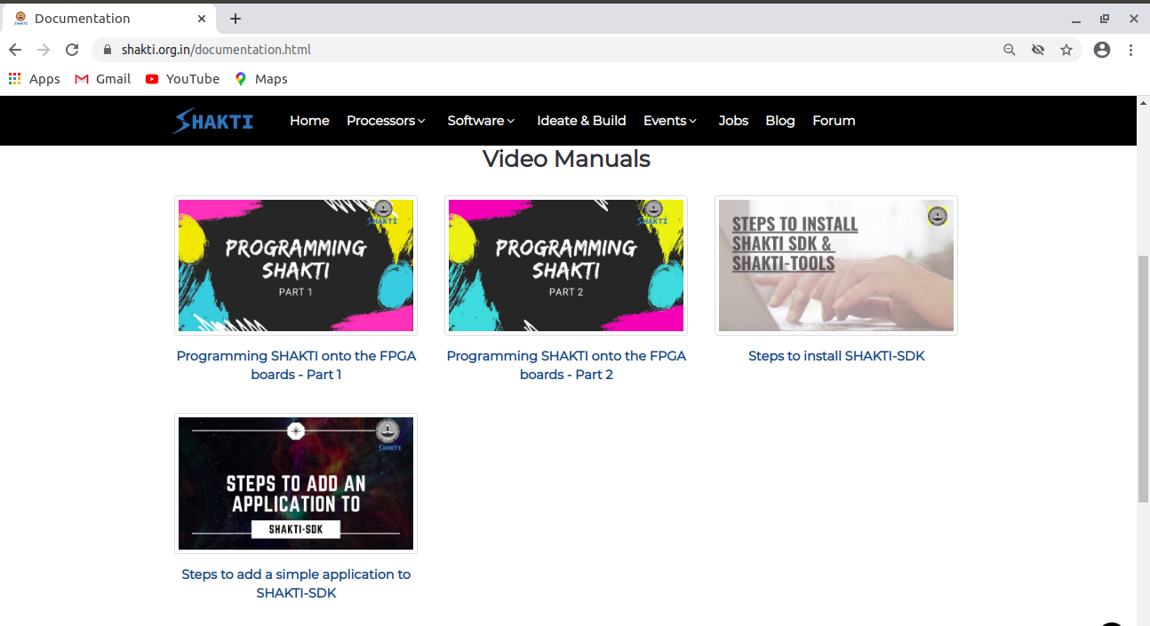
Manuals

Slide 46
References:
Shakti Documentation: https://shakti.org.in/documentation.html
Shakti Blogs: https://blogshakti.org.in/
Shakti FPGA files: https://gitlab.com/shaktiproject/sp2020
Shakti SDK: https://gitlab.com/shaktiproject/software/shakti-sdk
Shakti on Arduino: https://blogshakti.org.in/how-to-print-hello-world-on-shakti-using-arduino-ide/
Linux on Shakti: https://gitlab.com/shaktiproject/software/linux-on-shakti
Platform IO: https://registry.platformio.org/platforms/platformio/shakti
Shakti cores: https://gitlab.com/shaktiproject/cores
Shakti peripherals: https://gitlab.com/shaktiproject/uncore/devices

Slide 47
Queries

Slide 48
Thank You !

