Slide 1
Introduction to GDB
SHAKTI Group | CSE Dept | PS-CDISHA - RISE Lab | IIT Madras
RISE LAB
IIT - Madras

Slide 2
Preview of the Session
1. Introduction to GDB
2. GDB Commands
3. RISC-V CSR’s
4. RISC-V Exceptions
5. Demo

Slide 3
Introduction to GDB
1. GDB (GNU Debugger) -
Debugging tool designed for RISC V architecture.
Program that helps to see what the code is doing inside the processor - while it runs, stops, crashes, or behaves weirdly.

Slide 4
GDB Commands
Command | Functionality
set remotetimeout unlimited | Disables the timeout for that remote connection
target remote localhost : 3333 | Tells GDB to connect to a remote target (e.g. OpenOCD) running on your computer at port 3333
file <path> | Informs GDB of the file with its path
load/l | Informs GDB to load the file specified in the path
compare-sections | To make sure the loaded file has been loaded properly
c/continue | To continue to execute the instruction from start

Slide 5
GDB Commands
Command | Functionality
jump <*addr> | Jumps to the specified address. The debugger resumes program execution at that point unless it encounters a breakpoint there.
step / s | Steps from one function to another
stepi / si | Steps into assembler instructions, into any function calls.

Slide 6
GDB Commands
Command | Functionality
b break [Function Name] break [filename]:[Line Number] break [Address] | Creates a breakpoint at a specified line, address
display breakpoint / info breakpoint | To display all breakpoints
delete delete [number] | Deletes specific breakpoints or all breakpoints.

Slide 7
GDB Commands
Command | Functionality
p/x <address> x/bx , x/hx , x/wx <address> | Used for displaying value of specific address “x” is hex , can be replaced with other format specifier
set {format} <address>=<value> Format (char,short,int) | Used for setting value of specific address . Format depend on the accessible size of address
info reg / i r / info registers info all-registers / i all-registers / info registers [Register name] | Displays the contents of all processor registers
bt | Backtraces to the function where exception was raised

Slide 8
RISC-V Exceptions
Cause Value | Cause Meaning
0 | Instruction Address Misaligned
1 | Instruction Access Fault (Instruction does not exist)
2 | Illegal Instruction
3 | Breakpoint
4 | Load Address Misaligned
5 | Load Access Fault
6 | Store Address Misaligned
7 | Store Access Fault

Slide 9
RISC-V CSR’s
As part of Machine Mode Trap Handling Register RISC-V has 3 important CSR Registers
1) mtval ( machine trap value ) - exception-specific information to assist software in handling the trap
2) mepc (machine expectation pc) - points to the program counter where the exception occurred
3) mcause ( machine cause ) - the value indicate the type of exception that occurred

Slide 10
DEMO

Slide 11
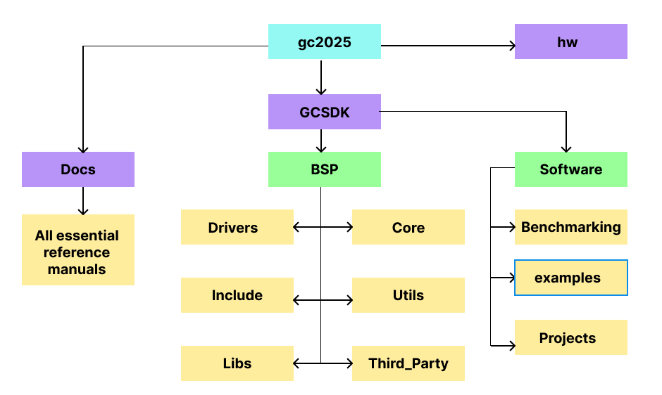
GCSDK Framework
https://gitlab.com/shaktiproject/gc2025.git

Slide 12
BSP - Board Support Package
The BSP is layer above the hardware. It consists of
Driver files for various protocols (peripherals).
Header files for driver files.
Essential functions and reusable code like ‘printf’ and multi-level logging for debugging.
Startup code , trap handler , memory initialisation.
Files required for booting
Platform dependent definitions tailored to each SoC.

Slide 13
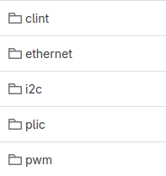
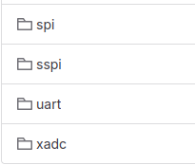
Drivers
Drivers are for all supported peripherals (protocols).
Inside each driver file is a set of software constructs (functions / API ).
Executes a particular task in hardware.
Called by the application code / project.

Slide 14
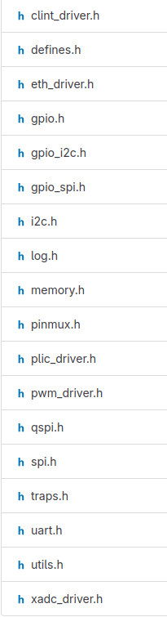
Include
Header files for all the peripheral drivers.
Generic But Board specific.
Peripheral registers are mapped as arrays.
Instance of arrays used to access the registers.
Macros for bit level description of the registers.

Slide 15
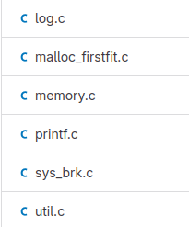
Lib
Utilities are defined as APIs with definitions and implementations. e.g Printf, multi level log prints, delay loops, string operations, etc.
Called repeatedly in the application codes. e.g. Print library, delay_loop.

Slide 16
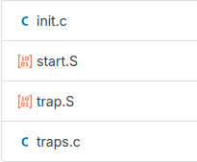
Core
Trap Handling initialisations & calling the main function.
Register initialisation, Section initialisation like (stack, text, global, data, etc.)
Pushing the register values into Stack, Call ISR, Pop the register values.
Find the cause for the trap and jump to the Handler
Core has implementation which
Initialises memory.
Trap handler functions to handle exceptions and interrupts.
Startup file which initialises the RISC-V Registers.
Handlers for different privilege levels.

Slide 17
Third Party
Board specific address mapping (platform.h).
Configuration files to be used for debugging (ftdi.cfg).
Linker for various sections of the code.
Support for backward compatibility.
Ganga
Yamuna

Slide 18
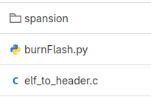
Utils
Board SPI or External SPI can be used for uploading the application code into flash.
Application code to be flashed is converted into a header file before uploading.
Has the required python scripts required to flash the application code.

Slide 19
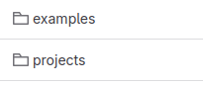
Software
Example driver codes for peripherals.
Application Project with many drivers.
“Examples” consist of Application code targeted use the functionality of individual peripheral.
“Projects” consists of Application code involving multiple peripherals.
“BenchMarks” It is a set of Standard works , used to evaluate performance of the Core.

Slide 20
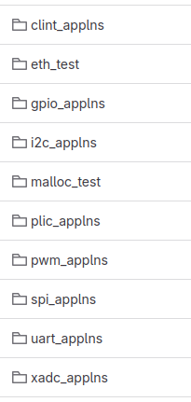
Examples
Simple code to show how the driver API can be called.
Application code which uses only one peripheral (driver) as main one.
Has multiple application code for each driver.

Slide 21
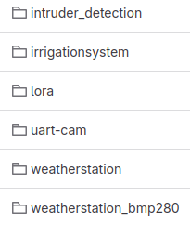
Projects
Integrates more than one peripheral driver.
Application code which uses more than one peripheral.
Focus here is to show how multiple drivers can be integrated into a single top file and used.

Slide 22
Demo : Compile and Execute “Hello World” Program

Slide 23
Prerequisite
Vivado - to program the FPGA.
OpenOCD - to configure the host as server.
RISCV-GNU-TOOLCHAIN - connect the core (SoC) as client to server and accesses the core/SoC.
GTKTerm - for viewing the console prints.
Refer the “tool setup manual” in GCSDK/Docs

Slide 24
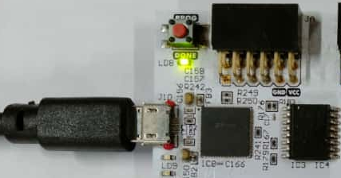
Program the FPGA
As demonstrated in previous session , program the FPGA with the bitstream / mcs using Vivado
Refer the “Bitstream/MCS Generation and FPGA Target Configuration” manual in GCSDK/Docs
After Programming the board

Slide 25
Compile the Application
Make sure the working directory is /GCSDK
Execute the following command
The <target_soc> can either be ‘ganga’ or ‘yamuna’.
*please note <target_soc> is case sensitive
Refer the “Shakti SDK ” user manual in GCSDK/Docs
make software PROGRAM=hello TARGET=<target_soc>

Slide 26
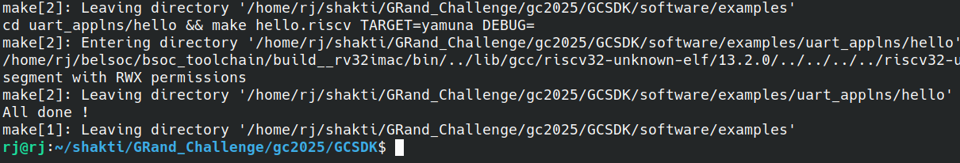

Slide 27
Connecting Openocd
Make sure the working directory is /GCSDK
Execute the following command
The <target_soc> can either be ‘ganga’ or ‘yamuna’.
*please note <target_soc> is case sensitive
Refer the “Shakti SDK ” user manual in GCSDK/Docs
cd bsp/third_party/<Target_SoC> sudo ./openocd -f ftdi.cfg

Slide 28
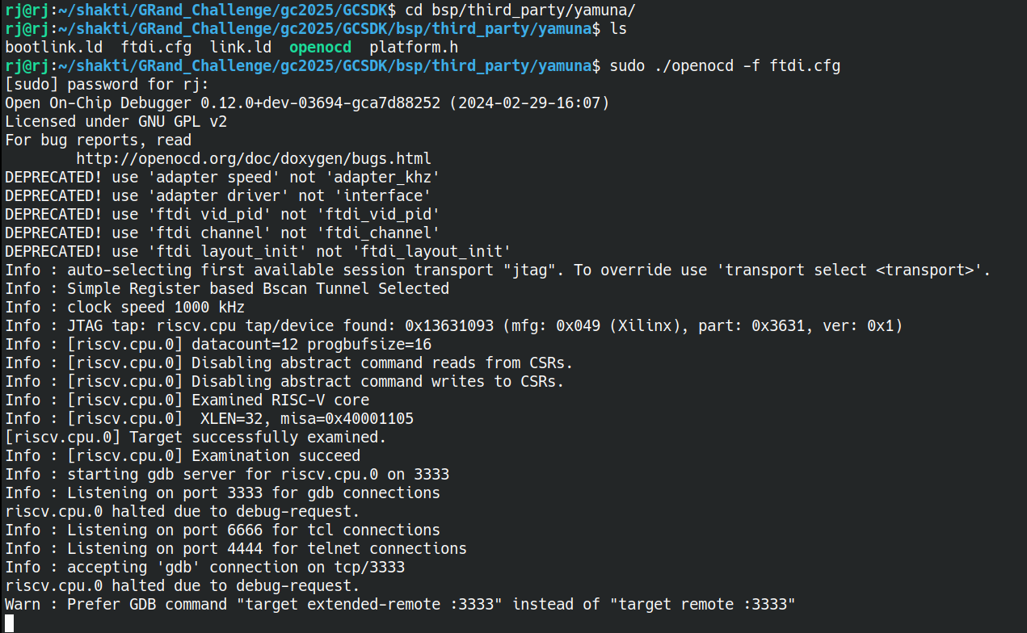

Slide 29
Connecting Debugger
Make sure the working directory is /GCSDK
Execute the following command
*please note XLEN depends on the toolchain you have installed
RV64 : XLEN = 64 ; RV32 : XLEN = 32
Refer the “Shakti SDK ” user manual in GCSDK/Docs
riscv(XLEN)-unknown-elf-gdb -x gdb.script

Slide 30
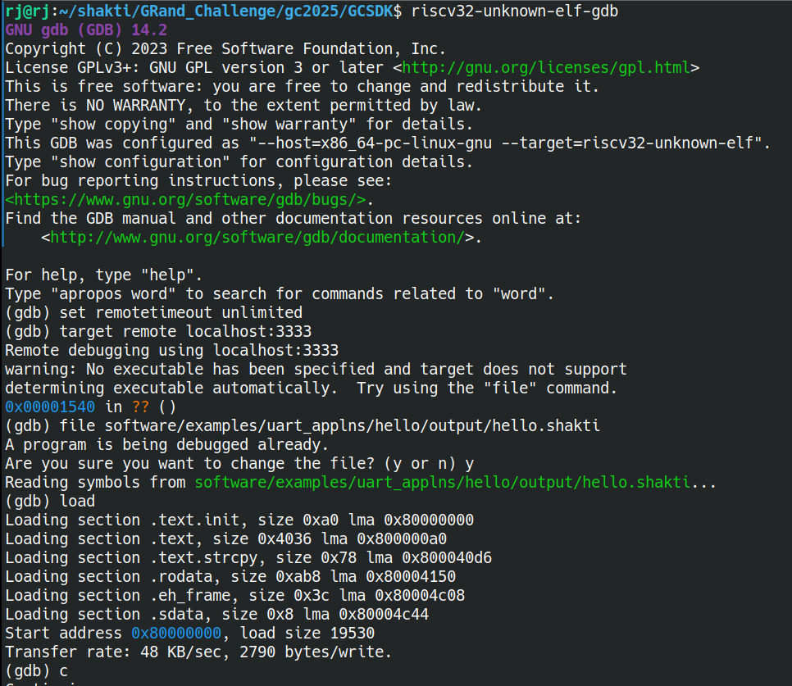

Slide 31
Viewing the Output
Make sure the working directory is /GCSDK
Execute the following command
Refer the “Shakti SDK ” user manual in GCSDK/Docs
sudo gtkterm

Slide 32
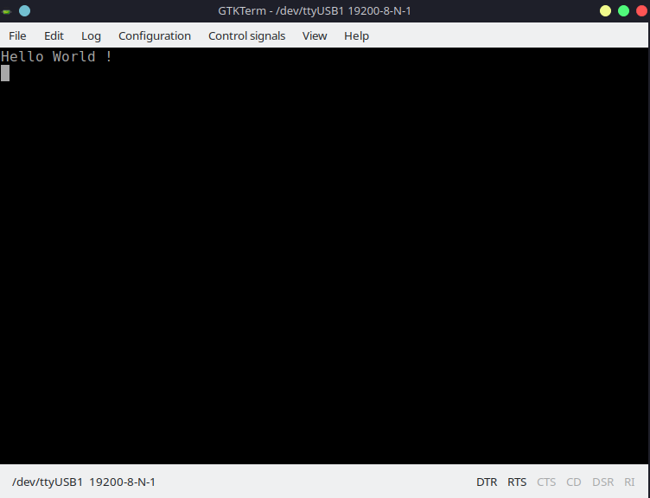

Slide 33
Adding new Application to GCSDK

Slide 34
Makefile
To compile programs more efficiently the GNU’s MAKE utility is used.
The make utility uses the Makefile to compile programs from source code.
The output generated by the MAKE utility is in ELF format (with extension as “shakti”).

Slide 35
Steps to add a new Application to GCSDK
Create a folder inside the target application
example : new application - my_first_code , (it is a uart based application)
Note*: Do not add any spaces in between the file name.

Slide 36
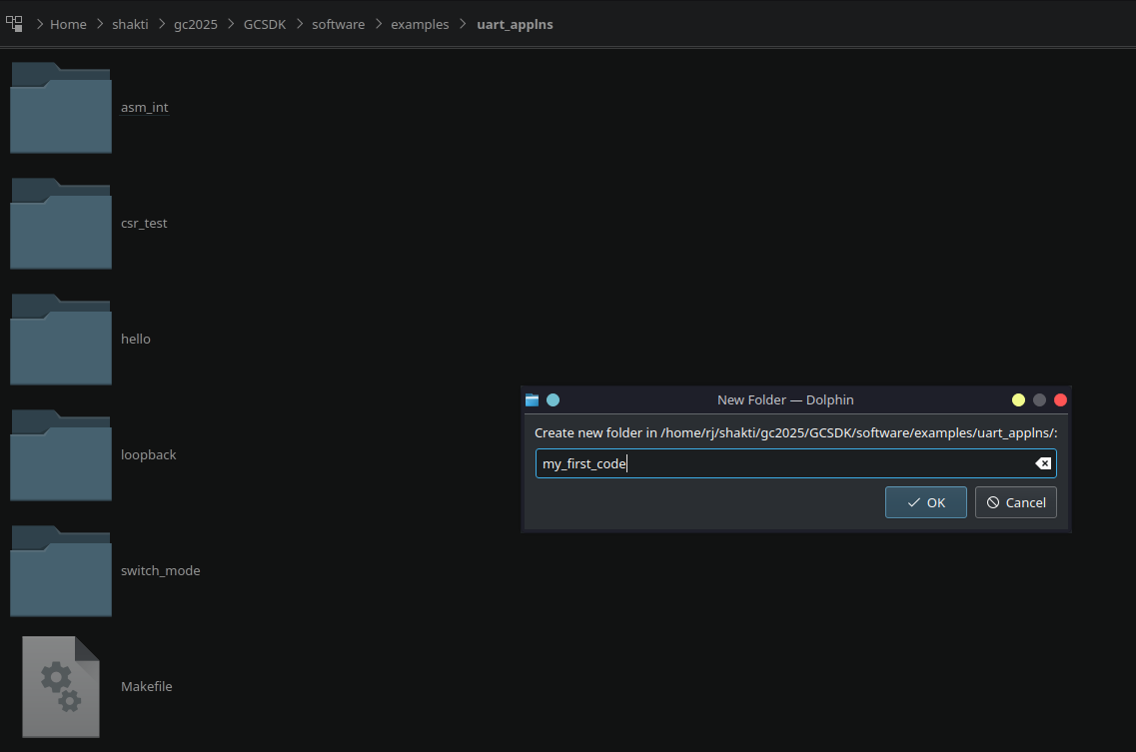

Slide 37
Steps to add a new Application to GCSDK
Create a file with the same name of folder inside the newly created folder.
example : my_first_code.c

Slide 38
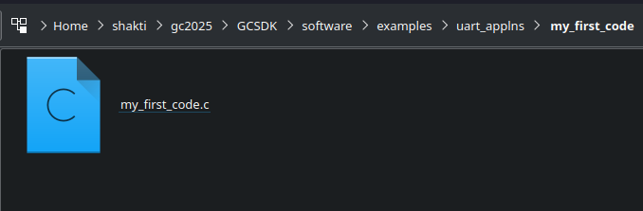

Slide 39
Steps to add a new Application to GCSDK
Add a makefile to the newly created folder
Re-use existing Makefile file from another folder within the same application
Write your own custom Makefile.

Slide 40
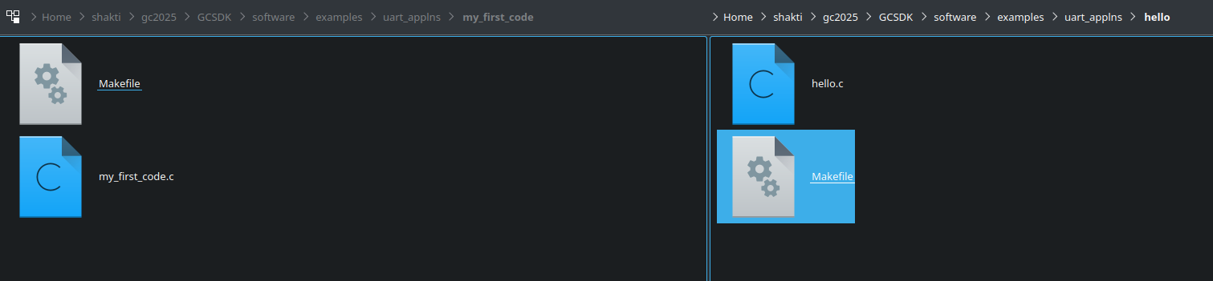

Slide 41
Steps to add a new Application to GCSDK
Open the Makefile in the ‘examples’ directory.
Add an new ‘ifeq’ block
Provide path and file name
Add and ‘endif’ block to close the ‘ifeq’ block

Slide 42
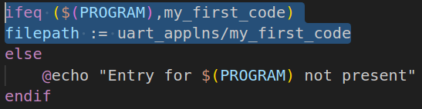

Slide 43
Steps to add a new Application to GCSDK
Make sure the working directory is /GCSDK
Execute the following command
The <target_soc> can either be ‘Ganga’ or ‘Yamuna’.
*please note <target_soc> is case sensitive
make software PROGRAM=my_first_code TARGET=<target_soc>

Slide 44
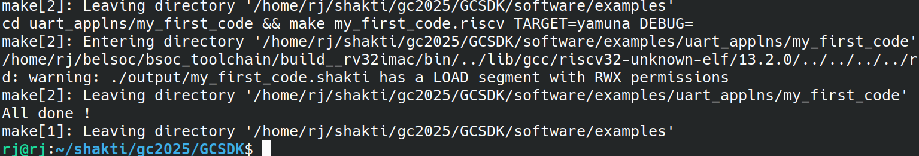

Slide 45
Adding New Peripheral to GCSDK

Slide 46
Adding New Peripheral Details
In the directory /bsp/third_party/<target_SoC> modify “Platform.h” to :
Add new peripheral base address.
Peripheral offset.
Peripheral count.

Slide 47
Adding New Peripheral Registers Details
In the directory /bsp/include add “<new_peripheral>.h” to :
Add new peripheral registers in structures.
Be careful in adding variable length registers.
All registers are uniformly placed with 32 bit offset.

Slide 48
Initializing New Peripheral Address
Inside /bsp/driver/ , create new folder <new_peripheral> for the newly added peripheral
Inside the newly created folder , create <new_driver>.c file.
Initialises the base address for a particular set of peripheral.
Peripheral instance with array index can be used to point to the registers of the peripheral.

Slide 50
Add New Driver to Makefile
In /examples ‘Makefile’ add the path to the new driver under appropriate TARGET in ‘compile’ section
Add the path to the object file to new driver under appropriate TARGET in ‘build’ section

Slide 51
Adding and Compiling New Project to GCSDK

Slide 52
Add New Project

Slide 53
Compiling Newly added Project

Slide 54
References
Shakti Documentation: https://shakti.org.in/documentation.html
Shakti Blogs: https://blogshakti.org.in/
Shakti FPGA files: https://gitlab.com/shaktiproject/sp2020
Shakti SDK: https://gitlab.com/shaktiproject/software/shakti-sdk
Shakti on Arduino: https://blogshakti.org.in/how-to-print-hello-world-on-shakti-using-arduino-ide/
Linux on Shakti: https://gitlab.com/shaktiproject/software/linux-on-shakti
Platform IO: https://registry.platformio.org/platforms/platformio/shakti
Shakti cores: https://gitlab.com/shaktiproject/cores
Shakti peripherals: https://gitlab.com/shaktiproject/uncore/devices

Slide 55
Thank you

