Slide 1



NAME: VAIBHAV TEZ SHAKYA
COURSE: BVOC SOFTWARE DEVELOPMENT
ROLL NO. : 20222751
TOPIC: IMAGE PROCESSING WITH OPENCV AND MATPLOTLIB

Slide 2

CAMSCANNER

Slide 3
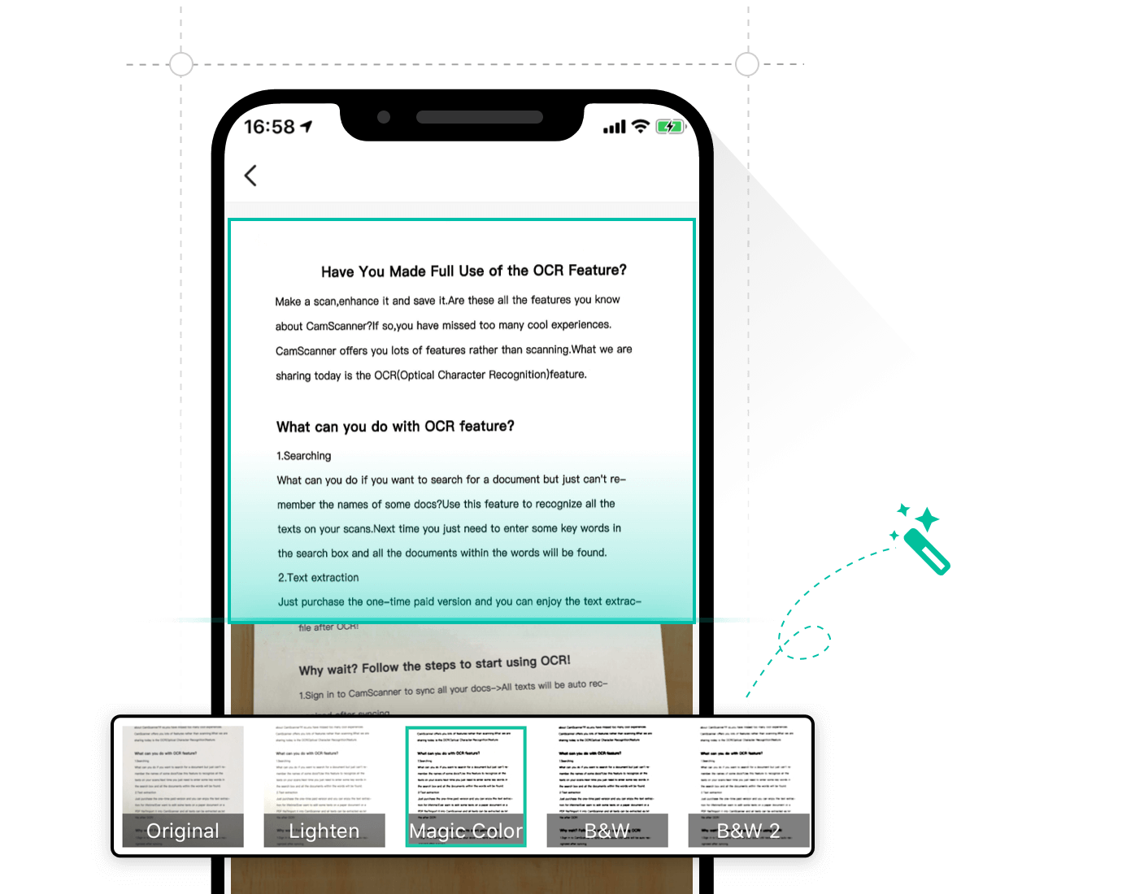
ABOUT PROJECT
It allows users to 'scan' documents (by taking a photo with the device's camera) and share the photo as either a JPEG or PDF
The free app, CamScanner, converts images you take with your phone into PDF documents. According to security firm Kaspersky Lab.

Slide 4

LIBRARIES USED
Matplotlib.pyplot
cv2
numpy
01
02
03

Slide 5
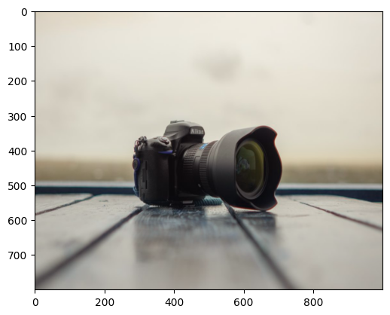
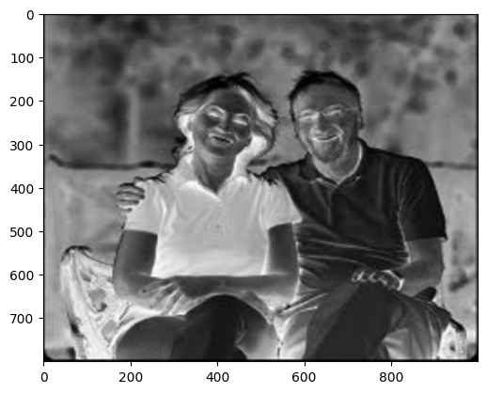
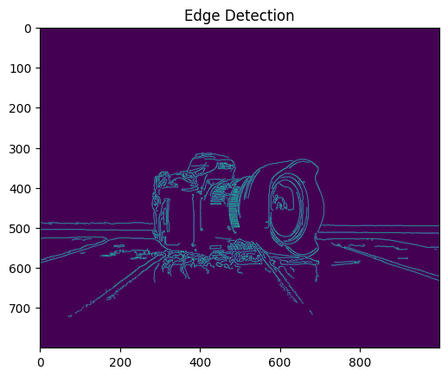
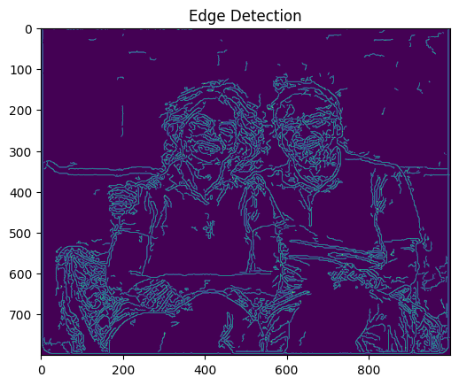
LOADING & RESIZING IMAGE
Load the image using cv2.imread
Check if the image path is correct and the file exists
Resize the image to desired dimensions
Display the original and resized images

Slide 6
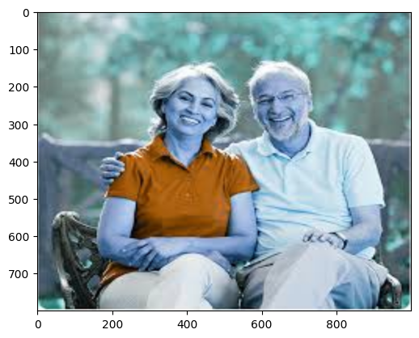
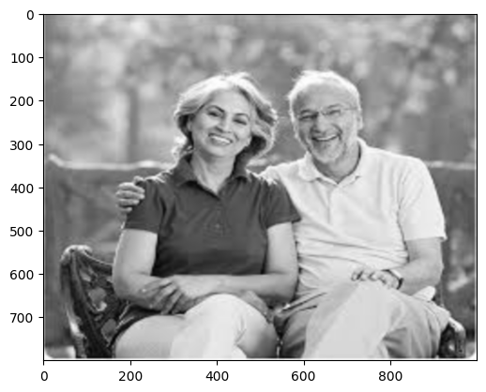
GRAYSCALE & BLURRING
Convert the image to grayscale using cv2.cvtColor
Apply Gaussian blur using cv2.GaussianBlur
Display the grayscale and blurred images
Purpose: Reduce noise and detail in the image to focus on the main structures.
Method: Use cv2.GaussianBlur to apply a Gaussian blur to the grayscale image.
Importance: Visualize the grayscale image to ensure the conversion is correct.

Slide 7

EDGE DETECTION
Use Canny edge detection to find edges in the blurred image
Display the edge-detected image
Purpose: Identify the boundaries of objects within the image.
Importance: Essential for segmenting the image and identifying the document's edges.
Method: Use the Canny edge detection algorithm.

Slide 8

POTENTIAL USES OF MY WORK
Document Scanning and Digitization
Image Enhancement and Restoration
Object Detection and Recognition
Robotics and Automation
Quality Control in Manufacturing

Slide 9
THANK YOU

