Slide 1

Predict the claim Competition: Will they Claim it ?

Slide 2
Problem Statement
- For an insurance company, you need to analyze the available data and predict whether to sanction the insurance or not.

Slide 3
Business Insights
To which destinations people visit most ?
Which Agency people prefers most for claims
Which Product approves most claims
Stakeholders
Chief Marketing Officer ?
Campaign Strategy Manager ?
Travelers/Insureres

Slide 4
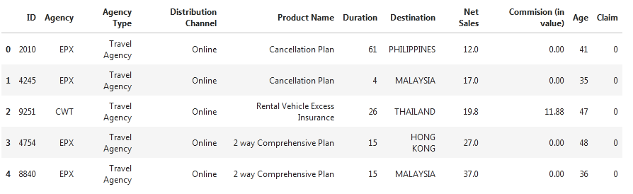
Data
Dataset Information : The training dataset consists of data corresponding to 52310 customers and the test dataset consists of 22421 customers. Following are the 10 features of the dataset and
Below are some of the features and the target variable –’Claim’(Claim Status) Yes-1, No- 0

Slide 5
Evaluation Metric
The evaluation metric for this task will be precision_score.

Slide 6
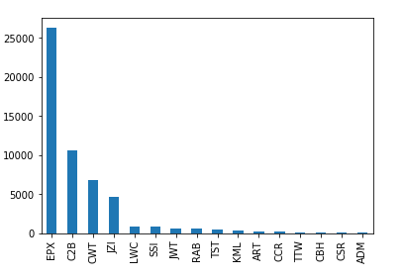
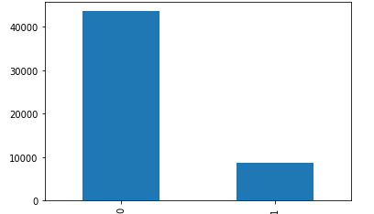

First steps - EDA
On the left is the univariate analysis of the target i.e. claim status and on the right is that of Agency
Claim Status
0-No
1-Yes
Which Agency people prefer most: EPX

Slide 7
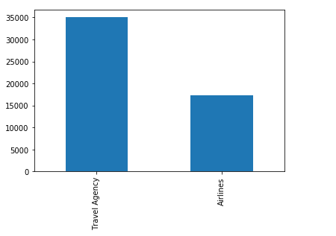
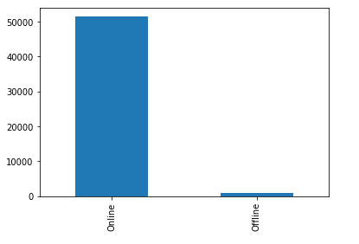
First steps - EDA
On the left is the univariate analysis of the feature Agency Type and on the right is that of Distribution Channel
Most of the customers choose travel agency than Airlines
Most people already choose online mode for booking

Slide 8
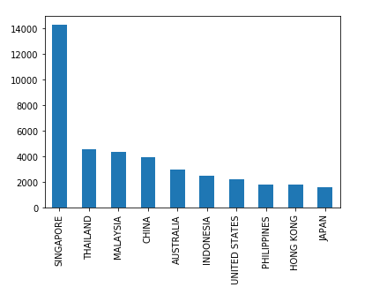
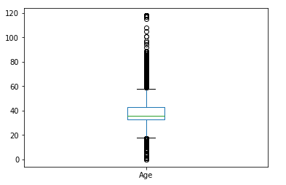

EDA
Age
Destination
Age: of peoples taking insurance and travelling.
Average age is 40
Destination : Where people travel most: Singapore Thailand and Malaysia

Slide 9
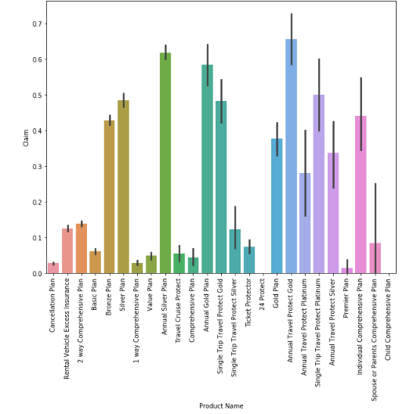
EDA - bivariate
Below are the bivariate analysis of features Product name and the Claim

Slide 10
Product plans having more than 50% claim status
There are only four Product plans which have more than 50% claim status
Product Plan | Claim Status | Claim Percentage
Annual Gold Plan | 1 | 58.305085 %
Annual Travel Protect Gold | 1 | 65.573770 %
Single Trip Travel Protect Platinum | 1 | 50 %
Annual Silver Plan | 1 | 61.79 %
So people can trust these plans

Slide 11
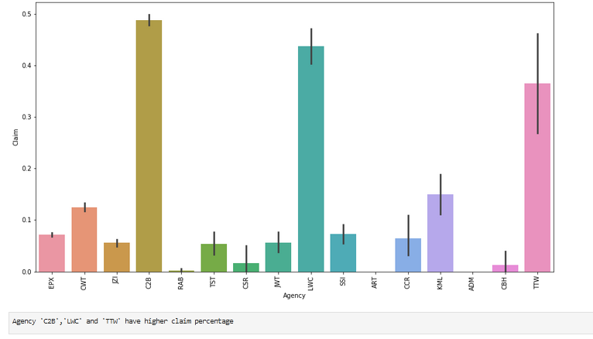
Claim and Agency

Slide 12
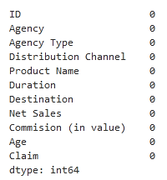
Pipeline
Missing Values :
There were no missing values in the continuous feature

Slide 13
Models and Approaches
Three vanilla models were assessed without performing any hyperparameter tuning and without treatment of class imbalance of the target. The models were
Logistic Regression
Random Forest Classifier
XGBoost Classifier
SVM
DecisionTree Classifier
All of the three models were able to give an precision score score above 70%.

Slide 14
Models and Approaches
Models Assessed : The vanilla models used yielded the following results below.
Modelling Method | Precision_Score
Logistic Regression | 0.8462371758108711
Random Forest Classifier | 0.8965143694640922
XGBClassifier | 0.8236520167041401
SVM Classifier | 0.8401197986363347
DecisionTree Classifier | 0.8462371758108711
Ensemble Learning(Soft Voting Classifier) | 0.8978525457210221
Ensemble Learning model has best score out of these: 0.897852545

Slide 15
Final Results
Confusion Matrix
 | Predicted Positive | Predicted Negative
Actual Positive | 12723 | 411
Actual Negative | 837 | 1722

Slide 16
We have Used Random Forest algorithm to Calculate this
Parameter | Score
Accuracy Score | 0.9204740967310265
Precision Score | 0.8073136427566807
Recall Score | 0.6729191090269636
F1_Score | 0.7340153452685423

Slide 17
Insights & Decisions
Customers to be targeted
Product Plan: Annual Travel gold protect plan
Age has no correlation with claim status
Campaign Targets
Overall Claim status is 16.67 % only
Most of the people choose travel agency for their booking than Airlines
Average age of persons travelling is 40 years
Agencies like ‘C2B’, ‘LWC’ and ‘TTW’ have more claim approval rates than any other
People prefer 'Singapore',‘ Thailand' and 'Malaysia' more as travel destinations
Products 'Annual Gold Plan‘ , 'Annual Travel Protect Gold‘ , 'Annual Silver Plan' and 'Single Trip Travel Protect Platinum' have Higher claim Percentage
Destination wise 'Singapore‘ , 'South Africa' and 'Nepal' countries have higher claim percentage
Precision score of ensemble learning using soft voting classifier is :', 0.8978525457210221

Slide 18
Next Steps
If time permitted, could have tried the following :
Better feature engineering
An ensemble of different models
A UI for a real user

