Slide 1
ML-Based Detection of Deauthentication Attacks
in Edge-Computing Environments
A defensive Intrusion Detection System using Random Forest • DRDO Internship

Slide 2
1. Introduction
• Wi-Fi management frames are unauthenticated in classic 802.11.
• Attackers forge 'deauthentication' frames to disconnect devices (DoS).
• Edge-computing sensors/cameras rely on Wi-Fi and are prime targets.
• Goal: detect the attack in real time using machine learning.

Slide 3
2. Architecture
• Wi-Fi Traffic → Scapy Sniffer → Feature Extraction
• → 7-feature vector → Random Forest → Prediction → Alert
• Offline half: generate → preprocess → train → save model.pkl
• Online half: sniff → window features → predict → Normal / ALERT

Slide 4
3. Security Challenges
• Management frames have no encryption or authentication.
• Attacker can spoof the AP's MAC (BSSID) trivially.
• Edge devices are distributed and physically exposed.
• Legacy IoT hardware often can't run modern protections.
• A silenced sensor/camera can blind a monitoring system.

Slide 5
4. Deauthentication Attack
• Deauth frame = 802.11 type 0 (management), subtype 12.
• Attacker → forged deauth 'from the AP' → client disconnects.
• Repeated continuously = denial-of-service.
• Enables handshake capture (offline cracking) and Evil-Twin attacks.
• Signal: burst of deauths, high packet rate, tiny frames, repeated MACs.

Slide 6
5. Existing Solutions
• IEEE 802.11w (Protected Management Frames) — needs AP + client support.
• WPA3 — mandates PMF, but slow adoption on cheap edge hardware.
• Signature/threshold IDS — brittle, misses stealthy low-rate attacks.
• Gap: a learned detector that works even with legacy devices.

Slide 7
6. Proposed ML System
• Passive, defensive IDS — only observes, never transmits.
• Aggregates traffic into 2-second windows (attacks are patterns in time).
• 7 statistical features per window fed to a Random Forest.
• Raises an alert the instant a window is classified as Attack.
• Can run on the edge node itself with a cheap Wi-Fi adapter.

Slide 8
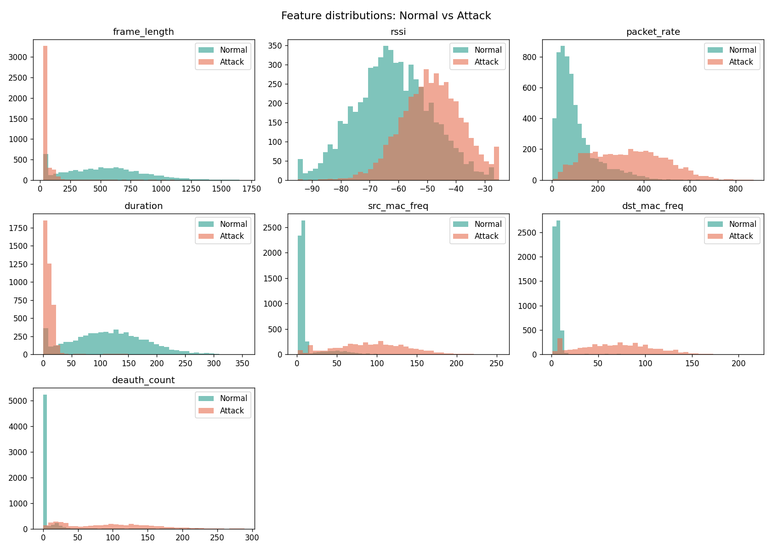
7. Dataset
• AWID-style labelled Wi-Fi traffic (synthetic stand-in included).
• Features: frame_length, rssi, packet_rate, duration,
• src_mac_freq, dst_mac_freq, deauth_count.
• Label: Normal = 0, Attack = 1.
• Realistic overlap: busy-normal & stealthy-attack + 2% label noise.
• Preprocessing: clean → stratified 80/20 split → StandardScaler.

Slide 9
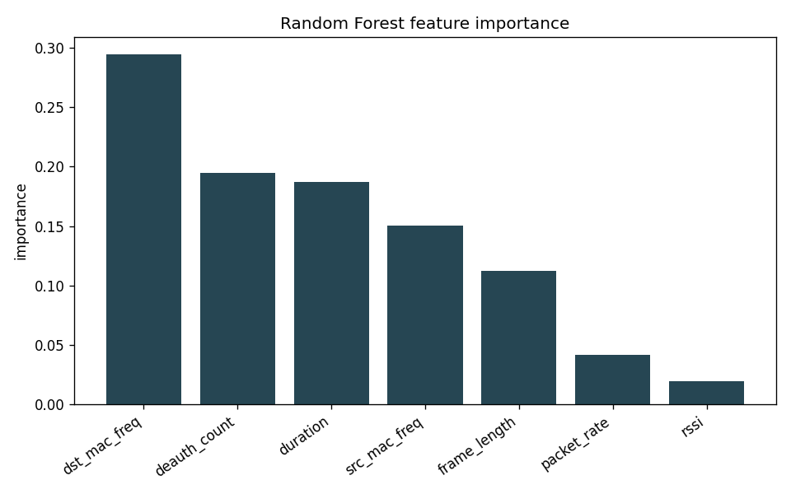
8. Random Forest Model
• Ensemble of 200 decision trees that vote (bagging).
• Captures non-linear 'combination of signals' logic of an attack.
• Robust to noise/outliers; little tuning; trains in seconds.
• Provides feature importance → explainable detections.
• deauth_count & packet_rate are the most important features.

Slide 10
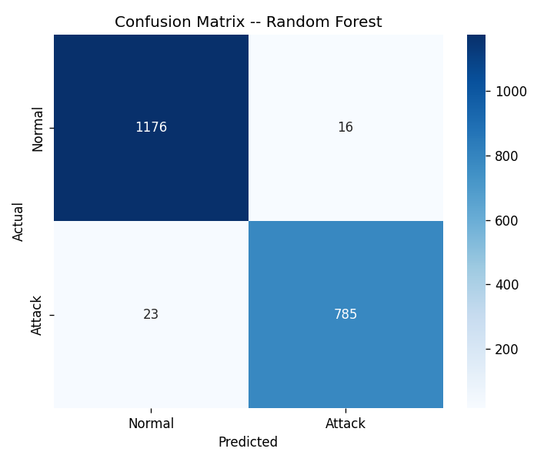
9. Results
• Accuracy 98.0% Precision 98.0% Recall 97.2% F1 97.6%
• Random Forest matches the best model and beats a lone Decision Tree.
• High recall — few real attacks are missed (the key IDS metric).
• Errors occur only on deliberately ambiguous stealthy/busy windows.

Slide 11
10. Conclusion
• Built an end-to-end, real-time, defensive Wi-Fi IDS.
• ~98% F1 detecting deauthentication attacks on realistic data.
• Complements 802.11w/WPA3 — useful where they can't be deployed.
• Future work: real AWID, multi-class attacks, on-device edge inference.
• Provides the basis for a DRDO report / IEEE paper.

