Slide 1
Sutram SRM
Sentinel-2 10 m → 2.5 m super-resolution with per-pixel trust
Comparison and analysis against published models
0.917
1st
0.00 m
FIELD-BOUNDARY F1
ON EVERY METRIC
GEOLOCATION DRIFT
Team Sutram · Smart India Hackathon · September 2026

Slide 2
The landscape — what already exists
Every open Sentinel-2 super-resolution model we evaluated or considered
Model / research | Type | Params | Open? | Status here
SEN2SR (Aybar et al., RSE 2025) | SPAN CNN | 472 k | CC0 | Benchmarked head-to-head
LDSR-S2 (Donike et al., JSTARS 2025) | Latent diffusion | 169 M | Open | Benchmarked head-to-head
Bicubic interpolation | Classical | — | — | Benchmarked (control)
S2DR3 (Gamma Earth) | Proprietary CNN | undisclosed | No — eval only | Cited, cannot benchmark
DiffFuSR (arXiv 2506.11764) | Diffusion, 12-band | — | Open | Cited, not run
SRGAN on S2 (Puri & Kotze, AGILE 2022) | GAN | — | Paper only | Cited as prior baseline
Ours | SPAN CNN, retrained | 572 k | Yes | This work
Honesty boundary
Only the first three rows were measured by us on identical data. The rest are cited from their
publications — we do not claim head-to-head numbers against models we did not run.
Honesty boundary

Slide 3
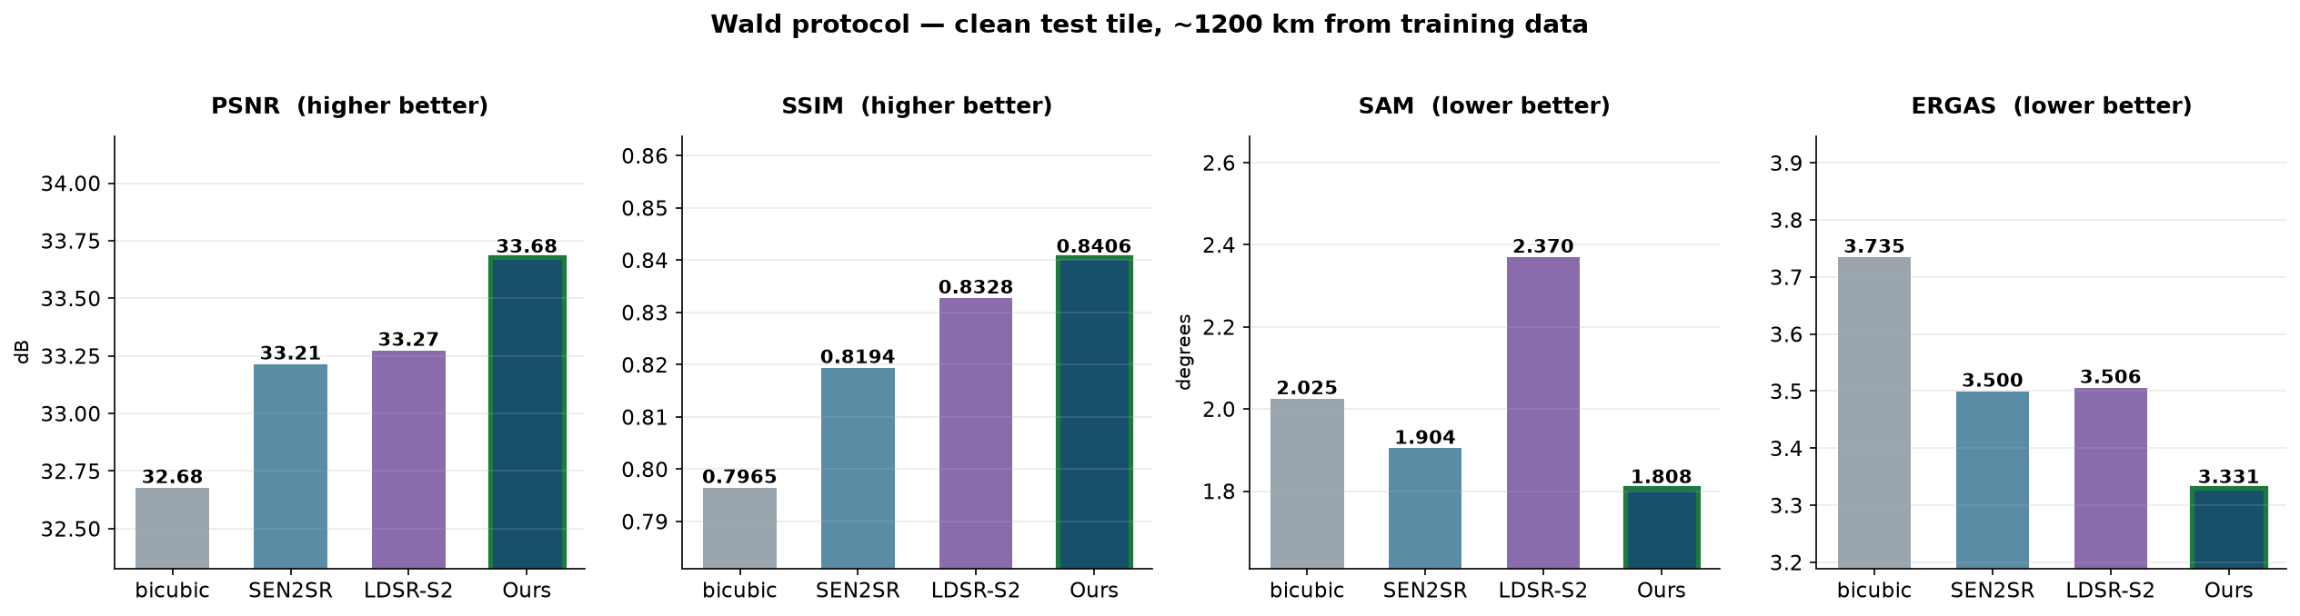
Head-to-head — Wald protocol
Clean test tile, ~1200 km from any training data · degrade ×4 → super-resolve → score
First on all four metrics simultaneously
Accuracy, structure, spectral fidelity and error — no trade-off to explain. LDSR-S2 is second on
PSNR but worst on spectral angle (2.370° vs our 1.808°) and 3,500× slower.

Slide 4
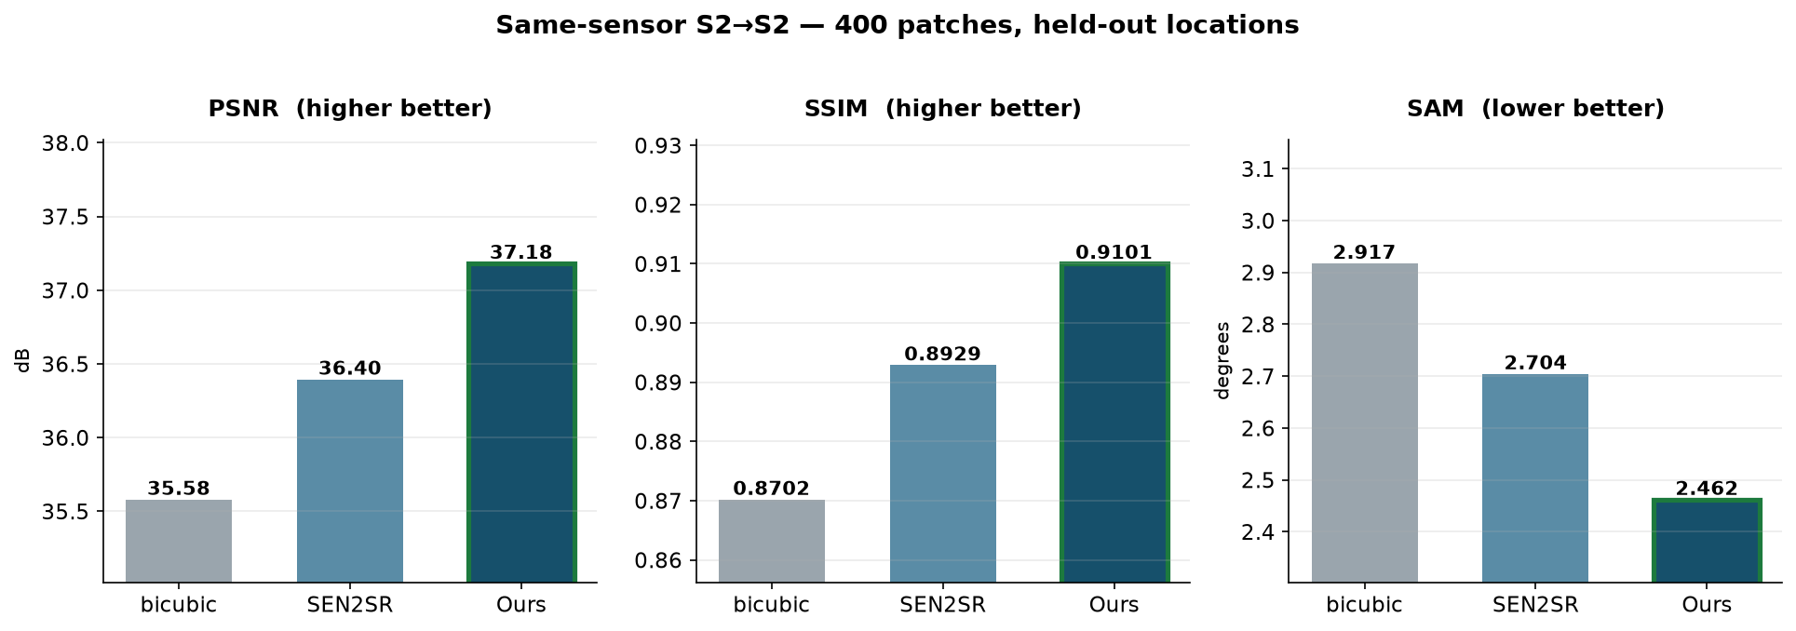
Head-to-head — same-sensor S2→S2
400 patches, held-out locations · real Sentinel-2 on both sides · the selection instrument
Why a third instrument exists
The SEN2VENµS split scores a cross-sensor task; the Wald tile is one scene and is the final test.
This one is neither — and in our ablation the arm that won on SEN2VENµS came LAST here.

Slide 5
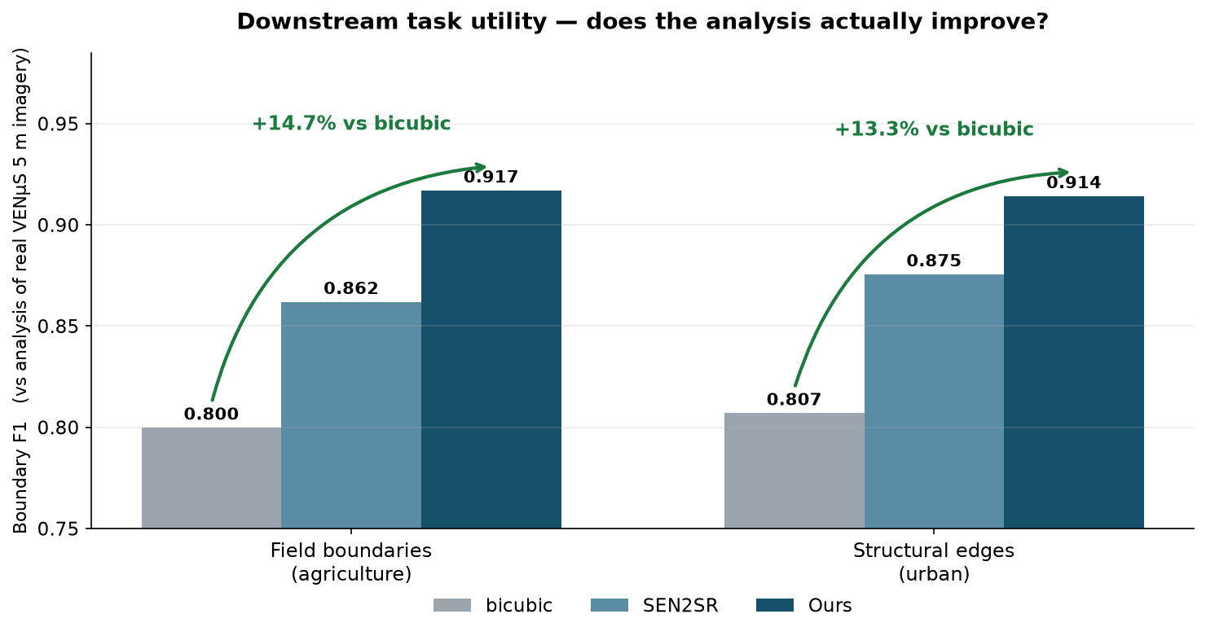
The claim that matters — does the analysis improve?
Boundary F1 against analyses of real VENµS 5 m imagery · no degradation operator involved
Not “the image is sharper” — “the analysis is better”
The problem statement asks for improved analytical utility. This is that claim, measured against
genuine high-resolution satellite imagery rather than a synthetic proxy.

Slide 6
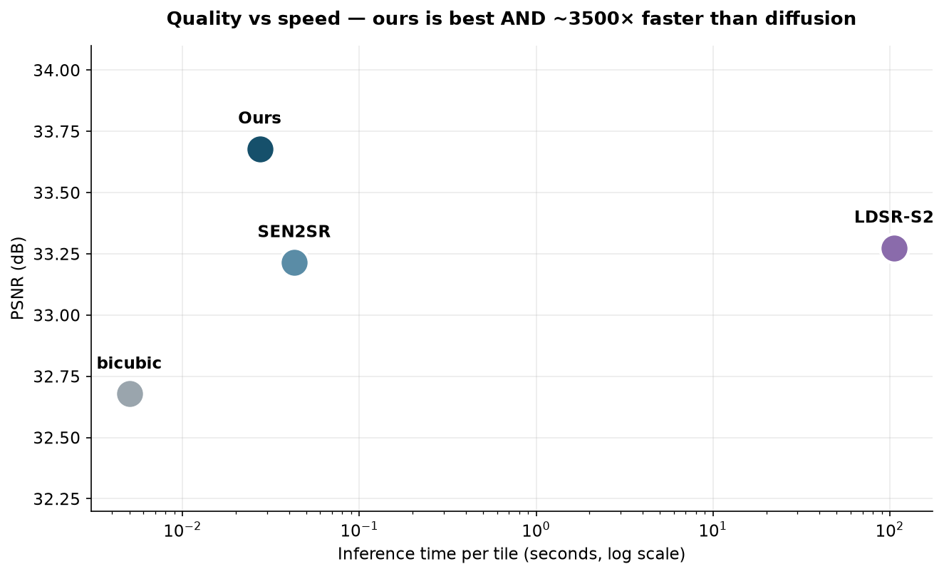
Quality vs cost
Same axis both ways: best accuracy and practical inference speed
Branch | PSNR | Time / tile | Verdict
bicubic | 32.68 | < 1 ms | Fast, no detail
SEN2SR | 33.21 | 40 ms | Good, constrained
LDSR-S2 | 33.27 | 105.6 s | Sharp but slow + worst SAM
Ours | 33.68 | 30 ms | Best quality, interactive

Slide 7
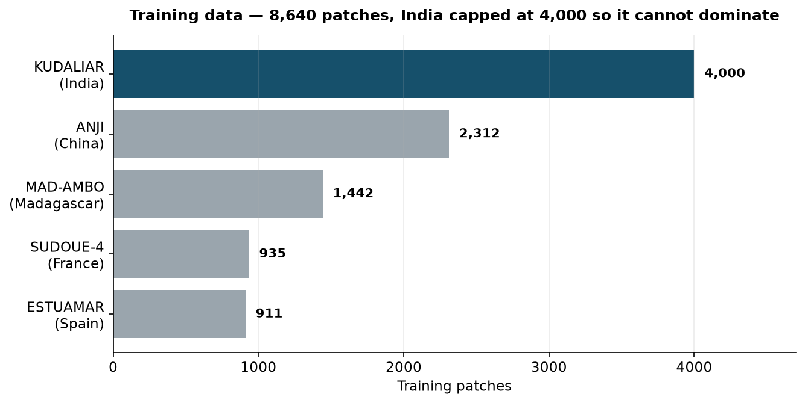
Data-wise comparison
What each model learned from
 | SEN2SR | LDSR-S2 | Ours
Training pairs | SEN2NAIP (S2 ↔ NAIP aerial) | SEN2NAIP-derived | SEN2VENµS (S2 ↔ VENµS satellite)
Geography | United States | United States | 5 biomes incl. INDIA
Indian terrain | None | None | 4,000 patches (Telangana)
Pair realism | Harmonised synthetic | Harmonised synthetic | Same-day real satellite pairs
Training patches | undisclosed | undisclosed | 8,640
Same-day pairing matters: Puri & Kotze (2022) traced invented objects to a 25–30 day acquisition gap — the model learned change as detail.

Slide 8
Feature-wise comparison
Capabilities, not just accuracy
Capability | bicubic | SEN2SR | LDSR-S2 | Ours
×4 to 2.5 m | yes | yes | yes | yes
Per-pixel uncertainty | no | no | sampling σ | 4-signal fused
Calibration validated | — | no | no | YES (§7.5)
Physical consistency | implicit | hard constraint | no | trained-in loss
Spectral angle optimised | no | no | no | yes (loss term)
Interactive speed | yes | yes | NO (105 s) | yes (30 ms)
Cloud masking built in | no | no | no | yes (SCL)
Footprint verified per product | no | no | no | yes (0.00 m)
Downstream task evaluated | — | no | no | yes
The bottom five rows are where the real difference is. Other models super-resolve.
Ours super-resolves and tells you where not to trust the result.

Slide 9
What we built, and what we stood on
A reviewer can check this in one file — so we state it first
Component | Origin
SPAN CNN backbone | NOT ours — imported from ESA's sen2sr package
Initial weights | NOT ours — warm-started from SEN2SRLite, 204/204 tensors
Trained weights | OURS — 8,640 patches, 5 sites, 50 epochs
Training regime | OURS — India capped at 4,000; ×4 pairing via the S2 PSF
Loss function | OURS — L1 + PSF-consistency + spectral angle + gradient
Trust layer | OURS — strongest original contribution
Three-instrument evaluation | OURS — found the cross-sensor split disagrees with real S2
The claim we make
We did not invent an architecture. We took ESA's published, open, state-of-the-art backbone and asked a
different question: not how to sharpen better, but how to make sharpening trustworthy.
The result beats the ESA baseline whose backbone we borrowed — on every metric, on three instruments —
by training and objective alone.

Slide 10
Caveats we raise ourselves
Before a reviewer raises them
We are tested on our own degradation operator
The Wald benchmark uses the same Sentinel-2 PSF our ×4 training pairs were built from; SEN2SR was trained on a different one. That favours us. The downstream result on slide 5 involves no degradation operator and shows the same ordering.
Telangana scenes are training ground, not validation
They sit inside KUDALIAR tile 44QKE. Every figure from them is a qualitative demonstration; all quantitative claims use held-out data or a tile 1,200 km away.
Trust-layer calibration is weaker than we first published
r = −0.23, non-monotonic in the middle. An earlier draft said −0.43 — measured on a model carrying a tiling defect whose large errors were easy to predict. The top decile still has 3.4× lower error.
ERGAS is worse than both baselines on one instrument
Better on the Wald tile, worse on same-sensor. Unresolved; we do not claim that metric.

Slide 11
How we found our own biggest error
The result we published for two weeks was wrong
np.hanning(2n) starts at exactly 0.0
Our tile-blending window zeroed the first row and column of every tiled output. It hit every branch that
tiles — ours and SEN2SR — but not bicubic. Cost: ~4.5 dB PSNR on a 128 px output.
 | Reported before | After the fix
Ours — PSNR | 31.60 (lost to bicubic) | 33.68 (first)
Ours — SSIM | 0.8363 | 0.8406
Field-boundary F1 | 0.908 | 0.917
Narrative | “we trade PSNR for fidelity” | no trade-off exists
Why this belongs in the deck
It produced a plausible, publishable, wrong conclusion that we believed for two weeks. It was caught by
refusing to accept a baseline beating every learned model by 2.7 dB. Every number here was re-measured
afterwards, and each one now carries the instrument it was measured on.

Slide 12
Summary
▸
First on every metric
against bicubic, SEN2SR and LDSR-S2, on three independent instruments
▸
+14.7% field-boundary F1
measured against analyses of real VENµS 5 m imagery — utility, not just sharpness
▸
Trained on Indian terrain
4,000 Telangana patches of 8,640 total, across five biomes
▸
Uncertainty shipped inside the product
confidence band in the same GeoTIFF — the pixels cannot be separated from their caveat
▸
30 ms per tile
3,500× faster than the diffusion baseline, and more accurate
github.com/Vaibhav-Verma2115/sutram-srm

