Slide 1

ResumeCraft : Resume Builder
Vaishnavi Bhojak - 23107022
Nidhi Shettigar - 23107041
Nishigandha Sawant - 23107047
Aditya Bhoir - 23107006
Project Guide
Ms. Ujwala Pagare

Slide 2
Contents
Introduction
Objectives
Scope
Features / Functionality
Project Outcomes
Technology Stack
Block Diagram if applicable

Slide 3
1. Introduction
To create Professional resume using customizable templates in less time
Problem Identified :
Difficulty Tailoring Resumes
Time-Consuming Process
Lack of skill recommendation
Solution Proposed :
This resume builder can provide pre-designed templates and formatting guidelines to ensure consistency and clarity
By providing a user-friendly interface and automation features using pre-created templates and AI based suggestions
Inside a single automation integrating several other features which can save time and can be easily accessed

Slide 4
2. Objectives
To develop a user-friendly login and signup system using JavaFX.
To enable efficient management of user skills, qualifications, and personal information.
To utilize JDBC to automatically generate well-structured resumes.
To incorporate the user's profile picture into the resume for a professional presentation and make it in downloadable pdf form

Slide 5
3. Scope
Can be used by those looking for work in a variety of sectors and professions.
Can be used by students who want to prepare resumes for internships or part-time work.
Can be useful for professionals wishing to enhance their careers or change employment.
Can be useful for people who are new to the job market and need help with resume writing.
Can be used to help individuals enhance the quality and effectiveness of their resumes.

Slide 6
4. Feature /Functionality
Easy Log In and Sign Up: Users can quickly create accounts or log in using a simple and secure authentication process.
User Data Management: Users can easily input, update, and manage their personal and professional information in one place.
Form a Formatted Resume: The system automatically generates a professional, well-formatted resume based on the information provided by the user.
Add Profile Picture: Users can enhance their resume by uploading and including their profile picture.

Slide 7
5. Outcome of Project
Users can log in and create a comprehensive profile, including personal information, work experience, and skills.
Users can add a profile picture that will be displayed in their resume
Automatically integrates user information from their profile into the resume
Provides the option to download a fully customized, professionally formatted resume.

Slide 8
6. Technology Stack
FrontEnd : Java.fx, JDBC, Appache NetBeans IDE22
BackEnd : MySQL 8.0.
Other OpenSource libraries- Itext for pdf formatting

Slide 9
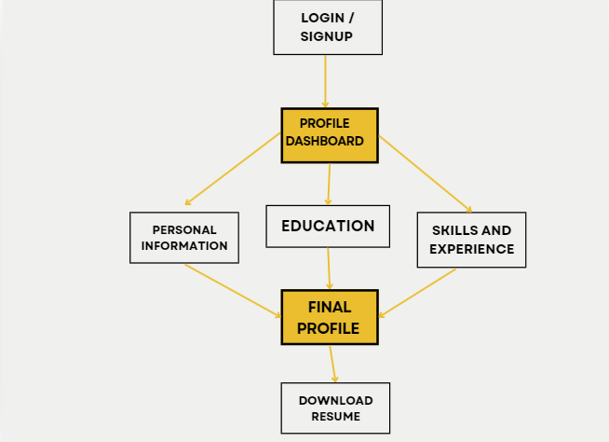
7. Block Diagram ( if applicable)

Slide 10
Thank You...!!

