Slide 1

ElectroPay Smart Billing System for Electricity
Abbas Sangameshwari - 23107116
Atharv Parab - 23107084
Jagdishkumar Nayak - 23107138
Adarsh Panigrahi - 23107117
Project Guide
Prof. Rajashri Chaudhari

Slide 2
Contents
Introduction
Objectives
Scope
Features / Functionality
Project Outcomes
Technology Stack
Block Diagram

Slide 3
1. Introduction
Problem Identified:
Time-consuming and labor-intensive, as staff must visit customers monthly for bill distribution and payment collection.
Maintenance of bills is done manually through hard copies, leading to a tedious and lengthy process.
Solution Proposed:
This project system eliminates the need to maintain paper electricity bills as all electricity bill records are managed electronically.
The administrator doesn't have to do the hard work as this system easily stores users manually.

Slide 4
2. Objectives
To keep the information of consuming unit energy every month.
To keep the customer’s information.
To keep the information of consuming unit energy of the previous month.
To calculate the units consumed every month regularly.
To generate the Customer Bill with calculated taxes.
To save time by implementing the payment process.

Slide 5
3. Scope
Can be useful for Consumer Management: It can be useful for consumers to register, view consumption patterns, check billing history, and manage account details, providing a seamless and transparent experience.
Can be applied for Administrative Control: The system can be applied to offer utility providers an admin dashboard for managing users, and other settings, ensuring efficient and centralized system management.
Can be applied for Data Security: The system can be applied to ensure the security of user data, payments, and consumption.
Can be applied for Historical Data Access: Customers can access their historical usage and billing data for personal records or analysis, making it easier to track long-term energy trends.

Slide 6
4. Feature / Functionality
User Registration and Login: Secure account creation and login for personalized access.
Bill Viewing: Users can view current and past electricity bills at any time.
Detailed Billing History: Displays a comprehensive history of past bills.
Payment Method: Option to pay bills through an integrated third-party payment portal.

Slide 7
5. Outcome of Project
The system can calculate electricity bills based on customer usage and pre-set tariff rates.
The system centralizes all relevant data, allowing easy access for both customers and operators.
The system streamlines the process of bill generation and distribution.
Proper authentication mechanisms (e.g., password protection) can be implemented.

Slide 8
6. Technology Stack
Front-End:- Java Swing: for creating the user interface.
Back-End:- MySQL 8.0 is used for database management, ensuring efficient storage and retrieval of billing data.
Java: The core programming language used to handle business logic, data processing, and managing user requests.
JDBC (Java Database Connectivity): To connect and interact with the SQL database for operations like storing and retrieving bill data.

Slide 9
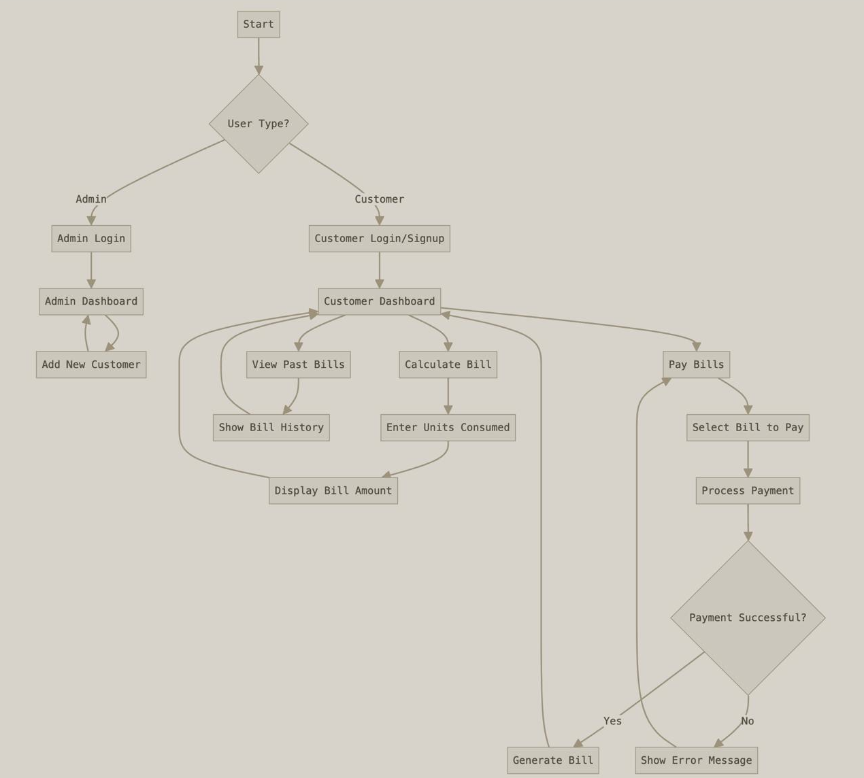
7. Block Diagram

Slide 10
Thank You...!!

