Slide 1



Stocks Analytics Dashboard
Janhavi verma - 23107125 Laxmi Choudhary - 23107140 Sneha raut - 23107033
Raj raut - 24207022
Project Guide Ms.Hardiki Patil

Slide 2

Outline
Introduction
Literature Survey of the existing systems Limitations of the existing systems Problem statement
System Design
Technologies and methodologies Implementation
Conclusion References

Slide 3
Introduction
The Stock Analytics Dashboard is an interactive system designed to analyze and visualize stock market data in a user-friendly manner.
It integrates financial indicators such as Moving Averages, RSI, and MACD to provide insights into market trends and momentum.
The system also evaluates investment risk using volatility-based metrics.
Additionally, machine learning and deep learning models like Linear Regression and LSTM are used to predict future stock prices.
This combination of analytics and prediction helps users make informed investment decisions.

Slide 4
Problem Statement
Stock market data is complex and difficult to analyze. Existing tools lack integrated analysis, visualization, and prediction. This project aims to provide a dashboard that simplifies stock analysis, risk evaluation, and price prediction.

Slide 5
Objectives
To develop an interactive stock analytics dashboard
To analyze stock trends using technical indicators
To evaluate stock risk using volatility-based metrics
To predict stock prices using machine learning models

Slide 6

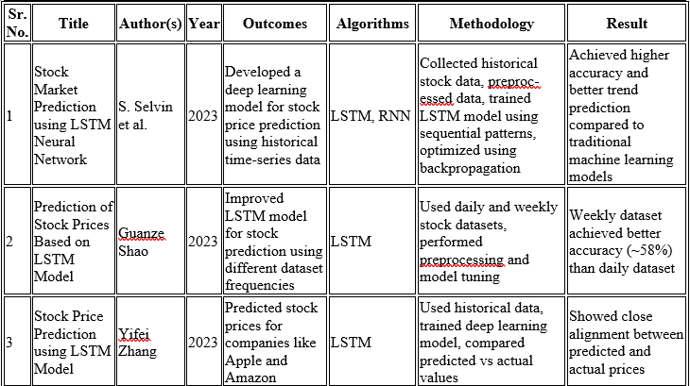

Literature Survey of the existing systems

Slide 7
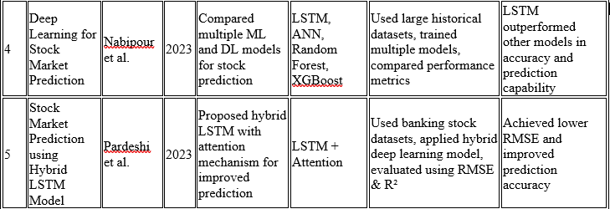
Literature Survey of the existing systems

Slide 8
Limitations of existing systems
Based only on historical data
Predictions are not 100% accurate
External factors not included
Depends on data quality
Limited deep learning performance

Slide 9
Proposed Solution
The proposed system is an interactive Stock Analytics Dashboard that integrates data visualization, financial analysis, and machine learning techniques.
It allows users to either upload stock datasets or fetch live market data using stock tickers.
The system processes and cleans the data, then applies technical indicators such as Moving Averages, RSI, and MACD to analyze trends and momentum.

Slide 10
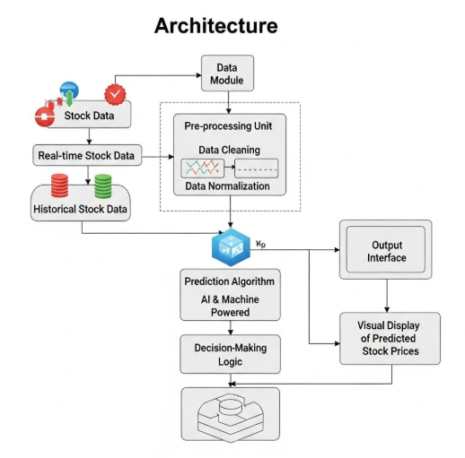
System Design

Slide 11
Sustainable Development Goals (SDG) mapped
1. United Nations SDG 8: Decent Work and Economic Growth
The project supports informed financial decision-making, helping investors and individuals make better investment choices, which contributes to economic growth and financial stability.
2. United Nations SDG 9: Industry, Innovation and Infrastructure
The system leverages modern technologies like machine learning and data analytics to build an innovative financial analytics platform.
3. United Nations SDG 4: Quality Education
The dashboard serves as a learning tool for students and beginners to understand stock market analysis, technical indicators, and machine learning concepts.

Slide 12
Technologies
Frontend → Streamlit
Backend → Python
Data → Pandas, NumPy
Visualization → Plotly
API → yfinance
ML → Scikit-learn

Slide 13
Methodology
The project follows a structured approach for analyzing and predicting stock market data. First, stock data is collected either through a live API using ticker symbols or by uploading a dataset in CSV format. The collected data is then preprocessed by converting date formats, handling missing values, and ensuring all required columns are in numeric form.
Next, feature engineering is performed to generate important financial metrics such as returns, moving averages, and volatility. These features are used to apply technical indicators like Moving Average, RSI, and MACD to analyze stock trends and momentum.
Risk analysis is carried out by calculating the rolling standard deviation of returns and normalizing it to obtain a risk score, which is further categorized into low, medium, or high risk levels.

Slide 14
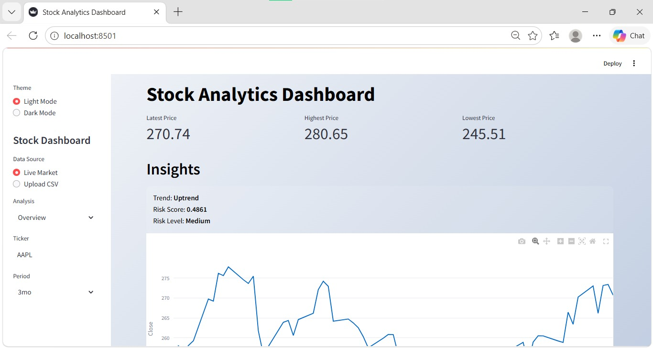
Implementation

Slide 15
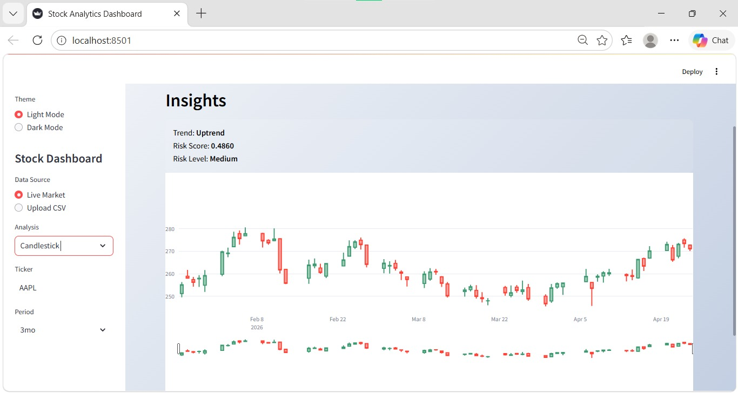
Implementation

Slide 16
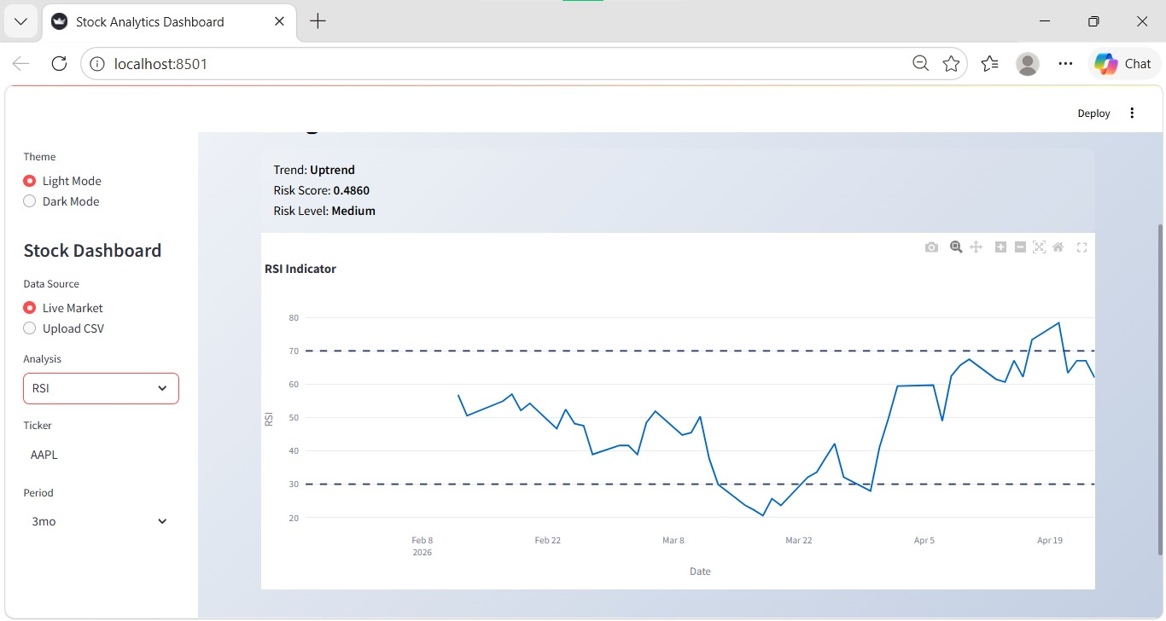
Implementation

Slide 17
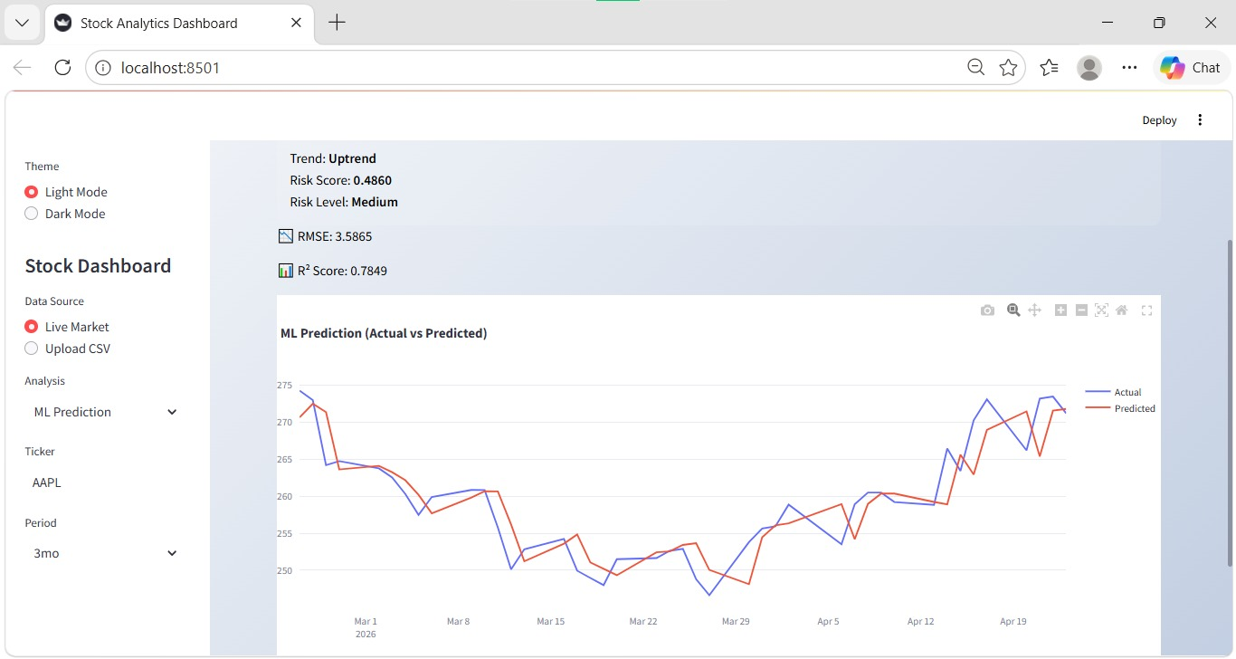
Implementation

Slide 18
Result Analysis
The stock shows high volatility in the initial period, with sharp fluctuations and unstable price movement.
A significant drop is observed early, followed by a long consolidation phase where prices remain relatively stable.
From the mid-period onwards, the stock demonstrates a consistent upward trend, indicating recovery and growth.
In the recent period, a strong price increase (bullish movement) is clearly visible.
The short-term moving average (MA20) closely follows price changes, while the long-term moving average (MA50) smooths the trend.
Multiple instances where MA20 stays above MA50 indicate sustained bullish momentum.
The convergence of both moving averages during stable phases reflects low volatility periods.

Slide 19
Conclusion
It enables users to analyze stock trends using technical indicators such as Moving Averages, RSI, and MACD, and evaluate investment risk through volatility-based metrics.
Overall, the project demonstrates how combining analytics and intelligent models can simplify stock market analysis and support informed decision-making.

Slide 20
References
Swarna Prabha Jena, Ankit Kumar Yadav, Dhiraj Gupta, Bijay Kumar Paitra. (2023). “Prediction of Stock Price Using Machine Learning Techniques”. IEEE 2nd International Conference on Industrial Electronics: Developments & Applications. Available at: https://www.researchgate.net/publication/375153752_Prediction_of_Stock_Price_Using_Machine_Learning_Techniques
Guanze Shao. (2023). “Prediction of Stock Prices Based on LSTM Model”. Available at: https://www.researchgate.net/publication/370759199_Prediction_of_Stock_Prices_Based_on_the_LSTM_Model
Yifei Zhang. (2023). “Stock Price Prediction using LSTM Model”. Available at: https://www.researchgate.net/publication/370219595_Stock_Price_Prediction_using_LSTM_Model
Nabipour et al. (2023). “Deep Learning for Stock Market Prediction”. Available at: https://www.researchgate.net/publication/343339583_Deep_Learning_for_Stock_Market_Prediction

Slide 21
5. Pardeshi et al. (2023). “Stock Market Prediction using Hybrid LSTM Model”. Available at: https://arxiv.org/abs/2308.04419

Slide 22
Thank You...!!

