Slide 1
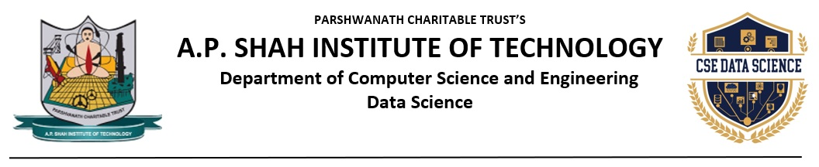
Job Recommendation and Resume Parsing with NLP and Chatbot
Shuban Devanpelli(22107023)
Rishi Bije(22107002)
Yash Kamble(22107055)
Dhanraj Bacche(22107056)
Project Guide
Ms.Sarala Mary

Slide 2
Outline
Introduction
Literature Survey of the existing systems
Limitations of the existing systems
Problem statement
System Design
Technologies and methodologies
Implementation
Conclusion
References

Slide 3
Introduction
This system helps users find the most suitable job opportunities based on their background and expertise.
It provides valuable insights into career options and industry trends.
The platform enhances user experience by making the job search process more efficient and interactive.
Motivation:
Observing that people should improve job matching accuracy based on skills ,we were inspired to create a unified solution for users.

Slide 4
Objective:
To design an intelligent resume parsing tool by implementing Natural Language Processing (NLP) algorithms, enabling efficient extraction and structuring of candidate data.
To design a personalized job recommendation system by utilizing content-based filtering algorithms, ensuring accurate matches based on user preferences and qualifications.
To develop a market rate analysis tool using predictive analytics and time-series forecasting algorithms providing real-time insights into salary trends and benchmarks.
To develop an AI-powered chatbot that leverages NLP for career guidance, job-related queries, and resume feedback.

Slide 5
Literature Survey of the existing system
Sr No | Title | Author | Year | Outcome | Methodology | Result
1. | [1]Automated Resume Parsing: A Natural Language Processing Approach | Sai Snehith K, Meena Belwal, Nithish Sagar Reddy, Thatavarthi Giri Sougandh | 2023 | The paper presents a system that reads resumes and extracts key details like names, skills, and experience using AI. It helps recruiters process resumes faster. | The resume parser uses NER (SpaCy) for entity recognition and Regex for structured data extraction. It processes resumes using Python, Pandas, YAML, PDFMiner, and docx2txt from PDFs and Word files. By combining NLP and pattern matching, it enhances recruitment automation with accurate resume analysis. | The resume parser accurately extracts key information—like name, email, skills, and experience—from resumes and displays it in a structured dataframe. The GUI allows comparison of 2 to 5 resumes, accommodating different resume formats.

Slide 6
Sr No | Title | Author | Year | Outcome | Methodology | Result
2. | [2]A Research of Job Recommendation System Based on Content-Based Filtering | Yingya Zhang, Cheng Yang, Zhixiang Niu | 2014 | The paper presents a system that recommends jobs based on user preferences and past applications, making job hunting easier. | The job recommendation system utilizes content based filtering to analyze user preferences and job similarities, improving personalized job matching. It processes user interaction data, applies machine learning techniques, and refines recommendations through continuous feedback. | The system improves job recommendations by leveraging content-based filtering, enhancing matching accuracy based on user preferences and job similarities. Experimental results show increased recommendation precision and user satisfaction compared to traditional methods

Slide 7
Sr No | Title | Author | Year | Outcome | Methodology | Result
3. | [3]A Machine Learning-Based Job Forecasting And Trend Analysis System To Predict Future Job Markets Using Historical Data | Sharanaja Senthurvelautham, Nipuna Senanayake | 2023 | The paper presents a system that uses AI to predict job market trends with 95.71% accuracy. It helps job seekers and companies plan for future job demand. | The system gathers job data via web crawling and APIs, analyzes trends using LSTM models, and predicts job market trends. It generates interactive reports with jQuery and Chart API, with bidirectional LSTM proving most accurate. | The system accurately predicts job market trends using historical data and bidirectional LSTM models, outperforming traditional methods. It enables interactive trend analysis with jQuery and Chart API, helping job seekers and employers make data-driven decisions.

Slide 8
Limitations of existing systems
Lack of Personalization : Many Job recommender are often generic and do not consider individual preferences such as career growth, interests or company culture which is leading to irrelevant job recommendations.
Poor User Experience and Engagement : Complex user interfaces makes job searching inconvenient and confusing.
Limited Support for Career Growth: Most systems lack a chatbot-driven approach to guide users on upskilling courses or certifications that can enhance their job eligibility, focusing solely on skill assessment.
Ineffective Resume Parsing : Many job portals do not extract relevant details from resumes effectively i.e skills and experiences listed in resumes may not be mapped correctly to job requirements.

Slide 9
Problem statement
Users struggle to find relevant job opportunities because existing job portals rely on keyword-based matching rather than contextual NLP-driven recommendations.
Job seekers lack insights into their career progress, required skills, and job market trends due to inadequate data visualization and predictive analytics.
The absence of AI-driven chatbots leaves job seekers without personalized career guidance and real-time support.
Many existing platforms have complicated interfaces that make job searching and resume submission cumbersome.

Slide 10
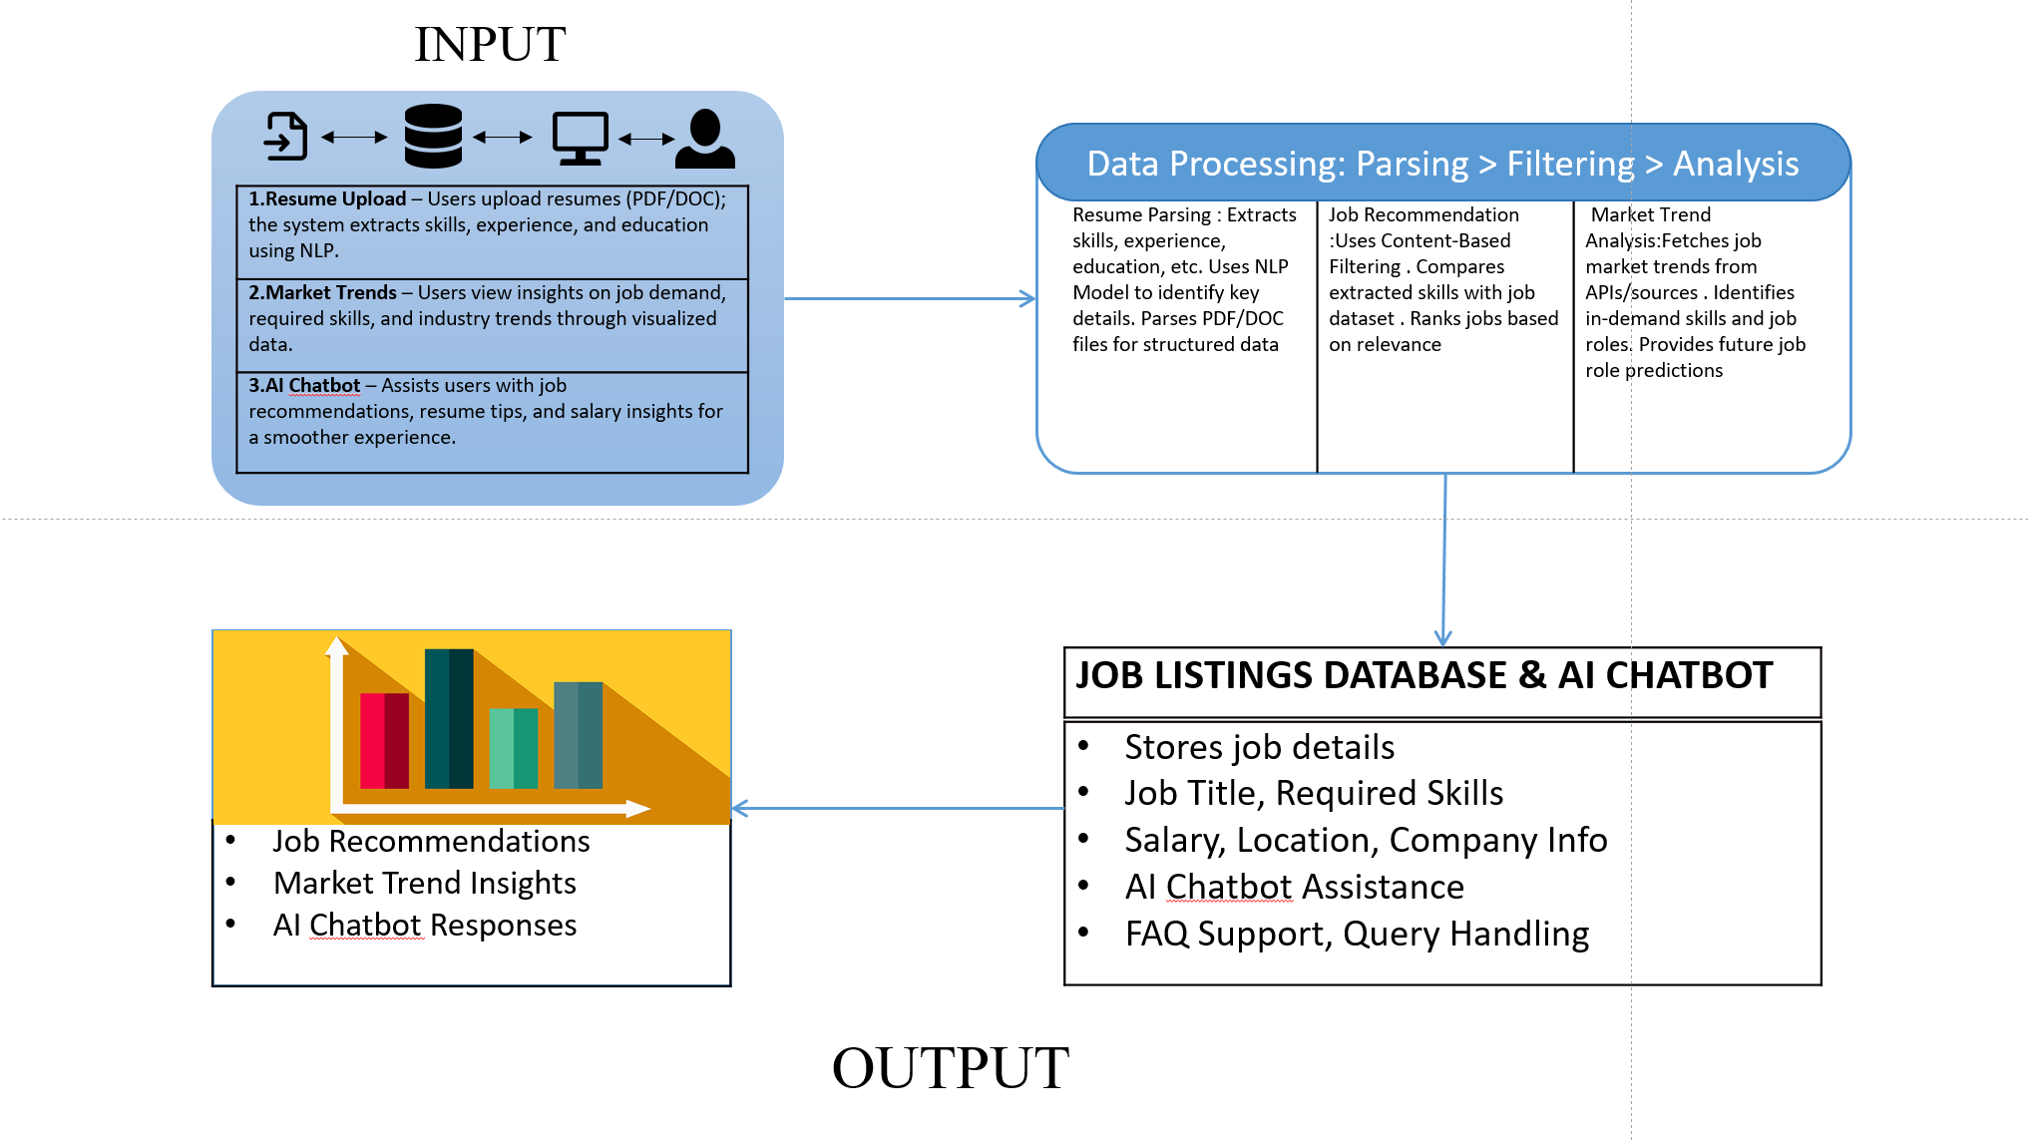
System Design

Slide 11
Technologies and methodologies
Front-End
HTML5
CSS
JAVASCRIPT
Back-End
Flask: Python Framework
Database
SQL
Algorithm
Natural Language Processing
Content-Based Filtering

Slide 12
Implementation

Slide 13
Conclusion
Hence, Devlopment and Implementation of 100% of Web based platform providing seamless user experience.
Job Recommendation and Resume Parsing with NLP and Chatbot is providing a comprehensive platform for user ,through it’s user-friendly interface.

Slide 14
References
[1] Automated Resume Parsing: A Natural Language Processing Approach,7th International Conference on Computation System and Information Technology for Sustainable Solutions, Zhejiang University,2023
[2]A Research of Job Recommendation System Based on Content-Based Filtering, 7th International Symposium on Computational Intelligence and Design , Zhejiang University,2014.
[3]A Machine Learning-Based Job Forecasting And Trend Analysis System To Predict Future Job Markets Using Historical Data, 8th International Conference for Convergence in Technology Pune, India,2023

Slide 15
Thank You...!!

