Slide 1
BENGALURU · 2019 – 2022
Bengaluru Municipality
EDA
Issue Analysis
Exploratory Data Analysis of Bengaluru's civic complaint dataset (2019 – 2022)
16,071
43
15
198
Exploratory
Data Analysis
Total
Complaints
Unique
Categories
Civic
Agencies
Wards
Covered
Data Source: OpenCity · data.opencity.in · I Change My City - Janaagraha
Notes:
This EDA covers 16,071 civic complaints submitted to Bengaluru Municipality between 2019 and 2022 via the I Change My City platform by Janaagraha. Analysis performed using Python, Pandas, Matplotlib and Seaborn.

Slide 2
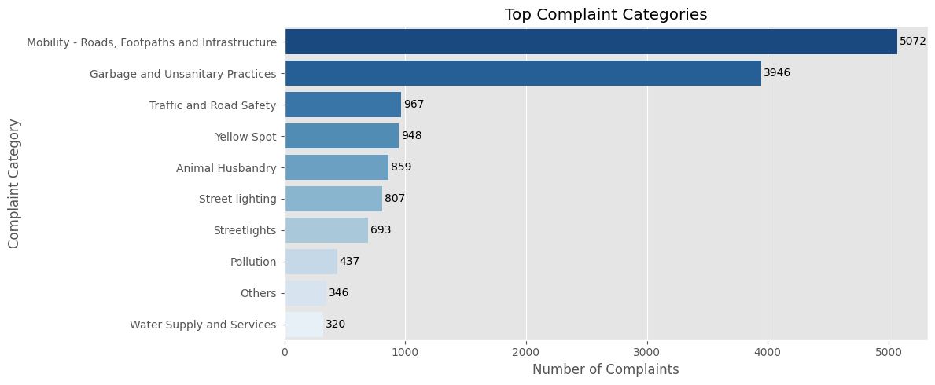
01
What Are Bengaluru Citizens Complaining About?
Top Complaint Categories
Complaints by Agency
BBMP receives over 83% of all reported complaints, indicating a high concentration of municipal service requests within a single agency.
🛣 Roads & Infrastructure is the largest complaint category, followed by Garbage & Unsanitary Practices.
🗑 The top two categories together account for more than half of all complaints.
💡 Traffic & Road Safety and Yellow Spot emerge as the next most reported complaint categories.
Notes:
Roads and garbage together = ~70% of all 16,071 complaints. BBMP is responsible for 83%+ of all complaints. This structural concentration means one agency handles roads, garbage AND lights — a clear overload.

Slide 3
02
Complaint Trends & Key Findings
Annual Complaint Volume (2019–2022)
Key Findings
📉 79% Decline
Reported complaints declined from 7,383 (2019) to 1,551 (2022). Additional data is needed to explain this trend.
✅ Resolution Rate
Over 54% of complaints remain Open. Only 30.7% are marked Resolved - pointing to a significant backlog in complaint handling.
🔁 Re-opened Cases
2.1% of complaints were re-opened after closure, indicating that some issues required additional attention after the initial resolution
📍 Ward Hotspots
Complaint activity is concentrated in a limited number of wards, highlighting priority areas for targeted municipal intervention.
⚠ The sharpest decline occurred in 2020, coinciding with the COVID-19 lockdown period.
Analysis: Python · Pandas · Matplotlib · Seaborn | Full EDA available on GitHub
Notes:
The 79% decline from 2019 to 2022 is NOT a simple improvement story. 2020 drop is COVID-driven. Post-2020 decline may be improved services OR data incompleteness. Only 30.7% resolved vs 54.9% still open — major backlog. 2.1% re-opened = fake resolutions. Ward hotspots need targeted resource focus.

