Slide 1

School of Engineering & Sciences, Pune
Department of Electronics and Communication Engineering
“Toll Tax Smart System ”
Group Code: ECO2324UGMPII-03
Topic: Toll Tax Smart System
Roll No. | Div. | Enrolment No. | Name of Student
2224037 | ECO | MITU22BTEC0002 | Aditi Bansod
2224115 | ECO | MITU22BTEC0110 | Vaibhav Kathe
2224120 | ECO | MITU22BTEC0098 | Smriti Hundekari
2224121 | ECO | MITU22BTEC0099 | Soham Dhokariya
Name of Guide | Prof. Dr. Sachin Takale
Name of Co-guide / Industry Mentor (if any)

Slide 2

Contents
Introduction (1 slide)
Problem Statement (1 slide)
Objectives (1 slide)
Block diagram and Discussion (1 or 2 slides)
Conclusion (1 slide)
References (1 slide)

Slide 3
Introduction
The Toll Tax Smart System using Arduino Uno and RFID (Radio-Frequency Identification) module is an innovative solution designed to enhance and streamline the toll collection process. Traditional toll collection systems often involve manual operations, leading to delays, errors, and increased traffic congestion. The integration of Arduino Uno and RFID technology in this smart system aims to automate and optimize the toll collection process, providing a more efficient and user-friendly experience.

Slide 4
Problem Statement
Traditional toll collection systems are often characterized by manual processes, leading to inefficiencies, delays, and increased traffic congestion. The lack of automation in toll collection poses challenges in terms of accuracy, security, and overall user experience. The aim is to address these issues by implementing a Toll Tax Smart System using Arduino Uno and RFID technology.

Slide 5
Objectives
Automate Toll Collection:
Implement an automated toll collection system using RFID technology to reduce manual interventions and waiting times.
Enhance Accuracy:
Utilize RFID modules for accurate and reliable identification of vehicles, minimizing errors in toll transactions.
Improve Traffic Flow:
Alleviate traffic congestion by streamlining the toll collection process and reducing manual toll payment delays.
Ensure Security:
Implement a secure identification system using RFID tags to prevent fraudulent activities and unauthorized access.

Slide 6
4. Efficient :Data Management
Utilize a centralized database to store and manage toll transaction data for easy retrieval, analysis, and reporting.
5. Cost-Effective:
Automation reduces the need for manual toll collection, leading to cost savings in terms of labor and operational efficiency.
6. User-Friendly Experience:
With automated gates and a streamlined process, the toll system provides a convenient and user-friendly experience for both commuters and toll operators.

Slide 7
Components required for toll tax smart system
Arduino Uno
RFID reader module
RFID tags and cards
Servo Motor
Display screen
Motorized gate
Power supply
Wiring and breadboard

Slide 8
START
VEHICLE WITH RFID TAG
RFID READER
LOW BALANCE
INVALID
VALID
PAY AMOUNT
WELCOME`
SWITCH
GATE OPENS
DELAY
STOP

Slide 9
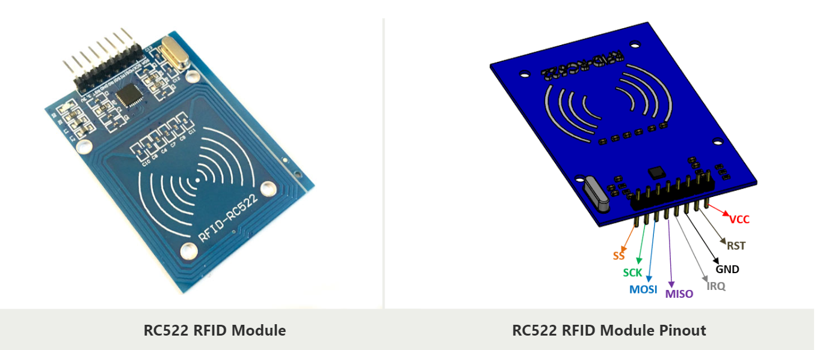
RFID Reader

Slide 10
Features
13.56MHz RFID module
Operating voltage: 2.5V to 3.3V
Communication : SPI, I2C protocol, UART
Maximum Data Rate: 10Mbps
Read Range: 5cm
Current Consumption: 13-26mA
Power down mode consumption: 10uA (min)

Slide 11
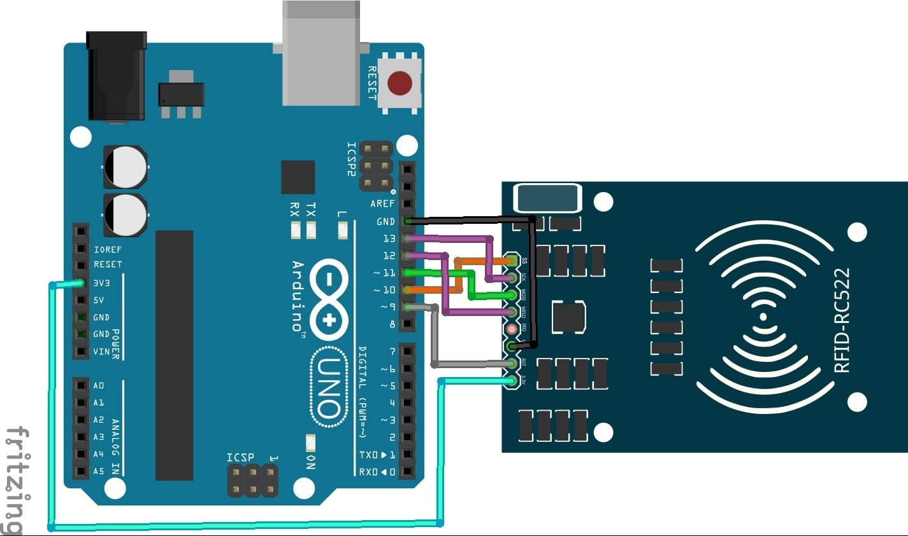
Connection between Arduino and RFID

Slide 12
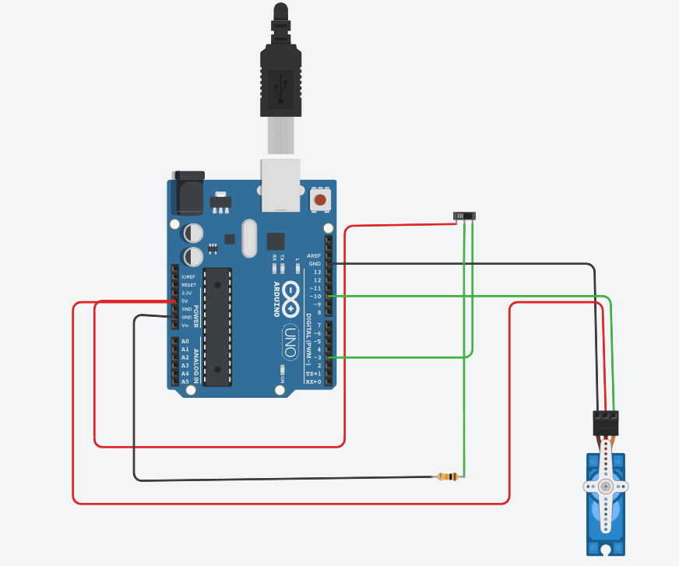

Slide 13
Conclusion
The Toll Tax Smart System offers a transformative solution to address the challenges associated with traditional toll collection methods. By integrating advanced technologies, this system brings about automation, efficiency, and enhanced user experiences in the toll collection process. The key components and features contribute to the success of the system, providing benefits such as accuracy, security, and streamlined operations.

