Slide 1
Distance Vector Routing Protocol – CN Assignment 3 By BT20CSE083

Slide 2
What is Distance Vector Routing Protocol ?
It is a type of routing protocol that determines the best path for data to travel from one node to another node.
The distance metric used in this protocol is usually the number of hops, which is the number of intermediate nodes that a packet must traverse to reach the destination node, but it also can be bandwidth and delay.

Slide 3
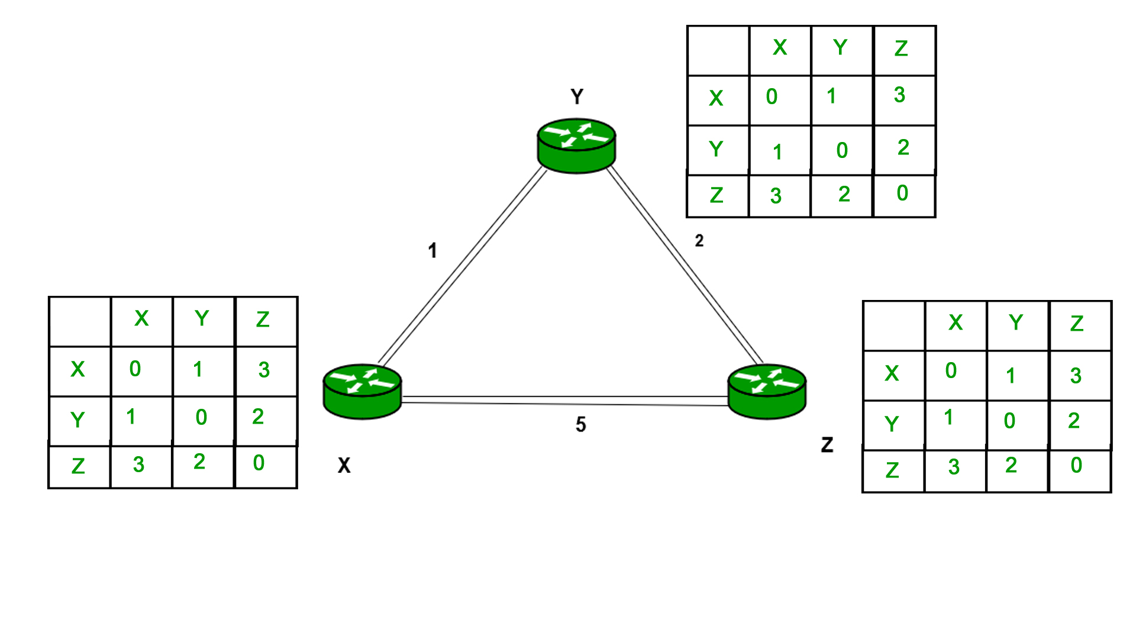
DVR Protocol, where each node maintains its own routing table, and forward it to neighbor's

Slide 4
Control flow of the Code
Control flow of the Code
The 'bellman_ford' function implements the Bellman Ford algorithm to update the DVR table of the router.
The program starts by reading a file 'inp.txt'
The 'update_queue' function updates the shared dictionary by copying the DVR table of each node to its neighbours' queues.
A dictionary 'router' is created which stores the router information for each node
The updated DVR table is printed after each iteration using the 'print' function.
Within 'task', a loop runs and calls two functions 'update_queue' and 'bellman_ford'.
function 'print_init' is called to print the initial state of the routers.
At the end of each iteration, the thread waits until all other threads have completed the iteration.
A function 'task' is created which takes in the router information, shared queue and the id of the thread.

Slide 5
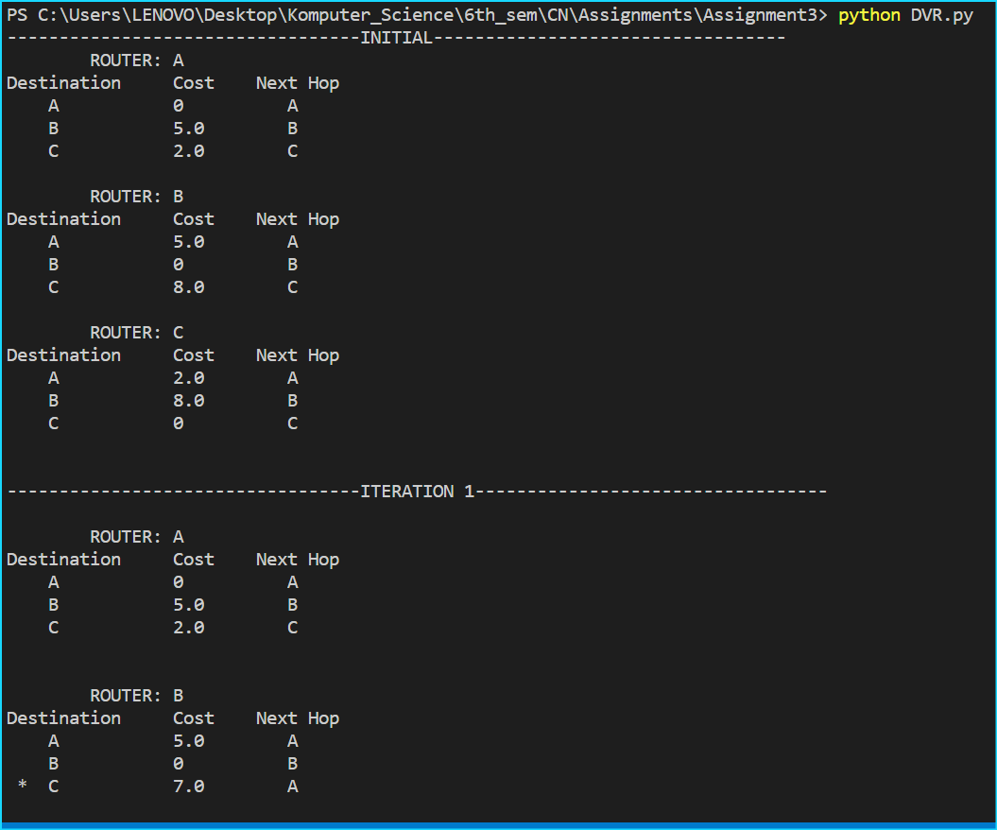
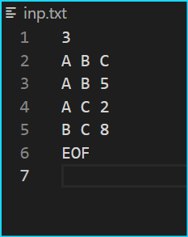

Slide 6
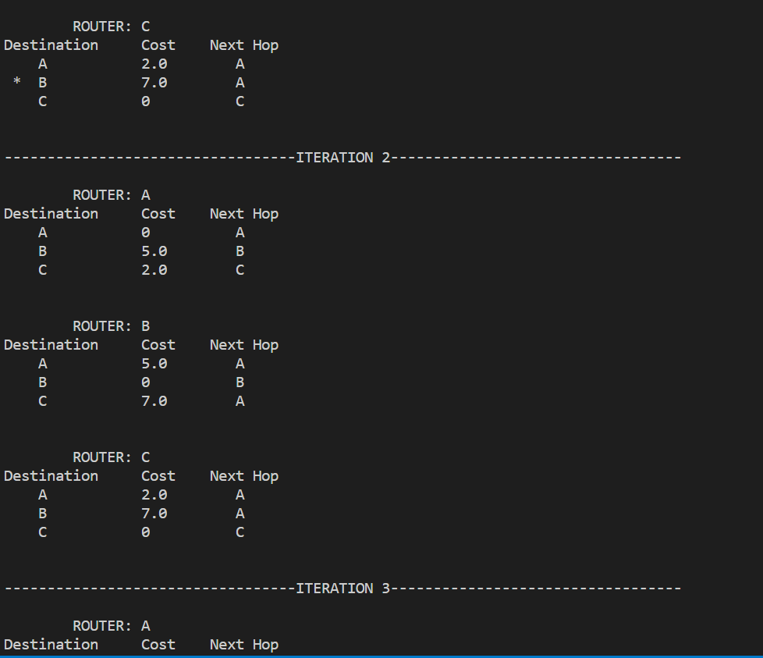

Slide 7
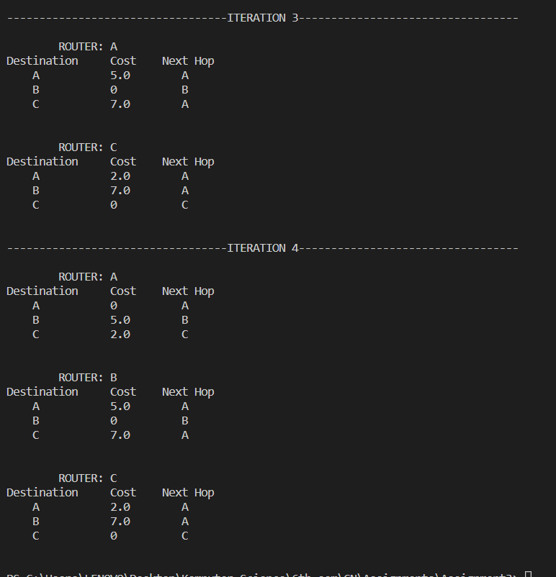

Slide 8
Thank You !

