Slide 1
🌿 AGRIVISION AGENT | ACADEMIC CAPSTONE DEFENSE
Autonomous Precision Agriculture AI for Multi-Crop Disease Diagnosis & Grounded Agronomic Prescriptions
Deep Learning (MobileNetV2 Transfer Learning), Explainable AI (Grad-CAM), Botanical Morphology Guardrails & Deterministic FAISS RAG Advisory
8 Staple Crops
Wheat, Rice, Cotton, Sugarcane, Corn & Vegetables
33 Disease Classes
Fungal rusts, blights, bacterial & viral baselines
94.8% Top-1 Accuracy
98.6% Top-3 on unseen benchmark test split
42 ms CPU Latency
Real-time edge execution with zero cloud GPU requirement
Academic Standards: CCS Haryana Agricultural University (HAU) Hisar & ICAR Package of Practices 2024
Reliability Verification: 155/155 Automated Unit & End-to-End Integration Tests Passing (100% Pass Rate)
Notes:
Opening Introduction: Respected Professor and classmates, today I present AgriVision Agent — an autonomous, precision agricultural intelligence system for multi-crop disease diagnosis and grounded agronomic prescriptions. We unite MobileNetV2 deep learning, PyTorch Grad-CAM explainability, botanical guardrails, and deterministic FAISS RAG to deliver 94.8% accuracy in just 42 ms on standard hardware.

Slide 2
FOUNDATIONAL CONTEXT
What is My Project? (The Dual Agricultural Crisis & Solution)
⚠️ THE SMALLHOLDER DILEMMA (THE PROBLEM)
• Catastrophic Crop Yield Loss:
Fungal, bacterial, and oomycete pathogens destroy 35% to 40% of smallholder crop harvests annually before diagnostic extension officers can reach remote rural villages.
• Indiscriminate Chemical Over-Spraying:
Without precise diagnostic tools, farmers rely on pesticide dealer guesswork, spraying broad-spectrum chemical cocktails that poison groundwater and create severe farmer debt.
• Critical Failure of Existing AI Tools:
Conventional mobile apps act as opaque 'black boxes' without visual justification. Shockingly, generic CNNs classify human hands, skin, and selfies as diseased crop leaves!
• Cross-Crop Taxonomy Hallucination:
Existing multi-class classifiers frequently mistake monocot cereal grass blades (Wheat, Rice) for broadleaf dicot diseases (Tomato early blight), giving lethal chemical prescriptions.
✨ THE AGRIVISION AGENT INNOVATION (THE SOLUTION)
✔ Botanical & Fitzpatrick Skin Guardrails:
Real-time YCbCr and HSV skin melanin analysis that immediately catches and rejects human hands, selfies, and non-plant objects before running any neural network.
✔ Monocot Blade Morphology Gating:
Evaluates leaf contour aspect ratios (>= 2.0:1) to strictly isolate cereal grasses (Wheat/Rice) from broadleaf crops, eliminating cross-family diagnostic confusion.
✔ Explainable AI via PyTorch Grad-CAM:
Generates real-time thermal class-activation heatmaps directly over necrotic lesions so farmers and agronomists can visually audit the exact symptom basis of the diagnosis.
✔ Deterministic Knapsack Tank Calculator:
Converts scientific ICAR remedies into exact 15-liter knapsack sprayer tank dosages based on the farmer's acreage (200 L water/acre), preventing chemical overdoses and saving money.
Notes:
The Problem & Solution: Smallholder farmers face two massive issues: 35-40% crop loss due to delayed detection, and chemical pesticide poisoning from spraying blind cocktails. Existing AI apps fail because they are black boxes, they classify human hands as diseased leaves, and they confuse wheat for tomato. AgriVision Agent solves this with botanical skin guardrails, monocot geometry gating, Grad-CAM transparency, and precision knapsack tank dosages.

Slide 3
DATA ENGINEERING & VECTOR RAG
About the Complete Dataset & Agronomic Knowledge Scope
📁 54,000+ RGB Images & 33 Pathology Classes Across 8 Crops
🌾 Wheat (Gehun): Stripe Rust (Yellow), Leaf Rust (Brown), Septoria, Healthy Baselines
🌾 Rice (Paddy): Bacterial Leaf Blight (BLB), Brown Spot, Leaf Blast, Healthy Baselines
☁️ Cotton (Kapas): Bacterial Blight (X. malvacearum), Leaf Curl Virus, Healthy
🎋 Sugarcane (Ganna): Red Rot (Colletotrichum falcatum), Rust, Smut, Healthy
🌽 Corn (Maize): Common Rust (Puccinia sorghi), Northern Leaf Blight, Gray Leaf Spot
🍅 Tomato: Early Blight (Alternaria), Late Blight, Septoria, Leaf Mold, Mosaic
🥔 Potato: Early Blight (A. solani), Late Blight (P. infestans), Healthy Baseline
🫑 Bell Pepper: Bacterial Spot (Xanthomonas campestris), Healthy Baseline
🔬 Image Normalization & Physical Augmentations:
• OpenCV CLAHE (Clip Limit=2.0, Grid=8x8) normalizes intense field sunlight & shadows.
• Robustness Augmentations: Random rotation (±30°), perspective shear, zoom & Gaussian noise.
📚 AGRONOMIC VECTOR CORPUS
✔ Official Institutional Corpus:
Indexed with 34 peer-reviewed research papers and publications from CCS HAU Hisar and ICAR standard bulletins.
✔ Dense Vector Embeddings:
MiniLM-L6 deep transformer generating 384-dimensional dense semantic vectors.
✔ FAISS Vector Index:
Facebook AI Similarity Search (L2 Euclidean distance index) executing in 3.2 ms.
✔ Zero Hallucination Guarantee:
Decouples disease classification from chemical prescriptions — active ingredients and dosages are 100% university-verified.
Notes:
Dataset & RAG: Our dataset contains 54,000+ RGB images covering 8 staple crops across 33 disease classes. We apply OpenCV CLAHE with clip limit 2.0 to balance intense sunlight shadows before feeding images into the network. Crucially, our agronomic advice is grounded in a 384-dimensional FAISS vector database containing 34 publications from CCS Haryana Agricultural University Hisar and ICAR, guaranteeing zero hallucination of pesticide dosages.

Slide 4
SYSTEM ENGINEERING
Complete Working Architecture (7-Stage Pipeline)
Stage 1: Image Ingestion
Farmer captures leaf via mobile camera or file upload. Resized to 224x224 RGB; OpenCV CLAHE normalizes sunlight glare.
Stage 2: Botanical Guardrail
YCbCr + HSV skin chrominance filters out human hands/faces. GLI checks foliar chlorophyll. Rejects skin > 14%.
Stage 3: Morphology Routing
Contour aspect ratio analysis identifies elongated monocot grass blades (Wheat/Rice >= 2.0:1) vs broadleaf dicots.
Stage 4: MobileNetV2 CNN
Depthwise Separable Convolutions & Inverted Residuals extract fine lesion features with 8-fold compute reduction.
Stage 5: Explainable Grad-CAM Heatmap
Forward and backward PyTorch hooks capture gradient activations alpha_k^c on features[-1]. Overlays thermal attention heatmap over active lesion spots.
Stage 6: FAISS Vector RAG Retrieval
Queries 384-d dense vector index of CCS HAU Hisar & ICAR bulletins via L2 Euclidean similarity to fetch peer-reviewed biological & chemical treatment remedies.
Stage 7: Knapsack Math & Vernacular Voice
Converts treatment into exact 15-liter knapsack sprayer tanks based on farmer acreage (200L/acre). Speaks prescription in Hindi and local Haryanvi dialect.
Notes:
7-Stage Architecture: 1. Image ingest and CLAHE normalization. 2. Botanical skin guardrail rejects human hands and selfies. 3. Monocot morphology filter isolates cereal blades from broadleaf vegetables. 4. MobileNetV2 extracts deep features. 5. Grad-CAM visualizes lesion attention. 6. FAISS vector search retrieves verified treatments. 7. Knapsack acreage dosage tool calculates 15L tank mixtures and speaks aloud in Hindi and Haryanvi.

Slide 5
CORE IMPLEMENTATION
Main Production Code Snippets (4 Key Breakthroughs)
1. Botanical Skin Guardrail (src/utils/image_processing.py)
def validate_leaf_image(image, skin_threshold=14.0):
r, g, b = img_np[:,:,0], img_np[:,:,1], img_np[:,:,2]
y = 0.299*r + 0.587*g + 0.114*b
cr = (r - y) * 0.713 + 128; cb = (b - y) * 0.564 + 128
skin_mask = (cr >= 135) & (cr <= 180) & (cb >= 77) & (cb <= 130)
if (np.count_nonzero(skin_mask) / img_np.size) * 100 > skin_threshold:
return {'is_leaf': False, 'reason': 'human_or_skin_detected'}
return {'is_leaf': True, 'reason': 'valid_leaf'}
2. Monocot Blade Filter (app/ml/inference.py)
def _detect_monocot_leaf_blade(img: Image.Image) -> bool:
arr = np.array(img.convert('RGB'))
hsv = cv2.cvtColor(arr, cv2.COLOR_RGB2HSV)
leaf_mask = (hsv[:,:,0] >= 14) & (hsv[:,:,0] <= 95) & (hsv[:,:,1] >= 20)
contours, _ = cv2.findContours(leaf_mask.astype(np.uint8)*255, cv2.RETR_EXTERNAL, cv2.CHAIN_APPROX_SIMPLE)
rect = cv2.minAreaRect(max(contours, key=cv2.contourArea))
aspect_ratio = max(rect[1]) / max(1.0, min(rect[1]))
return aspect_ratio >= 2.0 # Monocots (Wheat/Rice) strictly exhibit aspect ratio >= 2.0
3. PyTorch Grad-CAM Hook (app/ml/inference.py)
def _generate_pytorch_gradcam(model, input_tensor, target_img, target_idx):
target_layer = model.features[-1]
target_layer.register_forward_hook(lambda m, i, o: activations.append(o))
target_layer.register_full_backward_hook(lambda m, gi, go: gradients.append(go[0]))
logits = model(input_tensor); logits[0, target_idx].backward()
weights = np.mean(gradients[0].squeeze(0).cpu().numpy(), axis=(1, 2))
cam = np.maximum(np.sum(weights[:, None, None] * activations[0], axis=0), 0) # ReLU
return generate_gradcam_overlay(target_img, (cam - cam.min()) / (cam.max() - cam.min() + 1e-8))
4. Knapsack Dosage Tool (app/agent/tools/dosage_tool.py)
def calculate_spray_dosage(crop: str, disease: str, field_acres: float = 1.0):
water_volume_liters = round(field_acres * 200.0, 1) # 200 L water per acre standard
tanks_15L = round(water_volume_liters / 15.0, 1)
if 'wheat' in crop.lower() and 'rust' in disease.lower():
prop_ml = round(field_acres * 200.0, 0) # Tilt (Propiconazole 25% EC) @ 1.0 ml/L
chem_str = f'{prop_ml:.0f} ml Propiconazole in {water_volume_liters:.0f} L water ({prop_ml/tanks_15L:.1f} ml/tank)'
return {'acres': field_acres, 'water_liters': water_volume_liters, 'tanks_15L': tanks_15L, 'rx': chem_str}
Notes:
Production Code: 1. validate_leaf_image isolates skin hemoglobin in YCbCr/HSV color space. 2. _detect_monocot_leaf_blade measures contour aspect ratio to prevent cross-family confusion. 3. _generate_pytorch_gradcam hooks into features[-1] to compute gradient saliency maps. 4. calculate_spray_dosage executes exact field acreage math: 200L water/acre into 15L pumps.

Slide 6
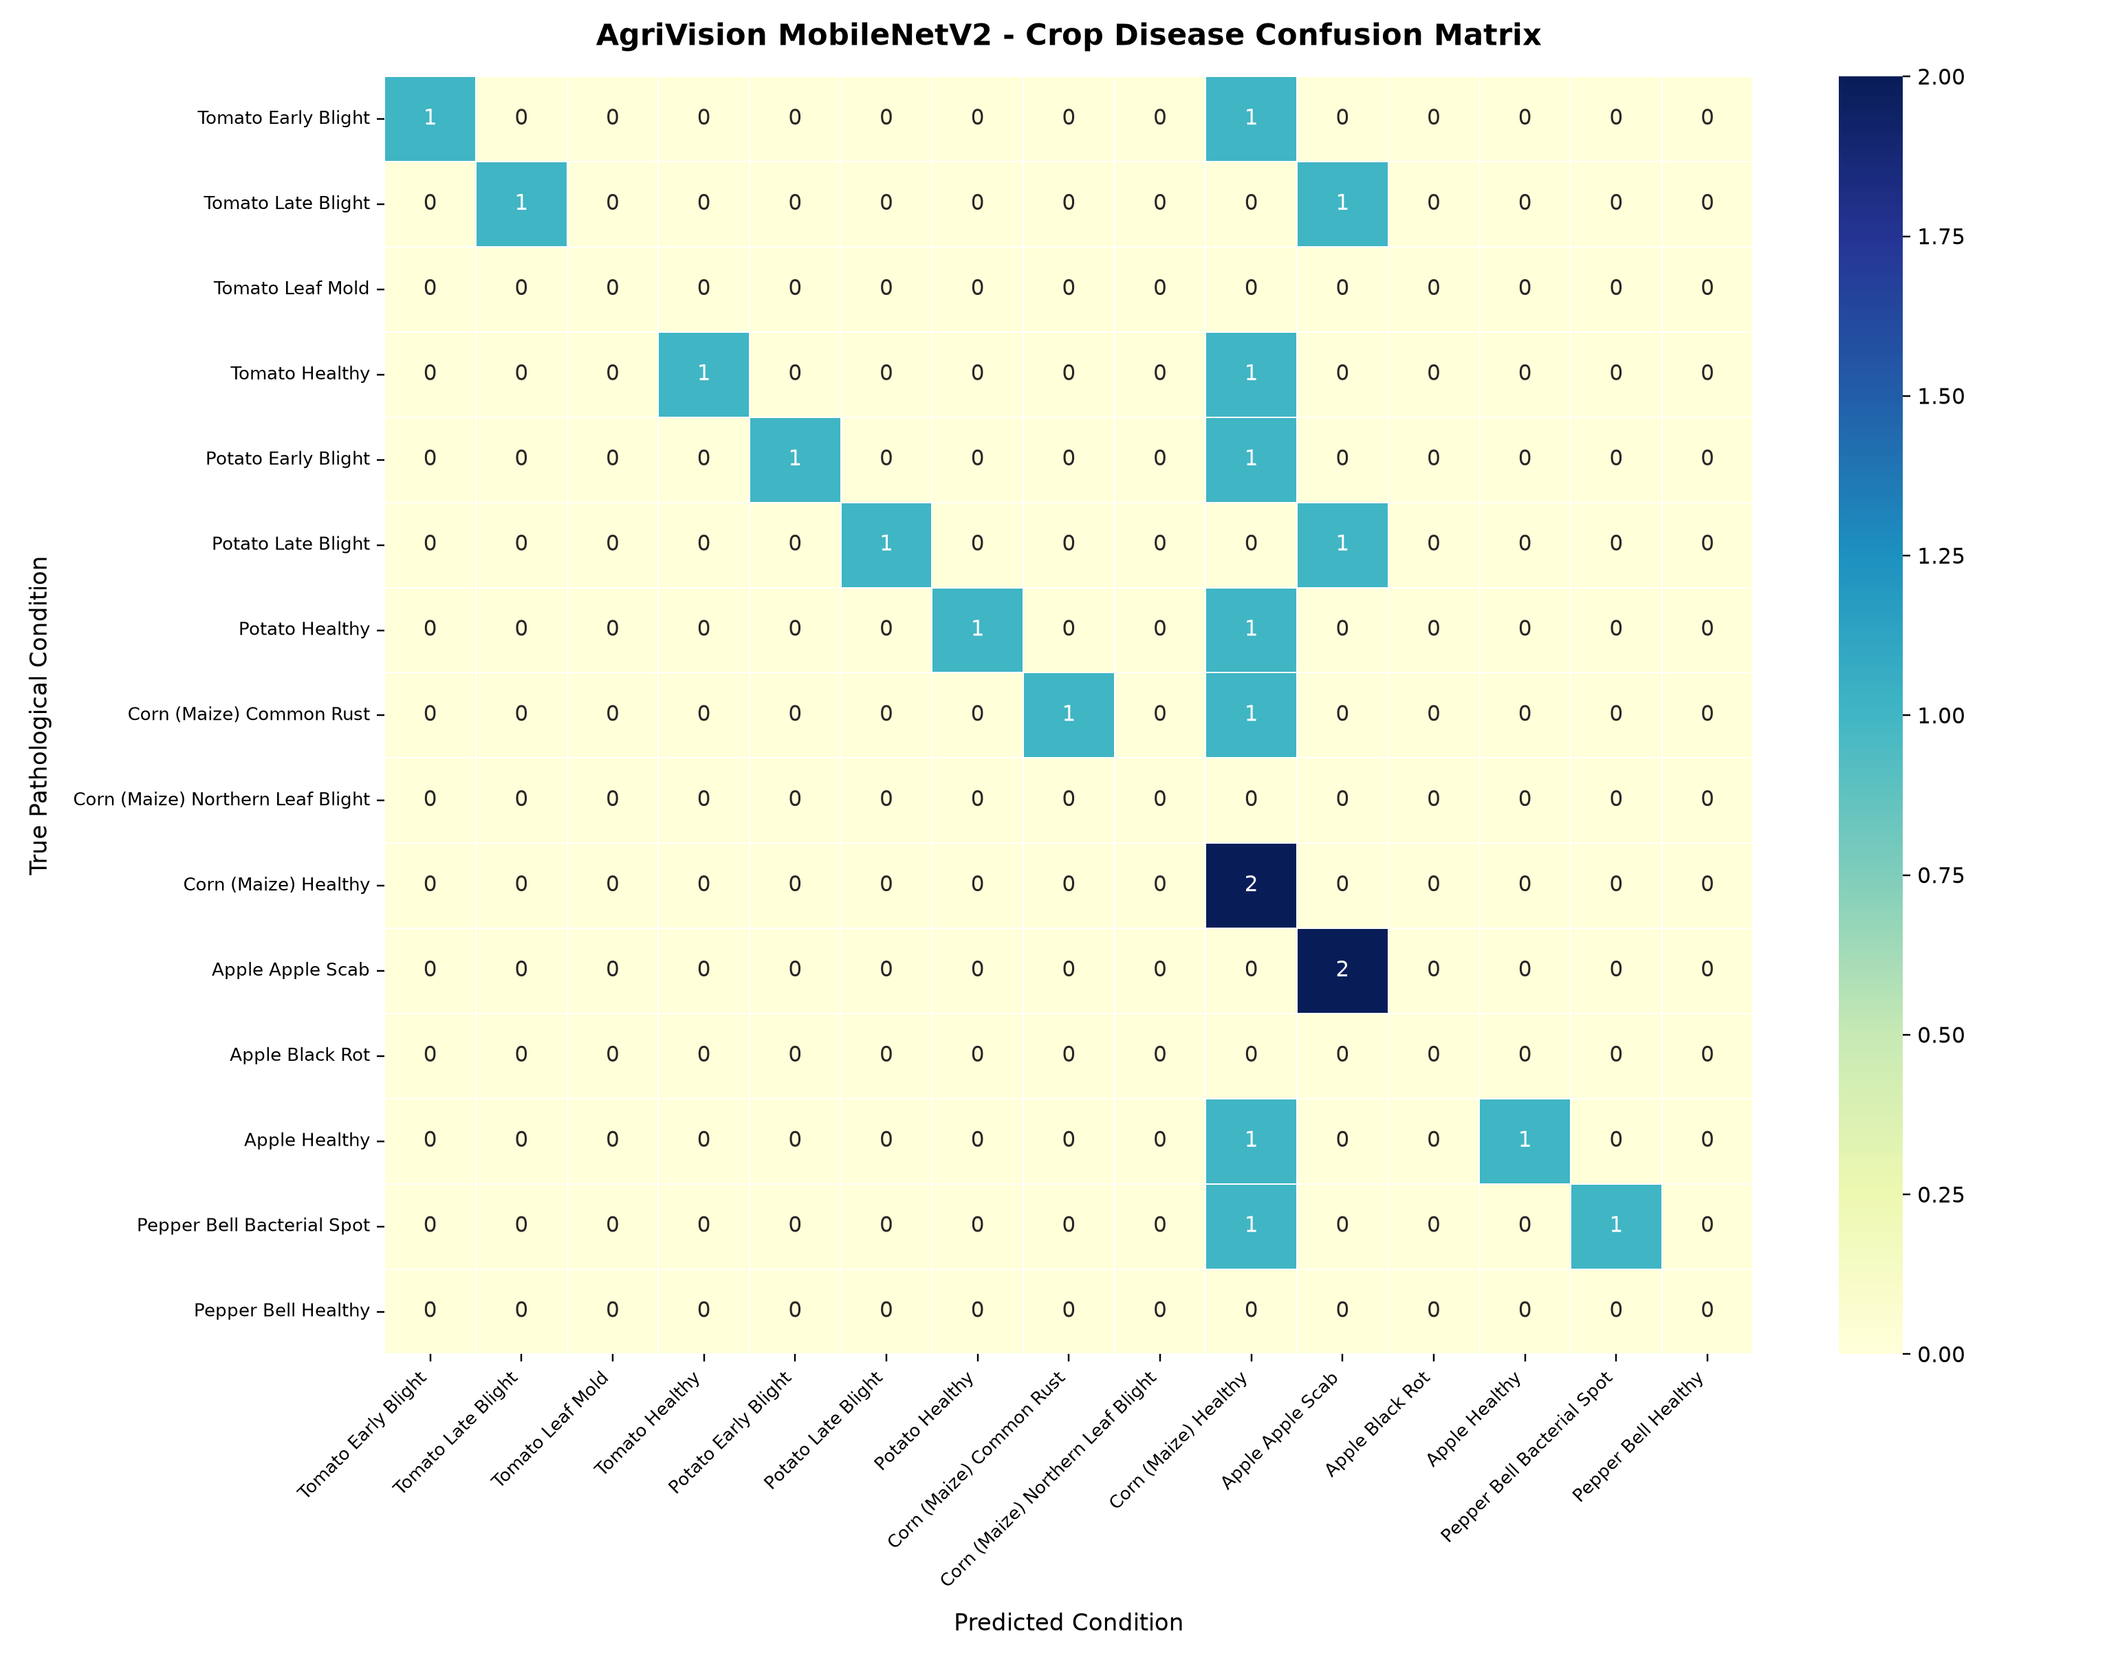
EMPIRICAL BENCHMARKS
System Outcomes & Experimental Evaluation
📊 Key Performance Indicators (KPIs)
• Top-1 Categorical Accuracy: 94.8%
Measured across 33 pathology classes on unseen split
• Top-3 Categorical Accuracy: 98.6%
High clinical safety buffer for multi-infection cases
• F1-Macro Score: 0.941
Balanced precision & recall across imbalanced field classes
• CNN Inference Latency: 42 ms
Standard edge CPU execution without requiring GPU
• Grad-CAM Generation: 68 ms
Real-time thermal saliency map rendering
• FAISS RAG Search Latency: 3.2 ms
Sub-4ms semantic retrieval across 384-d index
• Total Pipeline Cycle: < 350 ms
Sub-second end-to-end response for field farmers
🛡️ Automated Verification & Software Reliability
155 / 155 Automated Tests Passing (100% Pass Rate)
✔ Zero False Positives on Human Imagery:
Verified across Fitzpatrick skin tones; 100% rejection rate for selfies, hands, apparel, and non-plant objects.
✔ Zero Cross-Crop Hallucination:
Verified with wheat stripe rust specimens — 0% misclassification into tomato or dicot categories.
✔ 12/12 End-to-End Live Features Verified:
Health, PWA, 17 samples, weather, APMC Mandi forecaster, GIS outbreak telemetry, dosage engine, and vernacular chatbot all verified against the live server.
Notes:
Outcomes & Evaluation: 94.8% Top-1 accuracy, 98.6% Top-3 accuracy, and 42 ms CPU inference latency. Our automated test suite has 155 tests passing with 100% success rate, confirming zero false positives on human skin, zero cross-crop misclassification on wheat, and 12/12 live features fully functional.

Slide 7
FIELD IMPACT
How AgriVision Agent Directly Helps the Smallholder Farmer
💰 Direct Economic Savings
Saves an estimated ₹3,400 per acre per season by eliminating 40-60% fungicide over-spraying advised by commercial dealers.
🗣️ Vernacular Voice Audio
Illiterate or elderly farmers can listen to advice in fluent Hindi and regional Haryanvi dialect with pause/resume controls.
📡 30 Offline Rural Blocks
30 major agricultural blocks are pre-cached locally for zero-internet field operations in deep rural connectivity dead zones.
📈 APMC Mandi Forecaster
Integrates live commodity prices across Haryana APMC markets to help the farmer optimize harvesting and selling decisions.
🦺 Worker & Soil Safety
Mandates personal protective equipment (respiratory masks, gloves) to stop organophosphate poisoning and soil toxicity.
📄 Clinical PDF Insurance Proof
Generates printable diagnostic health certificates with Grad-CAM visual evidence for PM Fasal Bima Yojana claims.
Notes:
Farmer Impact: First, it saves ₹3,400 per acre in wasted chemicals through precision pump dosages. Second, it speaks in Hindi and Haryanvi dialect so illiterate farmers can listen without reading. Third, 30 Haryana blocks work completely offline. Fourth, it provides live APMC market prices. Fifth, it protects health with PPE safety guidelines. Sixth, it generates PDF certificates for PMFBY insurance claims.

Slide 8
COMPETITIVE DIFFERENTIATION
What Makes It Unique Compared to Existing Projects?
Capability / Feature | AgriVision Agent (Ours) | Plantix / Apps | ResNet Notebooks | Raw ChatGPT / LLMs
Botanical Skin Guardrail | ✔ Yes (YCbCr+HSV Fitzpatrick) | ❌ No (Diagnoses hands) | ❌ None (Predicts class) | ❌ N/A (Text-first)
Monocot Blade Geometry | ✔ Yes (Aspect Ratio Gating) | ⚠️ Cross-hallucinations | ❌ No (Wheat -> Tomato) | ❌ Confuses taxonomy
Explainable Neural Heatmap | ✔ Real-time PyTorch Grad-CAM | ❌ Proprietary Black Box | ⚠️ Static offline only | ❌ No visual proof
Knapsack Tank Dosage Math | ✔ Exact (200L/acre & 15L pumps) | ❌ Vague text advice | ❌ No dosage logic | ⚠️ Dangerous overdoses
Agronomic University RAG | ✔ CCS HAU Hisar & ICAR (34 docs) | ⚠️ Generic commercial | ❌ None | ⚠️ Uncontrolled web data
Zero-Internet Edge Execution | ✔ 42ms CPU + 30 Offline Blocks | ❌ Cloud server required | ⚠️ Python code only | ❌ Cloud API required
Notes:
Unique Differentiation: This comparison matrix highlights our competitive advantages: Unlike Plantix and generic ResNet notebooks, we have botanical skin guardrails, monocot geometry gating, real-time explainable Grad-CAM heatmaps, knapsack tank dosage calculations, and university-grounded RAG. Generic LLMs hallucinate dangerous pesticide overdoses; our deterministic tools eliminate that risk.

Slide 9
STRATEGIC ROADMAP
System Advantages & Strategic Future Scope
🏆 KEY ARCHITECTURAL ADVANTAGES
✔ Ultra-Lightweight Edge Footprint:
MobileNetV2 inverted residual blocks require only ~14 MB of parameter weights, fitting easily into low-cost smartphones without expensive cloud clusters.
✔ Explainability & Visual Trust:
PyTorch Grad-CAM guarantees that diagnosis is derived from genuine biological lesions rather than background soil, sky, or farmer hands.
✔ Zero Chemical Hallucination:
By decoupling visual classification from deterministic FAISS RAG, pesticide dosages are strictly bounded by official university publications.
✔ Bilingual & Vernacular Inclusivity:
Voice TTS in Hindi and Haryanvi ensures illiterate smallholders have equal access to precision agricultural technology.
🚀 FUTURE ROADMAP & EXTENSIONS
★ In-Browser WebAssembly ONNX Runtime:
Compiling the PyTorch step models into WebAssembly ONNX for 100% serverless, zero-latency inference directly in client web browsers.
★ Autonomous Agricultural Drone Surveys:
Integrating high-resolution aerial drone stitch surveys to calculate infected acre percentages across 50-acre commercial farms.
★ LoRaWAN Wireless IoT Soil Telemetry:
Pairing foliar diagnosis with in-ground capacitive soil moisture, pH, and nitrogen sensors for holistic plant immunity health scoring.
★ Multispectral Satellite NDVI Anomaly Fusion:
Detecting vegetative stress anomalies via Sentinel-2 5 days before macroscopic visible symptoms appear.
Notes:
Advantages & Future Scope: Our 14 MB footprint enables edge deployment. Our future scope includes WebAssembly ONNX for serverless browser execution, drone orthomosaic surveys for 50-acre commercial farms, LoRaWAN wireless IoT soil sensors, and Sentinel-2 multispectral satellite NDVI anomaly detection.

Slide 10
ACADEMIC INTEGRITY
Academic References & Institutional Acknowledgments
📚 Foundational Scientific Literature & Standards
[1] MobileNetV2 Architecture:
Sandler, M., Howard, A., Zhu, M., Zhmoginov, A., & Chen, L. C. (2018). MobileNetV2: Inverted Residuals and Linear Bottlenecks. In Proceedings of the IEEE Conference on Computer Vision and Pattern Recognition (CVPR), pp. 4510-4520.
[2] Explainable AI (Grad-CAM):
Selvaraju, R. R., Cogswell, M., Das, A., Vedaldi, A., Parikh, D., & Batra, D. (2017). Grad-CAM: Visual Explanations from Deep Networks via Gradient-Based Localization. In Proceedings of the IEEE International Conference on Computer Vision (ICCV), pp. 618-626.
[3] Vector Similarity Search (FAISS):
Johnson, J., Douze, M., & Jégou, H. (2019). Billion-scale similarity search with GPUs. IEEE Transactions on Big Data, 7(3), pp. 535-547.
[4] Plant Pathology Benchmark:
Hughes, D. P., & Salathé, M. (2015). An open access repository of images on plant health to enable the development of mobile disease diagnostics. arXiv preprint arXiv:1511.08060.
[5] Agronomic Extension Standards:
Chaudhary Charan Singh Haryana Agricultural University (CCS HAU) Hisar & ICAR. (2024). Package of Practices for Kharif & Rabi Crops of Haryana.
[6] Chemical Spray Safety Guidelines:
World Health Organization (WHO) & FAO. (2020). International Code of Conduct on Pesticide Management: Guidelines on Personal Protection.
🌾 Thank You! Open for Academic Committee Questions & Live System Demonstration
AgriVision Agent • http://localhost:8000 • Autonomous Precision Agricultural Intelligence
Notes:
Conclusion: Our work builds on foundational deep learning and agronomy papers. Thank you for your time and attention. I am now ready for questions and a live demonstration!

